Slide 1


INTRO TO PYTHON WORLD

Slide 2
Python Programming Platforms & Pip
Python programs can be written on:
1) Text Editors
2) Python Shell
3) IDE
There are several packages and libraries that can be used in Python
Python has 141,251+ such Packages. PyPI indexes all of those packages.
These packages can be installed using PIP on a system.
Pip is the package management system of python to install packages in following ways:
pip install <pacakage_name> // for python 2.7
pip3 install <package_name> // for python 3 or more

Slide 3








Various IDE’s and Editors

Slide 4
Data Types in Python
Number
String
List
Tuples
Set
Dictionary
Array
[One Dimensional]
Array
[Multi Dimensional]

Slide 5
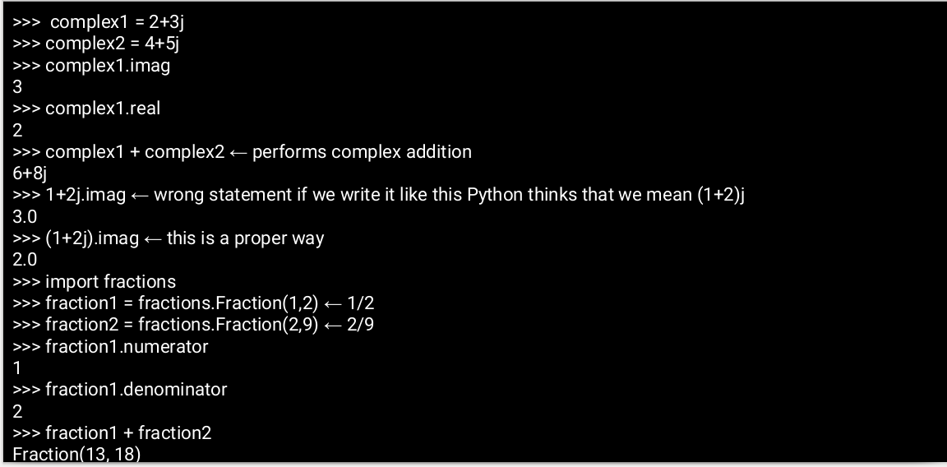
Number (int,float,complex,fractions)

Slide 6
Tuples Strings
iterable and immutable collection of objects
Homogeneous & Heterogeneous both
represented using ( ) literal
have only basic operations concatenation and iterable operations
A sequence of characters.
Represented using double or single quotes.
They are iterable
Reverse using x[ ::-1]
we can access a character in a string
eg. x = “abcd”
x[0] ← it will print a (This is indexing)

Slide 7
Lists
They are iterable, mutable collection of objects
represented using [ ] literal
It can be Multi Dimensional
Lists inside Lists
eg. x=[ [1, 2, 3, 4],
[5, 6, 7, 8],
[9, 10, 11, 12] ]
primarily 4 things we must know how to do in a list
adding an element. (.append(), .insert(), .extend() )
deleting an element. *( .remove(), .pop(), .clear(), .del() )
sorting a list (.sort(), .reverse())
Iterable operations (len, .count(), slicing, indexing, copying)

Slide 8
Sets Dictionaries
a mutable collection of unique objects
represented using { } literal with at least one element in them
supports the operations like difference, union, intersection
Also check if a set is set’s subset/superset
Also operations of list like add, pop,extend
used to establish a relation between two objects
Mutable, Mapping object type which maps hashable objects to their values.
created using { } literal or dict()
{ ‘key1’: ‘value1’, ‘key2’: ‘value2’ }

Slide 9
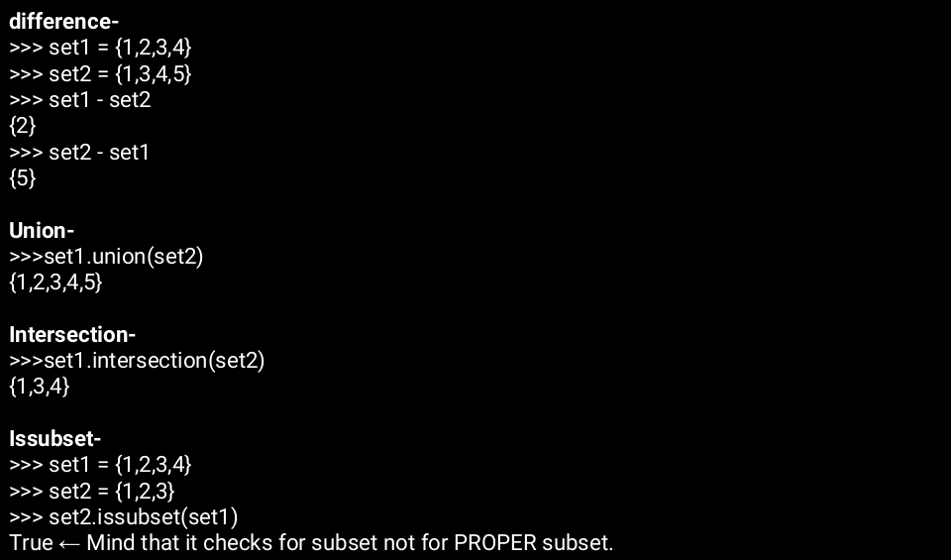
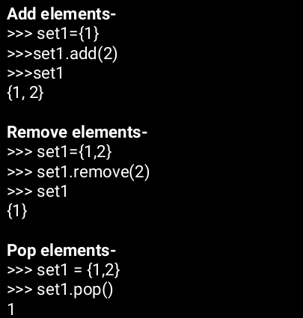

Slide 10
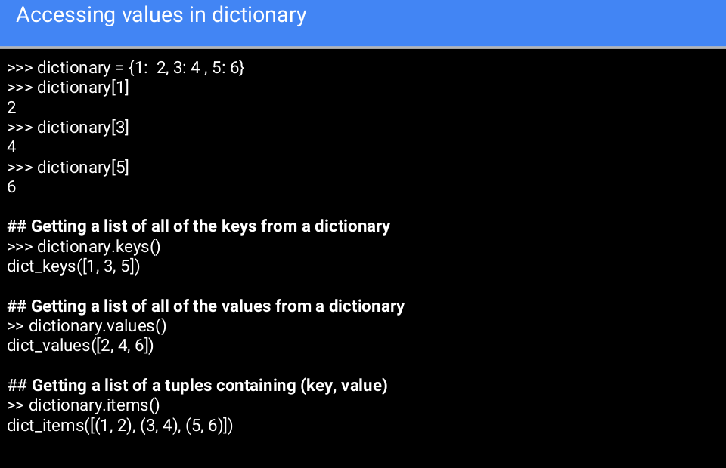

Slide 11
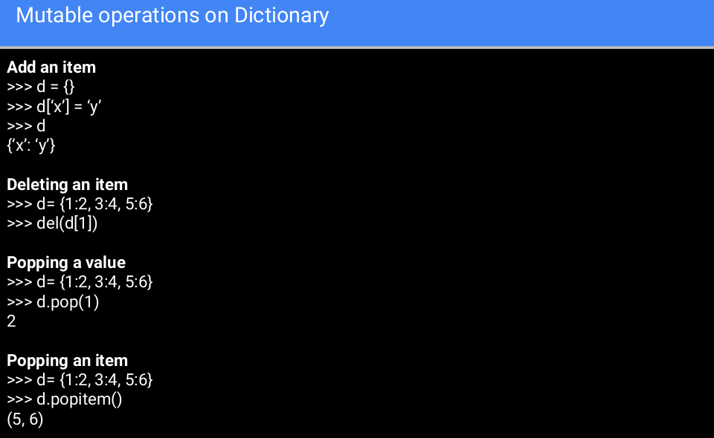

Slide 12



Taking INPUT
Input()
raw_input()
This method is not used in python 3.x versions

Slide 13
Conditional Statements in Python
If statement
IF BOOLEAN_EXPRESSION:
STATEMENTS TO EXECUTE IF BOOLEAN_EXPRESSION IS TRUE
NOTE:-Boolean expressions are those expression which result in a boolean value
Just like in C and Java we represent a code block using parenthesis.
In Python we represent a block of code using indentation.
Indentation means “some space which can be given using tabs or space character”.
All the statements under one block of code must have same indentation.

Slide 14
Conditional Statement in Python
If else statement
if BOOLEAN_EXPRESSION:
STATEMENTS TO EXECUTE IF BOOLEAN_EXPRESSION IS TRUE
else:
STATEMENTS TO EXECUTE IF BOOLEAN_EXPRESSION IS FALSE
Elif statement
if BOOLEAN_EXPRESSION1:
CODE_BLOCK1
elif BOOLEAN_EXPRESSION2:
CODE_BLOCK2
elif BOOLEAN_EXPRESSION3:
CODE_BLOCK3
else:
CODE_BLOCK4

Slide 15
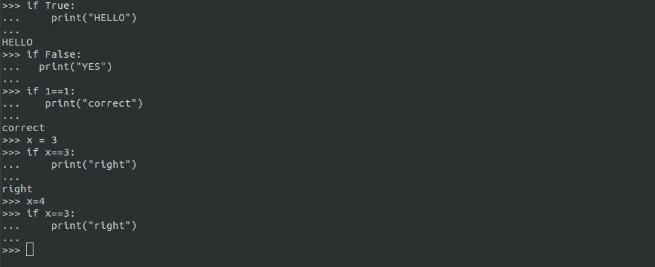

Slide 16
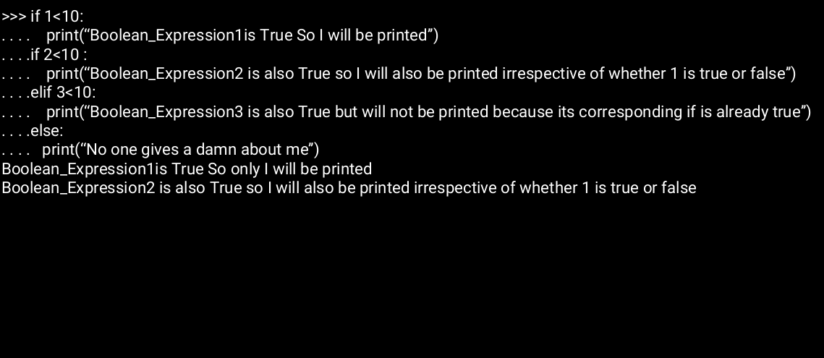

Slide 17
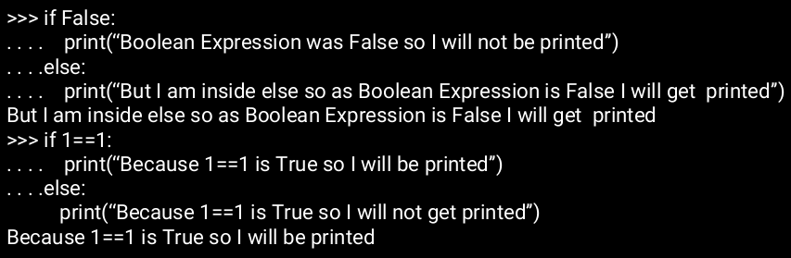

Slide 18
Loops in Python
while statement
while BOOLEAN_EXPRESSION:
STATEMENTS_TO_LOOP_THROUGH
Doing something till a condition is met or Doing something
Forever but it can also Do something N times with a little tweak.

Slide 19
Loops in Python
for statement
for iterating_variable in iterable:
STATEMENT_TO_LOOP_THROUGH_by_iterating_variable
Do something N times or Do something to a collection of things.
Note: range(start, end, step) by default step is 1 and start is 0.
If it is given as range(some_number) then python thinks that we need the range from 0 to some_number.
like range(3) means a list as [0,1,2]
Similarly range(1,10) means [1,2,3,4,5,6,7,8,9]

Slide 20
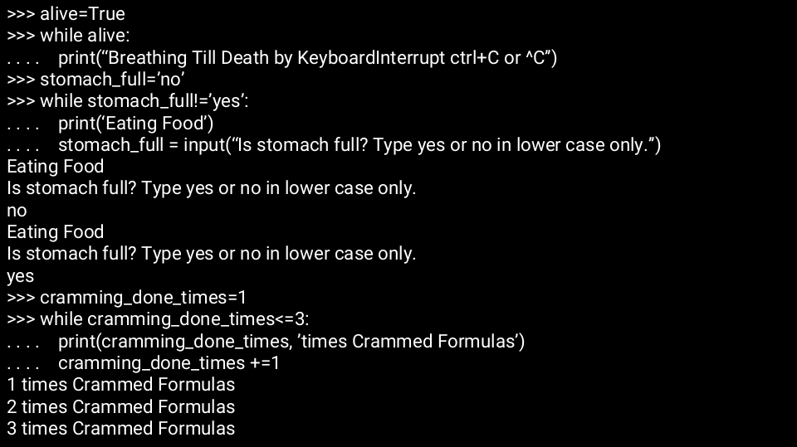

Slide 21
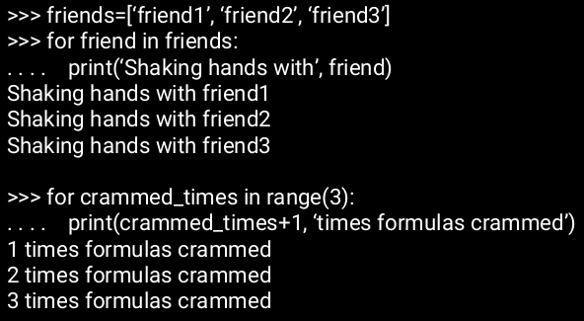

Slide 22
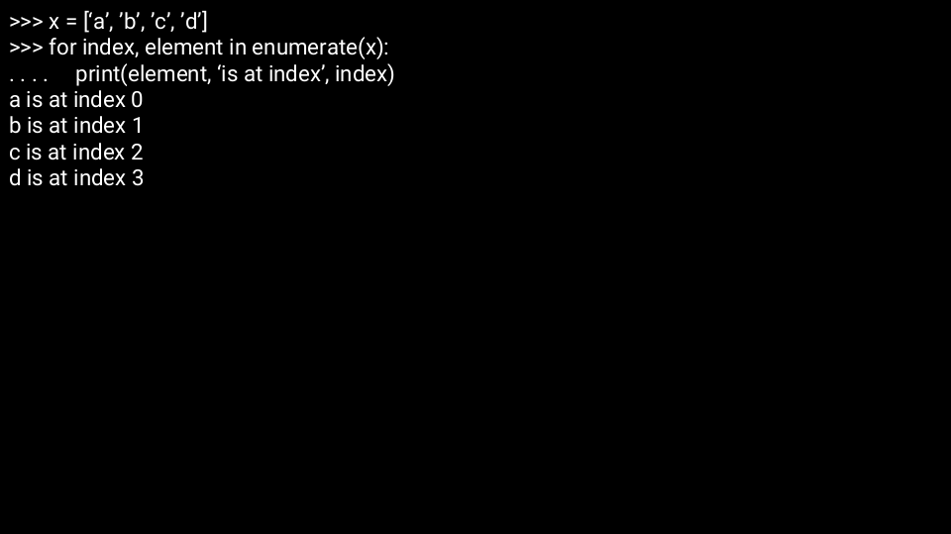
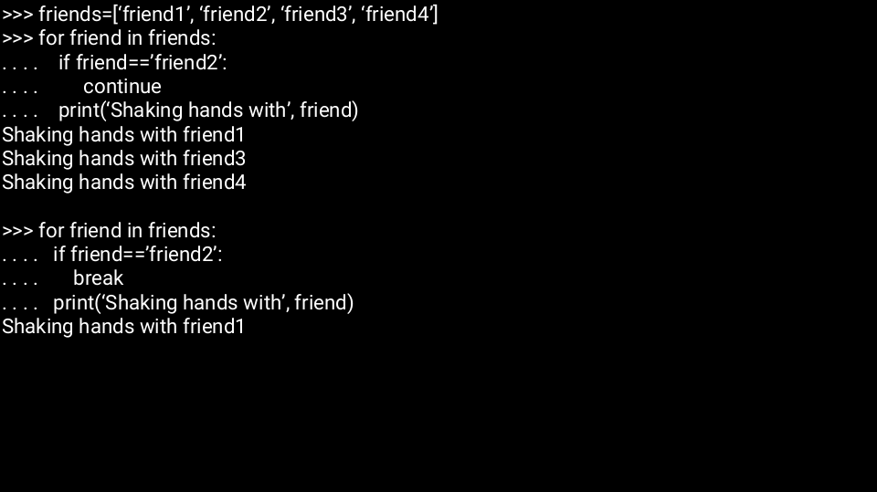
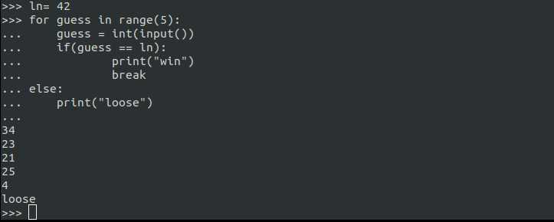

Slide 23
Pass:
Pass is used in order to do nothing in a code block.
It is equivalent code block as of C’s { }.
Continue:
Continue means just skip this time but keep doing what you were doing.
Break:
Break means just stop whatever you are doing.

Slide 24
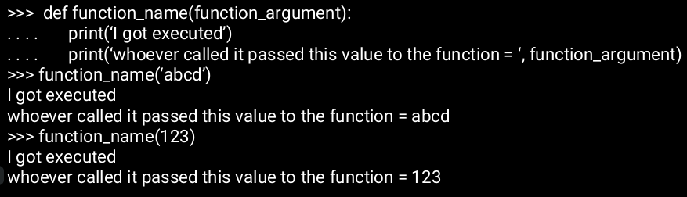
Functions in Python
In Python we declare that some identifier is a function by suffixing a keyword ‘def’ before it.
def FUNCTION_NAME(FUNCTION_ARGUMENTS):
STATEMENTS_TO_EXECUTE (ie. a code_block)

Slide 25
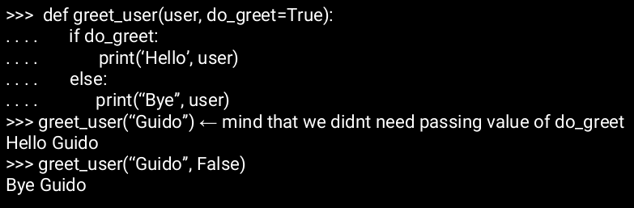
Arguments in Function
1) optional argument
def function_name(mandatory_args,optional_args=default_values):

Slide 26
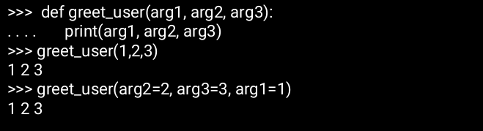

Arguments in Function
2) positional arguments:
we are mapping values to the position of arguments in the function signature.
function(arg1=value1, arg2=value2, arg3=value3)

Slide 27
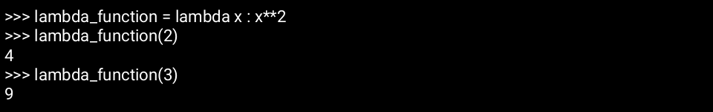
Lambda Functions
One Line Functions
single expression functions which are almost completely analogous to mathematical functions.
eg. f(x,y) = x+y can be written in lambda form as-
lambda x,y : x+y ← mind that as it is in one line there is no code block needed.

Slide 28
Some Methods of Python
Range
The range() function returns a sequence of numbers, starting from 0 by default, and increments by 1 (by default), and stops before a specified number.
Syntax : range(start, stop, step)
Split
The split() method returns a list of strings after breaking the given string by the specified separator.
Syntax : str.split(separator, maxsplit)

Slide 29
Some Methods of Python
Replace
The replace() is an inbuilt function in Python programming language that returns a copy of the string where all occurrences of a substring is replaced with another substring.
Syntax : range(start, stop, step)
Filter
The filter() method filters the given sequence with the help of a function that tests each element in the sequence to be true or not.
Syntax : filter(function, sequence)

Slide 30
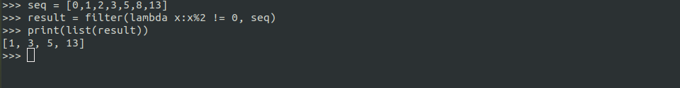
Some Methods of Python
Filter
It is normally used with Lambda functions to separate list, tuple, or sets
function: function that tests if each element of a
sequence true or not.
sequence: sequence which needs to be filtered, it can
be sets, lists, tuples, or containers of any iterators.

Slide 31
Some Methods of Python
Map( )
map() function returns a map object(which is an iterator) of the results after applying the given function to each item of a given iterable (list, tuple etc.)
Syntax: map(fun, iter)
Note: to know all built-in functions type
dir(__builtins__)

Slide 32
