Slide 1


INTRO TO PYTHON WORLD

Slide 2
Python Programming Platforms & Pip
Python programs can be written on:
1) Text Editors
2) Python Shell
3) IDE
There are several packages and libraries that can be used in Python
Python has 141,251+ such Packages. PyPI indexes all of those packages.
These packages can be installed using PIP on a system.
Pip is the package management system of python to install packages in following ways:
pip install <pacakage_name> // for python 2.7
pip3 install <package_name> // for python 3 or more

Slide 3








Various IDE’s and Editors

Slide 4
Data Types in Python
Number
String
List
Tuples
Set
Dictionary
Array
[One Dimensional]
Array
[Multi Dimensional]

Slide 5
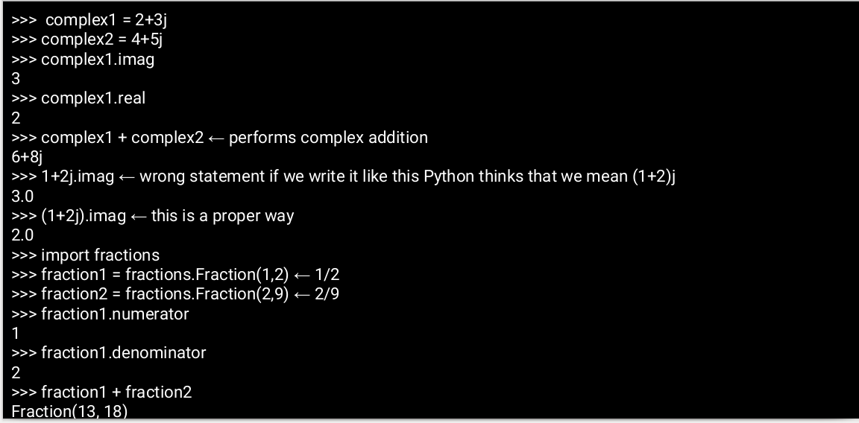
Number (int,float,complex,fractions)

Slide 6
Tuples Strings
iterable and immutable collection of objects
Homogeneous & Heterogeneous both
represented using ( ) literal
have only basic operations concatenation and iterable operations
A sequence of characters.
Represented using double or single quotes.
They are iterable
Reverse using x[ ::-1]
we can access a character in a string
eg. x = “abcd”
x[0] ← it will print a (This is indexing)

Slide 7
Lists
They are iterable, mutable collection of objects
represented using [ ] literal
It can be Multi Dimensional
Lists inside Lists
eg. x=[ [1, 2, 3, 4],
[5, 6, 7, 8],
[9, 10, 11, 12] ]
primarily 4 things we must know how to do in a list
adding an element. (.append(), .insert(), .extend() )
deleting an element. *( .remove(), .pop(), .clear(), .del() )
sorting a list (.sort(), .reverse())
Iterable operations (len, .count(), slicing, indexing, copying)

Slide 8
Sets Dictionaries
a mutable collection of unique objects
represented using { } literal with at least one element in them
supports the operations like difference, union, intersection
Also check if a set is set’s subset/superset
Also operations of list like add, pop,extend
used to establish a relation between two objects
Mutable, Mapping object type which maps hashable objects to their values.
created using { } literal or dict()
{ ‘key1’: ‘value1’,
‘key2’: ‘value2’ }

Slide 9
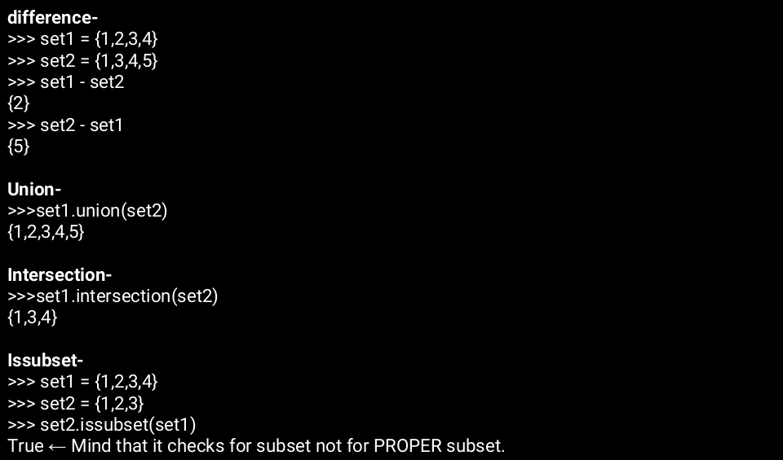
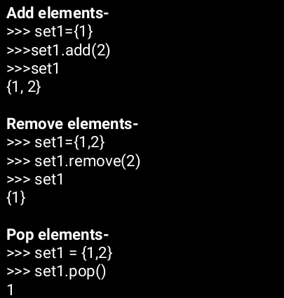

Slide 10
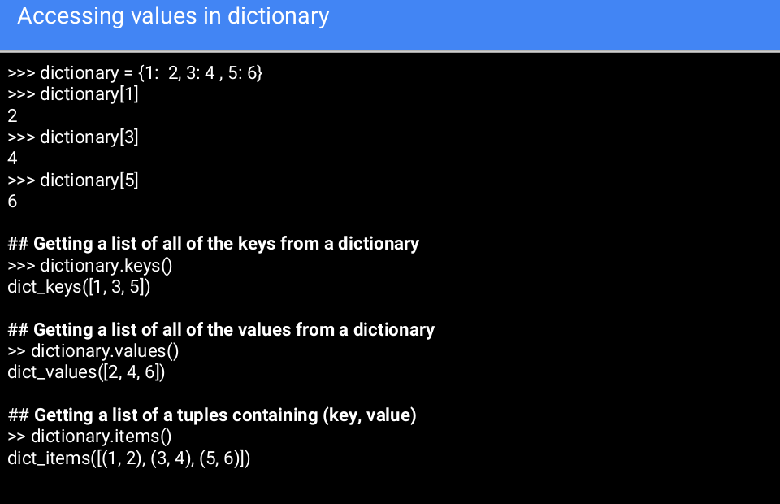

Slide 11
