Slide 1
PL/SQL
Introduction
Structure of a block
Variables and types
Accessing the database
Control flow
Cursors
Exceptions
Procedures and functions
BD05/06

Slide 2
Introduction
PL/SQL stands for Procedural Language/SQL.
PL/SQL extends SQL by adding constructs found in procedural languages, resulting in a structural language that is more powerful than SQL.
The basic unit in PL/SQL is a block. All PL/SQL programs are made up of blocks, which can be nested within each other. Typically, each block performs a logical action in the program.

Slide 3
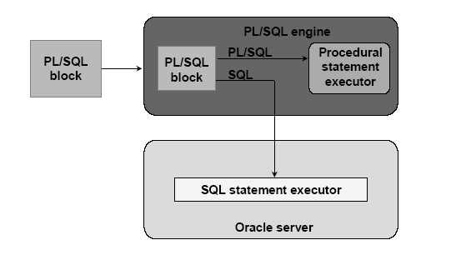
PL/SQL Environment

Slide 4
Benefits
Integrate of database technology and procedural programming capabilities
Provide improved performance of an application
Modularize program development
Portable among host environments supporting Oracle server and PL/SQL
Handle errors

Slide 5
Structure of a block
DECLARE
/* Declarative section: variables, types, cursors, user-defined exceptions */
BEGIN
/* Executable section: procedural and SQL statements go here. */
/* This is the only section of the block that is required. */
EXCEPTION
/* Exception handling section: error handling statements go here. */
END; /* mandatory */

Slide 6
Block (1)
The only SQL statements allowed in a PL/SQL program are SELECT, INSERT, UPDATE, DELETE and several other data manipulation statements plus some transaction control.
Data definition statements like CREATE, DROP, or ALTER are not allowed.
The executable section also contains constructs such as assignments, branches, loops, procedure calls, and triggers

Slide 7
Block (2)
PL/SQL is not case sensitive. C style comments (/* ... */) may be used.
To execute a PL/SQL program, we must follow the program text itself by: a line with a single dot ("."), and then a line with “run”; or a line with “/”
We can invoke a PL/SQL program either by typing it in sqlplus or by putting the code in a file and invoking the file
BD05/06

Slide 8
Variables and Types (1)
Information is transmitted between a PL/SQL program and the database through variables.
Every variable has a specific type associated with it, that can be:
  One of the types used by SQL for database columns
  A generic type used in PL/SQL such as NUMBER
  Declared to be the same as the type of some database column
BD05/06

Slide 9
Variables and Types (2)
The most commonly used generic type is NUMBER. Variables of type NUMBER can hold either an integer or a real number.
The most commonly used character string type is VARCHAR(n), where n is the maximum length of the string in bytes. This length is required, and there is no default.
BD05/06

Slide 10
Example
DECLARE
price NUMBER(2);
myAddress VARCHAR(20);

Slide 11
Declaring Boolean variables
Only the values TRUE, FALSE, and NULL can be assigned to a Boolean variable.
• The variables are compared by the logical
operators AND, OR, and NOT.
• The variables always yield TRUE, FALSE, or NULL.
• Arithmetic, character, and date expressions can be used to return a Boolean value.
BD05/06

Slide 12
Example
DECLARE
v_flag BOOLEAN := FALSE;
BEGIN
v_flag := TRUE;
END;

Slide 13
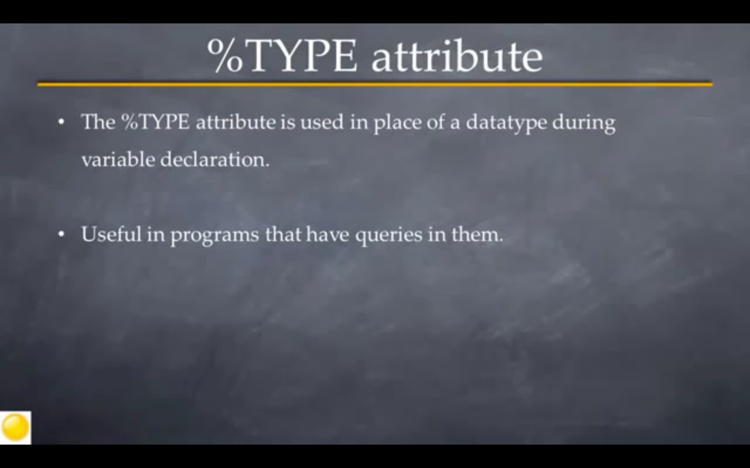

Slide 14
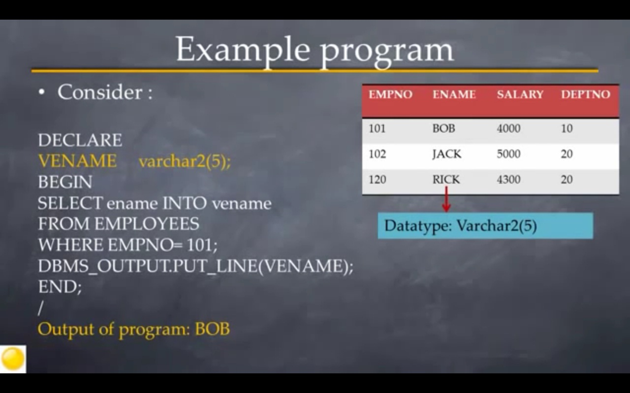

Slide 15
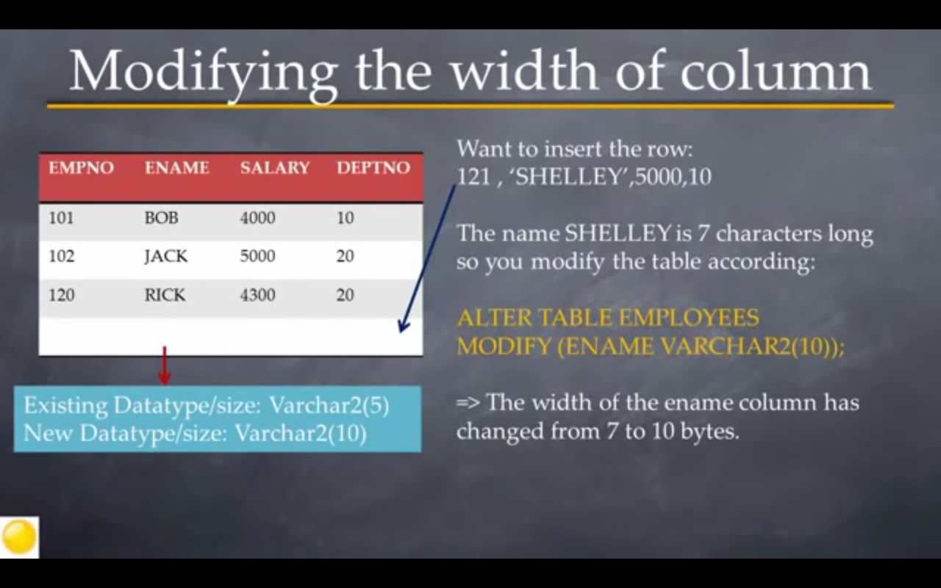

Slide 16
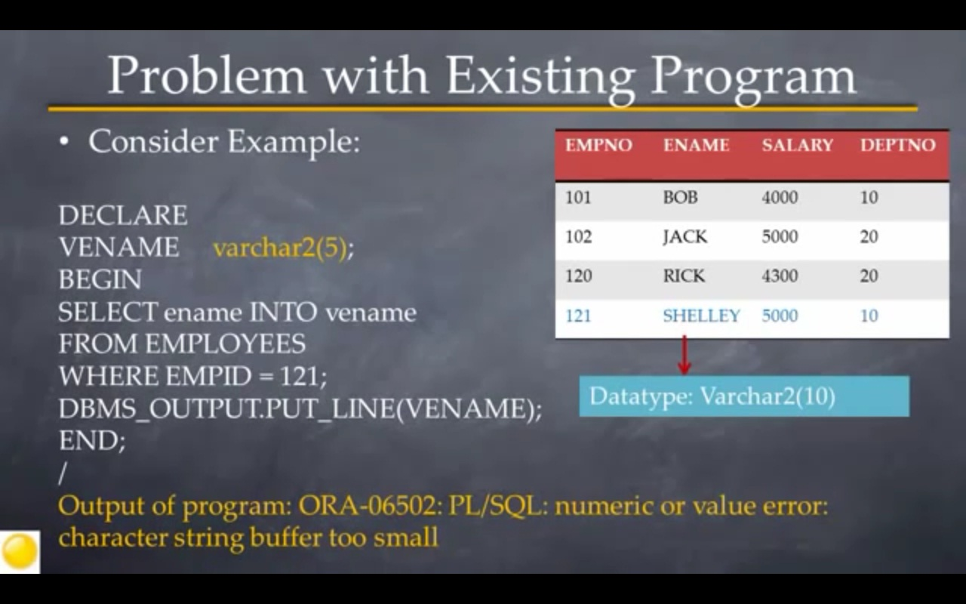

Slide 17
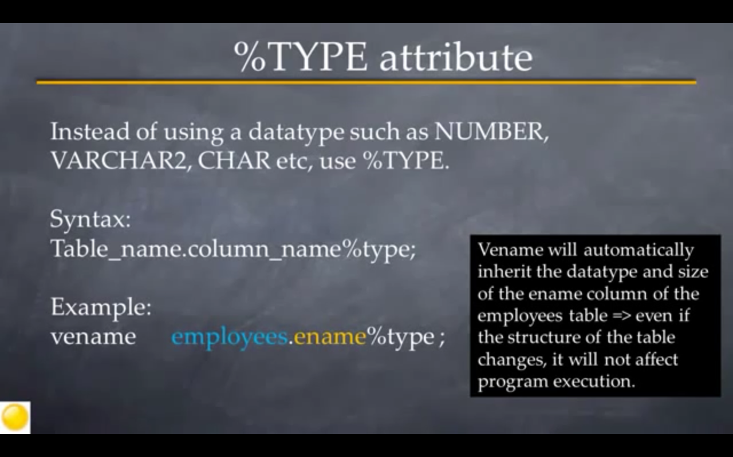

Slide 18
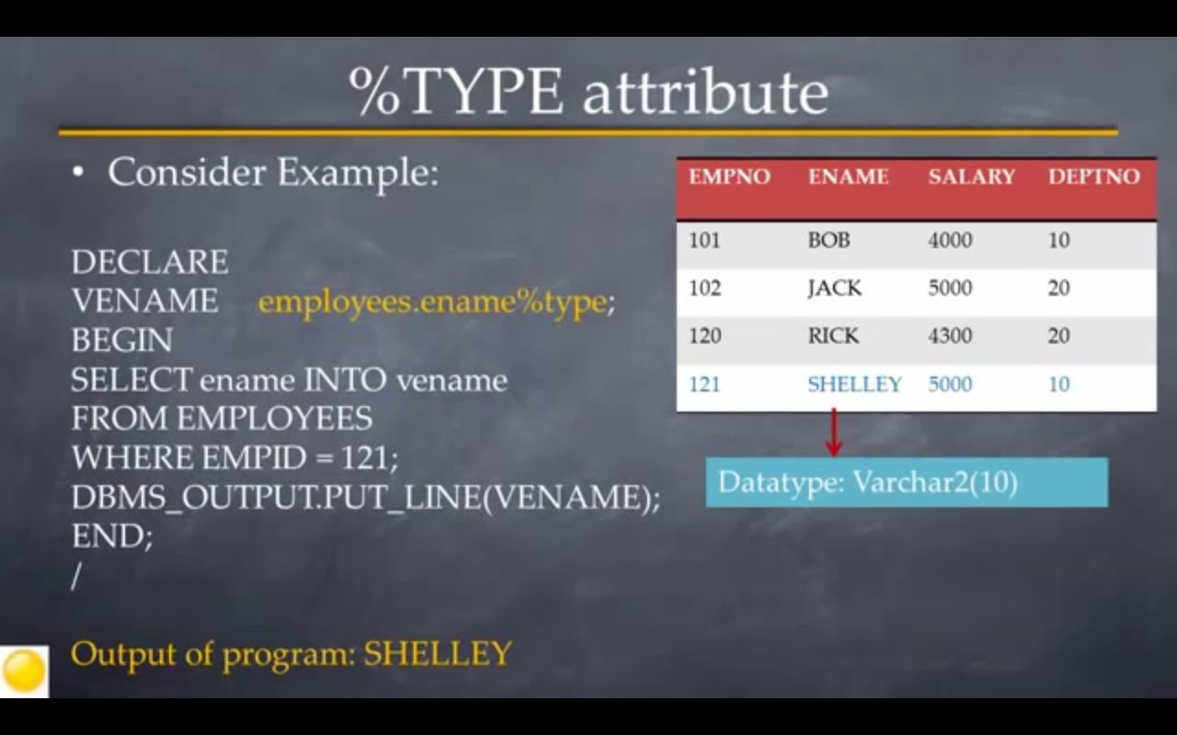

Slide 19
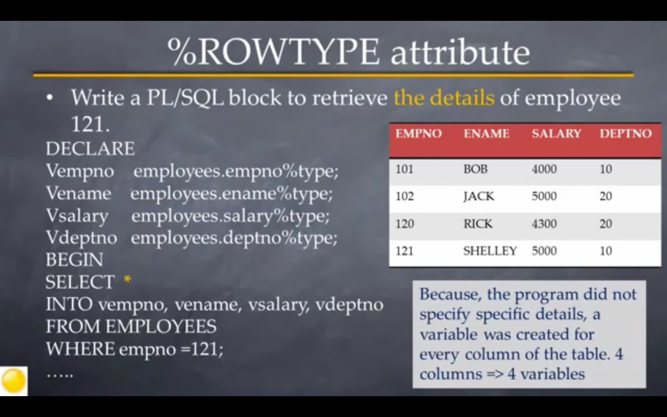

Slide 20
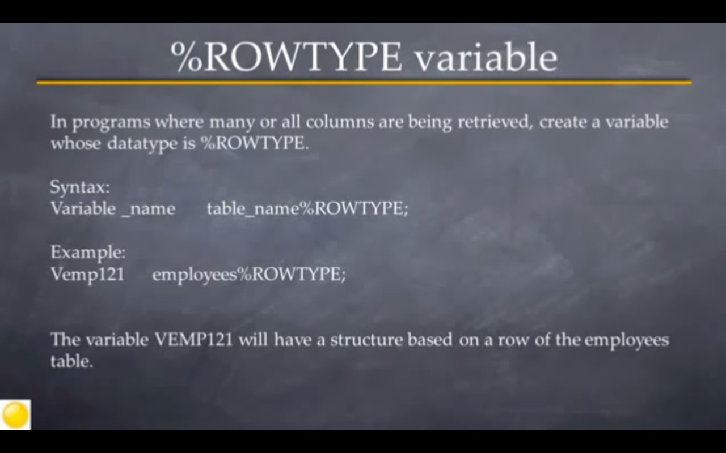

Slide 21
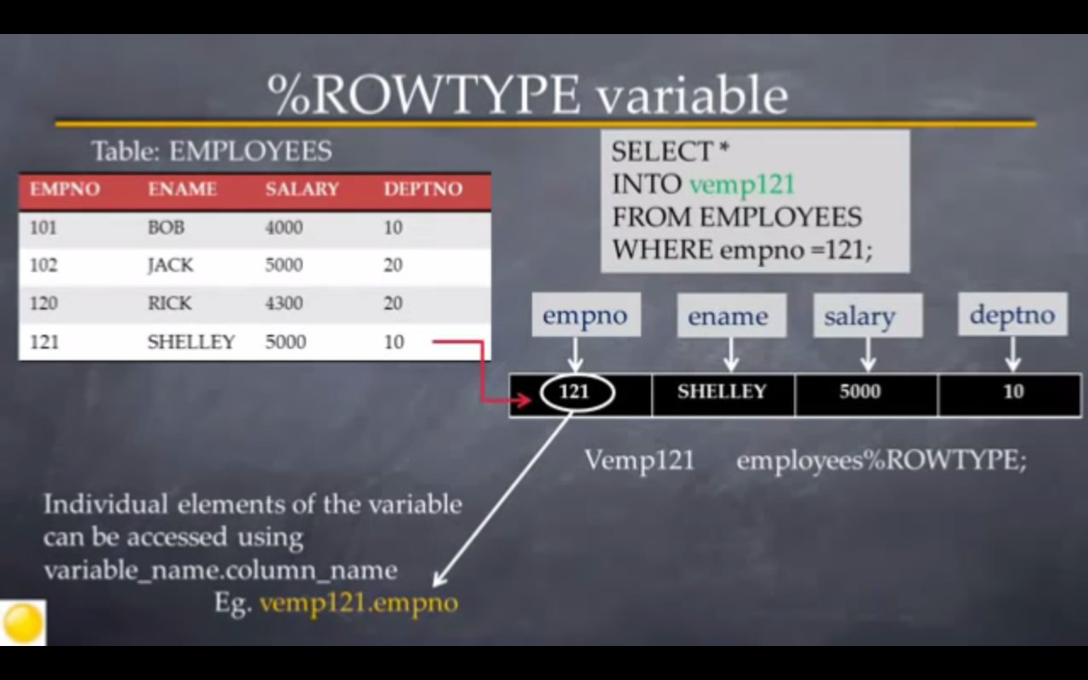

Slide 22
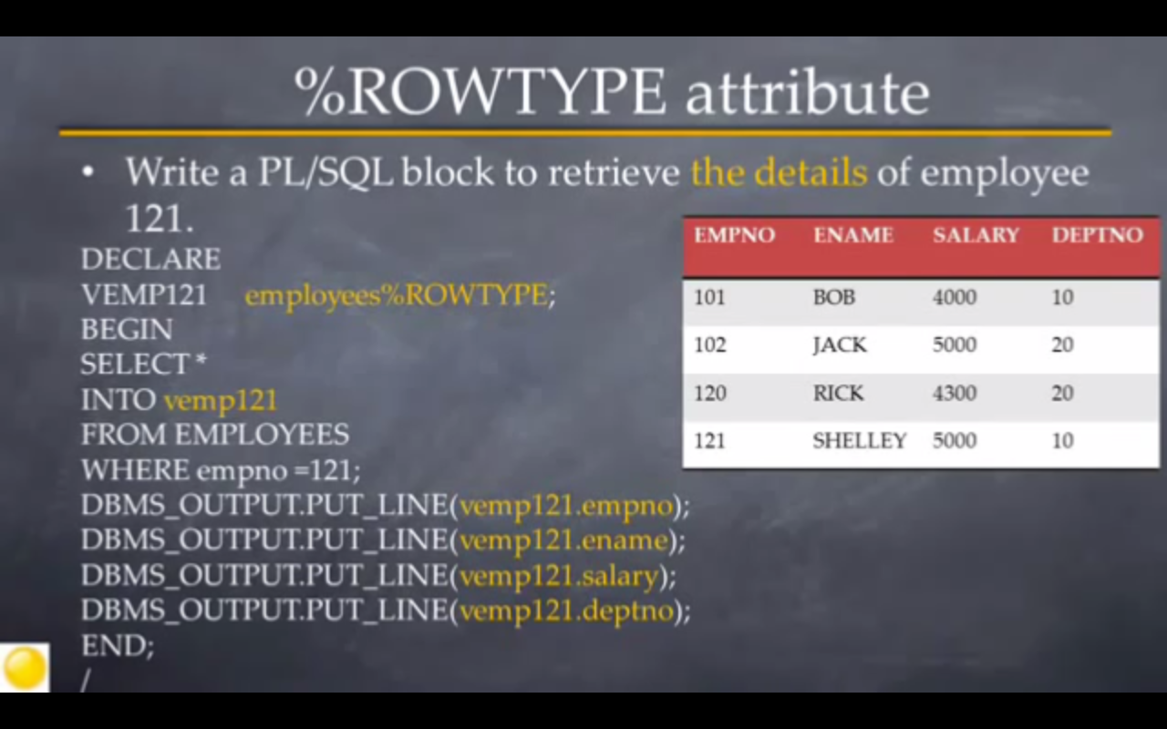

Slide 23
Default values and assignments
The initial value of any variable, regardless of its type, is NULL.
We can assign values to variables, using the ":=" operator.
The assignment can occur either immediately after the type of the variable is declared, or anywhere in the executable portion of the program.
Ex:
DECLARE
a NUMBER := 3;
BEGIN
a := a + 1;
END;
.
run;

Slide 24
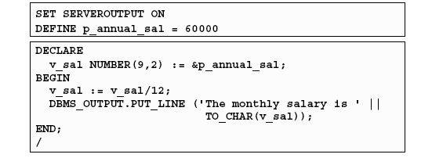
DBMS_OUTPUT.PUT_LINE package
An Oracle-supplied packaged procedure
An alternative for displaying data from a PL/SQL block
Must be enabled in SQL*Plus with: SET SERVEROUTPUT ON
BD05/06

Slide 25
Simple programs accessing the database
The simplest form of program has some declarations followed by an executable section consisting of one or more of the SQL statements with which we are familiar.
After the SELECT clause, we must have an INTO clause listing variables, one for each attribute in the SELECT clause, into which the components of the retrieved tuple must be placed.
The SELECT statement in PL/SQL only works if the result of the query contains a single tuple. If the query returns more than one tuple, you need to use a cursor
BD05/06

Slide 26
Example (SQL)
CREATE TABLE T1(
e INTEGER,
f INTEGER );
DELETE FROM T1;
INSERT INTO T1 VALUES(1, 3);
INSERT INTO T1 VALUES(2, 4);
BD05/06

Slide 27
Example (PL/SQL)
DECLARE
a NUMBER;
b NUMBER;
BEGIN
SELECT e,f INTO a,b FROM T1 WHERE e>1;
INSERT INTO T1 VALUES(b,a);
END;

Slide 28
PL/SQL - Conditions
PL/SQL programming language provides following types of decision-making statements.
IF-THEN Statement
IF-THEN-ELSE Statement
IF-THEN-ELSIF Statement
CASE Statement
Nested IF-THEN-ELSE Statements

Slide 29
Control flow
PL/SQL allows you to branch and create loops in a fairly familiar way.
An IF statement looks like:
IF <condition> THEN <statement_list>
ELSE <statement_list>
END IF;
The ELSE part is optional. If you want a multiway branch, use:
IF <condition_1> THEN ...
ELSIF <condition_2> THEN ... ... ...
ELSIF <condition_n> THEN ...
ELSE ...
END IF;

Slide 30
Example
DECLARE
a NUMBER;
b NUMBER;
BEGIN
SELECT e,f INTO a,b FROM T1 WHERE e>1;
IF b=1 THEN
INSERT INTO T1 VALUES (b,a);
ELSE
INSERT INTO T1 VALUES (b+10,a+10);
END IF;
END;

Slide 31
Example
DECLARE a number(3) := 100;
b number(3) := 200;
BEGIN
-- check the boolean condition
IF( a = 100 )
THEN
IF( b = 200 )
THEN
dbms_output.put_line('Value of a is 100 and b is 200' );
END IF;
END IF;
dbms_output.put_line('Exact value of a is : ' || a );
dbms_output.put_line('Exact value of b is : ' || b );
END;

Slide 32
Loops
Loops are created with the following:
LOOP
  <loop_body> /* A list of statements. */
  END LOOP;
At least one of the statements in <loop_body> should be an EXIT statement of the form
EXIT WHEN <condition>;
The loop breaks if <condition> is true.

Slide 33
Example
DECLARE
i NUMBER := 1;
BEGIN
LOOP
INSERT INTO T1 VALUES (i,i);
i := i+1;
EXIT WHEN i>100;
END LOOP;
END;

Slide 34
Other useful loop-forming statements
A WHILE loop can be formed with:
WHILE <condition> LOOP
<loop_body>
END LOOP;
A simple FOR loop can be formed with:
FOR <var> IN <start>..<finish> LOOP
<loop_body>
END LOOP;
Here, <var> can be any variable; it is local to the for-loop and need not be declared. Also, <start> and <finish> are constants.

Slide 35
Example
DECLARE i number(1);
j number(1);
BEGIN
<< outer_loop >>
FOR i IN 1..3 LOOP
<< inner_loop >>
FOR j IN 1..3 LOOP
dbms_output.put_line('i is: '|| i || ' and j is: ' ||j);
END loop
inner_loop;
END loop
outer_loop; END; /

Slide 36
Question
Write a PL/SQL code block to calculate the area of a circle for a value of radius varying from 3 to 7. Store the radius and the corresponding values of calculated area in an empty table named Areas, consisting of two columns Radius and Area.

Slide 37
Create table Area(r number(10,2), a number(10,2));
Desc Area;
declare
r number(10,2);
a number(10,2);
i number(10,2);
begin
for i in 3..7
loop
a:=3.14*i*i;
insert into Area values(i,a);
end loop;
end;

Slide 38
Exit /Continue Statement
the EXIT statement is encountered inside a loop, the loop is immediately terminated and the program control resumes at the next statement following the loop.
The CONTINUE statement causes the loop to skip the remainder of its body and immediately retest its condition prior to reiterating.

Slide 39
Example
DECLARE
a number(2) := 10;
BEGIN
-- while loop execution
WHILE a < 20 LOOP
dbms_output.put_line ('value of a: ' || a);
a := a + 1;
IF a = 15 THEN
-- skip the loop using the CONTINUE statement
a := a + 1;
CONTINUE;
END IF;
END LOOP;
END;
/

Slide 40
Goto Statement
A GOTO statement in PL/SQL programming language provides an unconditional jump from the GOTO to a labeled statement in the same subprogram.
DECLARE
a number(2) := 10;
BEGIN
<<loopstart>>
WHILE a < 20 LOOP
dbms_output.put_line ('value of a: ' || a);
a := a + 1;
IF a = 15 THEN
a := a + 1;
GOTO loopstart;
END IF;
END LOOP;
END;

