Slide 1

CONVOLUTIONAL NEURAL NETWORK(CNN)
DEEP LEARNING MODEL FOR IMAGE CLASSIFICATION
SUMON GHOSH

Slide 2
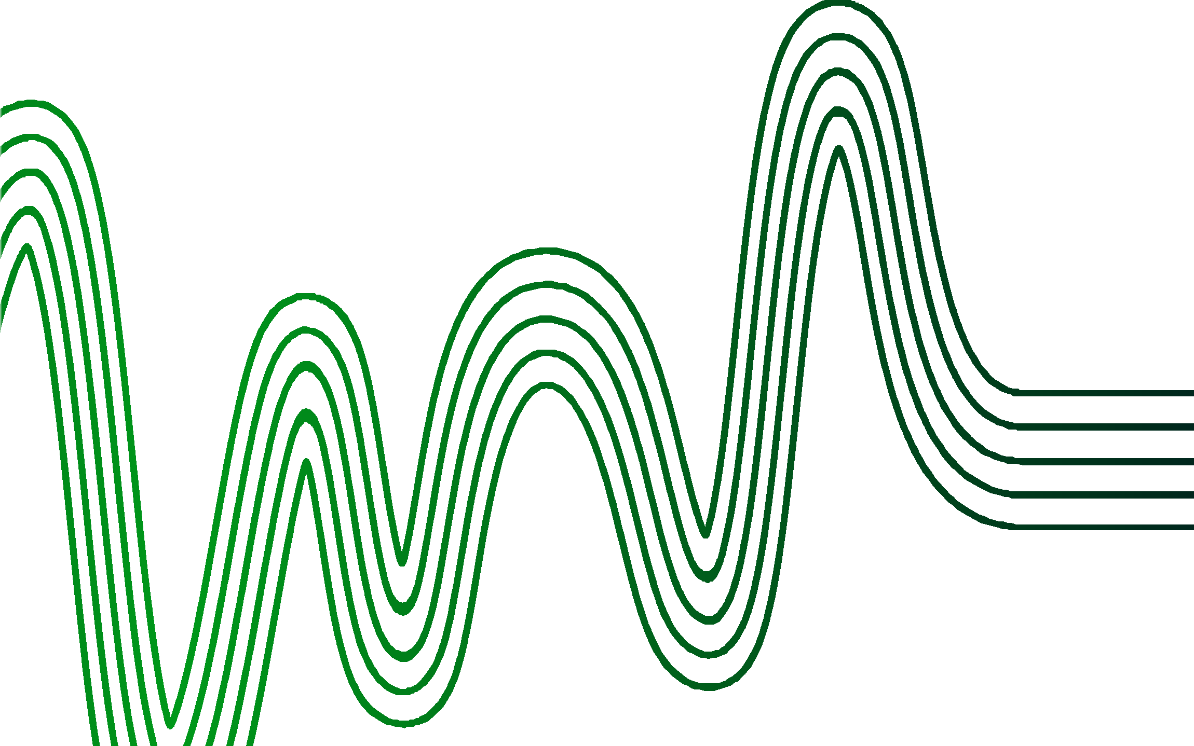
AGENDA
WHAT IS CNN | WHY CNN
LAYERS IN CNN
WORKING | METHODOLOGY TYPES OF CNN
SITES USED :- GFG MEDIUM
TOWARDS DATA SCIENCE , ANALYTICS VIDYA

Slide 3
WHAT IS CNN
/ WHY CNN ?
An image is stored in a digital format is represented in the form of pixel(picture element) which has its own dimensions and itensity.
A convolutional neural network (CNN), is a network architecture for deep learning which
learns directly from data. CNNs are particularly useful for finding patterns in images to recognize objects.
Convolutional Neural Network (CNN) is the
extended version of artificial neural networks
(ANN) which is predominantly used to extract the feature from the grid-like matrix dataset.
it is mainly used for image classification.
Each pixel has a color channel of either 3(red-blue-green) or 1(grayscale/black-white) . so an color image with dimention 250 X 250 will be represented as 250 X 250 X 3.
In ANN we feed an image in the input layer and it will have its corresponding hidden layer to do backprogation .
so for a single color image the input layer should have 250 X 250 X 3 and the hidden layer will have 187500(250 X 250 X 3) nodes .
Here overfitting problem occurs due to increased numbers of neurons in the hidden layer . so to overcome this issue CNN was introduced .

Slide 4

Layers in CNN
CNN CONSISTS OF FOUR LAYERS.
CONVOLUTION
RELU
POOLING
FULLY-CONECTED
Convolution layer is used for FEATURE EXTRACTION
relu is the activation function used for mormalisation
pooling layer helps to reduce dimensionality,or image size
this layer connects every layer and calculate the output function .
Back to Agenda

Slide 5
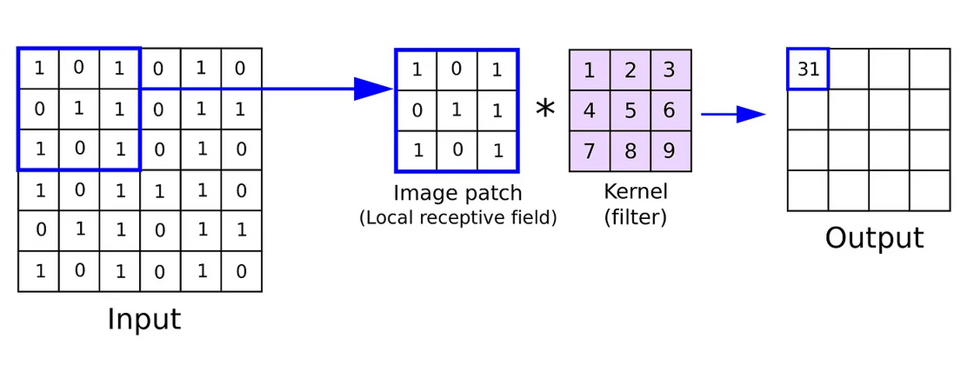
Convolution : HOW IT WORKS
A Filter / Kernel is used to extract the features from the image . it consists of auto-generated pixel values of user defined dimention , smaller dimention than the input image.
Stride -> no. of steps / movements over the image.
Padding -> it adds an extra dimension with pixel value 0, to decrease the loss of information.
convolutional layer takes an input image and applies a set of filters (kernels) to produce a 2D activation map (feature map) for each filter.
As the kernel slides across the input, it computes the dot product between its weights and the input at each position, resulting in a single value in the output feature map.
formula for new image :
O=[i-k] + 1 [only use kernel]
O=[i-k]/s +1 [only use kernel and stride]
O=[i-k+2p]/s + 1
i = size of input image , k = size of kernel , p = padding , s=stride
During training, the values of the kernel matrix are learned through backpropagation. The network adjusts these values to minimize the error in the output predictions.

Slide 6
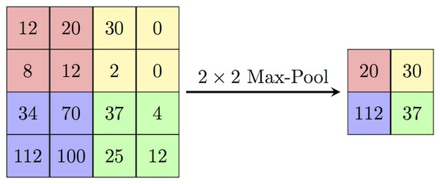
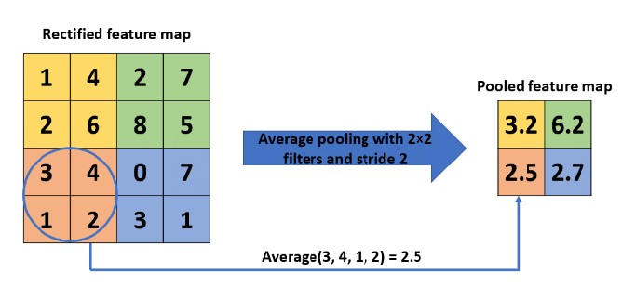
Relu/ pooling Layer
MAX POOLING
Takes the maximum value from each window of the input.
ReLu activation function is used for nomalisation. it transforms the values to a common range .
It is used to decrease the size of the convolved feature map to reduce computational costs. Basically its main work is dimentionality reduction.
Pooling has two types:- max pooling average pooling
AVERAGE POOLING
Computes the average of values within each window.
Provides a smoother downsampling compared to max pooling.

Slide 7
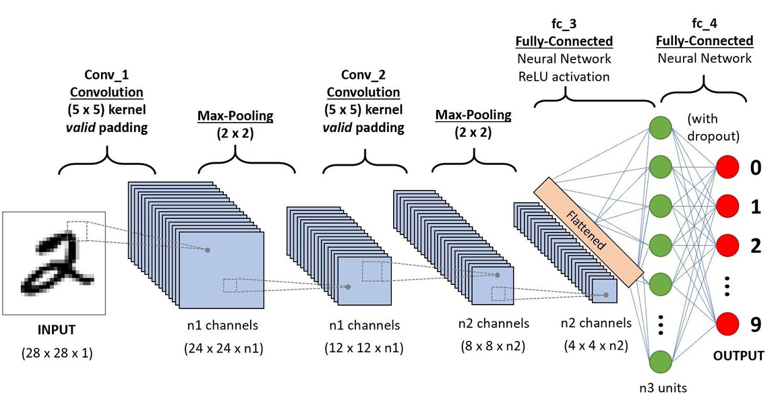

FULLY CONNECTED LAYER
The Fully Connected layer consists of the weights and biases along with the neurons and is used to connect the neurons between two different layers. These layers are usually placed before the output layer and form the last few layers of a CNN Architecture.
feature maps are flattened into a one-dimensional vector after the convolution and pooling layers so they can be passed into a completely linked layer for categorization or regression.
The output from the fully connected layers is then fed into a logistic function for classification tasks like sigmoid or softmax which converts the output of each class into the probability score of each class.

Slide 8
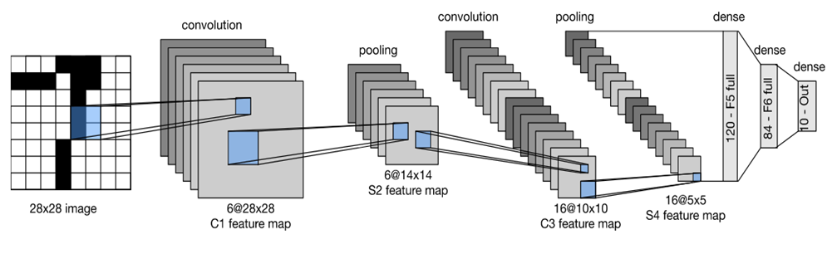
TYPES OF CNN : LENET
ARCHITECTURE
The network has 5 layers with learnable parameters and hence named Lenet-5. It has three sets of convolution layers with a combination of average pooling. After the convolution and average pooling layers, we have two fully connected layers. At last, a Softmax classifier which classifies the images into respective class.

Slide 9
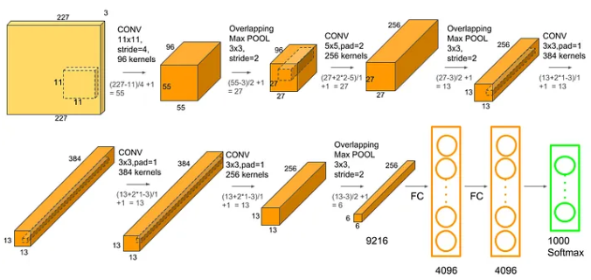
TYPES OF CNN : ALEXNET
It has 8 layers with learnable parameters.
The input to the Model is RGB images.
It has 5 convolution layers with a combination of max- pooling layers.
Then it has 3 fully connected layers.
The activation function used in all layers is Relu.
It used two Dropout layers. The activation function used in the output layer is Softmax.
The total number of parameters in this architecture is 62.3 million

Slide 10
TYPES OF CNN : VGG16

Slide 11
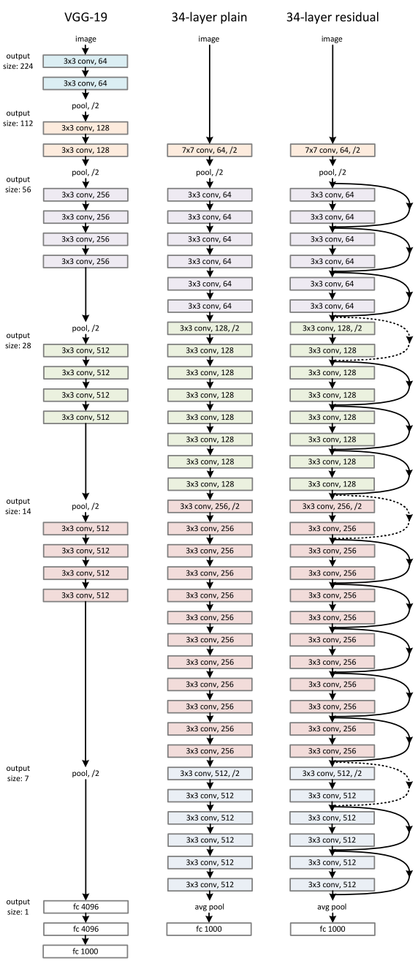
TYPES OF CNN: RESNET (Residual Network)
Key Features:
- Introduced by Microsoft in 2015 (ResNet-50, ResNet-101, etc.)
- Solves the "vanishing gradient" problem using skip connections (residual connections).
- Enables training of very deep networks (even over 100 layers) without performance degradation.
Architecture Highlights:
- Uses identity shortcuts to skip one or more layers.
- A Residual Block: Output = F(x) + x, where F(x) is the output of a few stacked layers and x is the input.
- Promotes gradient flow during backpropagation.
Advantages:
- Efficient in training deep networks.
- High accuracy in image classification tasks.
- Became a foundation for many later architectures.
Applications:
- Image classification (e.g., ImageNet)
- Object detection
- Semantic segmentation
Read more....

