Slide 1
Metaphor Detection in a Poetry Corpus
Vaibhav Kesarwani, Diana Inkpen, Stan Szpakowicz and Chris Tănăsescu (Margento)
University of Ottawa
Canada

Slide 2
Outline
Goal
Related Work
Metaphor Types and Examples
Rule Based Identification Method
Word Embeddings Based Method
Results
Conclusion
Future Work

Slide 3
Goal
Metaphor Detection in Poetry
Classification of sentences as Metaphor or Non-metaphor based on subject words in a sentence
Subject words are identified by finding various associations by Stanford parser in a sentence

Slide 4
Related Work
Neuman et al. (2013) propose to categorize metaphor by part-of-speech (POS) tag sequences such as Noun-Verb-Noun, Adjective-Noun, and so on. We follow the same categorization.
Neuman et al. (2013) describe a statistical model based on Mutual Information and selectional preferences. Our experiments do not involve finding selectional preference sets directly, instead we use word embeddings.
Shutova et al. (2016) introduce a statistical model which detects metaphor. Our is more focused on poetry.
Our current work belongs in the same category as the “GraphPoem” project (MARGENTO, 2012;Lou et al., 2015; Tanasescu et al., 2016).

Slide 5
Type 1 Metaphor
Part of Speech (POS) tag sequence of “noun-verb-noun” or “noun-verb-determiner-noun”.
Where verb is copula verb like [is, are, was, were, be, am].
Eg :
    Machines are the animals of the humans
    Words are a weight
    Eyes are lakes

Slide 6
Type 2 Metaphor
Part of Speech (POS) tag sequence of “noun-verb-noun” or “noun-verb-determiner-noun”.
Where verb is any non-copular verb like [eats, runs, played, etc..]
Eg :
    The war absorbed his energy
    My car drinks gasoline
    Money flows like liquid

Slide 7
Type 3 Metaphor
Part of Speech (POS) tag sequence of “adjective-noun”.
Eg :
    He had some dark thoughts
    She is a sweet girl
Type 4 & Type 5 (proposed) will be included in our future work

Slide 8
Metaphor Examples in Poetry
Type 1 : As if the world were a taxi, you enter it
Type 2 : I counted the echoes assembling, thumbing the midnight on the piers.
Type 3 : The moving waters at their priestlike task
Type 4 : The yellow smoke slipped by the terrace, made a sudden leap
Type 5 : To die – to sleep

Slide 9
Rule Based Identification Methods
(Turney et al.):
Concrete-Abstract rule : If noun1 is concrete & noun2 is abstract, then it is a metaphor
Eg :
    Eyes are strangers
    “eyes” class : concrete
    “stranger” class : abstract
WordNet is used to find the noun classes [concrete/abstract]

Slide 10
Rule Based Identification Methods (Turney et al.)
Concrete-Class Overlap rule : If both nouns are of concrete class, check for WordNet hyernym overlap. If no overlap, then it is a metaphor.
Eg :
    My lawyer is a shark
    “lawyer” class : concrete
    “shark” class : concrete

Slide 11
Wordnet Hypernyms
lawyer, attorney -- (a professional person authorized to practice law; conducts lawsuits or gives legal advice)
=> professional, professional person -- (a person engaged in one of the learned professions)
=> adult, grownup -- (a fully developed person from maturity onward)
=> person, individual, someone, somebody, mortal, soul -- (a human being; "there was too much for one person to do")
=> organism, being -- (a living thing that has (or can develop) the ability to act or function independently)
=> living thing, animate thing -- (a living (or once living) entity)
=> object, physical object -- (a tangible and visible entity; an entity that can cast a shadow;)
=> physical entity -- (an entity that has physical existence)
=> entity -- (that which is perceived or known or inferred to have its own distinct existence (living or nonliving))
shark -- (any of numerous elongate mostly marine carnivorous fishes with heterocercal caudal fins and tough skin covered with small toothlike scales)
=> cartilaginous fish, chondrichthian -- (fishes in which the skeleton may be calcified but not ossified)
=> fish -- (any of various mostly cold-blooded aquatic vertebrates usually having scales and breathing through gills; )
=> aquatic vertebrate -- (animal living wholly or chiefly in or on water)
=> vertebrate, craniate -- (animals having a bony skeleton with a segmented spinal column and a large brain )
=> animal, animate being, beast, brute, creature, fauna -- (a living organism characterized by voluntary movement)
=> organism, being -- (a living thing that has (or can develop) the ability to act or function independently)
=> living thing, animate thing -- (a living (or once living) entity)
=> object, physical object -- (a tangible and visible entity; an entity that can cast a shadow)
=> physical entity -- (an entity that has physical existence)
=> entity -- (that which is perceived or known or inferred to have its own distinct existence)

Slide 12
Word Embeddings Based Method (Proposed)
GloVe model (trained on Gigaword corpus) used to get word vectors of word1 & word2
Features Used for Classification:
  Word Vector Difference
  Cosine Similarity
  PMI (Pointwise Mutual Information)
  ConceptNet Overlap
WEKA tool used for classification task using above features

Slide 13
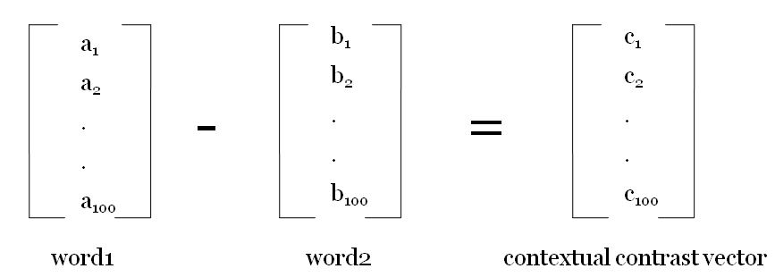
Vector Difference of Word Vectors
Vector Difference of vectors of word1 and word2 to capture contextual contrast
100 dimensional word vectors trained on Glove Gigaword corpus
For metaphor, Σ |C_{i}| should be significantly high

Slide 14
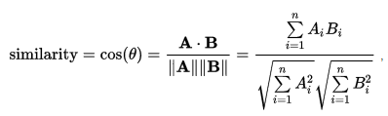
Cosine Similarity of Word Vectors
Cosine Similarity of vectors of word1 and word2 to capture contextual similarity

Slide 15

Pointwise Mutual Information
PMI of word1 and word2 (trained on British National Corpus)
Captures collocation information between the two words

Slide 16
ConceptNet Overlap
ConceptNet Overlap computed from SurfaceText entities of ConceptNet knowledge base
For example "birds" shows below associations:
[[Birds]] have [[feathers]]
[[birds]] can [[fly through the air]]
[[Some birds]] do not [[migrate in the Winter]]
[[birds]] have [[beaks]]
[[Birds]] have [[hollow bones]]
[[birds]] have [[wings]]
[[Birds]] are [[not mammals]]
[[birds]] can [[sing songs]]
[[birds]] can [[spread their wings]]
[[birds]] have [[two wings]]
[[Birds]] can be [[colored]]
[[The birds]] are [[singing]]
[[Some birds]] are [[very colorful]]

Slide 17
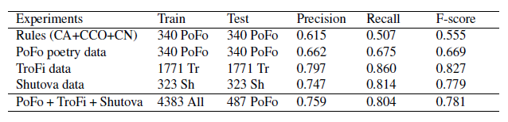
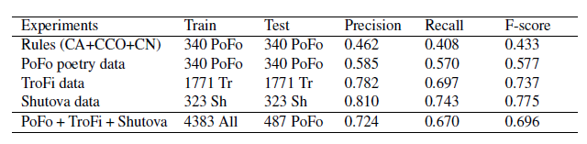
Results
Results for the class metaphor
Results for the class non-metaphor

Slide 18
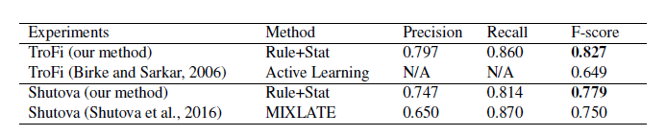
Results of the direct comparison with related work
(Rule+Stat = rule-based and statistical)

Slide 19
Conclusion
Statistical methods better than rule-based methods
Non-poetry data works well with poetry
Precision better for metaphor class prediction than non-metaphor class

Slide 20
Future Work
Analyze phrase compositionality(Mikolov et al.) to handle multi-word expressions and phrases better
Type-independent metaphor detection
Apply Deep Learning classifiers(like CNN) to improve classification results
Distinguish between poetic and common-speech metaphors
For rule-based methods, apply context overlap to remove ambiguity between various word senses

Slide 21
“Genuine poetry can communicate before it is understood.”
– T.S. Eliot.
Questions?

