Slide 1
Metaphor Detection in a Poetry Corpus
Vaibhav Kesarwani, Diana Inkpen,
Stan Szpakowicz, and Chris Tănăsescu (Margento)
University of Ottawa
Canada

Slide 2
Outline
Goal
Related Work
The Graph Poem Project
Metaphor Types and Examples
Rule-Based Identification Method
Method Based on Word Embeddings
Results
Conclusion
Future Work

Slide 3
Goal
Metaphor Detection in Poetry
Classification of sentences as Metaphor or Non-metaphor is based on subject words in a sentence.
Subject words are identified in a sentence using POS tagging and the Stanford dependency parser.

Slide 4
Related Work
Neuman et al. (2013) propose to categorize metaphor by part-of-speech (POS) tag sequences such as Noun-Verb-Noun, Adjective-Noun, and so on. We follow the same categorization.
Neuman et al. (2013) also describe a statistical model based on Mutual Information and selectional preferences. Our experiments do not involve finding selectional preference sets directly. Instead, we use word embeddings.
Shutova et al. (2016) introduce a statistical model of metaphor detection. Ours is more focused on poetry.

Slide 5
The Graph Poem Project
Our work is part of the Graph Poem project (MARGENTO, 2012) http://artsites.uottawa.ca/margento/en/the-graph-poem/
The Graph Poem: A graph of poems connected by (multiple) edges, ever-ramifying, ever-expanding. The edges reflect the similarity of topics, themes, meter, rhyme, diction, time period, and so on.
Multi-label subject classification of poems
(Lou et al. @FLAIRS 2015)
Meter detection (Tanasescu et al. @FLAIRS 2016)
Rhyme detection, metaphor detection

Slide 6
Type 1 Metaphor
Part of Speech (POS) tag sequence of “noun-verb-noun” or “noun-verb-determiner-noun”
The verb is a copula such as is, are, was, were, be, am.
Examples:
    Machines are the animals of the humans
    Words are a weight
    Eyes are lakes

Slide 7
Type 2 Metaphor
Part of Speech (POS) tag sequence of “noun-verb-noun” or “noun-verb-determiner-noun”
The verb is any non-copular verb: eats, runs, played, ………
Examples:
    The war absorbed his energy
    My car drinks gasoline
    Money flows like liquid

Slide 8
Type 3 Metaphor
Part of Speech (POS) tag sequence of “adjective-noun”
Examples:
    He had some dark thoughts
    She is a sweet girl
We also propose types 4 “noun-verb” and 5 “verb-verb” (examples on the next slide), to be included in our future work.

Slide 9
Metaphor Examples in Poetry
Type 1: As if the world were a taxi, you enter it
Type 2: I counted the echoes assembling, thumbing the midnight on the piers
Type 3: The moving waters at their priestlike task
Type 4: The yellow smoke slipped by the terrace, made a sudden leap
Type 5: To die – to sleep

Slide 10
Rule-Based Identification Methods
Concrete-Abstract rule:
If noun1 is concrete and noun2 is abstract, then we have a metaphor.
Example:
    Eyes are strangers
    “eyes”: concrete; “stranger”: abstract
WordNet is used to find the noun classes [concrete/abstract].
(This method has been proposed by Turney et al., 2011)

Slide 11
Rule-Based Identification Methods
Concrete-Class Overlap rule:
If both nouns are of concrete class, check for WordNet hypernym overlap. If there is no overlap, then it is a metaphor.
Example:
    My lawyer is a shark
    “lawyer”: concrete; “shark”: concrete
(This method is also from Turney et al., 2011)

Slide 12
Wordnet Hypernyms
lawyer, attorney -- (a professional person authorized to practice law; conducts lawsuits or gives legal advice)
=> professional, professional person -- (a person engaged in one of the learned professions)
=> adult, grownup -- (a fully developed person from maturity onward)
=> person, individual, someone, somebody, mortal, soul -- (a human being; "there was too much for one person to do")
=> organism, being -- (a living thing that has (or can develop) the ability to act or function independently)
=> living thing, animate thing -- (a living (or once living) entity)
=> object, physical object -- (a tangible and visible entity; an entity that can cast a shadow;)
=> physical entity -- (an entity that has physical existence)
=> entity -- (that which is perceived or known or inferred to have its own distinct existence (living or nonliving))
shark -- (any of numerous elongate mostly marine carnivorous fishes with heterocercal caudal fins and tough skin covered with small toothlike scales)
=> cartilaginous fish, chondrichthian -- (fishes in which the skeleton may be calcified but not ossified)
=> fish -- (any of various mostly cold-blooded aquatic vertebrates usually having scales and breathing through gills; )
=> aquatic vertebrate -- (animal living wholly or chiefly in or on water)
=> vertebrate, craniate -- (animals having a bony skeleton with a segmented spinal column and a large brain )
=> animal, animate being, beast, brute, creature, fauna -- (a living organism characterized by voluntary movement)
=> organism, being -- (a living thing that has (or can develop) the ability to act or function independently)
=> living thing, animate thing -- (a living (or once living) entity)
=> object, physical object -- (a tangible and visible entity; an entity that can cast a shadow)
=> physical entity -- (an entity that has physical existence)
=> entity -- (that which is perceived or known or inferred to have its own distinct existence)

Slide 13
Our Method: Use Word Embeddings
GloVe model (trained on the Gigaword corpus) is used to get word vectors of word1 and word2.
Features for Classification:
  Word Vector Difference
  Cosine Similarity
  PMI (Pointwise Mutual Information)
  ConceptNet Overlap
We use Weka to classify based on these features.

Slide 14
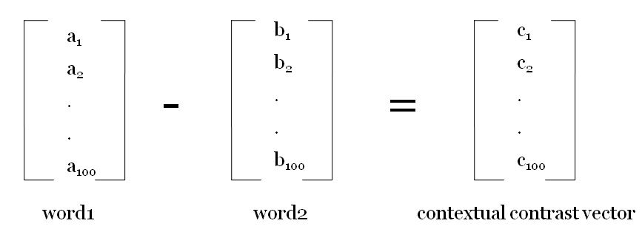
Vector Difference of Word Vectors
Vector Difference of vectors of word1 and word2 captures contextual contrast
100-dimensional word vectors trained on GloVe Gigaword corpus
For metaphor, Σ|C_{i}| should be high

Slide 15
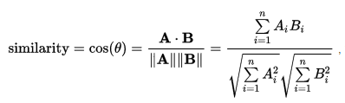
Cosine Similarity of Word Vectors
Cosine Similarity of vectors of word1 and word2 captures contextual similarity.

Slide 16

Pointwise Mutual Information
PMI of word1 and word2 (trained on the British National Corpus) captures collocation information between the two words.

Slide 17
ConceptNet Overlap
ConceptNet Overlap is computed from the SurfaceText entities of ConceptNet knowledge base.
For example, "birds" shows these associations:
[[Birds]] have [[feathers]]
[[birds]] can [[fly through the air]]
[[Some birds]] do not [[migrate in the Winter]]
[[birds]] have [[beaks]]
[[Birds]] have [[hollow bones]]
[[birds]] have [[wings]]
[[Birds]] are [[not mammals]]
[[birds]] can [[sing songs]]
[[birds]] can [[spread their wings]]
[[birds]] have [[two wings]]
[[Birds]] can be [[colored]]
[[The birds]] are [[singing]]
[[Some birds]] are [[very colorful]]

Slide 18
New Dataset: Metaphor in Poetry
680 lines of English poems from the Poetry Foundation (PoFo) website.
340 as training data and 340 as test data.
Two annotators labelled them as metaphor or not. Initially, kappa value was 0.39 and agreement 66.79%.
After involving a third annotator kappa increased to 0.46 and agreement to 72.94%.
Majority vote used in the cases of disagreement.

Slide 19
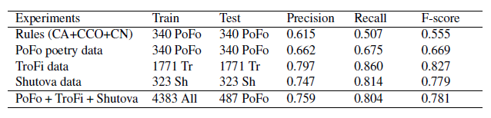
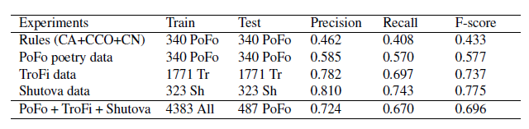
Results
Results for the class metaphor
Results for the class non-metaphor

Slide 20
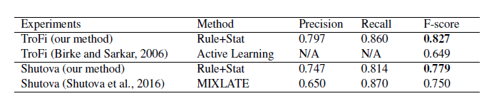
Direct comparison with related work
(Rule+Stat = the best between our rule-based and and our statistical ML method, namely the ML method)

Slide 21
Conclusion
Statistical methods are better than rule-based methods.
Non-poetry training data helps to find metaphors in poetry.
Precision is better at predicting the metaphor class than the non-metaphor class.

Slide 22
Future Work
Analyze phrase compositionality (Mikolov et al., 2013) to handle multi-word expressions and phrases better.
Try type-independent metaphor detection.
Try Deep Learning classifiers (like CNN) to improve classification results.
Distinguish between poetic and common-speech metaphor.
For rule-based methods, apply context overlap to remove ambiguity between various word senses.

Slide 23
Genuine poetry can communicate before it is understood.
– T. S. Eliot.
Thank you!
Questions?

