Slide 1
ENCOUNTER TASK WEB VIEW
Mobile Dispatch Server

Slide 2
Introduction
Our project deals with building a user friendly encounter between doctors/workforce and patients in order to develop a healthy environment. In order to have a successful encounter, there must be healthy “partnership” between concerned authorities. In case of doctor – patient scenario , both patient and doctor must be aware of each other’s conditions. Indeed it is a “two way” street. This allows the patient to be actively involved in decision making process and achieve desirable results in a smart way.

Slide 3
Team Members And Their Roles
Project lead – Vaibhav Lella
Research Analyzer and Code Interpreter – Vishnu Sankar
Code Breaker – Ananda Biswas
Reporting progress – Pranav P.
Unit tester – Akshat Dubey

Slide 4
Background
Patient is registered into system through encounter by surgeon/work force or any concerned authorities including the diagnosis information ,status of appointment and all the required information initiating the basic workflow of Haiti plot.

Slide 5
Significance
To develop a healthy relationship between concerned authorities
To facilitate in decision making process.
To be accountable to all necessary details
To help in maintaining a hospitable environment

Slide 6
Objective
To build a web interface that displays the encounters between patients and doctors/workforce displaying the status of appointment, diagnosis type along with some user friendly options for doctors/workforce to evaluate the patients list of encounters.

Slide 7
Approach
We developed the web application using Node.js for the backend along with Sails.js on top of it for an MVC web app. Taking scalability into consideration we have used Mysql for database management and front end is HTML, CSS and jQuery.
We managed to follow the guidelines provided by our mentor so as to facilitate view layers into Django framework. We have used the same REST API conventions used in MDS for accessing any objects using http CRUD methods and managed to achieve consistency of models used for objects in database with development version of MDS.

Slide 8
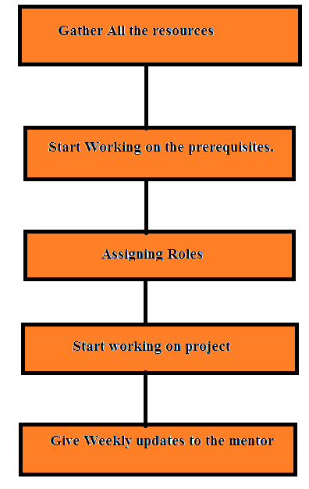
Our Approach

Slide 9
Methodology
Given the inexperience we had ,we did stumble at the beginning to get the push in order to move in right direction. Thanks to our mentor, we were able to build the basic model using the resources we learnt over period of four weeks.
We had to be good in HTML,CSS to build basic web interfaces. We checked through some of the web interfaces like that of Practice fusion :EHR to build our knowledge on the subject.
We developed use case scenarios after every group discussion and tried to update our previous versions after every meeting.
Following the agile development methodology made it easy for us to come up with a standalone web application within the stipulated time period.

Slide 10
Progress
Week 1
-> Meeting of group members and consensus on the positions held by the group members.
->Creation of the GitHub usernames of all team members completed
Week 2
-> Encounter Task Web View project was assigned by mentor, since the the initially opted "Reporting" project was inadvertently posted outside of the Haiti group .
-> Creation of the GitHub usernames of all team members and registration in the form on piazza completed
Week 3
-> Attended the followup meeting with the instructor alongwith Team 11 working on Push Notifications.
-> Understood the initial use case and looked into the various issues that need to be addressed.
Week 4
-> Asked mentor for further guidelines on how to proceed with the project and which technology is to be used for implementation of the system and more briefing on how to implement the same.
-> Understood the initial use case and looked into the various issues that need to be addressed.

Slide 11
Result
We built the basic web interface taking care of the deliverables and thus are successful in meeting the objectives. Hence the project has been concluded successfully.

Slide 12
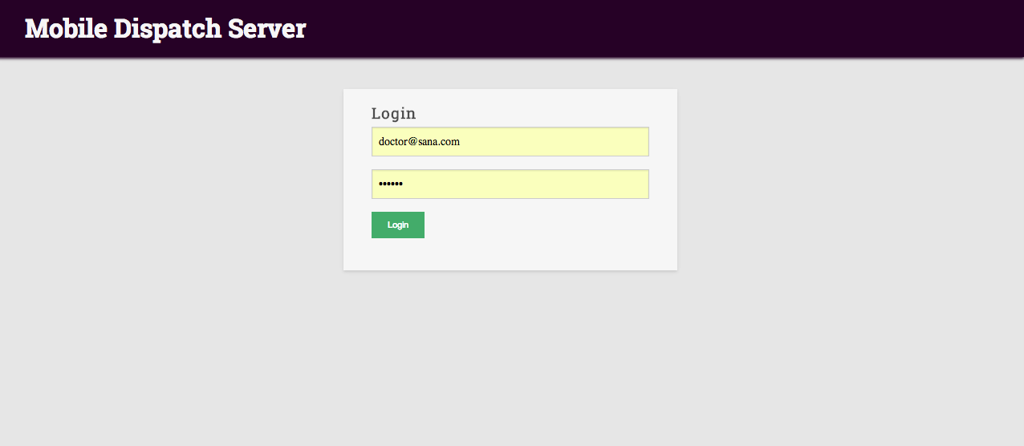
Encounter Task Web View

Slide 13
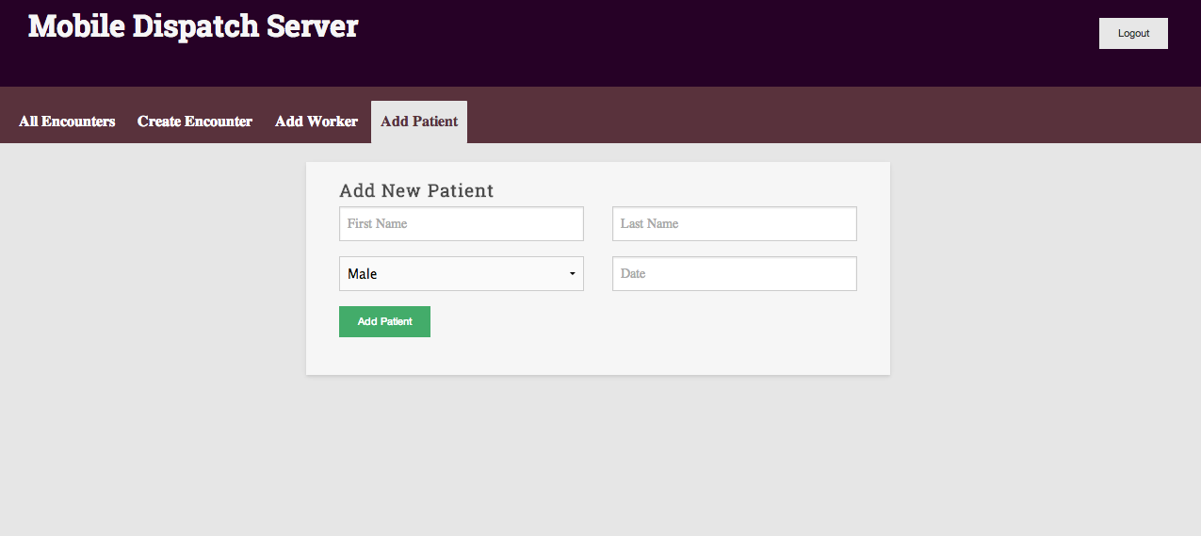
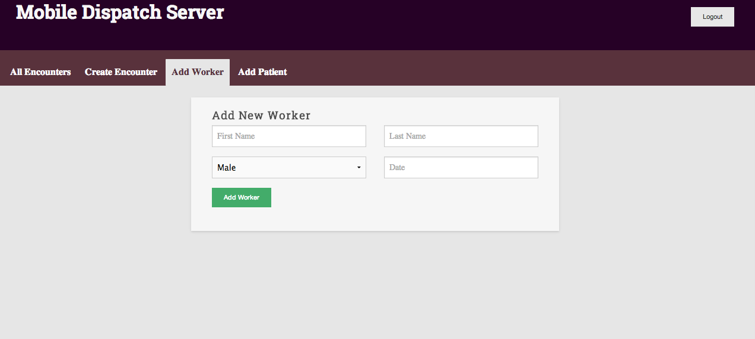

Slide 14
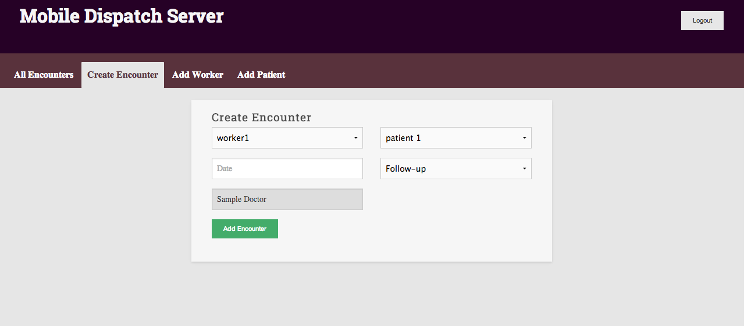
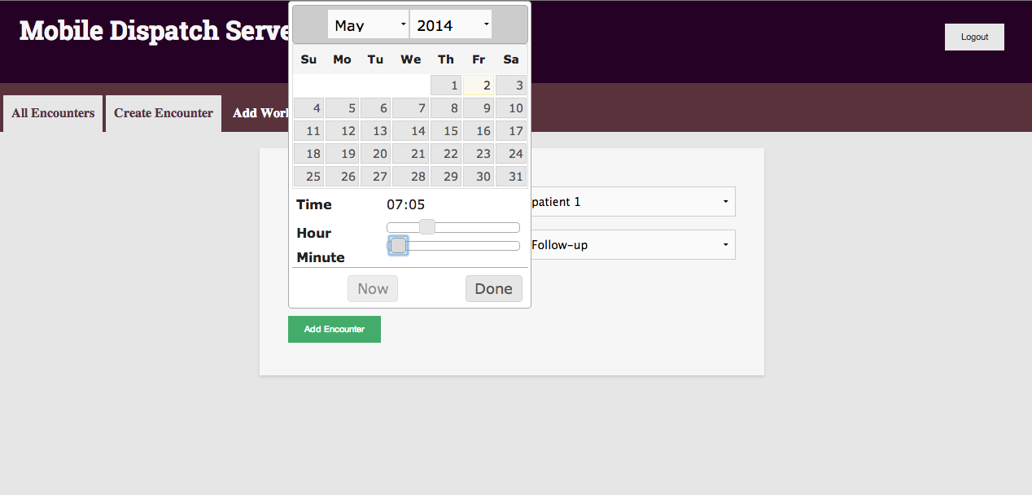

Slide 15
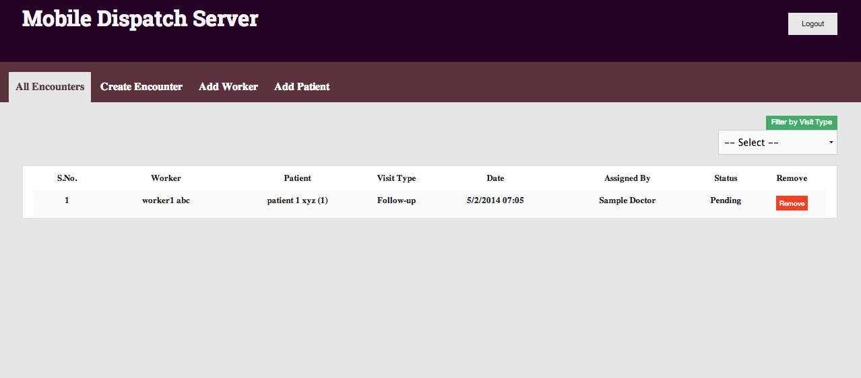

Slide 16
Acknowledgment
We would like to thank our mentors to help us throughout our tussle with the understanding of our project and to all the concerned authorities of SANA to let us be a part of this remarkable initiative.

