Slide 1
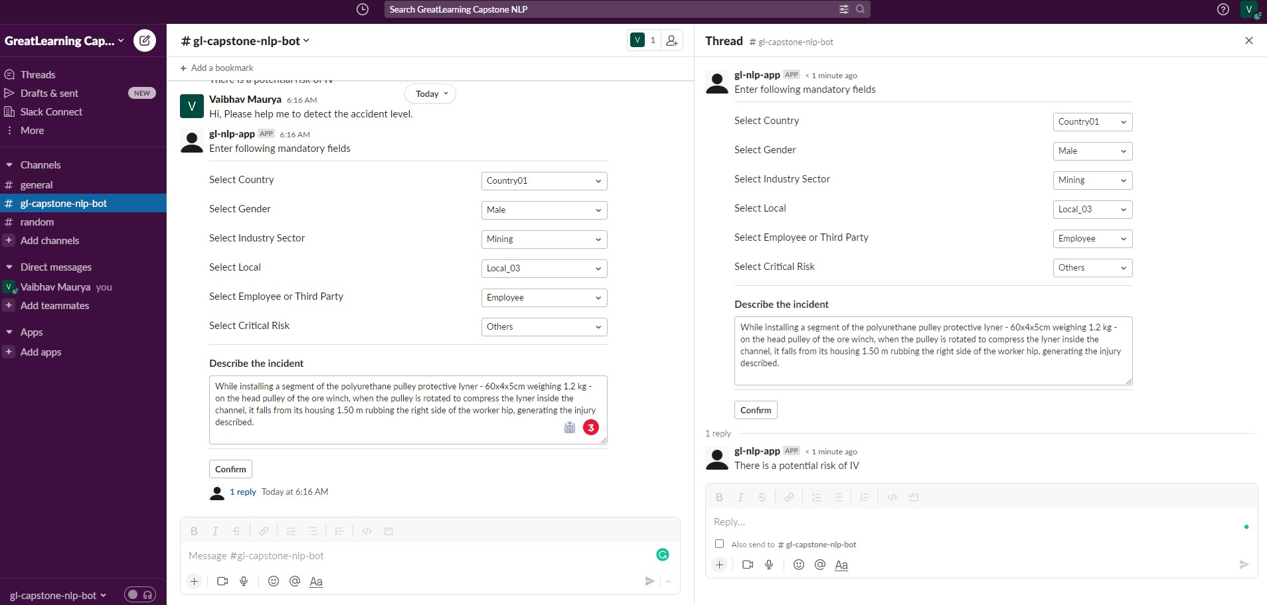
1
Triggers Slack Event
2
Bot responds with a form
User fills the details and click Confirm button
3
Bot’s response
User click the reply and it opens a thread
Bot replies
5
4

