Slide 1


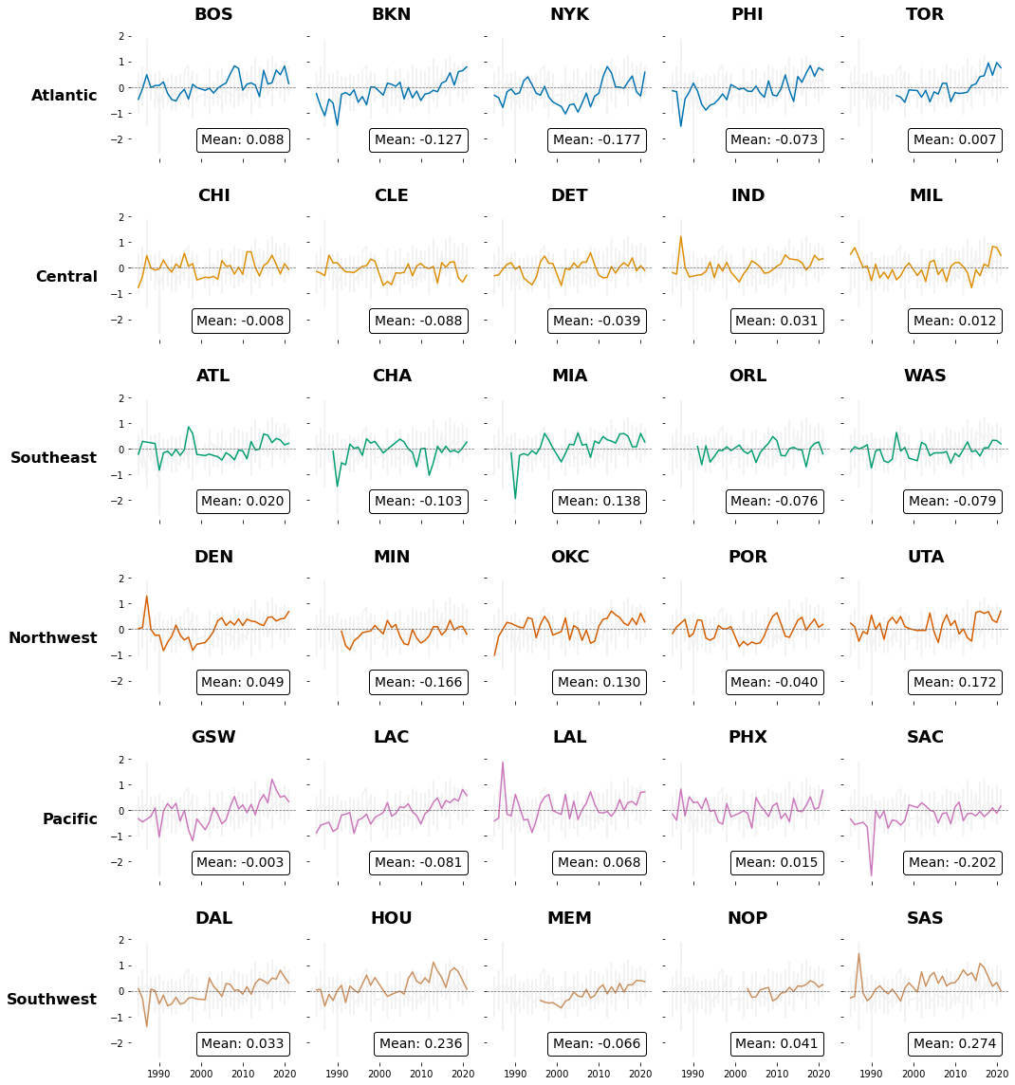
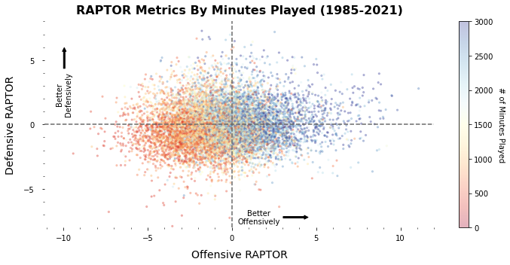
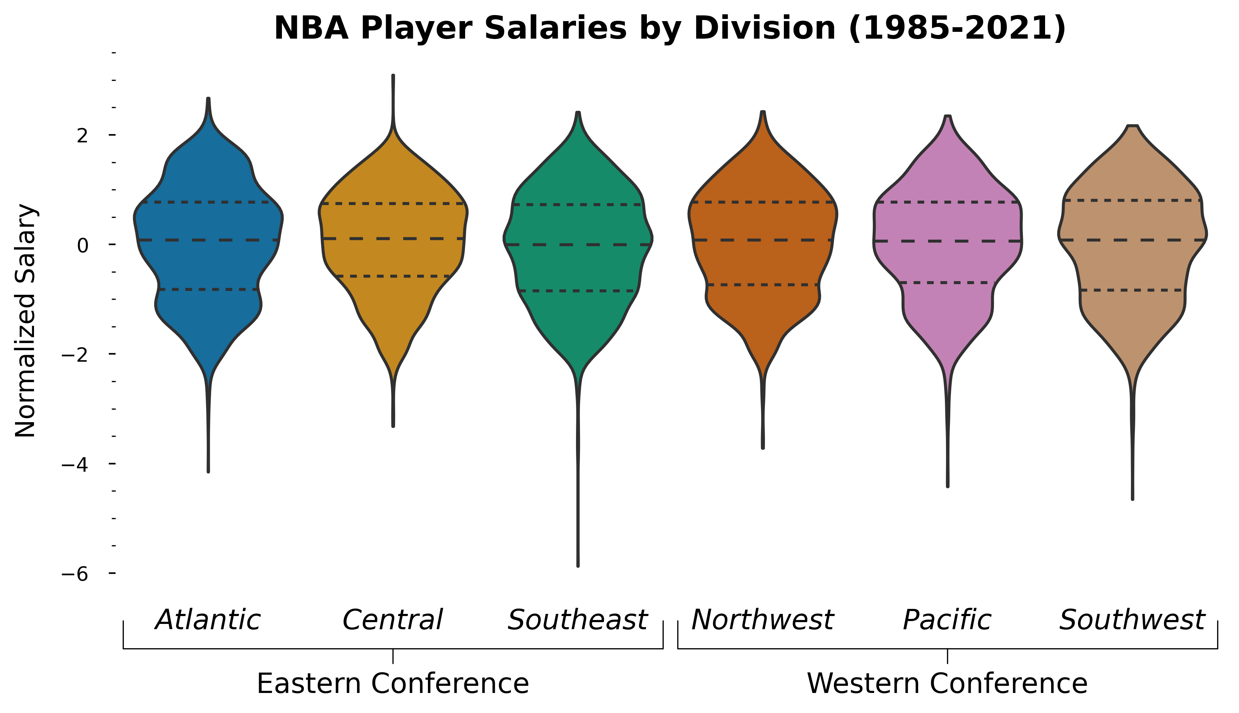
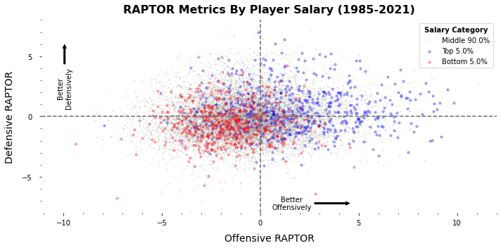
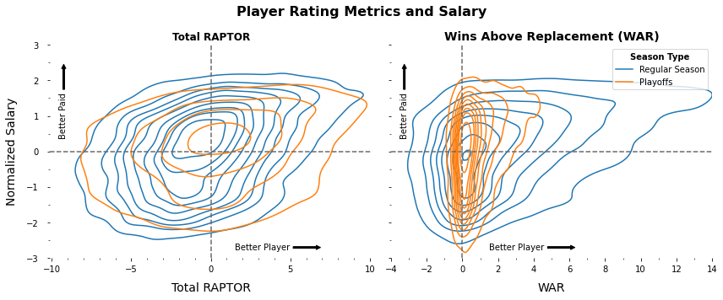


An Exploration of NBA Player Performance & Salary
Yashwanth Manne
CMSE 402 | Michigan State University
Overview
Average Player Value of Teams Over Time
Regular Season RAPTOR
This project tracks patterns between NBA player performance and player salary to see if any specific team is generally better at evaluating player talent and leveraging spending effectively.
Salaries are similar across divisions but for a few outliers:
Michael Jordan’s 1997 and 1998 seasons in Chicago (Central)
Jordan McRae’s signing at end of 2019 for Washington (Southeast)
Methodology
RAPTOR
A novel, aggregative metric of player rating based on traditional box-score metrics, advanced play-by-play components, and overall evaluation of how much better a team is when a player is present
Data set tracks metrics for offense, defense, and total extracted from FiveThirtyEight
Data also uses RAPTOR to calculate Wins Above Replacement (WAR) metric that is similar but accounts for playing time.
Metrics were normally distributed about 0 with SD of 3
SALARY
Data was scraped from each player’s Basketball-Reference pages
Salaries were divided by the league’s salary cap in each season to allow for cross-time comparisons
Salary cap is the limit of a team’s spending on players’ salaries
Scaled salaries follow a lognormal distribution
Scaled salaries were log-transformed and normalized to form a normal distribution with mean 0 and SD of 1
PLAYER VALUE
Z-score of normalized salary is subtracted from Z-score of the total RAPTOR to identify a player’s value respective of their salary
DATA FILTERING
Players who played more than 300 minutes in the regular-season
Players who played in the 1984-1985 season and later
Players who had more than the league minimum salary
Players with better offensive and defensive ratings tend to play more minutes and players who perform better tend to have higher salaries. This is inline with expectations.
Conclusions
Very few teams are net positive over time and most have peaks of success.
Only San Antonio Spurs, Houston Rockets Utah Jazz, and Oklahoma City are +0.1.
Best Metric to Evaluate Talent
It seems disadvantageous to pay any type of max contract due to diminishing returns in player value
San Antonio Spurs and present-day Toronto Raptors are examples of teams with multiple pretty good players and no expensive super stars and thereby are shown to have favorable player value metrics
Most teams have favorable net team value during periods of postseason success and low ratings otherwise
Current rating metrics doesn’t playoff team success into account and should be incorporated in the future
Need to correct for different salary cap rules over the last 20 years
References
RAPTOR is more stable than WAR and better for comparison with player salaries.

