Slide 1
REDUNDANT MULTI-FLOOR
ENTERPRISE CAMPUS NETWORK
Design, Implementation, Security & Verification using Cisco Packet Tracer
Team Lead
Assigned By
Dhruv Gaidhane
Harish Sir
Team Members
Project Type
Vaibhav Mule, Tejas Bargal
Group Project — 3 Members
Organization
NextGen Education
01 / 15

Slide 2
GROUP PROJECT • NEXTGEN EDUCATION
Problem Statement & Objectives
The Challenge
Project Objectives
Traditional campus networks can suffer from single points of failure.
1
Implement VLAN-based segmentation
2
Provide inter-VLAN communication
Different departments require network segmentation.
3
Provide gateway redundancy using HSRP
4
Implement dynamic routing using OSPF
Network communication must remain available during link/device failures.
5
Implement link aggregation (EtherChannel/LACP)
6
Implement STP/PVST+ for loop prevention
Device management must be secure.
IP addressing should be centrally managed.
7
Configure DHCP for automatic addressing
8
Configure SSH for secure management
Network traffic must be controlled using security policies.
Implement ACLs for traffic filtering
Verify connectivity and redundancy
9
10
02 / 15

Slide 3
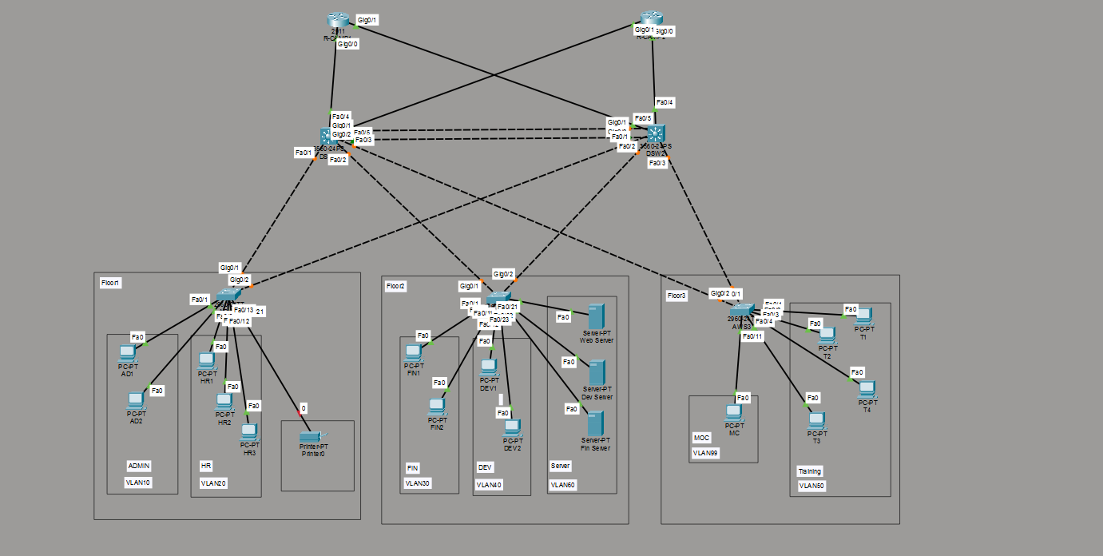
PHYSICAL & LOGICAL DESIGN — CISCO PACKET TRACER
Network Topology
R-CAMP1 / R-CAMP2 = core routers • DSW1 / DSW2 = 3560-24PS distribution (HSRP + EtherChannel) • Floor 1–3 access switches uplink redundantly to both
03 / 15

Slide 4
METHODOLOGY
Project Flowchart
1
2
3
4
5
Requirement Analysis
Network Topology Design
Router & Switch Configuration
VLAN & IP Addressing
HSRP + OSPF + EtherChannel
6
7
8
9
10
DHCP & SSH Security
ACL Implementation
Connectivity & Network Testing
Troubleshooting & Verification
Final Secure & Redundant Network
04 / 15

Slide 5
LAYER 2 / LAYER 3 DESIGN
VLAN & IP Addressing
VLAN | Department | Network | Gateway
10 | ADMIN | 10.10.10.0/24 | 10.10.10.1
20 | HR | 10.10.20.0/24 | 10.10.20.1
30 | FINANCE | 10.10.30.0/24 | 10.10.30.1
40 | DEVELOPMENT | 10.10.40.0/24 | 10.10.40.1
50 | TRAINING | 10.10.50.0/24 | 10.10.50.1
60 | SERVER | 10.10.60.0/24 | 10.10.60.1
99 | MANAGEMENT | 10.10.99.0/24 | 10.10.99.1
Design Notes
VLAN segmentation isolates department traffic
Separate broadcast domains per VLAN
Department-level traffic isolation
SVI-based gateways on the distribution switches
Structured, centrally-managed IP addressing
05 / 15

Slide 6
LAYER 2 RESILIENCE
Distribution Layer & STP
DSW1
DSW2
STP / PVST+
Primary Distribution Switch
Secondary Distribution Switch
Prevents Layer-2 loops
✓
STP Root
✓
STP Secondary Root
Predictable forwarding paths
✓
HSRP Active
✓
HSRP Standby
Maintains backup paths
✓
Layer-3 routing
✓
Layer-3 routing
DSW1 = primary root
✓
VLAN gateways
✓
VLAN gateways
Simplified STP Path Illustration
DSW1
DSW2
Root Bridge
Alt. Bridge
ASW1
ASW2
ASW3
Dashed link = blocked (backup) path
06 / 15

Slide 7
LINK AGGREGATION
EtherChannel / LACP
Concept
Aggregated Link
LACP is used for link aggregation
Multiple physical links act as one logical link
DSW1
DSW2
Improves redundancy across the DSW1–DSW2 link
Port-Channel 1
Provides higher aggregate bandwidth
Gi0/1 & Gi0/2 bundled into one logical link
Removes dependence on a single physical link
2
1
LACP
show etherchannel summary
Physical Links
Logical Link
Protocol Used
Po1(SU)
Gi0/1(P)
Gi0/2(P)
07 / 15

Slide 8
GATEWAY REDUNDANCY
HSRP & Inter-VLAN Routing
Inter-VLAN Routing
Virtual GW
10.10.X.1
Layer-3 switches use SVIs
Each VLAN has a default gateway
VLANs communicate through the distribution layer
DSW1
DSW2
Active (.2)
Standby (.3)
HSRP
HSRP hello / state sync
Provides a virtual default gateway
show standby brief
DSW1 = Active
Interface Grp Pri State Active Standby
Vlan10 1 110 Active local 10.10.10.3
DSW2 = Standby
End devices keep using the same virtual gateway during failure
08 / 15

Slide 9
LAYER 3 REDUNDANCY
OSPF Dynamic Routing
Implementation Details
Redundant Routed Paths (Area 0)
OSPF Process ID: 1
R-CAMP1
Single-area design — Area 0
DSW1
DSW2
Router ID configured on each device
Dynamic route exchange between routers and switches
R-CAMP2
Redundant Layer-3 paths
Automatic route convergence on failure
show ip ospf neighbor / show ip route
Neighbor ID State Dead Time Interface
10.10.99.2 FULL/BDR 00:00:38 Gi0/0
09 / 15

Slide 10
AUTOMATIC ADDRESSING
DHCP Implementation
DHCP Request Flow
Configuration Highlights
PC
Separate DHCP pools defined for each VLAN
▼
Access Switch
Automatic IP address assignment to end devices
▼
Default gateway distributed via DHCP options
DSW SVI
▼
DNS server configuration included in each pool
DHCP Relay
▼
DHCP relay using ip helper-address on router SVIs
R-CAMP1
▼
DHCP bindings verified successfully
DHCP Pool
▼
show ip dhcp binding
IP Address Assigned
IP address Client-ID/Hw addr Lease expiration
10.10.10.10 0100.5079.6684.1a Automatic
10 / 15

Slide 11
HARDENING THE CAMPUS
Network Security
1
2
3
4
SSH
ACL
Port Security
PortFast + BPDU Guard
Secure remote management
Controls permitted/denied traffic
Limits MAC addresses per port
Faster endpoint connectivity
SSH version 2
Restricts unauthorized communication
Sticky MAC learning
Protects ports from unexpected BPDUs
Local authentication
Applies traffic filtering policies
Protects access ports
The ACL implementation has been completed and verified.
✓
11 / 15

Slide 12
VALIDATION
Connectivity & Network Testing
Test | Purpose | Result
Ping | End-to-end connectivity | ✓ PASS
Traceroute | Path verification | ✓ PASS
VLAN verification | VLAN configuration | ✓ PASS
Trunk verification | VLAN transport | ✓ PASS
EtherChannel | Link aggregation | ✓ PASS
HSRP | Gateway redundancy | ✓ PASS
OSPF | Routing adjacency | ✓ PASS
DHCP | IP assignment | ✓ PASS
SSH | Secure management | ✓ PASS
ACL | Traffic filtering | ✓ PASS
12 / 15

Slide 13
REAL IMPLEMENTATION EVIDENCE
Troubleshooting & Challenges
Issue 1 — Trunk Configuration
Issue 2 — R-CAMP2 Connectivity
Issue 3 — Duplicate Transit IP
Issue 4 — OSPF Neighbor
PROBLEM
PROBLEM
PROBLEM
PROBLEM
Trunk command rejected
Routed link was not functioning
Duplicate IP addressing on a transit interface
OSPF adjacency was not established
CAUSE
CAUSE
CAUSE
CAUSE
Encapsulation was Auto
Incorrect/missing /30 addressing
Misconfigured DSW1 transit address
Interface / addressing mismatch
SOLUTION
SOLUTION
SOLUTION
SOLUTION
Configure 802.1Q encapsulation before trunk mode
Correct the interface IP configuration
Correct the DSW1 transit address
Verify interface status, IP addressing and OSPF configuration
Problem → Cause → Solution → Verification
13 / 15

Slide 14
FINAL RESULTS
Verification & Final Results
Verified Components
Outcome
✓
VLANs
✓
Trunks
The implemented network provides segmentation, redundancy, dynamic routing, secure management and traffic control.
✓
STP / PVST+
✓
EtherChannel / LACP
✓
HSRP
✓
Inter-VLAN Routing
✓
OSPF
✓
DHCP
✓
SSH
✓
ACL
✓
Port Security
✓
PortFast
✓
BPDU Guard
✓
End-to-End Connectivity
Insert important Packet Tracer command-output screenshots here
14 / 15

Slide 15
CONCLUSION & FUTURE SCOPE
A Secure + Redundant + Segmented + Dynamically Routed Enterprise Campus Network
Implemented and verified using Cisco Packet Tracer.
Key Achievements
Future Scope
✓
Department-based VLAN segmentation
Network monitoring using SNMP
✓
Redundant gateway using HSRP
Syslog-based centralized logging
✓
Dynamic routing using OSPF
Network automation
✓
Link aggregation (EtherChannel/LACP)
IPv6 implementation
✓
Layer-2 loop prevention via STP
Wireless integration
✓
Centralized DHCP
Advanced ACL policies
✓
Secure SSH management
ACL-based traffic control
Firewall / IDS integration
✓
✓
Access-layer port security
Real-device deployment
✓
End-to-end connectivity verified
15 / 15

Slide 16
Thank You
15 / 15

