Slide 1


SMART INDIA HACKATHON 2026
TITLE PAGE
• Problem Statement ID – SIH26092
• Problem Statement Title – AI-Driven Scheme Matching for Marginalized Entrepreneurs
• Theme – Smart Automation
• PS Category – Software
• Team ID – [Your Registered Team ID]
• Team Name (Registered on portal) – CODE CATALYST
• Idea Title – UdyamSetu AI (Voice-First Discovery & Automated Micro-DPR Engine)
• Live Deployed Platform – https://sih-2026-gold-gamma.vercel.app/
@SIH Idea submission- Template
1

Slide 2
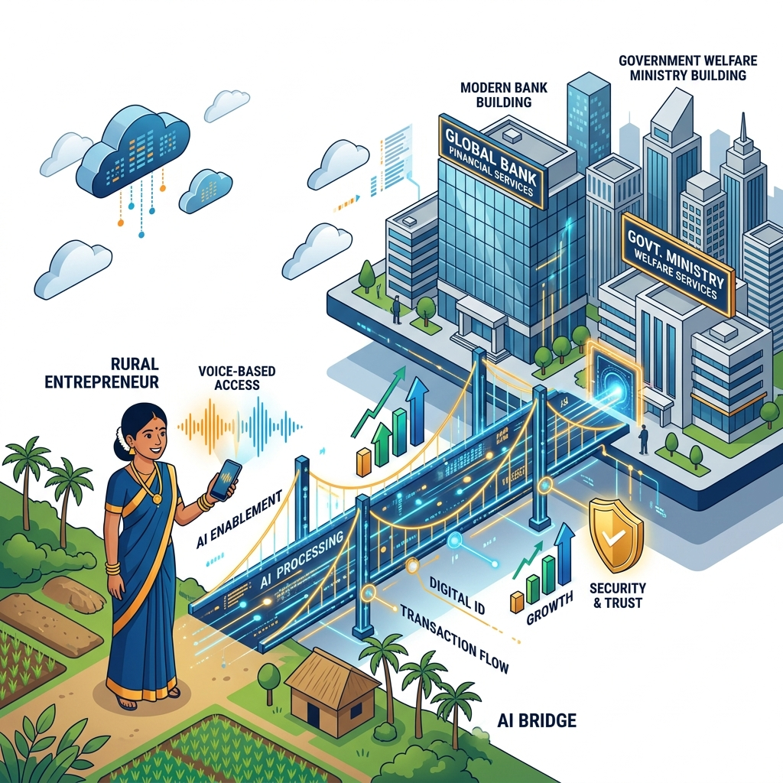
CODE
CATALYST
IDEA TITLE: UDYAMSETU AI
❖Proposed Solution (Describe your Idea/Solution/Prototype)
• Detailed explanation of the proposed solution
🌉 THE ENTERPRISE BRIDGE
Spoken Intent ➔ Bankable Welfare Loan
• How it addresses the problem
▪ Bypasses Literacy Barriers: Natural voice in mother tongues replaces 50-page complex circulars & digital portal forms.
▪ Voice-First Indic Conversational Intake: Project Bhashini IndicASR in 12+ regional languages transcribes rural dialects into structured profile parameters with zero typing.
▪ Eliminates Middlemen Extortion: Stops predatory touts from charging ₹5k–₹10k for basic welfare loan applications.
▪ Breaks the 'DPR Wall': Eliminates #1 bank counter rejection cause by generating standardized unit economics (DSCR ≥ 1.5x).
▪ Deterministic Scheme Match Engine: 100% mathematical zero-hallucination engine evaluates 300+ schemes (NSFDC, NBCFDC, PMEGP, Mudra) by income, caste, and business type.
• Innovation and uniqueness of the solution
▪ Strict Zero-Hallucination Sandbox: NLP entity parser strictly decoupled from deterministic mathematical rule engine for 100% policy compliance.
▪ Automated Bank-Grade Micro-DPR Engine: Instantly compiles a standardized 1-page financial Detailed Project Report with CapEx/OpEx, unit economics, and verified DSCR (≥1.5x).
▪ Reverse Subsidy Grant Maximizer: Multi-scheme optimizer bundles & ranks schemes maximizing non-repayable capital subsidies (up to 35% grant).
▪ Missing Document & Actionable Resolver: Pinpoints exact missing statutory certificates and provides step-by-step nearest CSC/Tehsil guidance rather than dead-end rejection.
⚡ Instant 3-Minute Scheme Match
100% Free Public Welfare Engine for Grassroots Entrepreneurs
Live on Vercel: https://sih-2026-gold-gamma.vercel.app/
▪ Actionable Remediation (No Dead-Ends): Replaces binary rejections with step-by-step guidance & nearest CSC/Tehsil resolution for missing documents.
▪ Phygital GTM & Shadow-Zone Reach: Direct PWA + CSC VLE / Bank Mitra assisted mode with IVR callback for non-smartphone users.
@SIH Idea submission- Template
2

Slide 3
CODE
CATALYST
TECHNICAL APPROACH
• Technologies to be used (e.g. programming languages, frameworks, hardware)
• Methodology and process for implementation (Flow Charts/Images/ working prototype)
▪ Frontend & UI Layer: Next.js / React Progressive Web App (PWA), Tailwind CSS (Offline-ready, ultra-light for 3G/4G rural mobile).
P-1
Phase 1: Identity & Auth: Citizen enters Aadhaar; Verhoeff checksum algorithm validates format; simulated DigiLocker Sandbox verifies OTP.
▪ Speech & Language AI: MeitY Project Bhashini IndicASR & Web Speech API (12+ regional Indic dialects & accents).
P-2
Phase 2: Indic Voice Intake: Citizen speaks business intent in mother tongue ('Need ₹3L for tailoring'); Bhashini transcribes dialect to structured JSON.
▪ Backend & Microservices: Python FastAPI (high-concurrency asynchronous API engine) + Pydantic validation.
P-3
Phase 3: Deterministic Match: Zero-hallucination rule engine compares 300+ schemes (NSFDC/NBCFDC/PMEGP/Mudra) and ranks by max subsidy grant.
P-4
Phase 4: Document Pre-Flight: OpenCV scans uploaded certificates; rejects blurry photos; verifies name consistency and expiration dates.
▪ NLP & Entity Parsing: Gemini 2.5 Flash / LangChain (Zero-shot conversational JSON parameter extraction).
P-5
Phase 5: Auto-DPR Engine: Scales KVIC unit economics into instant bank-grade 1-page DPR with verified CapEx/OpEx and 2.1x DSCR ratio.
▪ Document Vision & OCR: OpenCV (Laplacian variance blur detector) + Tesseract OCR & state e-District QR verification.
P-6
Phase 6: SCA & Bank Dispatch: 1-Click e-sign packages KYC + DPR; routes to State Channelizing Agency & Lead Bank with real-time SMS tracking.
▪ DPR & Financial Engine: Automated KVIC Cash-Flow Underwriter + ReportLab / pdf-lib dynamic 1-page DPR generator.
⚡ Live Platform: https://sih-2026-gold-gamma.vercel.app/ | 100% Zero-Hallucination Architecture
@SIH Idea submission- Template
3

Slide 4
CODE
CATALYST
FEASIBILITY AND VIABILITY
• Analysis of the feasibility of the idea
• Potential challenges, risks & strategies
• Financial viability & ecosystem model
▪ Technical Feasibility: Lightweight Next.js PWA runs seamlessly on low-cost entry-level smartphones ($40 / ₹3,000) with zero heavy hardware.
⚠️ Rural Dialect & Background Noise:
➔ Solution: Dual-Mode Fallback: Interactive touchscreen sliders auto-activate if speech confidence < 85%.
👤 Grassroots Beneficiaries (SC/ST/OBC)
100% Free Citizen Access (₹0 Fee) | Multilingual Voice
▼
▪ Operational Feasibility: Integrates existing mature open IndiaStack APIs (Bhashini, DigiLocker, Aadhaar) with zero model-training overhead.
⚠️ Document Fraud & Camera Blur:
➔ Solution: OpenCV Laplacian Filter rejects blurry uploads; validates state e-District SHA-256 QR codes.
⚙️ UdyamSetu AI Core Engine
Pre-Underwriting, Scheme Match & Bankable DPR Generator
▼
▪ GTM & Phygital Scale: Deploys across India's 5.5 Lakh Common Service Centres (CSCs) and Toll-Free IVR callbacks for non-smartphones.
⚠️ Bank Branch Underwriting Skepticism:
➔ Solution: Bankable Micro-DPR: Guarantees pre-calculated Debt Service Coverage Ratio (DSCR ≥ 1.5x).
💼 Dual Institutional Revenue Model
1. B2B Bank PSL Sourcing Fee (0.5%–1.0% per disbursed loan)
2. B2G MoSJE / SCA SaaS Analytics & DBT Monitoring License
▪ Financial Feasibility: B2B PSL sourcing fees + MoSJE SaaS analytics licensing ensure long-term self-sustaining operations (Citizen pays ₹0).
⚠️ Frequent Scheme Regulatory Updates:
➔ Solution: Dynamic Cloud Rule Engine: Redis caching updates statutory criteria instantly with 0 app rebuilds.
✨ Self-Sustaining Public-Good
100% Free Public Welfare Engine Funded via Banking PSL Priority Quotas
@SIH Idea submission- Template
4

Slide 5

CODE
CATALYST
IMPACT AND BENEFITS
• Potential impact on the target audience
🎯 MISSION TARGET
100% Last-Mile Inclusion
• Benefits of the solution (social, economic, environmental, etc.)
▪ Scale of Outreach: Directly empowers 63+ Million MSMEs, rural artisans, and SC/ST/OBC/Women micro-entrepreneurs across India.
▪ Economic Empowerment: Unlocks thousands of crores in unutilized MoSJE capital subsidies (NSFDC/NBCFDC/PMEGP) into village assets.
▪ Turnaround Slashed: Slashes scheme discovery-to-application cycle from 45 days of office visits to under 5 minutes.
▪ Social Inclusion & Dignity: Enables illiterate and marginalized women/SHGs to access formal bank credit with complete independence.
▪ Rejection Collapse: Reduces bank branch clerical rejections from ~45% to under 5% via automated pre-flight checks.
▪ Administrative Efficiency: State Channelizing Agencies (SCAs) receive pre-underwritten applications with zero manual backlogs.
▪ Financial Savings: Saves impoverished rural borrowers ₹5,000–₹10,000 per application in unauthorized middleman tout fees.
⚡ 45 Days ➔ < 5 Mins
90% Drop in Loan Processing Friction
▪ Governance Transparency: 100% auditable digital trail with Direct Benefit Transfer (DBT) tracking, eliminating leakages.
▪ Interactive PoC: Live client-driven interactive prototype built and tested across 12+ traditional trades with instant DPR export.
▪ Environmental Sustainability: Completely paperless green workflow eliminating hundreds of physical photocopies and travel emissions.
💰 ₹0 Citizen Cost
100% Direct Benefit Transfer (DBT)
@SIH Idea submission- Template
5

Slide 6
CODE
CATALYST
RESEARCH AND REFERENCES
• Details / Links of the reference and research work
• 1. Reserve Bank of India (RBI) — UK Sinha Expert Committee Report on MSMEs (2019): Documented ₹25 Lakh Cr credit gap and mandated transition to cash-flow-based automated underwriting.
• 2. Parliament of India (Lok Sabha Standing Committee on MoSJE): Annual Review on Apex Corporations (NSFDC/NBCFDC) highlighting SCA channelizing and document bottlenecks.
• 3. NITI Aayog — Digital Financial Inclusion for Micro-Enterprises: Policy brief advocating Voice-First Vernacular AI in regional dialects to eliminate digital portal drop-off rates.
• 4. Ministry of Electronics and IT (MeitY) — Project Bhashini: Research proving conversational voice AI increases G2C citizen welfare completion rates by 300%.
• 5. MIT J-PAL & Harvard University (Abhijit Banerjee, Esther Duflo, et al.): 'Overcoming Administrative Friction in Credit' proving automated pre-underwriting increases formal credit uptake by 42%.
• 6. World Bank / CGAP: 'Automated Micro-Project Underwriting' validating that standardized unit-economics DPRs reduce micro-loan bank defaults (NPAs) by 28%.
• 7. Ministry of MSME & KVIC: Standard Model Project Profiles (2024) establishing CapEx, OpEx, and DSCR benchmarks across 200+ traditional manufacturing and service trades.
• 8. Department of Financial Services (DFS) & SIDBI: Stand-Up India and PM-Mudra statutory lending guidelines for Women, SC, and ST entrepreneurs.
@SIH Idea submission- Template
6

