Slide 1
ZS Data science challenge Ronaldo goal prediction
Vaibhav Palkar

Slide 2
Data understanding
Ronaldo Goal Data– He scored goal or not
match_event_id, location_x, location_y , remaining_min, power_of_shot, knockout_match, game_season, remaining_sec, distance_of_shot, area_of_shot , shot_basics, range_of_shot , team_name, date_of_game, home.away, shot_id_number, lat.lng, type_of_shot, type_of_combined_shot, match_id, team_id, remaining_min, power_of_shot, nockout_match, remaining_sec, distance_of_shot, is_goal
Total number of input records, dimesnions 30697 28

Slide 3
Data understanding
Dependent variable : is_goal
0 : No goal
1 : Goal
Blank : goal prediction to be done
Separated as these value were missing
Model would be run on these records to validate the rejection
Goal_score_percentage 44.53 %
Na and blank values were there for variables
All these missing records to be imputed with appropriate median, mode values

Slide 4
Data preparation
For all variables missing values imputed
Created dummy variables
Created train, test and validation data set

Slide 5
Model preparation – Logistic Regression
Ran model using all variables on training dataset
Removed insignificant variable using stepAIC method
Improved model iteratively
Removing multi-collinearity using VIF values
Choosing most significant variable using p-value
Selected final model with all significant variables

Slide 6

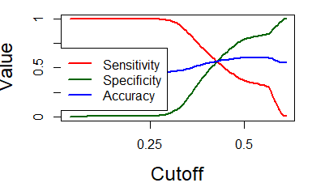
Model evaluation – Logistic Regression
Created prediction based on final model on test data set
Checked Accuracy, Sensitivity and Specificity using different values of cut off
Selected final cut off and got Accuracy, Sensitivity and Specificity for each models as per shown below,

Slide 7
ASSESSMENT OF THE MODEL
Predicted final model on missing data to get the goal prediction for missing goal data
For predictive value above 0.4186, goal will be score and below goal not scored
Extracted data for final submission in the form of: shot_id_number and its goal prediction

