Slide 1
BA Call Data (SQUAD)
Vaibhav Palkar

Slide 2
Business Understanding
The brokerage provides the real estate agent with leads (leads are people who are looking to buy, sell or rent), and the agent's job is to help them in their home buying, selling or renting process
Find the parameters which help agent to improve to him to help leads which are provided by the broker
Agent follow this process by making call to each lead and puts note in CRM
Objectives :
to determine performance metrics for agents along with providing advice on what can be done to help agents improve

Slide 3
Data understanding
BA Call Data – Agent and leads data
Data includes Call id, UserId, personId, Call time stamp and lead timestamp, call duration, outcome, left a note etc.
Call Id data – Numeric values which are unique identifier of call made
Created – Call timestamp in UTC
CratedById – it is user Id of who created call(agent)
Created_at – it timestamp for call created
Duration – It is the call time in seconds
isIncoming – it is about who made the call(False – agent & True - Lead)
Outcome - call outcome(unreliable)
Lead created at – Lead created timestamp
PersonId – Unique lead id
UserId – agent id
Left a note – if user had left a note after the call

Slide 4
Data understanding
For BA_Call_Data
Total 180488 observation and 11variables
No duplicate values found
Only for outcome variable on blank values found
70594
For timestamp values need convert to r date format
There are erroneous data for CreatedById and userId (-1 as id)
20 observation are common from both columns
70594 has id as -1 in created by id
Duration of call is between 0 to 63841 (most of the call duration is 0 seconds)
IsIncoming data agent has contacted 174138 leads and 6330 lead called by themselves
Agent has left note for 169120 leads and note is not there for 11348

Slide 5
Basic data cleaning
Checked for duplicates values but no duplicate values found
Checked for blank values and there were 155175 blank values only for outcome variable (for exploratory analysis we did not treat it as it has humongous data and cant be treated so easily)
R is case sensitive so outcome variable has converted to lower
Timestamp data is converted to r date format using parsed date function
Removed createdById and userid values with -1, and few values treated as both column have same data

Slide 6
Feature engineering/data preparation
For timestamp data we have call timestamp and lead timestamp
Converted to standard R format data
Extracted the date and time
Created new variable of days, date and time slots base on the time

Slide 7
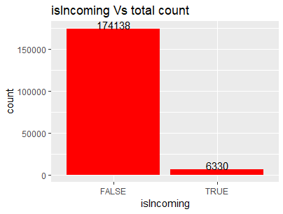
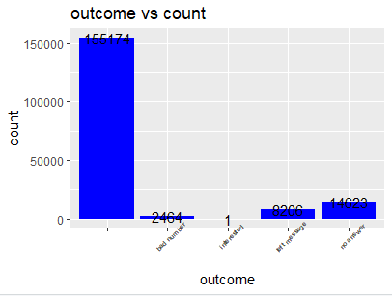
EXPLORATORY DATA analysis
IsIncoming Variable
Outcome Variable
only around 3% (6330) leads have call personally and almost 97%(174138) called by agent
for most of the count outcome entry is blank then 14623 call have not received calls, 8206 leads have left message, remaining 2464 are bad customer and only one customer is interested so it is clear that outcome variable it not reliable

Slide 8
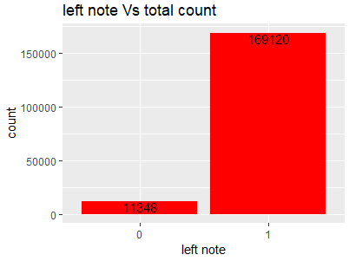
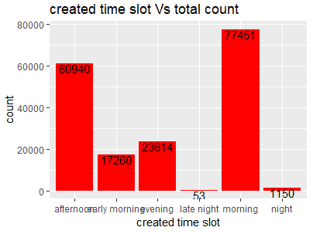
EXPLORATORY DATA analysis
Left note Variable
Actually for 169120 calls agent has left a note for 11348 calls agent did not left a not
Here most of called happened in morning, afternoon and evening

Slide 9
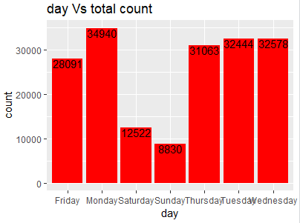
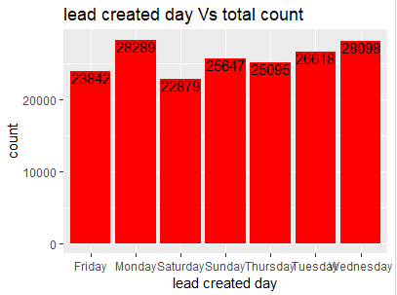
EXPLORATORY DATA analysis
Created day(call) Variable
on Monday, Tuesday, Wednesday, Thursday maximum leads are contacted
most lead created on Monday, Tuesday, Wednesday

Slide 10
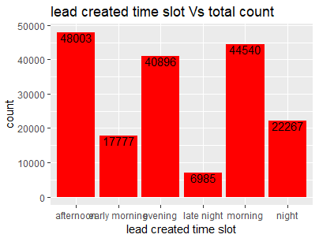
EXPLORATORY DATA analysis
Lead created time slot Variable
most number of lead created at morning, afternoon, evening

Slide 11
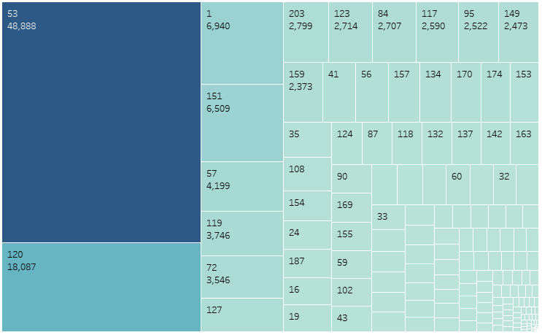
EXPLORATORY DATA analysis
Tree Map of Call count per agent

Slide 12
Data Analysis INSIGHTS
Based on the data analysis we got few insights which are as follows
Top 5 leads who has received max number of calls
ID 156299 - 1271 calls, ID 156301 - 181 calls, ID 132034 - 170 calls,
ID 130581 - 156 calls, ID 163356 - 144 calls
Bottom 5 who received only single call
ID 182678 - 1 call, ID 182685 – 1 call, ID 182690 – 1 call, ID182692 – 1 call,
ID 182697 – call
Top 5 agents who have contacted max leads (TOP PERFORMING)
ID 53 – 48888 calls , ID 120 – 18087 calls, ID 1 – 6940 calls,
ID 151 – 6509 calls , ID 57 – 4199 calls
bottom 5 agents who have contacted min leads (WORST PERFORMING)
ID 79 – 1 calls, ID 140 – 1 calls, ID 190 – 1 calls, 142 -1 calls , ID 209 – 1 calls

Slide 13
DATA ANALYSIS INSIGHTS
Based on the time difference between lead create and call created time stamp
We found that many agents have not called leads immediately or they have forgot to call
Top 10 (WORST PERFORMING) agents who has called after 7 days passed or more lead created are
ID 53 – 11389 count, ID 1 – 6280 count, ID 120 - 4548 count ,
ID 57 – 2796 count, ID 119 – 2722 count, ID 203 – 2653 count,
ID 72 – 2322 count, ID 123 - 2270 count, ID 117 – 2024 count,
ID 149 – 1776 count
Based on the Lead contacted first and agent ignored
We found that many times lead has called and has ignored (WORST PERFORMING)
Top 10 (WORST PERFORMING) agents who has called after 7 days passed or more lead created are
ID 53 – 11389 count, ID 1 – 6280 count, ID 120 - 4548 count ,
ID 57 – 2796 count, ID 119 – 2722 count, ID 203 – 2653 count,
ID 72 – 2322 count, ID 123 - 2270 count, ID 117 – 2024 count,
ID 149 – 1776 count

Slide 14
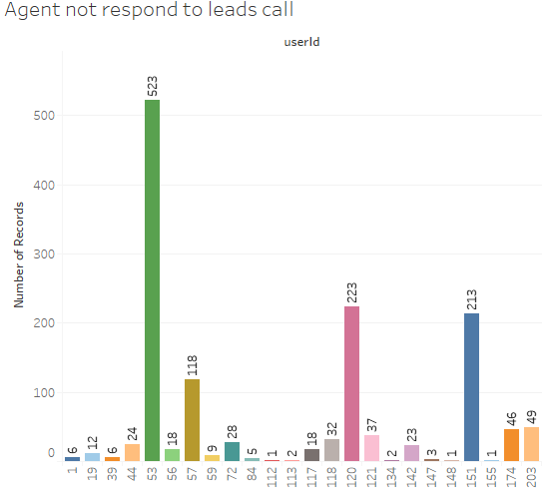
DATA ANALYSIS INSIGHTS
Based on the Lead contacted first and
agent ignored
We found that many times lead has
called and has ignored
(WORST PERFORMING)
ID’s - 53, 120, 151, 57, 203, 174, 121,
118, 72, 44, 142, 56, 117, 19, 59, 1,
39, 84, 147, 113, 134, 112, 148, 155
Based on the Agent has contacted
quickly after lead created
We found that many times agents
has responded quickly
(TOP PERFORMING)
ID’s - 53, 120, 151, 84, 72, 57, 95,
119, 127, 159

Slide 15
DATA ANALYSIS INSIGHTS
Based on the maximum time actual conversation(in seconds) with lead by agent
Few agent had maximum number of conversation with leads (BEST PERFORMING), so those are agents who had conversation more than 900 times
ID’s - 53, 120, 1, 151, 119, 203, 117, 57, 95, 127, 72, 170, 118, 155, 174, 16, 124, 87, 43, 125
Based on the less time actual conversation(in seconds) with lead by agent
Few agent had minimum number of conversation with leads (WORST PERFORMING), so those are agents who had conversation less than 9 times
ID’s - 58, 148, 143, 213, 47, 63, 110, 122,, 45, 67, 162, 176, 208, 219, 212, 223, 206, 93, 96, 103, 132, 137, 160, 178, 49, 79, 83, 101, 106, 123, 133, 144, 165, 182, 190, 214, 222

Slide 16
DATA ANALYSIS INSIGHTS
Agent who had maximum average conversation with leads
ID 144 - 828.00 sec, ID 122 - 732.1667, ID 214 - 478.00 sec, ID 17 - 460.20,
ID 53 - 390.00 sec, ID 43 - 343.2924 sec, ID 195 - 339.7135 sec, ID 39 - 336.589
ID 16 - 335.4110 sec, ID 103 - 320.50 sec
we can say agent who is continuously following and talking more to leads are performing well
Agent who had minimum average conversation with leads
ID 110 - 36.00 sec, ID 222 - 26.00 sec, ID 132 - 18.50, ID 53 - 18.1082 sec,
ID 101 - 15.00, ID 137 - 13.00 sec, 79 - 11.00 sec, ID 106 - 10.00 sec,
ID190 - 8.00sec, ID165 - 1.00 sec

Slide 17
Performance metrics
Below are the metrics for performance calculation of agents
Agents who are contacting by themselves after got lead
Agents who are putting note after conversation (whether conversation happened or not)
Agent should contact immediately to lead a
Agent who are trying to contact on weekend and always weekdays
Agent who are maximum times follow up lead
Agent who are putting outcome

Slide 18
Suggestion to improve agent performance
Agent should contact leads more often to convert it in business
When lead is contacting then agent should focus on him
After lead create agent must have to contact him on same day
Agent always have to take follow up of lead after contact established
Call conversation should be longer to target leads

