Slide 1
Data Analyst Intern Assignment @ Yulu - Vaibhav Palkar

Slide 2
Objective :
To build a dummy database for Zomato with multiple tables and to find an answer for the question
Strategy :
Created schema
Created tables and defined constraint primary key and foreign key
Inserted values into the tables
Created EER diagram
Wrote queries to get answers

Slide 3
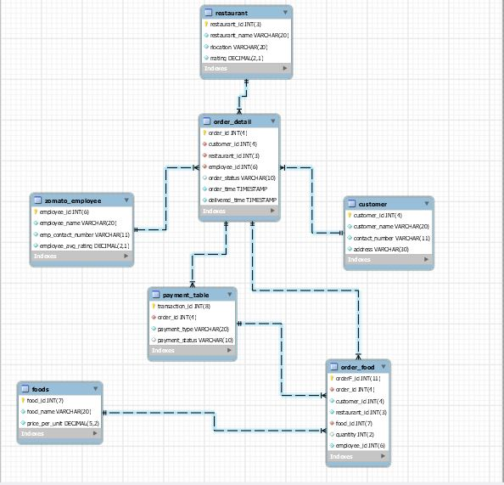
Enhanced Entity – Relationship (EER) Diagram

Slide 4
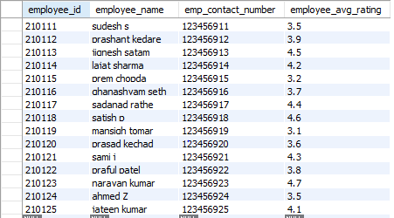

Question - 1 : Write a SQL query to find the number of Zomato
Ans - there are total 17 users
Question - 2 : Write a SQL query to find details of Zomato delivery Boy
Ans –
Question - 3 : Write a SQL query to find the list of Zomato users who made more than 10 orders in a particular month
Ans –

Slide 5
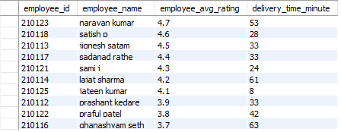
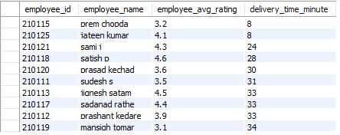
Question - 4 : Write a SQL query to find top 10 Zomato delivery Boy on basis of customer rating and time to deliver the item
Ans - top 10 Zomato delivery Boy on basis of customer rating
top 10 Zomato delivery Boy on basis of deliver the item

Slide 6
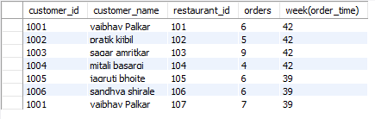
Question - 5 : Write a SQL query to find the list of Zomato users who order food from the same restaurants more than 3 times in a week
Ans –

