Slide 1
Electronic store Accelerator setup in hybris 6.7
Vaibhav Parve

Slide 2
Pre-requisite:
1. Download hybris 6.7 and extract in C drive like C:\hybris.
2. set up environment variables HYBRIS_HOME_DIR, HYBRIS_BIN_DIR, ANT_HOME.
C:\>echo %HYBRIS_HOME_DIR%
C:\hybris
C:\>echo %HYBRIS_BIN_DIR%
C:\hybris\hybris\bin
C:\>echo %ANT_HOME%
C:\hybris\hybris\bin\platform\apache-ant-1.9.1

Slide 3
Install b2c_acc accelerator recipe
Commands:
Go to path C:\hybris\installer and run below commands in cmd.
Install.bat –r b2c_acc (will take around 20 min depending on machine)
Install.bat –r b2c_acc initialize (will take around 1 hr 45 min).
Once finished. Start server from C:\hybris\hybris\bin\platform using
Hybrisserver.bat command.
Once the server is up: electronic site can be accessed through below url
url: https://localhost:9002/yacceleratorstorefront/?site=electronics

Slide 4

https://localhost:9002/yacceleratorstorefront/?site=electronics

Slide 5
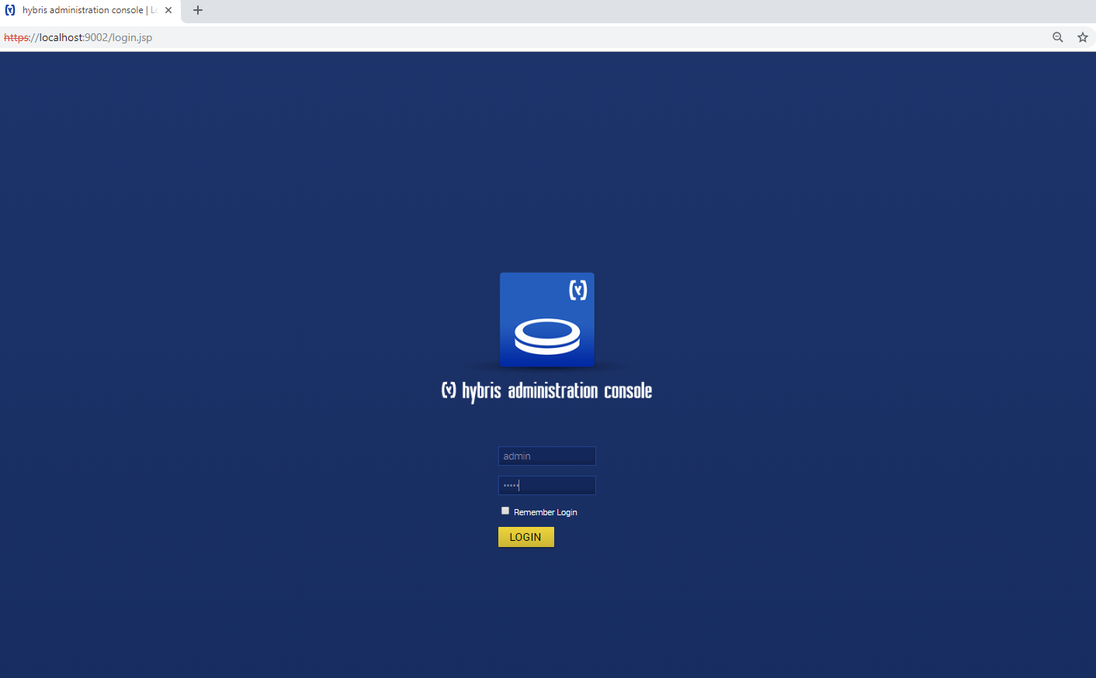
HAC: https://localhost:9002/login.jsp credentials: admin/nimda

Slide 6
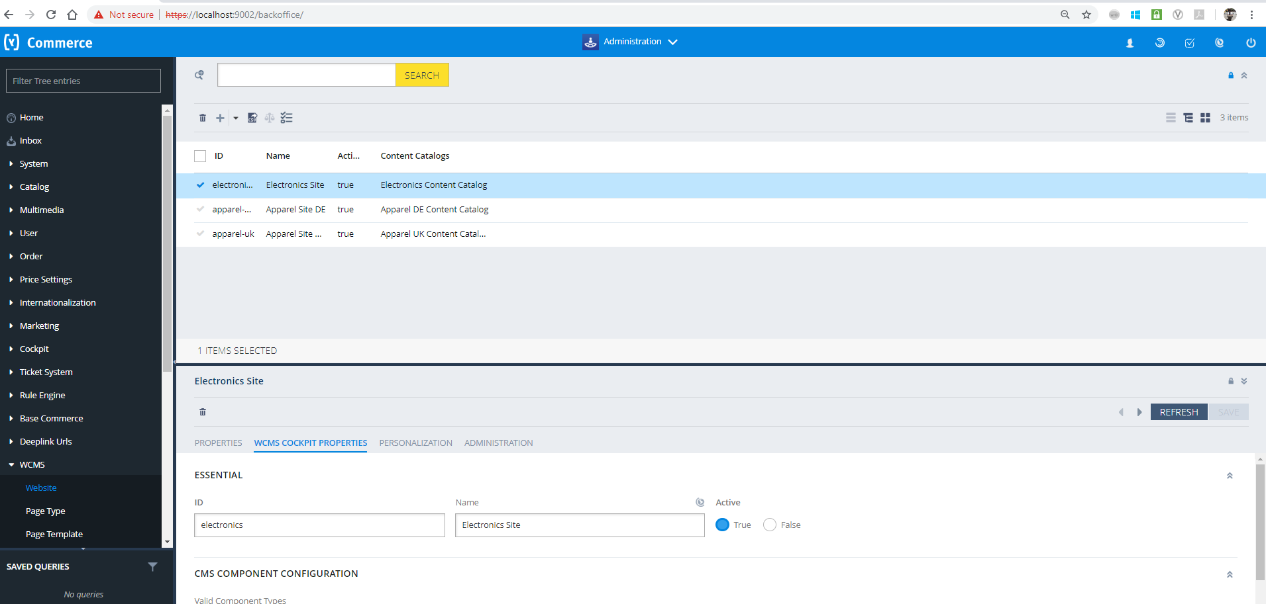
Backoffice: https://localhost:9002/backoffice/ credentials: Admin/nimda

Slide 7
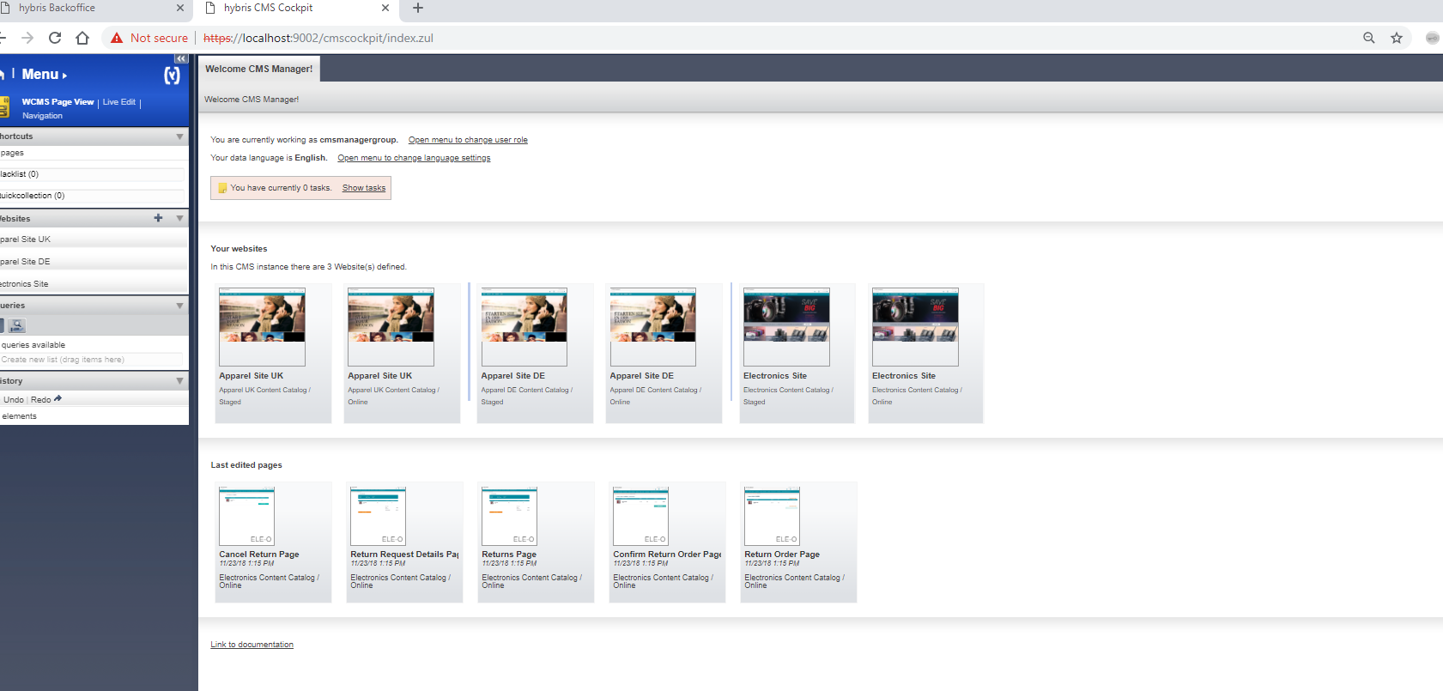
CMS cockpit: https://localhost:9002/cmscockpit/index.zul

