Slide 1

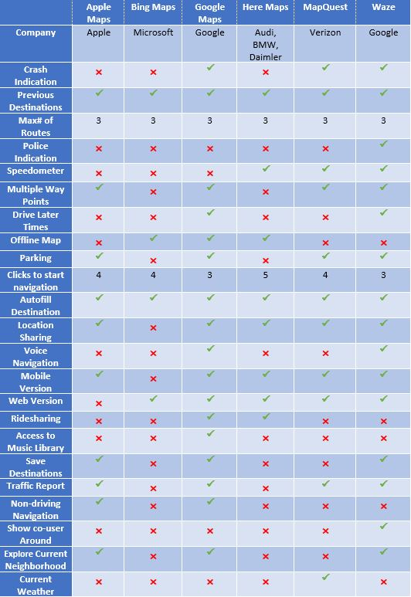
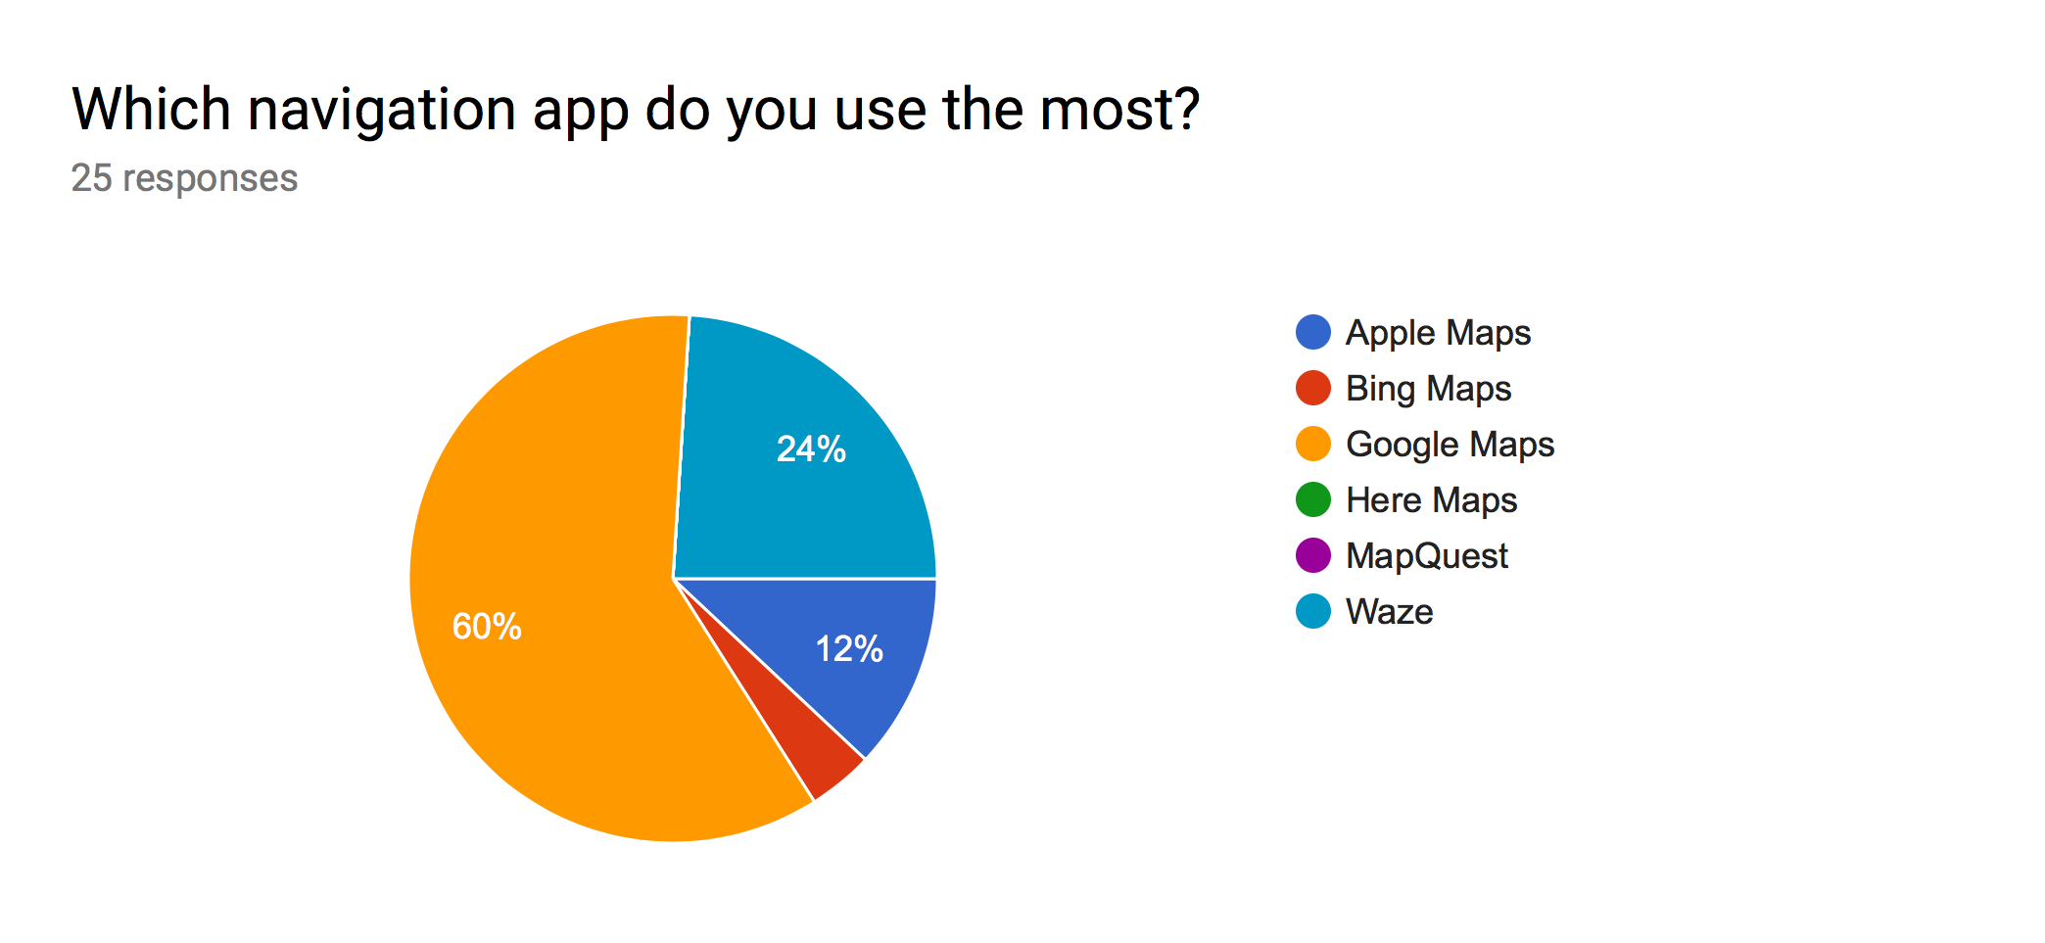
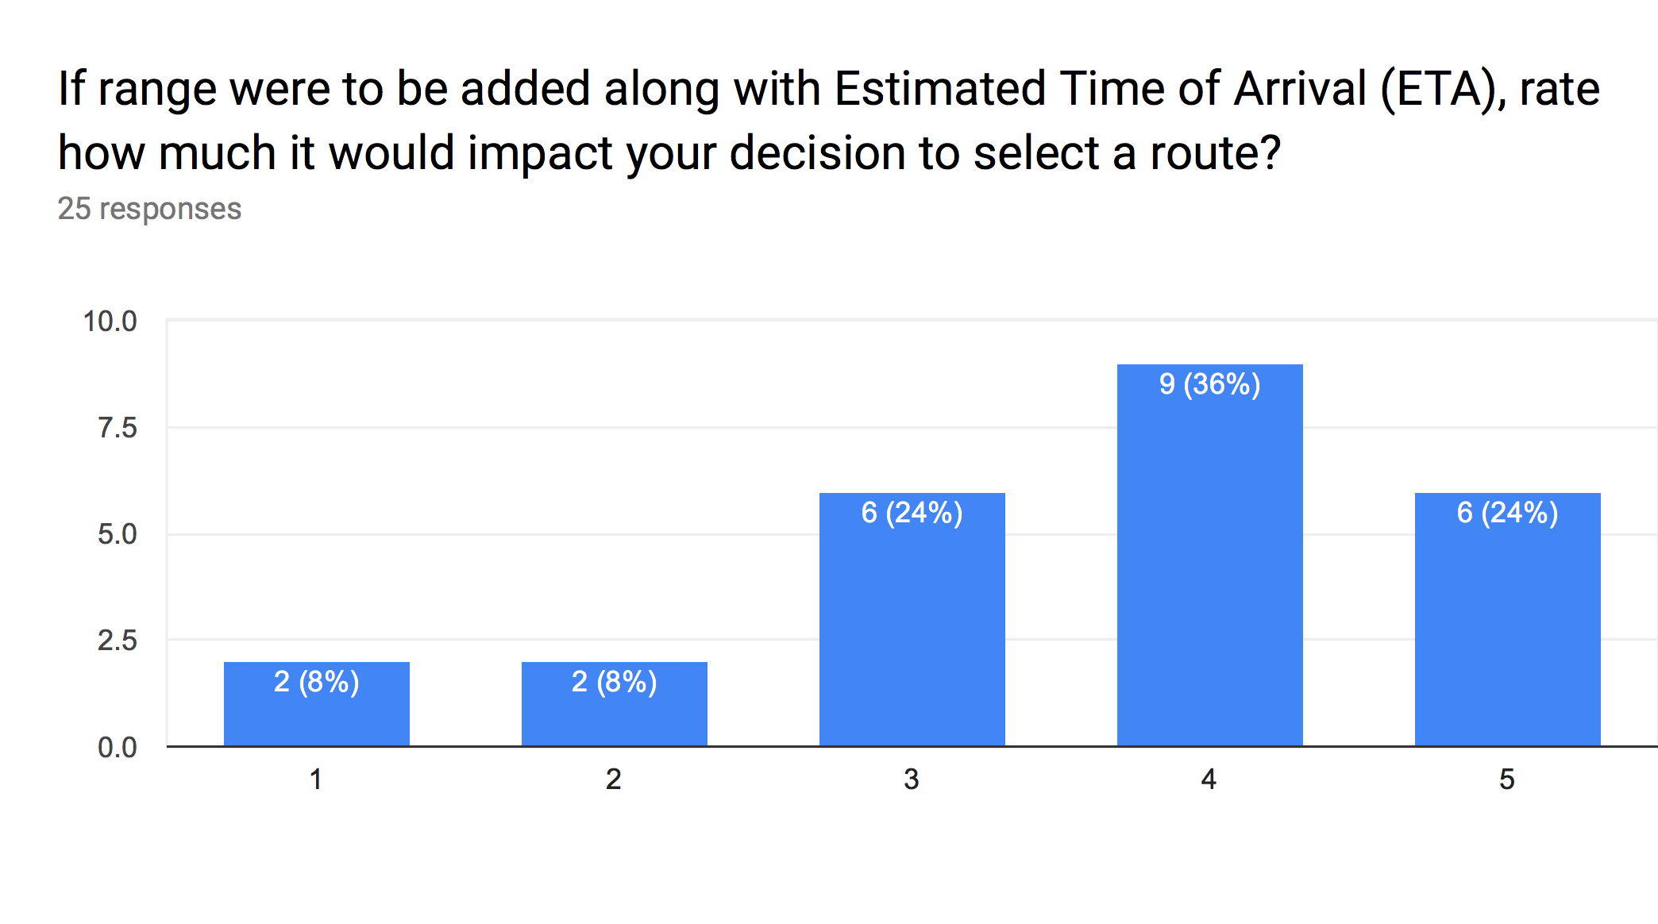
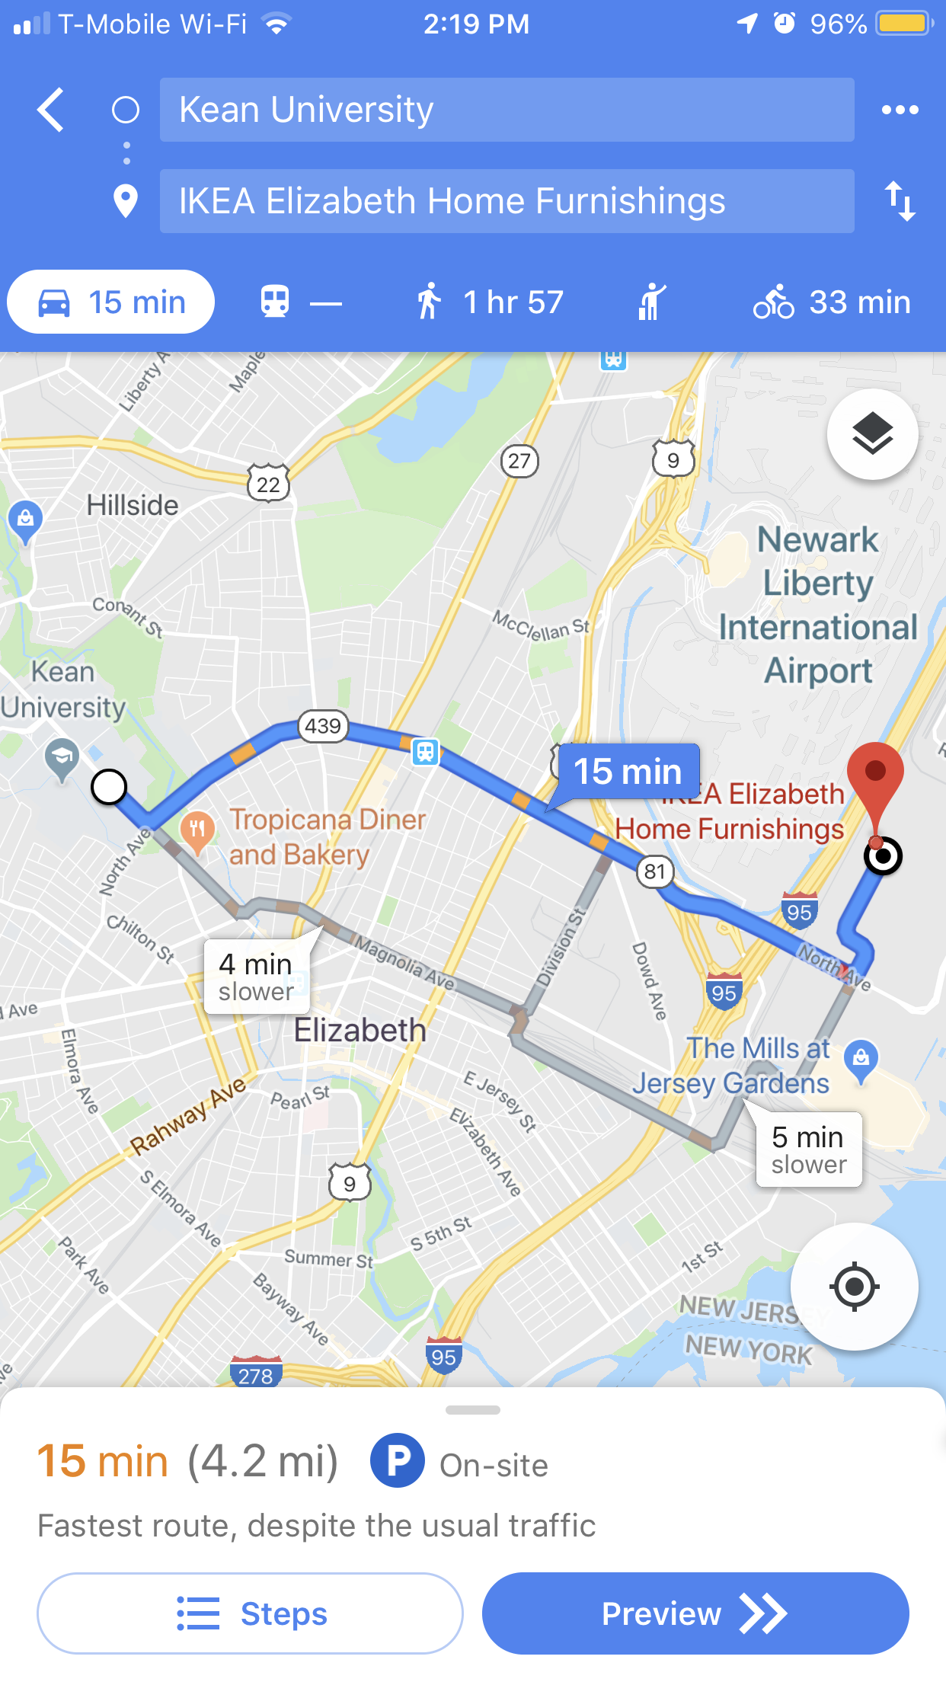
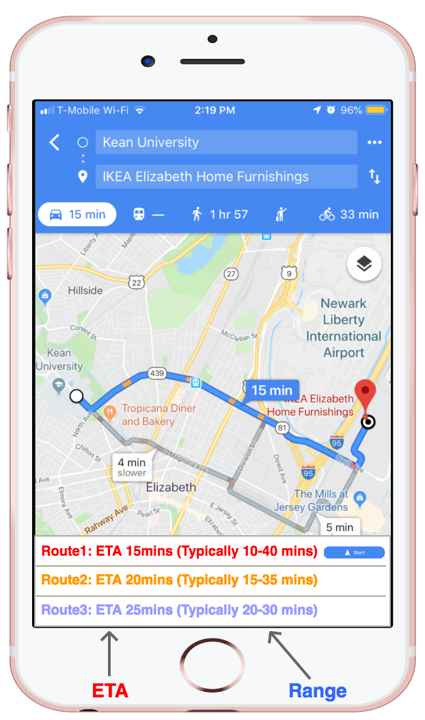
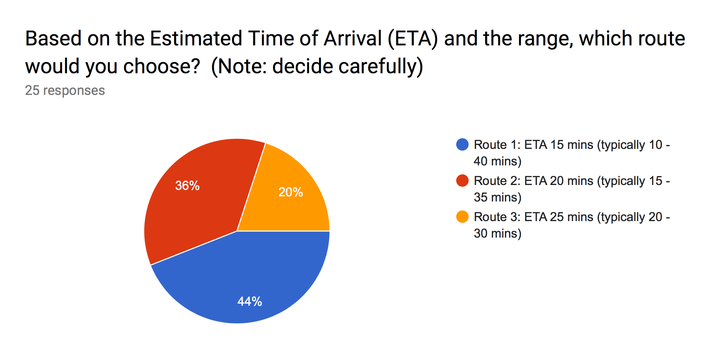
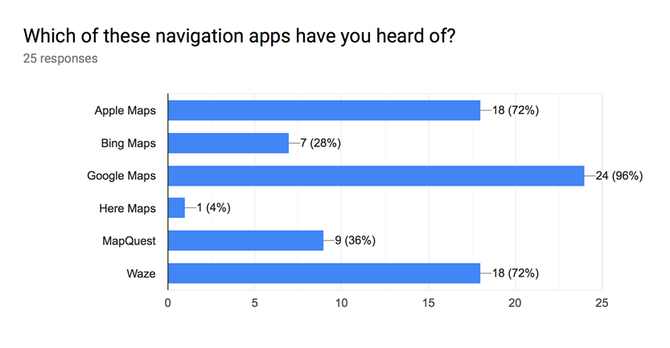
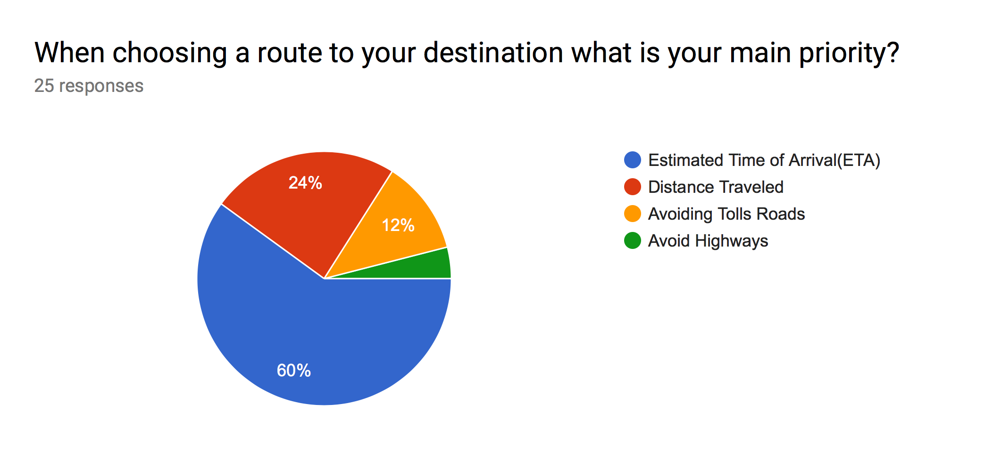
Mobile Navigation Apps User Interface Proposal
Faculty Advisor Dr. Daehan Kwak
Vaibhav Patel, Presnir J. Senat
Abstract
In today’s world, we need reliable navigation systems which lead us to our destination quickly and efficiently. In addition, the most important thing in the navigation apps is its user interface (UI). The UI features of the navigation apps must be organized in a user-friendly way as safety is vital. Those features may include steps in adding addresses, selecting between multiple routes, avoiding tolls, switching between routes during the travel. In this study, a comparison of the UI for different apps with their features such as, route switching during travel, Steps until navigation starts, traffic alerts, and toll alerts are analyzed. Currently, the main deciding factor to decide on route are based on ETA or distance. We propose a new UI to supplement ETA by showing the range of the ETA on routes (i.e. variation). A user study was conducted where 25 participants completed a questionnaire. The purpose of this questionnaire was to gain demographic information about the users; see their navigation app preferences; and to see if the proposed UI using the ETA range was useful.
Background
Comparative Analysis
Results
Millions of people use mobile navigation apps for real time directions. Mobile navigation apps are a convenient tool for traveling and searching locations.
Most smart phones have automatic inbuilt navigations applications making mobile apps readily available.
In this paper, I address the need for adding a range component to ETA, to provide a more precise ETA because travel time is dynamic because of a range of factors, including changes in demand, traffic operations, weather and accidents (van Lint et al., 2008).
Current User Interface
Proposed User Interface
References
ETA is the most widely used feature to select among alternate routes.
In the current user interface, ETA of alternate routes in not shown.
In the proposed user interface, the ETA and range among of all the routes is shown, making is more convenient for user to select best route.
[1] Van Lint et al., “Online learning solutions for freeway travel time prediction” 2008
[2] S. Kim, J.Chung “Exploration on origin destination based travel time variability: insights from Seoul metropolitan area”(2018)

