Slide 1
Spring Boot production Ready Application
Vaibhav Patil
Email -vaibhav.h.patil@gmail.com
Version 1.1

Slide 2
History
Release | History details | Date
R1.0 | Initial draft shared for review | Dec 30 2020
R1.1 | Incorporated review comments and update test results | Jan 24 2021

Slide 3
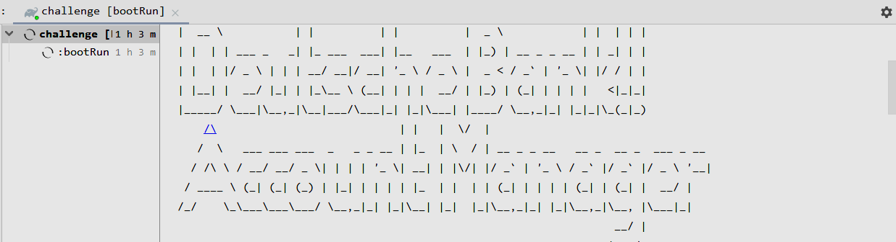
About
This document can provide some implementation details of Account Manage with some below points:
Technical details
Requirements
Service implantation details
Rest API documentation
Dev Build, Release, Run
Dev Integration and cross cutting services
Development practice and reports
Futures enhancements

Slide 4
Technical details
Technologies and framework /OS used :
Name | Details
Gradle-6.7.1-bin | Use code build tool and its plugins
OS | Window10
Spring boot - 1.5.4.RELEASE | Server side framework and its cover features like REST API, Services and exception management , application configurations
Spring swagger-2.9.2 | API documentation
Spring cloud zipkin:1.0.0.RELEASE | Distributed tracing
Spring Actuator | Application APM support
Docker/ Minikube / K8-1.19.3 | Used for container-orchestration system for automating computer application deployment, scaling, and management
Junit and Mocking | Unit testing application feature
JDK and concurrency | JDK 1.8 APIs used to manage concurrency

Slide 5
Requirements
Find some details of feature cover in this scope of POC
Business goal :
Create service which can support to transfer amount from one account to other
Assumptions :
System not covering security and authorization concerns in current scope of implementation.
Persistent state can be managed in in memory, notification service integration not in current scope
Functional aspects :
1 System should validated for transaction details (account and amount ) before transfer amount from one account to other account.
2 System should provide some APIS to manager user account operation –GET/POST/DELETE
3 System should support high concurrency and fault tolerant money transfer operation.
No Functional aspect :
1. Application should support for cloud native deployment/management and can easy to scale
2. Application should support system monitoring features like metrics , health check and so on
3. Application should support valid exception mechanism

Slide 6
Service implantation details

Slide 7
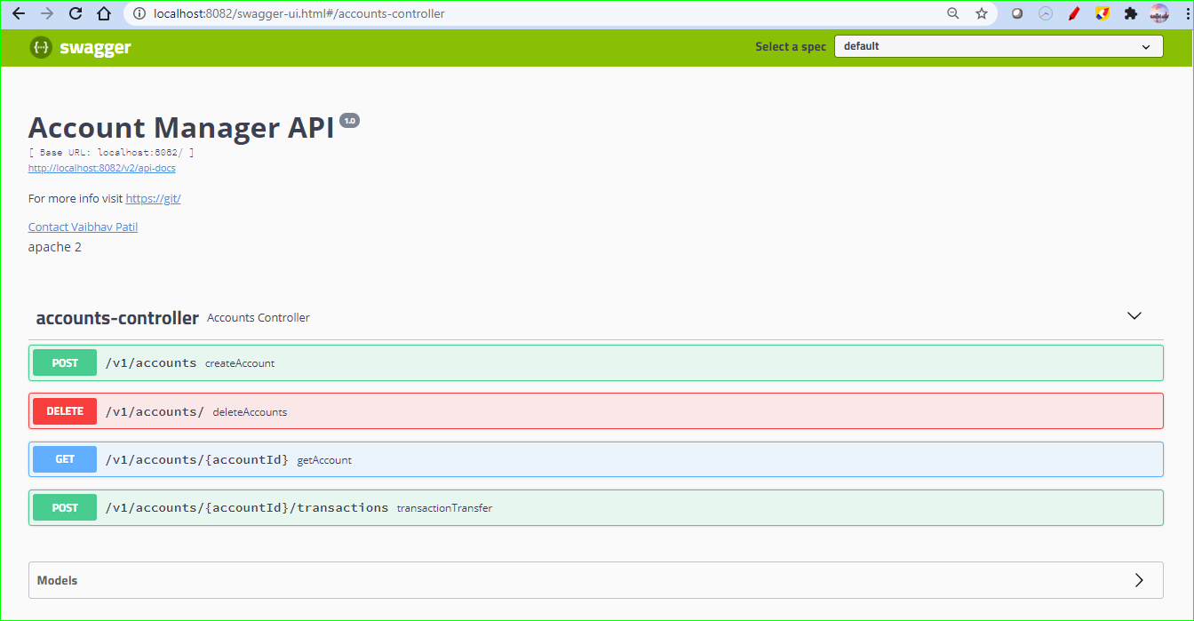
Rest API documentation
Rest API documentation

Slide 8
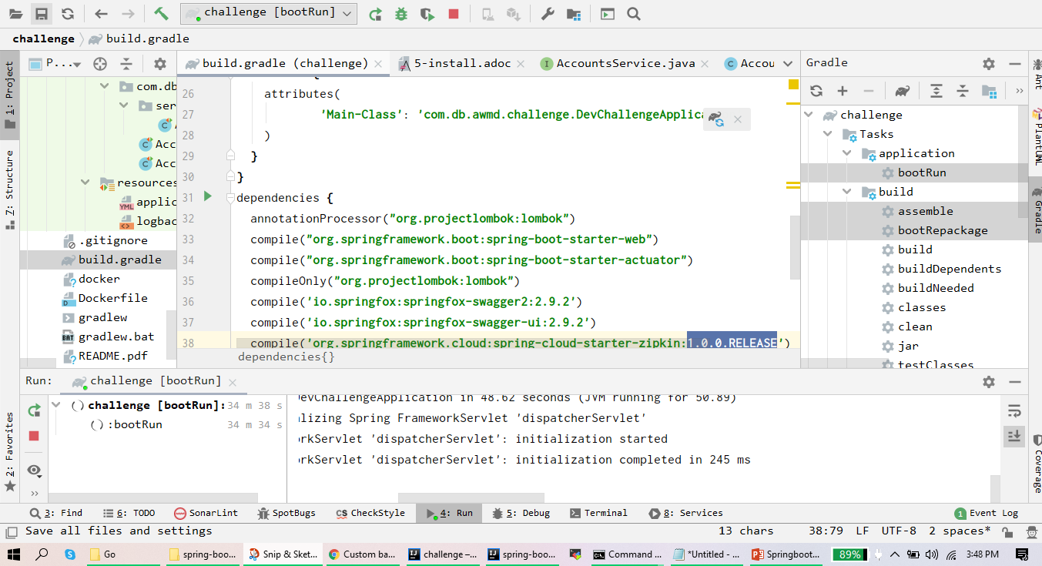
Dev Build, Release, Run
Step 1: Build ,release and run local spring boot app
Dev build managed using Gradle-6.7.1 and used IDE options to build and run /test application

Slide 9
Dev Build, Release, Run
Step 2. Create Docker image and push it into local repository
Application has at root level Dockerfile which used to create docker image
Used openjdk:8-jdk-alpine as base image
Used native using docker copy command
build/libs/challenge-0.0.1-SNAPSHOT.jar app.jar
Ports are exposed from Docker file
Unit test result of Docker file ? YES find below steps
1. Run above docker file using command docker build –t minkube-accounts-service ./
2 . Run docker image using command docker run –p 8080:8080 minkube-accounts-service:leatest
Verified health api and normal operations of service working – DONE
NOTE :
Above command pushed image in local Docker repository to access it in Minikube required some settings to pulling local Docker REPO image in K8s then refer [https://minikube.sigs.k8s.io/docs/handbook/pushing/]

Slide 10
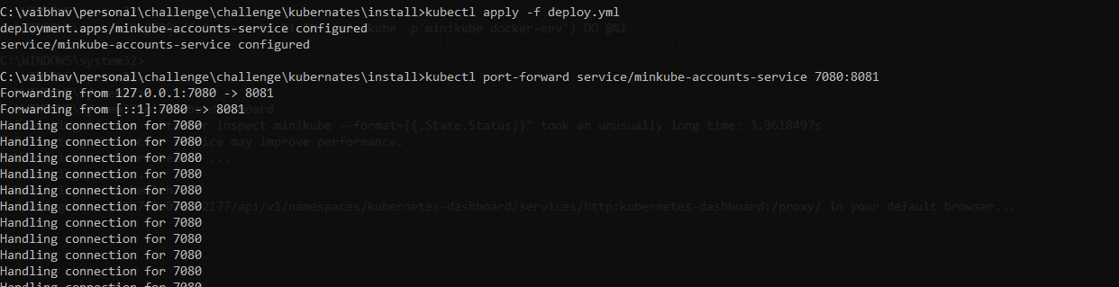
Dev Build, Release, Run
Step 3. Kubernates deployment using local Minikube cluster
Application has deployment folder in future we can add different configuration and setting per environment to easily cover configuration aspect of cloud native app development
After setup and locally running Minikube cluster below command executed to deploy app in cluster environment
1. kubernates deployment
2. Run application using service

Slide 11
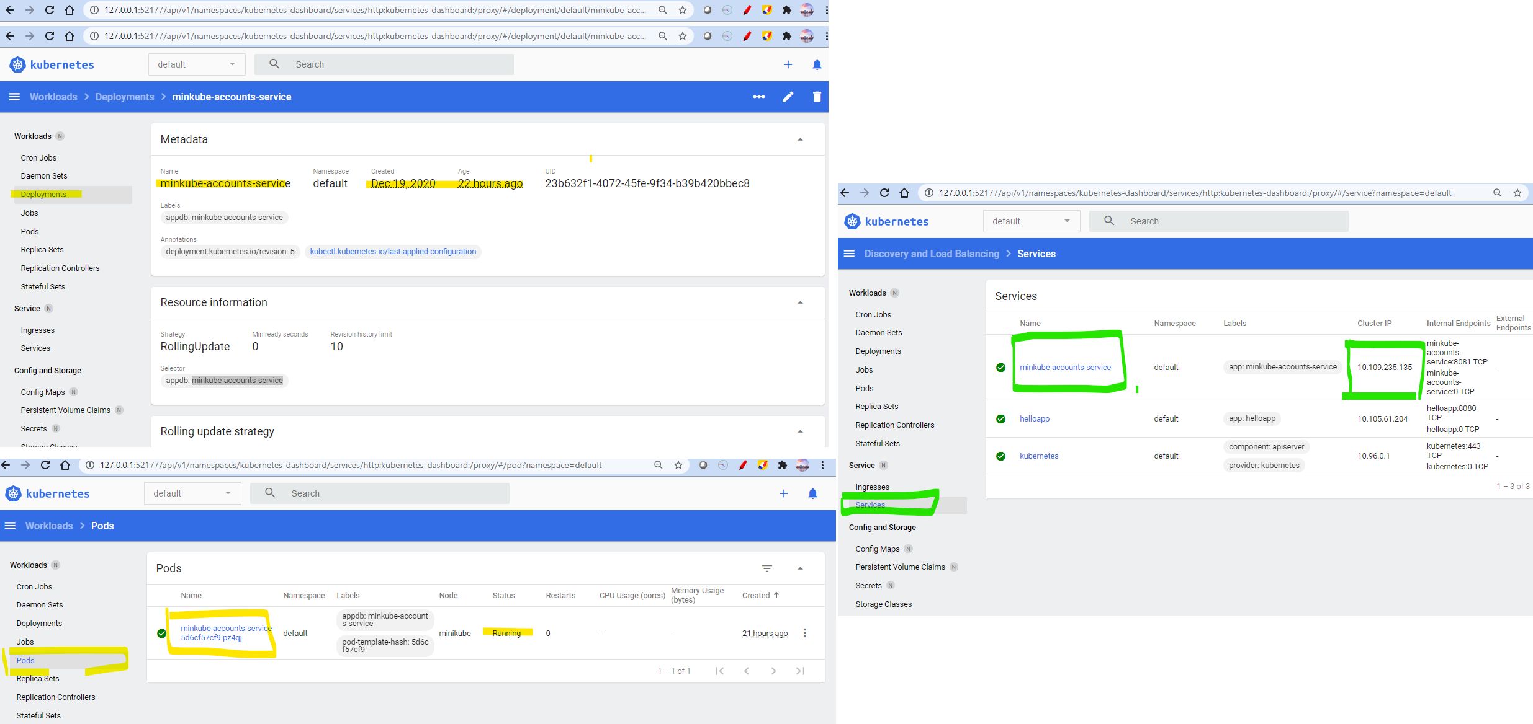
Dev Build, Release, Run
3. Verify application up and running in Kubernates cluster

Slide 12
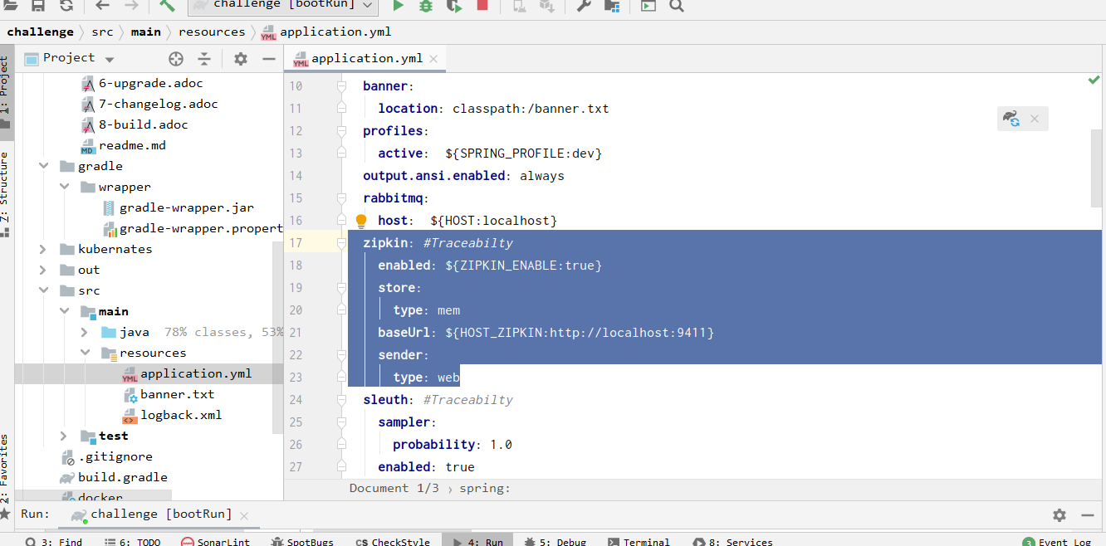
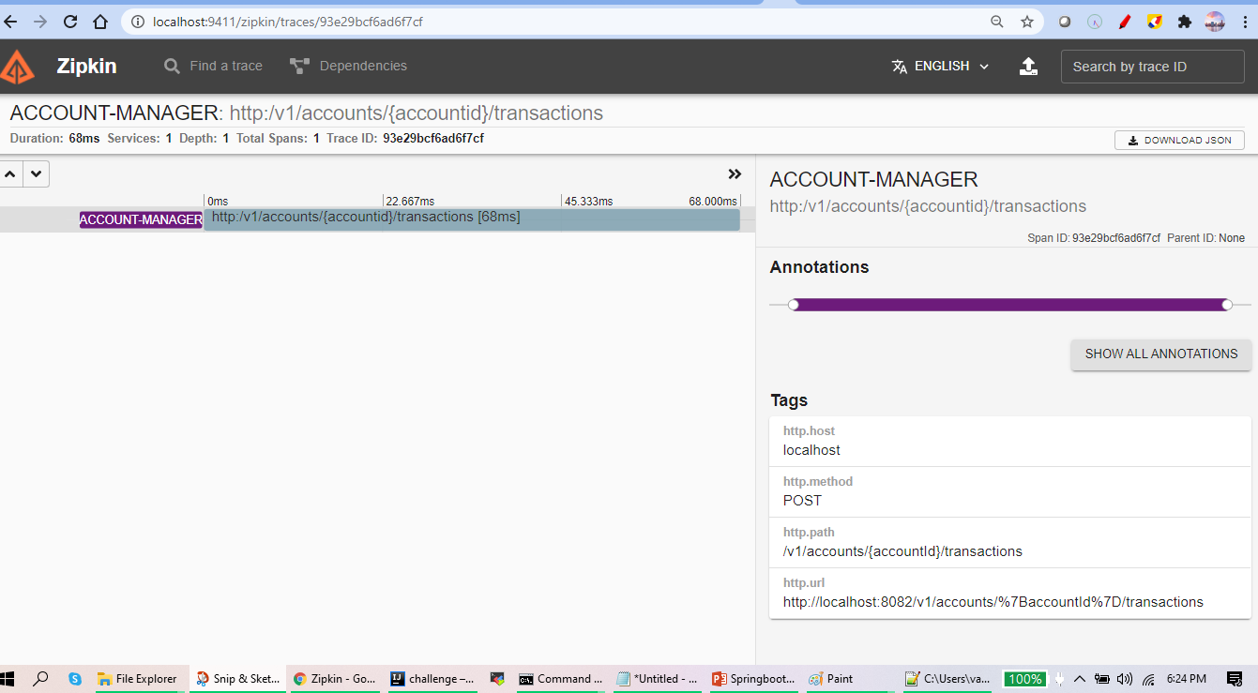
Dev Integration and cross cutting services
Service already integrated with distributed tracing mechanism and tested with local Zepkin service find result of it
Locally server setup done before use of this service and application configuration file server integration configured . Find application configuration file having

Slide 13
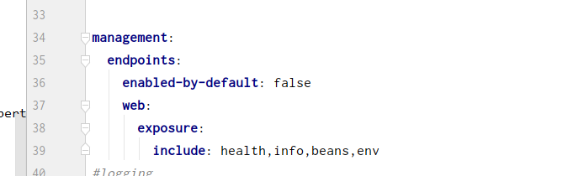
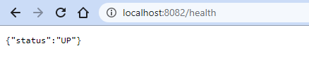
Dev Integration and cross cutting services
Service already integrated spring management API using service Actuator
Find result execution of these APIs

Slide 14
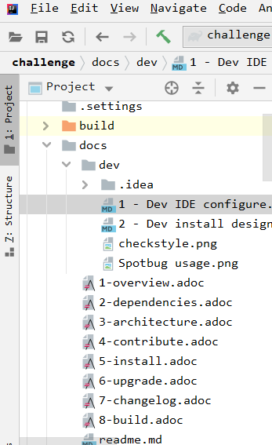
Dev development practices
Used code quality tools and aligned code to standards to achieve better performance and improve memory management
Configured below some IDEA IntelliJ plugins correctly , find in how guide under codebase /doc/dev

Slide 15
Dev development practices
1 IDE configure check style for code Install code style plugin - https://plugins.jetbrains.com/plugin/1065-checkstyle-idea
2 IDE configure find bugs plugin https://plugins.jetbrains.com/plugin/14014-spotbugs
3 IDE configure auto code formatter which will fix lots of check style issues Formatted by Jindent --- http://www.jindent.com
4 IDE configure Sonar Lint 1. option in DEV mode – used now https://plugins.jetbrains.com/plugin/7973-sonarlint 2. we can integrate it with centralised development service and put al configs/ rule file at single place docker run -d --name sonarqube -p 9000:9000 sonarqube
Refer https://yashints.dev/blog/2020/02/23/sonarqube-docker
Find some results executions and usage reports :

Slide 16
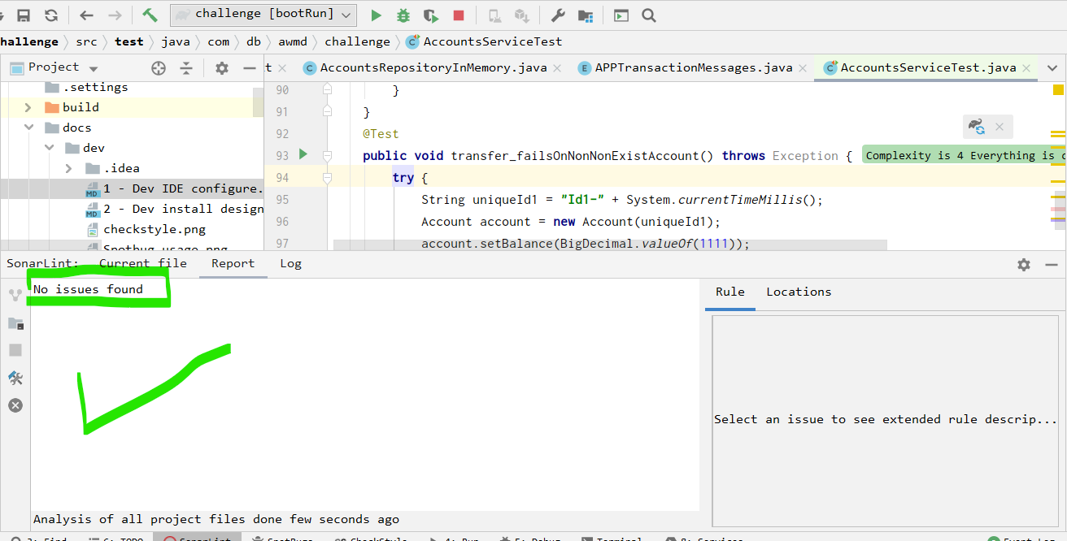
Dev development practices
1 Sonar qube code scan execution result fixed all open issues of code

Slide 17
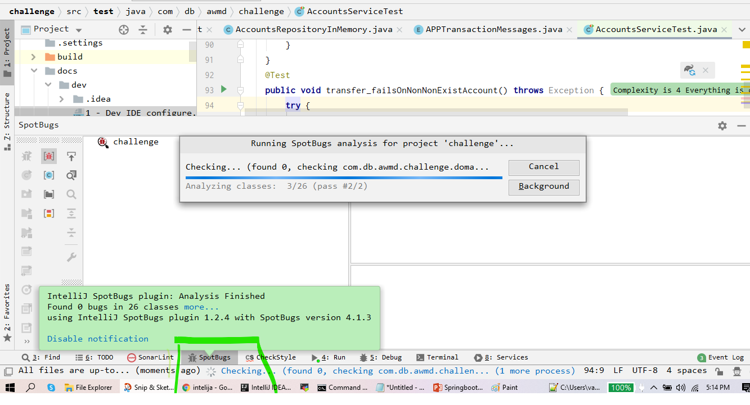
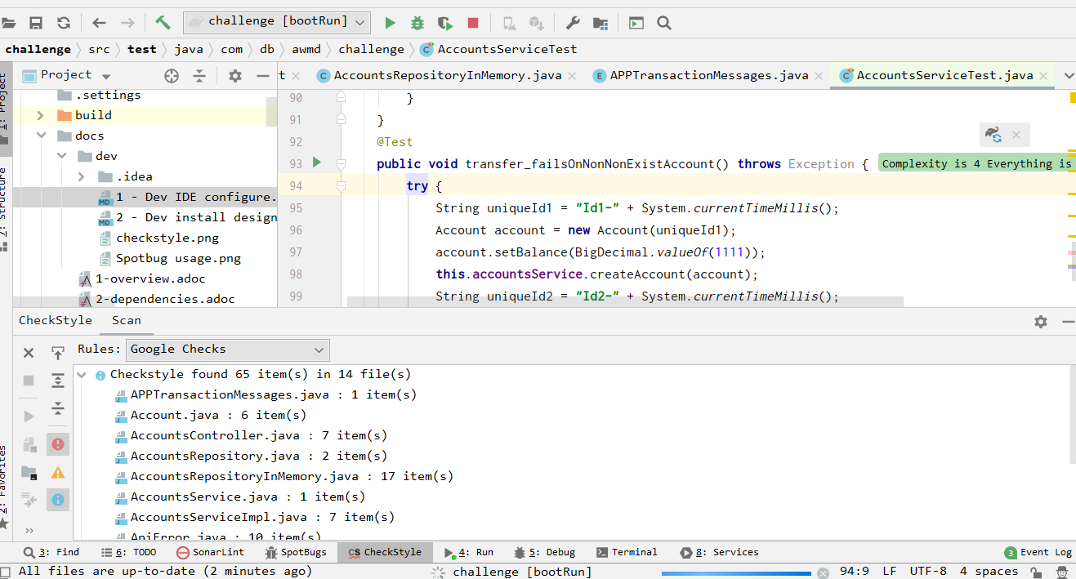
Dev development practices
2 Find bug /check style code scan execution result

Slide 18
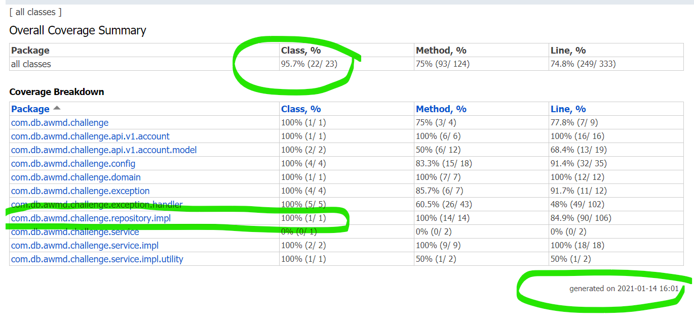
Dev development practices
3 Find JUNIT code coverage result
Used Junit MVC mock to test service and Integration test approach used to test REST APIS
Find dev execution results on git under /dev/code_coverage_report
Note currently supported 80% code coverage can be extend to 100% easily

Slide 19
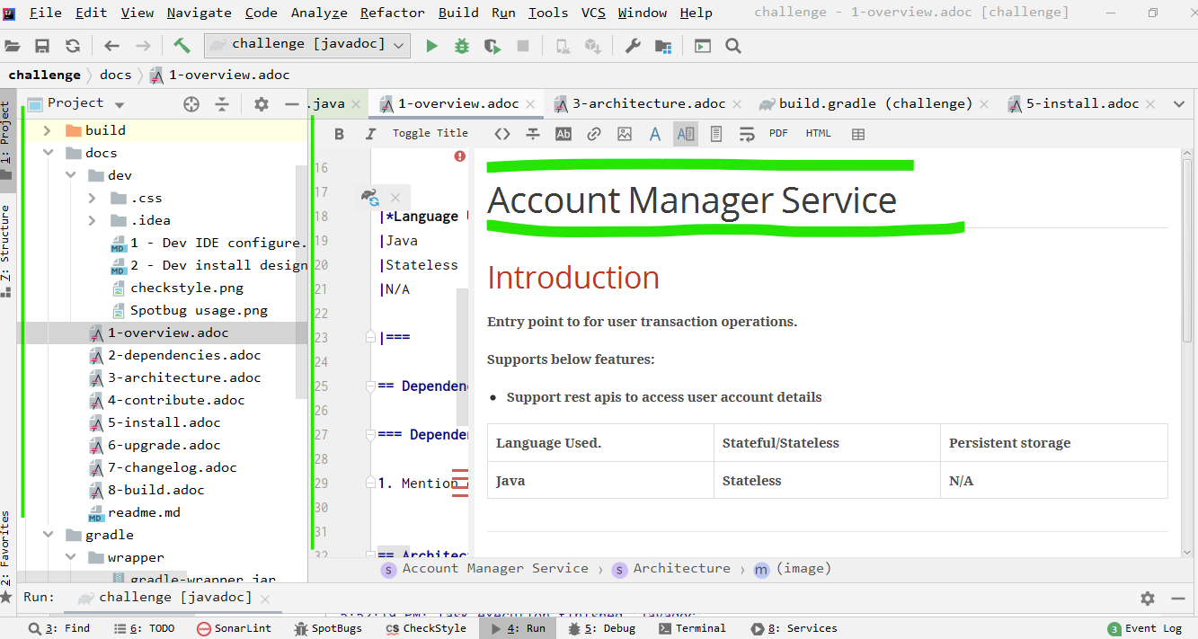
Dev development practices
Used some documentation tool plugin Markdown and added documentation for application. At build time using this documentation folder we can create PDF file as release version document which can contains all release details APIs documentations, deployment instructions , developer guide and so on

Slide 20
Future enhancements
Below are list feature improvement items we can consider to make our application cloud native and can support 12 factors of micros vice application.
Add security aspects and align application security with global standards.- Secure by design
Use and integrated security scan tools with CI/CD integration. Also we can utilize cloud provided security scan tools
Support Prod profile setting in application using standard practices
https://tomgregory.com/how-to-measure-code-coverage-using-sonarqube-and-jacoco/
https://cloud.google.com/security/infrastructure
Use JWT or authentication service as per requirement and enforce authorization in service, develop or encryption service to securely transfer data.
2. Integrate service to APM (application performance and monitoring ) and Monitor, troubleshoot, and improve application performance.
Couple of option we can select depends on our requirement (manage/in house )

Slide 21
Future enhancements
Some options we can consider those are :
Prometheus
Gray Log
Easy to integrated Syslog and cross application events and easily we can gain insights of cross service events
Google cloud stack driver or other cloud provider services as manage services
Use JMeter and write K6 script for performance benchmarking
Use JProfiler to instrument our service and run SVT test cases

Slide 22
Future enhancements
3. Integration of BDD testing using cucumber we can easily use BDD development approach and verify and execute feature test cases using Cucumber integration testing
4. Enhance and improve current Kubernates deployment strategy and integrated this with CI/CD and use industry best practices of it (SRE)
Deploy and test application using different dev/prod/svt environment and test it and fix issues
5. Use emerging spring boot alternate options consider as continues improvement option to speed up development process and improve application performance https://dzone.com/articles/microservices-quarkus-vs-spring-boot
6. Use of database manage service as per requirement and support distributed truncations and use caching options in account service

Slide 23
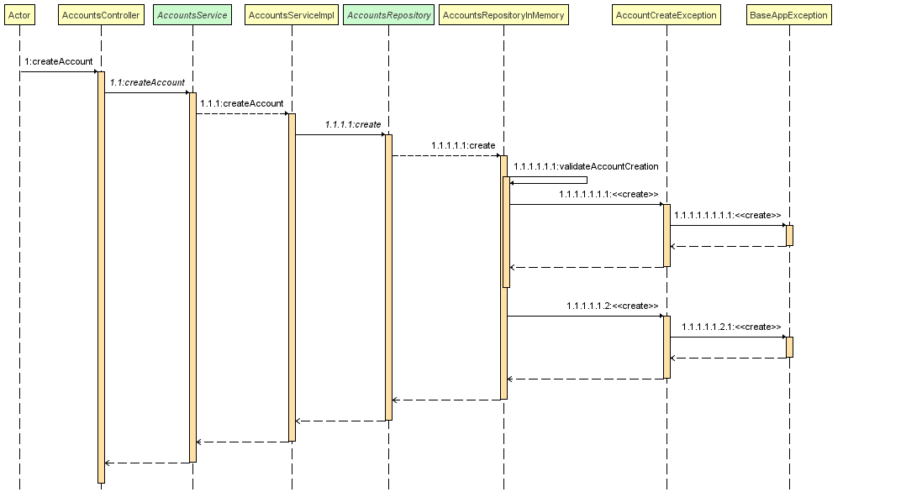
Design details
Sample sequence diagram of create account

Slide 24
How to guide
Location of code base ?
https://github.com/vaibhavpatil123/challenge/master
Documentation
https://github.com/vaibhavpatil123/challenge/tree/master/docs

Slide 25
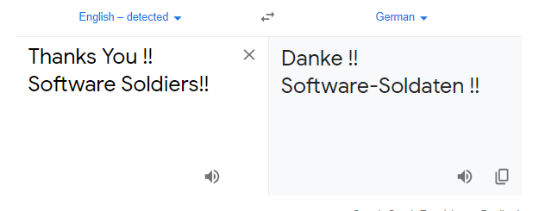
T H A N K Y O U !!!

