Slide 1
Anomaly Detection

Slide 2
Agenda
Introduction
Examples
Challenges
Anomaly types
Detection methods
Metrics
Further reading

Slide 3
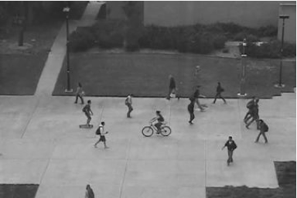
Introduction
Do you see any abnormal behavior?

Slide 4
What is anomaly detection?
Anomaly detection refers to the problem of finding patterns in data that do not conform to expected / normal behavior.
Anomalies are also known as -
Outliers
Discordant observations
Exceptions
Aberrations
Surprises
Peculiarities
contaminants

Slide 5


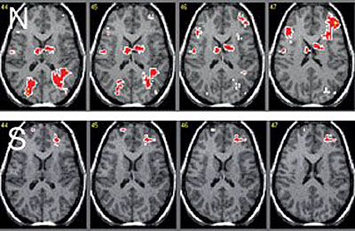
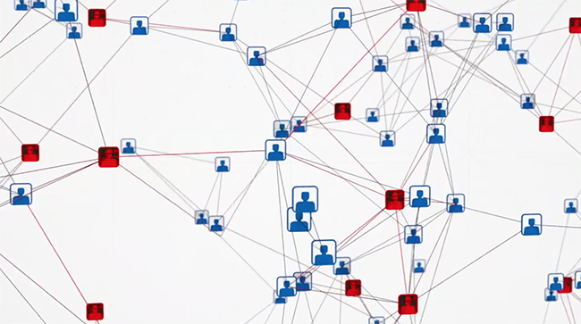
Applications

Slide 6
Challenges
Defining what is normal is often difficult
Availability of labelled data for training/validation
Malicious adversaries
Data might contain noise
Normal behavior keeps evolving

Slide 7
Types of anomaly
Pointwise anomaly
If a data instance can be considered as anomalous with respect to the rest of data, then the instance is termed as a point anomaly.
Add example, notes

Slide 8
Types of anomaly
Contextual anomaly
If a data instance is anomalous in a specific con- text (but not otherwise), then it is termed as a contextual anomaly.
Add examples, notes

Slide 9
Types of anomaly
Collective anomaly
If a collection of related data instances is anomalous with respect to the entire data set, it is a collective anomaly.
Add examples, notes

Slide 10
Detection methods
Supervised – both normal and anomalies are known
Decision tree
Neural network
All other classification techniques
Semi-supervised - only normal points are known
One-class SVM
PU Learning
Unsupervised – no labels available
Percentiles / histogram
Clustering
kNN (k nearest neighbors)
Isolation forest
Autoregressive model

Slide 11
Detection methods
Supervised
Semi-Supervised
Unsupervised
Labels for both normal and anomalous records are available.
Methods
Decision tree
Random forest
Neural networks
Other classification techniques
…
Only a set of normal records is available
Methods
One-class SVM
PU Learning
…
No labels in any form are available
Methods
Percentiles / histogram
Clustering
kNN (k nearest neighbors)
Isolation forest
Autoregressive model
…

Slide 12
Decision tree
Multivariate, supervised
Steps
Build a decision tree to separate anomalies from normal points
Run the rules on a new record
If the probability of being anomaly is beyond a certain cutoff, mark it as anomaly

Slide 13
Percentiles
Univariate, unimodal, unsupervised
Steps
Sort the values
Calculate percentile values as -
Calculate IQR
Calculate upper and lower limits to identify anomalies – Q1-1.5*IQR, Q3+1.5*IQR
anomalies
Q3 + 1.5*IQR
1.5*IQR
Q3
IQR
Median
Q1
1.5*IQR
Q1 – 1.5*IQR
anomaly

Slide 14
kNN
Multivariate, unsupervised
Steps
Find k nearest neighbors for each point
Calculate average of distance
Points which are on average far from their k NN are likely anomalies

Slide 15
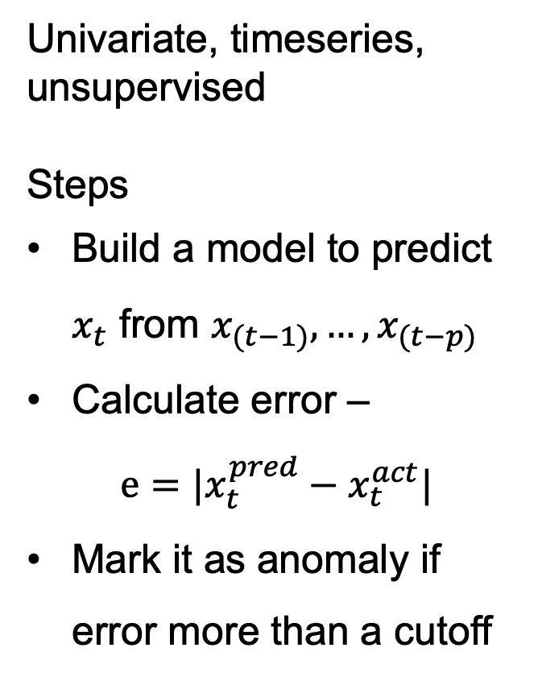
Autoregressive model
Univariate, timeseries, unsupervised
Steps
Build a model to predict $x_{t}$ from $x_{(t−1)},…,x_{(t−p)}$
Calculate error –
$$e=|x_{t}^{pred}−x_{t}^{act}|$$
Mark it as anomaly if error more than a cutoff

Slide 16
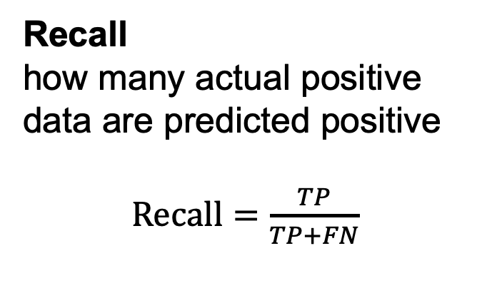
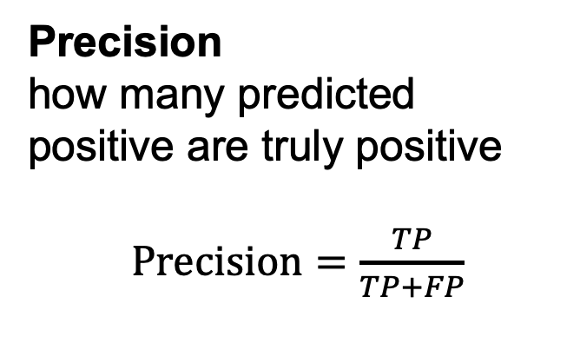
Metrics
 | Actually anomalous (positive) | Actually normal (negative)
Predicted anomalous (positive)
Predicted normal (negative)
Precision
how many predicted positive are truly positive
$Precision=\frac{TP}{TP+FP}$
No problem!
False Alarm!
True Positive (TP)
False Positive (FP)
Recall
how many actual positive data are predicted positive
$Recall=\frac{TP}{TP+FN}$
Trouble!!
No problem!
False Negative (FN)
True Negative (TN)

Slide 17
Reading
https://blog.floydhub.com/introduction-to-anomaly-detection-in-python/
http://www.cs.uwyo.edu/~clan/teach/rampe18_anomaly.pdf
https://iwringer.wordpress.com/2015/11/17/anomaly-detection-concepts-and-techniques/

Slide 18
What is anomaly detection?
Anomaly detection refers to the problem of finding patterns in data that do not conform to expected / normal behavior.
Anomalies are also known as -
Exceptions
Outliers
contaminants
Peculiarities
Aberrations
Surprises
Discordant observations

Slide 19
Clustering
Multivariate, unsupervised
Steps
Create clusters from the data
Clusters below a certain size can be treated as anomalies

Slide 20
Metrics
 | Actually anomalous (positive) | Actually normal (negative)
Predicted anomalous (positive) | True Positive (TP) | False Positive (FP)
Predicted normal (negative) | False Negative (FN) | True Negative (TN)

