Slide 1
Causal Inference with Non-experimental Data
29-Oct-2020
Vaibhav Pawar

Slide 2
Overview
Correlation vs Causation
Gold standard for causal inference is randomized controlled trial or A/B test
But what if A/B test is not possible?
That's when we use non-experimental / observational data
Examples
What is the impact of shares (community/self) on STR?
How do delayed orders impact user engagement?
How do buyer comments impact buyer retention?

Slide 3
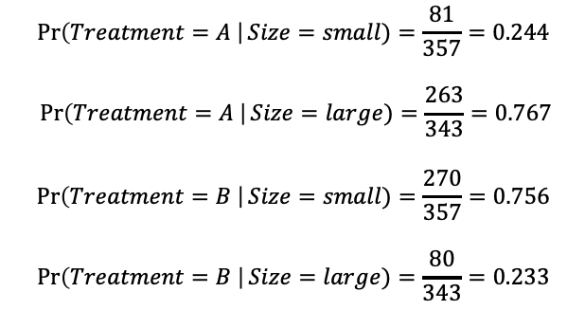
Simpson’s Paradox
 | Treatment Type
Kidney stone size | Treatment A | Treatment B
Small | 81/87 = 93% | 234/270 = 87%
Large | 192/263 = 73% | 55/80 = 69%
Both | 273/350 = 78% | 289/350 = 89%
What treatment is given is dependent on the size of the kidney stone which is also a driver of success/failure
This is called confounding - there is a common factor affecting both the treatment and the outcome
The common factor is called a confounder (‘size’ in this case)
Not accounting for confounders will produce incorrect / paradoxical causal conclusions
How do we solve this?
$$\operatorname{Pr}\left(Treatment=A \right|Size=small)=\frac{81}{357}=0.244$$
$$\operatorname{Pr}\left(Treatment=A \right|Size=large)=\frac{263}{343}=0.767$$
$$\operatorname{Pr}\left(Treatment=B \right|Size=small)=\frac{270}{357}=0.756$$
$$\operatorname{Pr}\left(Treatment=B \right|Size=large)=\frac{80}{343}=0.233$$

Slide 4
Resolving the paradox
# cases
Prob of treatment given size
Prob of treatment independent of size
 | Treatment
Size | A | B | Total
Small | 87 | 270 | 357
Large | 263 | 80 | 343
Both | 350 | 350 | 700
 | Treatment
Size | A | B | Total
Small | 0.24 | 0.76 | 1
Large | 0.77 | 0.23 | 1
Both | 0.50 | 0.50 | 1
 | Treatment
Size | A | B | Total
Small | 0.50 | 0.50 | 1
Large | 0.50 | 0.50 | 1
Both | 0.50 | 0.50 | 1
Pseudo-population
Observed success rate
# success in pseudo-population
Success rate in pseudo-population
 | Treatment
Size | A | B | Total
Small | 357 | 357 | 714
Large | 343 | 343 | 686
Both | 700 | 700 | 1400
 | Treatment
Size | A | B
Small | 0.93 | 0.87
Large | 0.73 | 0.69
Both | 0.780 | 0.826
 | Treatment
Size | A | B
Small | 332.4 | 309.4
Large | 250.4 | 235.8
Both | 582.8 | 545.2
 | Treatment
Size | A | B
Small | 0.93 | 0.87
Large | 0.73 | 0.69
Both | 0.833 | 0.779

Slide 5
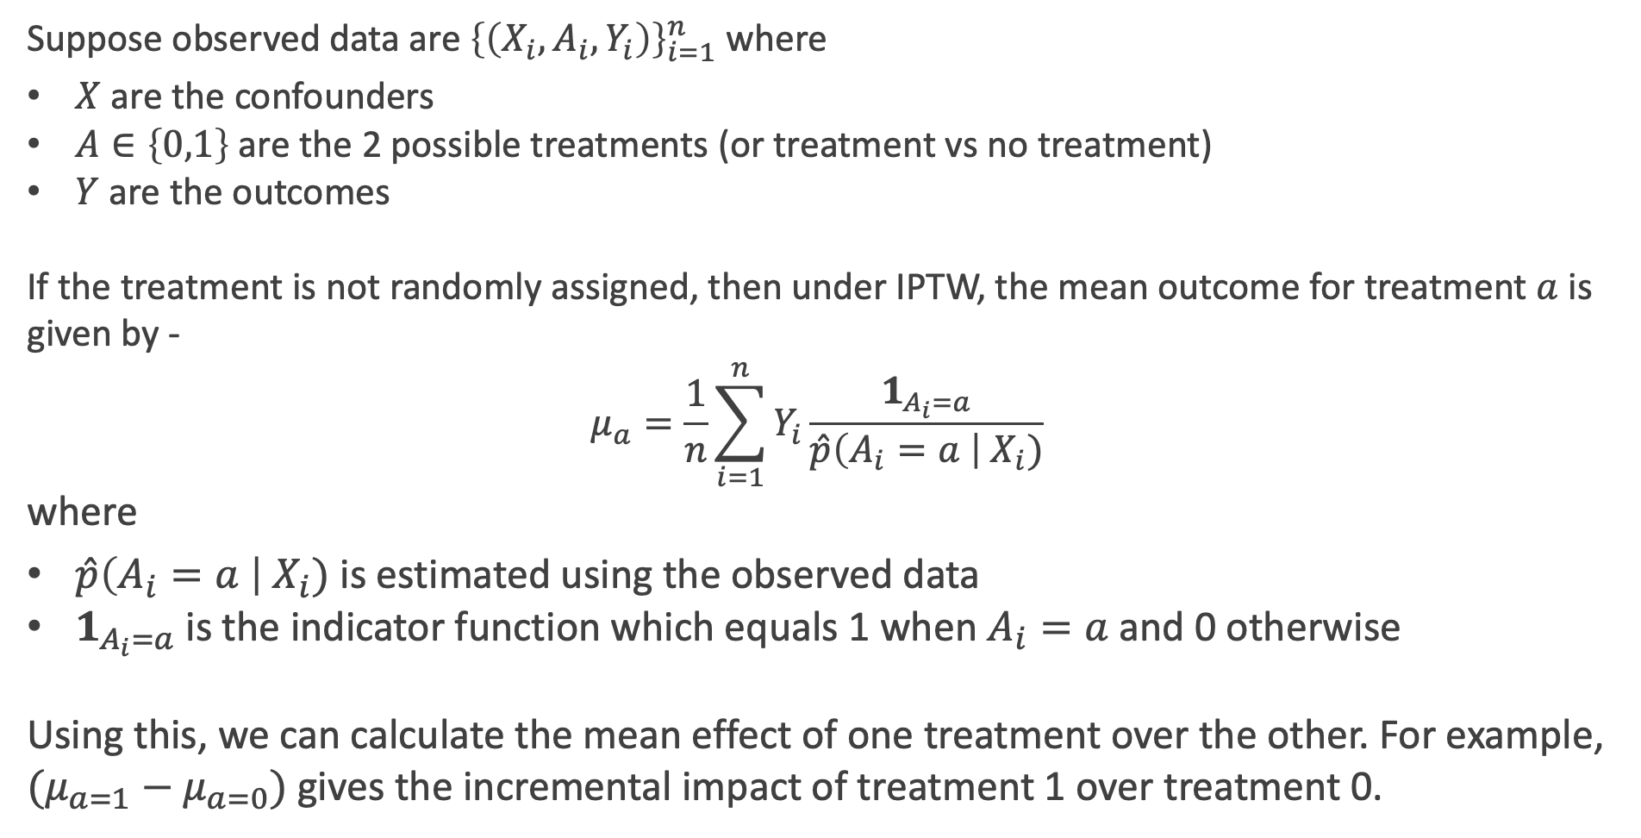
IPTW (Inverse Probability of Treatment Weighting)
Suppose observed data are ${\left\{\left(X_{i},A_{i},Y_{i}\right)\right\}}_{i=1}^{n}$ where
$X$ are the confounders
$A∈\left\{0,1\right\}$ are the 2 possible treatments (or treatment vs no treatment)
$Y$ are the outcomes
If the treatment is not randomly assigned, then under IPTW, the mean outcome for treatment $a$ is given by -
$$μ_{a}=\frac{1}{n}\sum_{i=1}^{n}{Y_{i}\frac{1_{A_{i}=a}}{\hat{p}\left(A_{i}=a \right|{ X}_{i})}}$$
where
$\hat{p}\left(A_{i}=a \right|{ X}_{i})$ is estimated using the observed data
$1_{A_{i}=a}$ is the indicator function which equals 1 when $A_{i}=a$ and 0 otherwise
Using this, we can calculate the mean effect of one treatment over the other. For example, $(μ_{a=1}−μ_{a=0})$ gives the incremental impact of treatment 1 over treatment 0.

Slide 6
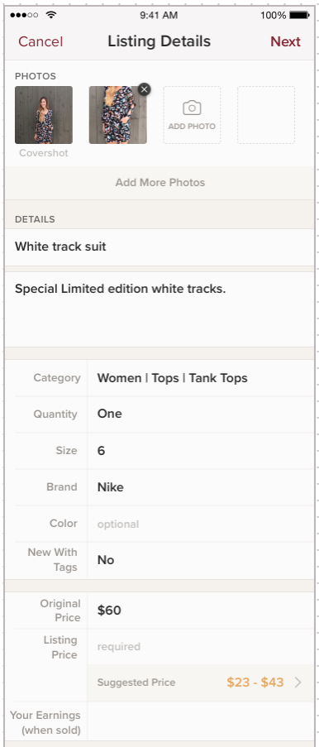

Price Suggester - Impact of click
Does clicking on the suggested price result in more adherence to suggested price range?
Obvious approach – compare the listings for which the lister clicked the link vs those listings for which there was no click.
But there are multiple confounders
Lister characteristics
Listing characteristics
Suggestion accuracy (not observable)
…
How do we estimate the true effect?
Does making this clickable help?

Slide 7

IPTW with many confounders
Approach
Create a model to estimate the probability of treatment using confounders as an input
Use the model output to do the inverse weighting
Calculate the causal effect using the pseudo-population
Model Input Variables
Target Variable
$$\operatorname{Pr}\left(clicked\right)\sim f(confounder_variables)$$
Model Output
$$\frac{1}{Pr⁡(clicked)}$$
Outcome Variable
Calculate the mean outcomes for clicked vs not-clicked groups using the weights

Slide 8
Limitations
All confounders must be known and observable – requires deep domain knowledge and assumptions
Estimation of probability of treatment is difficult when there are many confounders
Weights can become unstable if the probability of treatment is very small

Slide 9
Other methods
Propensity score matching
Doubly-robust estimation
Instrumental variables

Slide 10
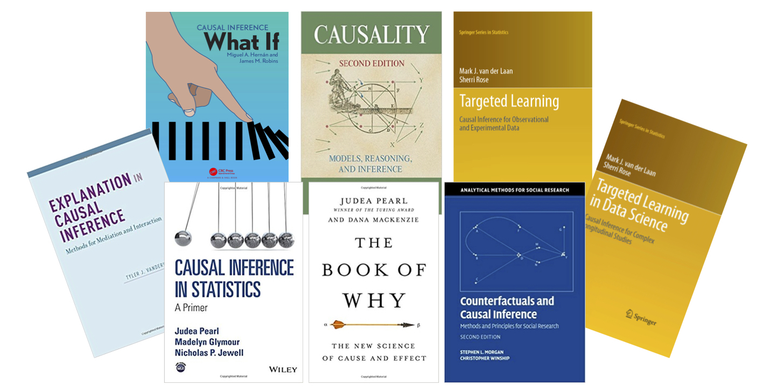
Readings

Slide 11
Thank you!

