Slide 2

Algorithm
Advanced Encryption Standard cryptography

Slide 3

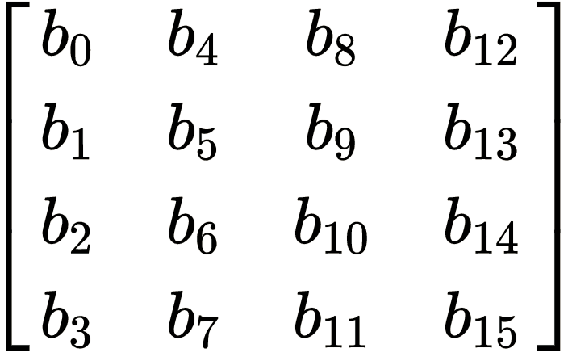
AES has a fixed block size of 128 bits, and a key size of 128, 192, or 256 bits
AES operates on a 4 × 4 column-major order matrix of bytes, termed the state
For instance, if there are 16 bytes, , these bytes are represented as this matrix:
The key size used for an AES cipher specifies the number of repetitions of transformation rounds that convert the input, called the plaintext, into the final output, called the ciphertext. The number of cycles of repetition are as follows:
10 cycles of repetition for 128-bit keys.
12 cycles of repetition for 192-bit keys.
14 cycles of repetition for 256-bit keys.

Slide 4
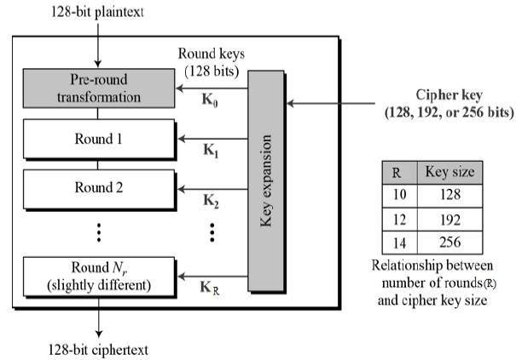

Slide 5
High Level Description of the Algorithm
Step 1: KeyExpansions
Round keys are derived from the cipher key using Rijndael's key schedule. AES requires a separate 128-bit round key block for each round plus one more.
Step 2: InitialRound
AddRoundKey—each byte of the state is combined with a block of the round key using bitwise xor.
Step 3: Rounds
SubBytes—a non-linear substitution step where each byte is replaced with another according to a lookup table.
ShiftRows—a transposition step where the last three rows of the state are shifted cyclically a certain number of steps.
MixColumns—a mixing operation which operates on the columns of the state, combining the four bytes in each column.
AddRoundKey
Step 4: Final Round (no MixColumns)
SubBytes
ShiftRows
AddRoundKey.

Slide 6
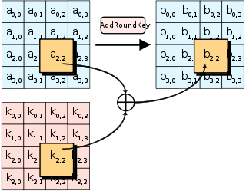
The AddRoundKey step
In the AddRoundKey step, each byte of the state is combined with a byte of the round subkey using the XOR operation (⊕).

Slide 7
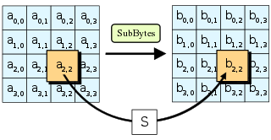
The SubBytes step
In the SubBytes step, each byte in the state is replaced with its entry in a
fixed 8-bit lookup table, S; bij = S(aij).

Slide 8
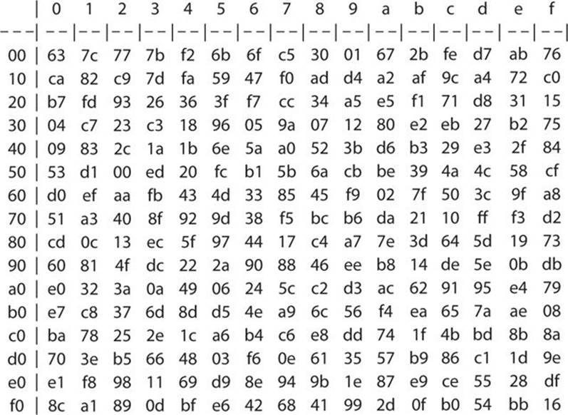

Slide 9
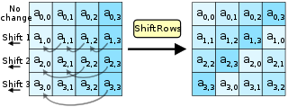
The ShiftRows step
In the ShiftRows step, bytes in each row of the state are shifted cyclically to the left. The number of places each byte is shifted differs for each row.
Row {n} is shifted left circular by {n-1} bytes

Slide 10
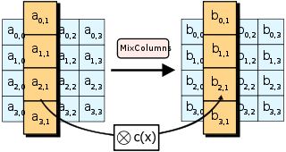
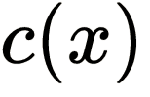
The MixColumns step
In the MixColumns step, each column of the state is multiplied with a fixed polynomial

