Slide 2
Tables Used

Slide 3
USER
Email
Password
Fname
Lname
Gender
Mobile
Address
KYC
Email
Voter_card
status
Entry_time
Update_time
ADMIN
Admin_id
Admin_password
NODES
Name
Url
ASSEMBLY_USER
Email
Assembly_id
ASSEMBLY
Assembly_id
Assembly_name
ELECTION
Election_id
Title
Description
Assembly_id
Election_date
Start_time
End_time
Status
ELECTION_CONTESTANT
Election_id
Contestant_id
CONTESTANT
Contestant_id
Contestant_name
Contestant_photo
Contestant_details
Party_id
PARTY
Party_id
Party_name
Party_logo

Slide 4
Project Structure

Slide 5
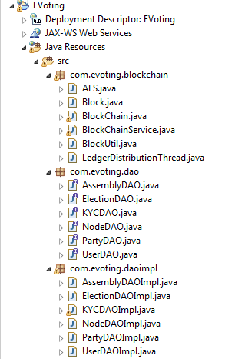
Blockchain Implementation
Data Access Operations Interface objects for each of the tables in the project
Data Access Operations Implementation objects for each of the tables in the project

Slide 6
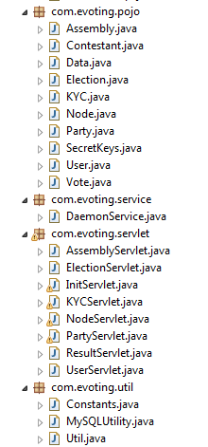
Mapping Classes from the database tables to the Java objects (Plain Old Java Objects)
Background Job which polls the election timestamps and takes appropriate actions
Numerous servlets for handling all the requests from the client layer
Commonly used utility classes in this project

Slide 7
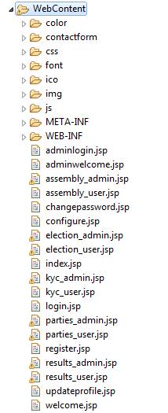

Slide 8
Modules Breakdown

Slide 9
Module 1: User Account Operations
Module 2: Blockchain implementation
Module 3: KYC Layer
Module 4: Assembly layer
Module 5: Party Layer
Module 6: Elections and Results

Slide 10
Module 1:
User Account Operations

Slide 11
index .jsp
register .jsp
Deployment descriptor
UserDAOImpl
Request_type
=register
Register()
getUserDetails()
Changepassword()
Updateprofile()
Deleteprofile()
login .jsp
User
Servlet
Request_type
=login
request_type
Register
Login
Changepassword
Updateprofile
Deleteprofile
welcome .jsp
Update_propfile .jsp
User
Request_type
=updateprofile
changepassword .jsp
MySQLUtiliy
Request_type
=changepassword
GetConnection()

Slide 12
Module 2: Blockchain Implementation

Slide 13
ledgerDistributionThread
Blockchain Service
Blockchain Implementation
Block
Blockchain
BlockUtil
AES

Slide 14
Module 3: KYC

Slide 15
Client Layer
Web Layer
Deployment Descriptor
kyc_user .jsp
KYC Servlet
kyc_admin .jsp
KYC Business Logic
KYC
KYCDAO
KYCDAOImpl

Slide 16
Module 4: Assembly

Slide 17
Client Layer
Assembly _admin.jsp
Assembly _user.jsp
Deployment Descriptor
Assembly Servlet
Assembly Business logic
Assembly
AssemblyDAO
AssemblyDAOImpl

Slide 18
Module 5: Party

Slide 19
Client Layer
Web Layer
Party Business logic
Deployment Descriptor
Party
Party DAO
parties _admin.jsp
Contestant
Party DAOImpl
parties _user.jsp
Party
Servlet

Slide 20
Module 6: Elections and Results

Slide 21
Client Layer
elections _admin.jsp
elections _user.jsp
results _admin.jsp
results _user.jsp
Business logic
Deployment Descriptor
Assembly Servlet
Election
Election DAO
Election DAOImpl
Blockchain Service
LedgerDistribution Thread
DaemonService
Node1
Node2
Node3

