Slide 1
Blockchain-Enabled E-Voting

Slide 2
Blockchain-Enabled E-Voting
Problem Identification
Literature Review (Existing systems)
Proposed System and its Advantages
Hardware and Software Requirements
Project Architecture Diagram
Use case Diagram
Modules Breakdown

Slide 3
Blockchain-Enabled E-Voting
Problem Identification
General elections still use a centralized system, there is one organization that manages it.
In the traditional electoral systems, an organization has the full control over the database and system.
It is possible to tamper with the database of considerable opportunities

Slide 4
Blockchain-Enabled E-Voting
Literature Review (Existing Systems)
Conventional Voting systems
Online Voting Systems
[1] "SELES: an e-voting system for medium scale online election" C. Garcia-Zamora ; F. Rodriguez-Henriquez ; D. Ortiz-Arroyo Sixth Mexican International Conference on Computer Science (ENC'05)
[2] "Building a reliable e-voting system: functional requirements and legal constraints" C. Lambrinoudakis ; D. Gritzalis ; S. Katsikas Proceedings. 13th International Workshop on Database and Expert Systems Applications
[3] "Design and development of voting data security for electronic voting (E-Voting)" Supeno Djanali ; Baskoro Adi Pratomo ; Karsono Puguh Nindyo Cipto ; Astandro Koesriputranto ; Hudan Studiawan 2016 4th International Conference on Information and Communication Technology (ICoICT)
[4] "Agent-Based Offline Electronic Voting" Mehmet Tahir Sandikkaya ; Bulent Orencik 30th Annual International Computer Software and Applications Conference (COMPSAC'06)

Slide 5
Blockchain-Enabled E-Voting
Literature Review (Existing Systems) - continued
Drawbacks of existing systems
All the systems operates over a centralized architecture where the entire process will be governed by a single organization
Cheating sources of database manipulation is possible

Slide 6
Blockchain-Enabled E-Voting
Proposed System and its Advantages

Slide 7
Blockchain-Enabled E-Voting
Proposed System and its Advantages
In this project, we incorporate Blockchain technology as the solution for the problems seen in the traditional voting systems, because it embraces a decentralized system.

Slide 8
Blockchain-Enabled E-Voting
Proposed System and its Advantages
In this project, we incorporate Blockchain technology as the solution for the problems seen in the traditional voting systems, because it embraces a decentralized system.
Advantages
This technique introduces the decentralized system and thus the entire database are owned by many users

Slide 9
Blockchain-Enabled E-Voting
Proposed System and its Advantages
In this project, we incorporate Blockchain technology as the solution for the problems seen in the traditional voting systems, because it embraces a decentralized system.
Advantages
This technique introduces the decentralized system and thus the entire database are owned by many users
Cheating sources of the database manipulation is reduced

Slide 10
Blockchain-Enabled E-Voting
Proposed System and its Advantages
In this project, we incorporate Blockchain technology as the solution for the problems seen in the traditional voting systems, because it embraces a decentralized system.
Advantages
This technique introduces the decentralized system and thus the entire database are owned by many users
Cheating sources of the database manipulation is reduced
Simple and feasible solution. The results of the election will be available on the go and will be accurate and cheating-free.

Slide 11
Blockchain-Enabled E-Voting
Hardware Requirements
Processor | Intel Core i5 or AMD FX 8 core series with clock speed of 2.4 GHz or above
RAM | 4GB or above
Hard disk | 40 GB or above
Input device | Keyboard or mouse or compatible pointing devices
Display | XGA (1024*768 pixels) or higher resolution monitor with 32 bit color settings
Miscellaneous | USB Interface, Power adapter, etc

Slide 12
Blockchain-Enabled E-Voting
Software Requirements
Operating System | Windows or Linux
Programming Language – Backend | Core Java, Advanced Java, J2EE, MVC Framework
Programming language - Frontend | Bootstrap Framework, HTML, CSS, JavaScript, Ajax, JQuery
Development environment | Eclipse Oxygen
Application Server | Apache Tomcat v9.0
Database | MySQL

Slide 13
Project Architecture Diagram

Slide 14
Results
Distributed Ledger Network
Access
Manage
Elections
Schedule
Assembly Mapping
Contestant Mapping
Participate
Delete
Node 1
Parties
Create
Edit
Delete
Map Contestant
View
Node 1
Assembly
.
Create
Edit
Delete
User Mapping
View
.
.
KYC
Upload Documents
Take Action
View Status
Node ‘n’
User Authentication and Authorization

Slide 15
Use case Diagram

Slide 16
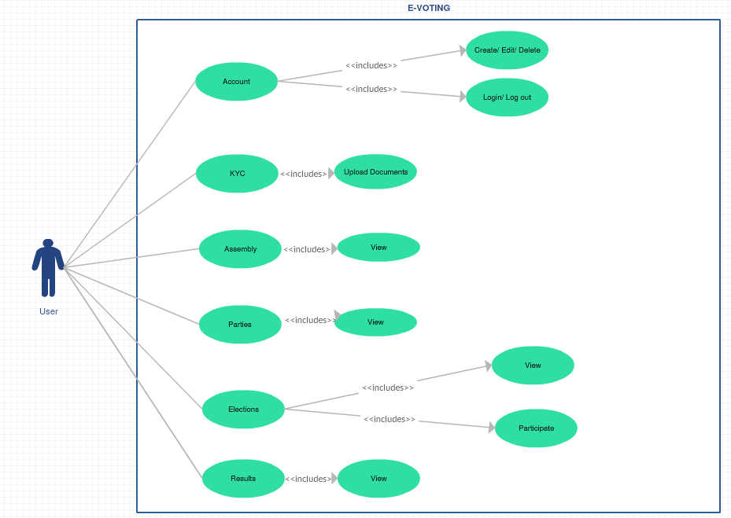

Slide 17
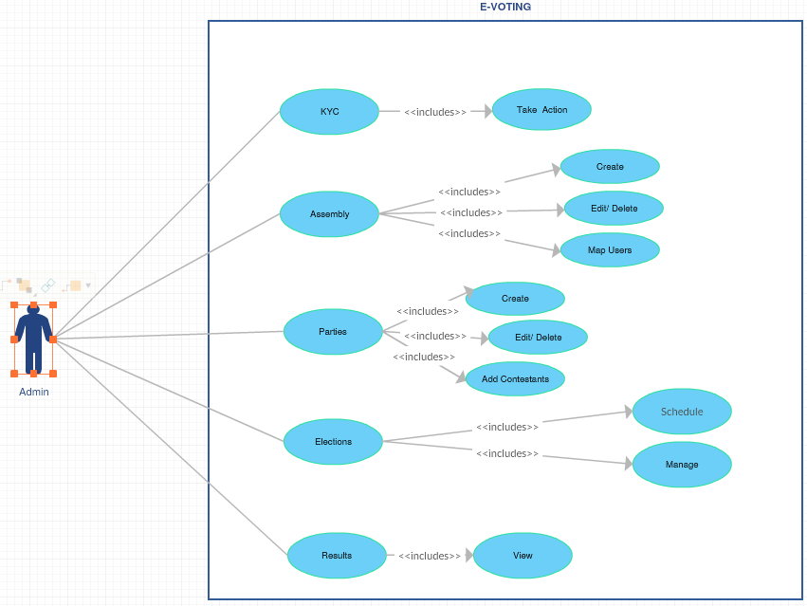

Slide 18
Modules Breakdown
Module 1: User Authentication and Authorization
Module 2: KYC Process
Module 3: Assembly Component
Module 4: Parties Management
Module 5: Election Process with Distributed Ledger Network
Module 6: Results

