Slide 1
Portfolio Management System
Team members:
Madhu Sudan Ojha (THA075BEI019)
Rewan Gautam (THA075BEI032)
Shovit Nepal (THA075BEI040)
Suman Karki (THA075BEI042)
Supervisor:
Er. Rama Bastola
Department of Electronics and Computer Engineering
Institute of Engineering, Thapathali Campus
July 16, 2021

Slide 2
Presentation outline
Introduction
Motivation
Objectives
Scope and De-limitations
Applications
Methodology
ER Diagram
Expected Outputs and Reports
Task division
Timeline

Slide 3
Introduction
Share Market is the aggregation of buyers and sellers of stocks
A portfolio is a collection of financial investments like stocks
Portfolio management is the art and science of selecting and overseeing a group of stocks
Fundamental and technical analysis to select stocks

Slide 4
Motivation
Increment of investors in share market
Messy circumstances to managing huge bundles of shares
No time to analyze fundamental, technical details and see news related to current holdings

Slide 5
Objectives
To create a portfolio for each user
To add transaction and update the portfolio accordingly
To display fundamental and technical report consisting of metrics like EPS, P/E Ratio, ROE, Volume, RSI, etc.
To suggest the user to buy or sell according to the fundamental and technical report
To display net profit and loss for user

Slide 6
Scope and De-limitations
Investment alternatives and analysis
Risk Analysis
Fundamental analysis
Technical analysis
Portfolio Evaluation
Forecasting not accurate
Risky and no protection
Confusion for new investors
No charts for technical signals

Slide 7
Applications
For anyone who is a stock investor
Can explore share values
Check if fundamentally strong
Know if it’s buying or selling signal easily

Slide 8
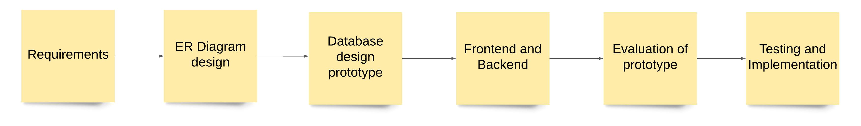
Methodology
Figure: Block diagram for System design

Slide 9
ER Diagram
Ten entities
Fundamental Report
Technical Signals
Dividend History
News
Transaction
Company price
Company profile
Watchlist
Holdings
User

Slide 10
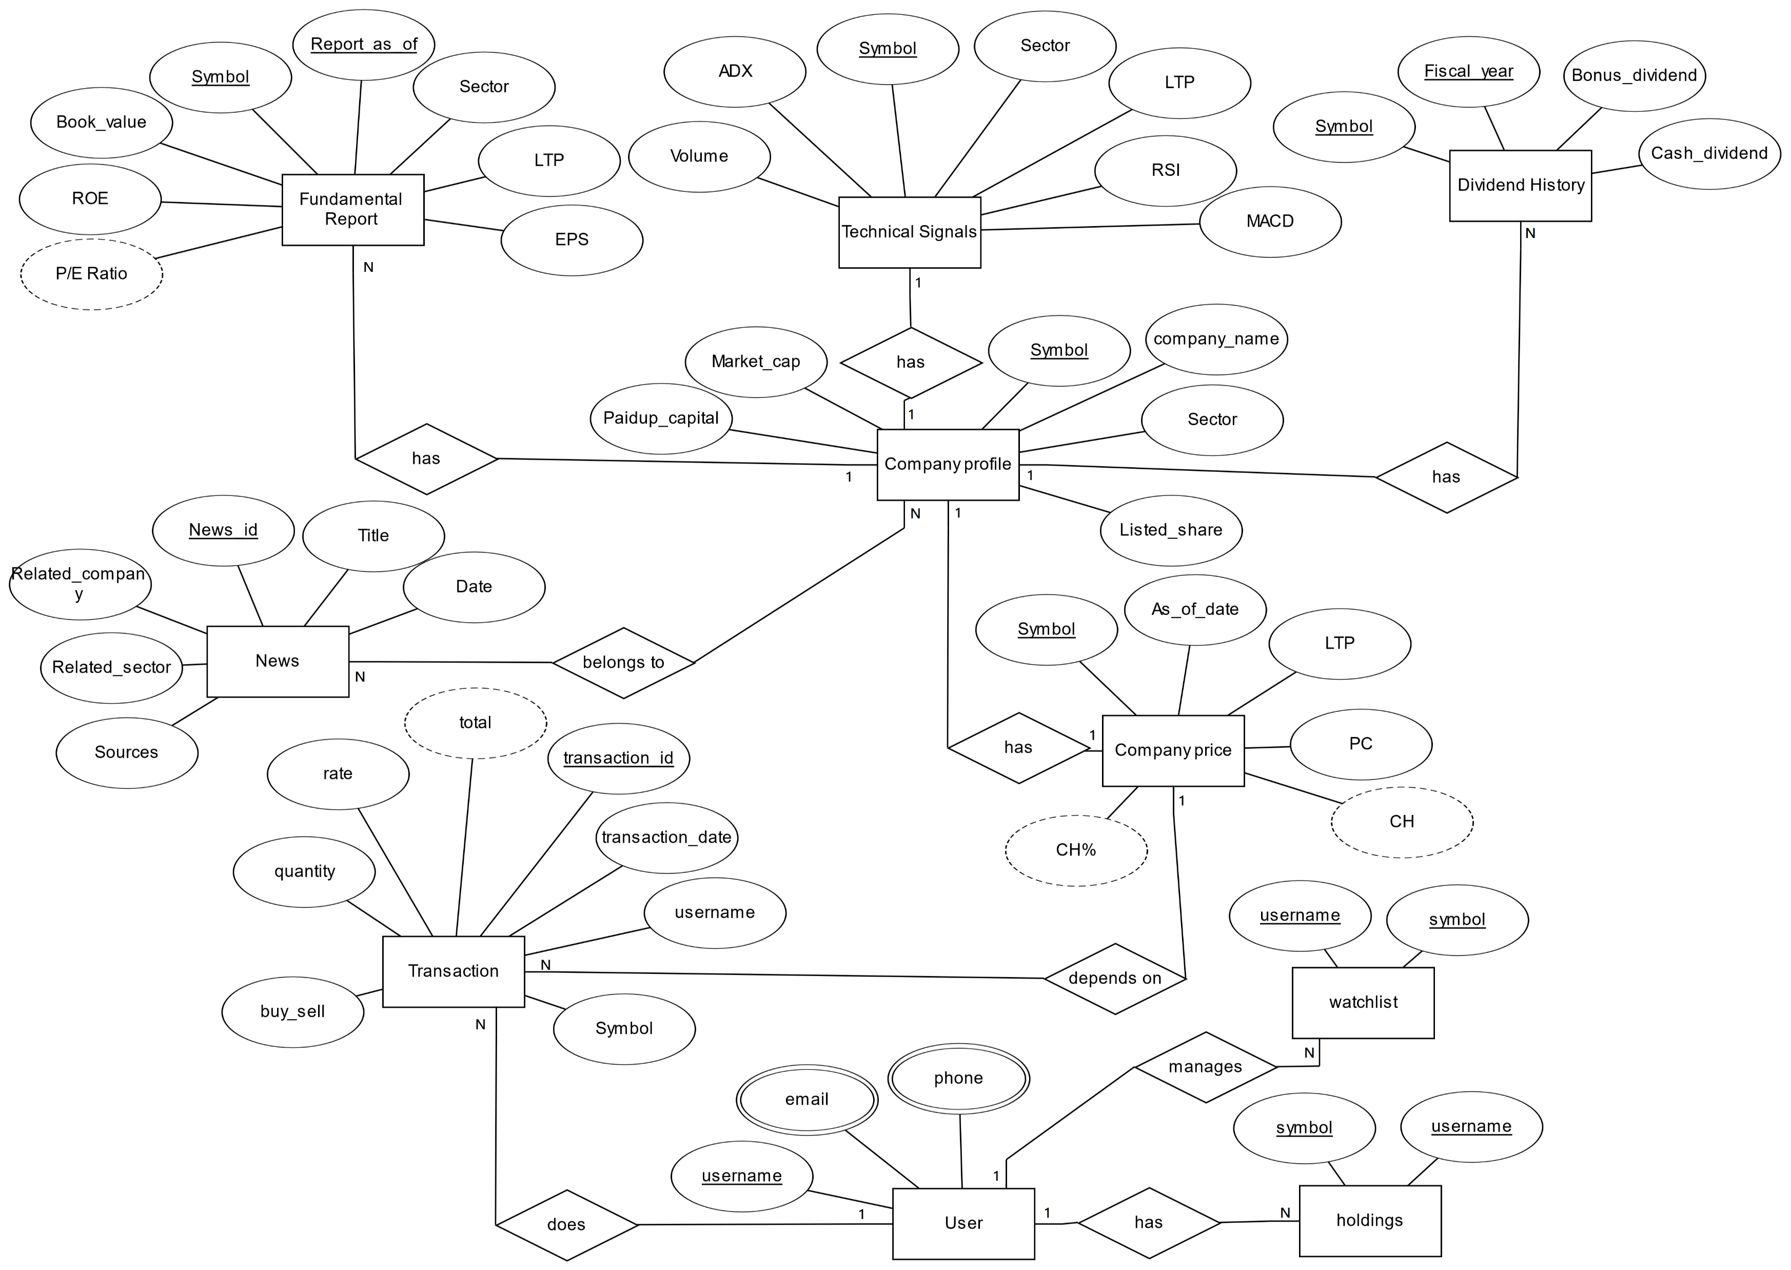
ER Diagram cont..

Slide 11
Expected Output and Reports
Create portfolio
Enter your details
Add stock details
Display portfolio
Here is your portfolio.
Click to see news, fundamental and technical details for your holdings.

Slide 12
Expected Output and Reports cont..
Portfolio analysis
The EPS of these companies are below 15.
MACD crossover bullish signal for these companies.
P/E ratio for these companies is higher than 50.
Suggest is not to buy.
Your stock is fundamentally weak
Technically a sell signal.

Slide 13
Task Division
Database system lead – Rewan Gautam
Front end lead – Shovit Nepal
Reporting lead – Suman Karki
Share market domain exploration lead – Madhu Sudan Ojha

Slide 14
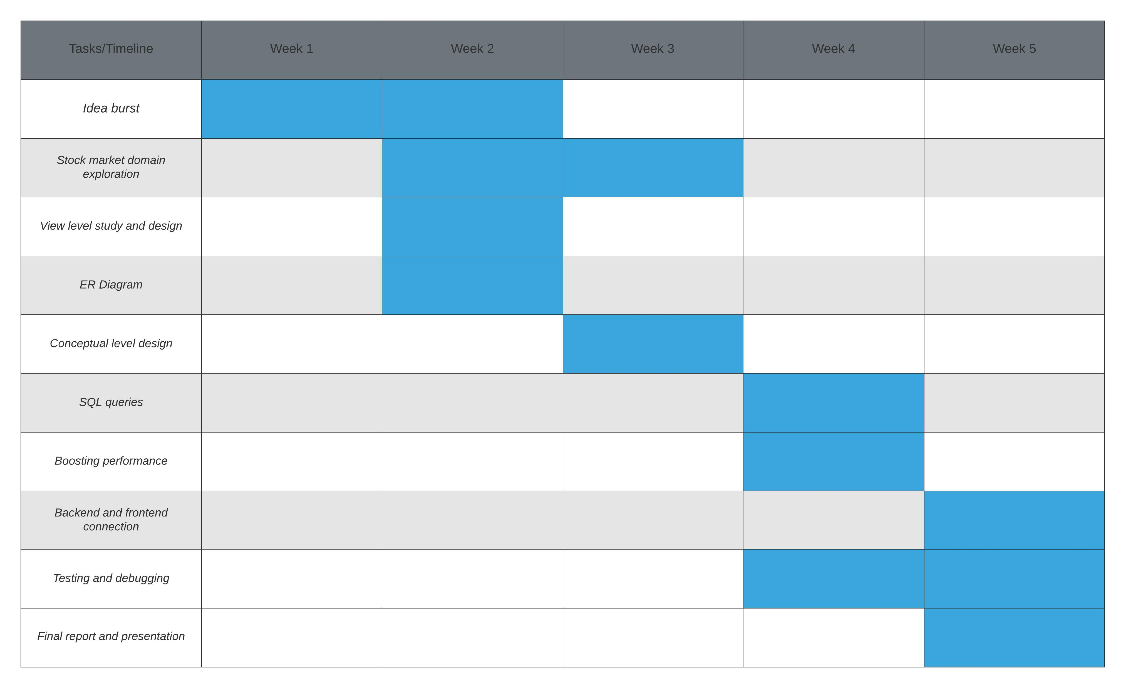
Timeline
Figure: Gantt Chart

Slide 15
References
Tutorialspoint.com. 2021. SQL Tutorial - Tutorialspoint. [online] Available at: <https://www.tutorialspoint.com/sql/index.htm> [Accessed 10 July 2021].
Python.org. 2020. Welcome to Python.Org. [online] Available at: <https://www.python.org/> [Accessed 11 July 2021].
"MySQL - Wikipedia", En.wikipedia.org, 2021. [Online]. Available: https://en.wikipedia.org/wiki/MySQL. [Accessed: 12- Jul- 2021]
"HTML - Wikipedia", En.wikipedia.org, 2021. [Online]. Available: https://en.wikipedia.org/wiki/HTML. [Accessed: 12- Jul- 2021]
"CSS - Wikipedia", En.wikipedia.org, 2021. [Online]. Available: https://en.wikipedia.org/wiki/CSS. [Accessed: 12- Jul- 2021]
"Flask (web framework) - Wikipedia", En.wikipedia.org, 2021. [Online]. Available: https://en.wikipedia.org/wiki/ Flask_(web_framework). [Accessed: 13- Jul- 2021]
"Bootstrap 3 Tutorial", W3schools.com, 2021. [Online]. Available: https://www.w3schools.com/bootstrap/. [Accessed: 14- Jul- 2021]

Slide 16
Thank you!

