Slide 1

android
Vaibhav Purohit

Slide 2
Agenda
What is android OS
How does it work
Architecture
Memory Management
Features
Fragmentation
App development
Security

Slide 3
Introduction
Android is an operating system owned by google for smartphones and tablets.
The Android operating system is a multi-user Linux system in which each app is a different user.
An OS with a slightly different library than linux.(BIONIC)
It is an activity based interface recognizing actions and acting as per.
Android is a software stack for mobile devices which includes an operating system, middleware and key applications

Slide 4
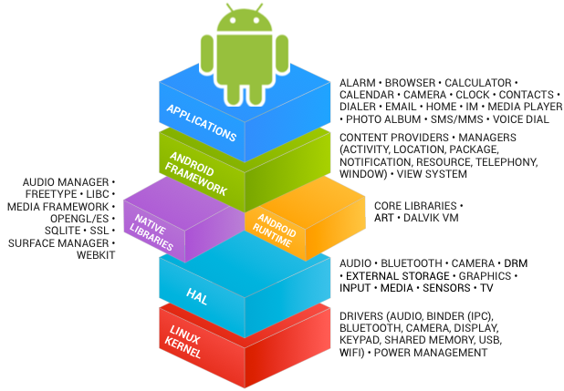
What is Android OS
Mobile device OS
Linux-based mobile platform
Open to innovation
Developed by Open Handset Alliance
Activity based GUI
Java API

Slide 5
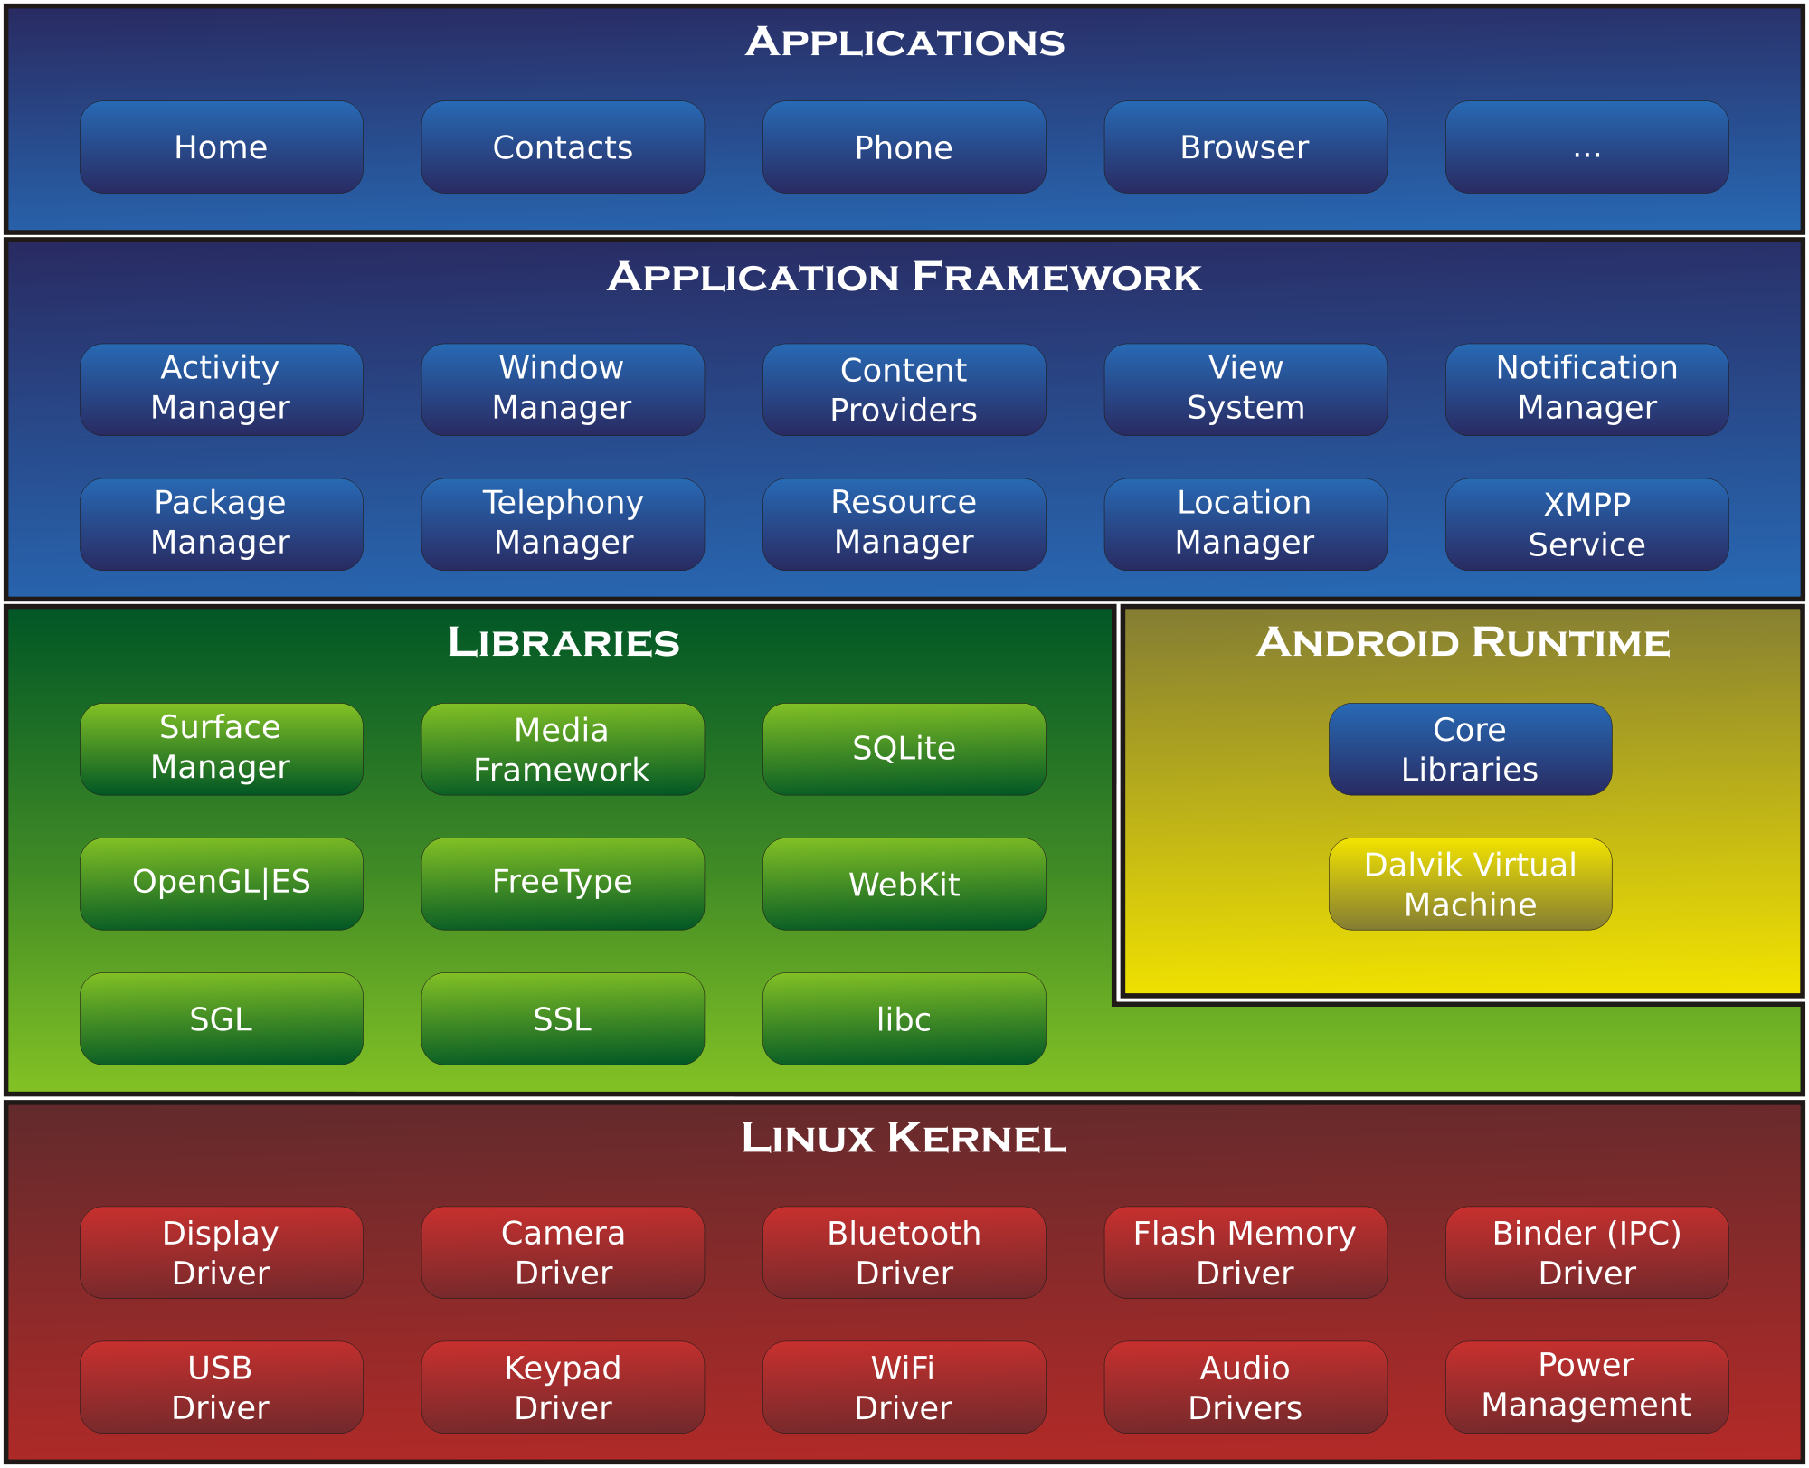

Slide 6
How does it work
Linux-Kernel
Platform for android apps
Activities are recognized
Dalvik – Process Virtual Machine
Just-In-Time Compilation
Android Runtime
Ahead-Of-Time Compilation

Slide 7
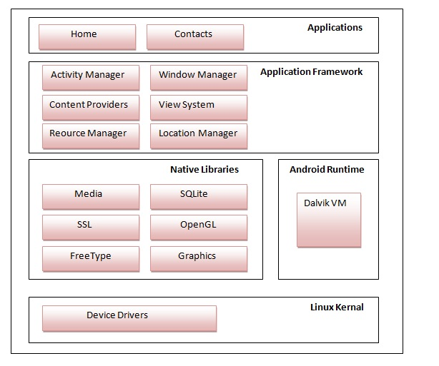
Architecture
Linux kernel
Native libraries
Android runtime
Framework
Applications

Slide 8
Memory Management
Native Linux-Kernel methodology
Android run time and virtual machine manage application memory
Priority based memory allocation

Slide 9
Features
Multi tasking
Sandboxing
Near Field Communication(NFC)
Screen capture
Wireless tethering
Java support

Slide 10
Fragmentation
Modules of activities with independent lifecycles
Sub-activity with its own input activity
Variant design layouts for different apps

Slide 11

App development
App Inventor
Android studio
Apache
Open JDK

Slide 12

Security
Sandboxing
Authorized app access
Full disk encryption
App verification

Slide 13
References
WhatIs.com
https://www.android.com/work/
http://www.dummies.com/how-to/content/looking-at-the-android-operating-system0.html
http://www.javatpoint.com/android-software-stack

