Slide 1
Salesforce
Vaibhav Purohit

Slide 2
Agenda
CRM – A vital business implementation concept
Salesforce.com – What, Why and Where
Understanding the environment
Implementing SFDC – End to end scenario
Classic vs. Lightning
App Exchange
Various Features

Slide 3
CRM
Customer Relationship Management
Management Strategy
Company-Customer relationships and interactions
CRM System/Tool- Oracle, Salesforce
Customer -> Relationship -> Management

Slide 4
SFDC
Cloud based CRM system
Customer success platform
Paas, Saas
One stop customer handling solution
Multi-tenancy
Governing Limits

Slide 5
Salesforce Platform
The Three views of Salesforce
Business User – SFDC Org
Administrator – Org Setup, Workbench
Developer – Developer Console, Force.com IDE

Slide 6
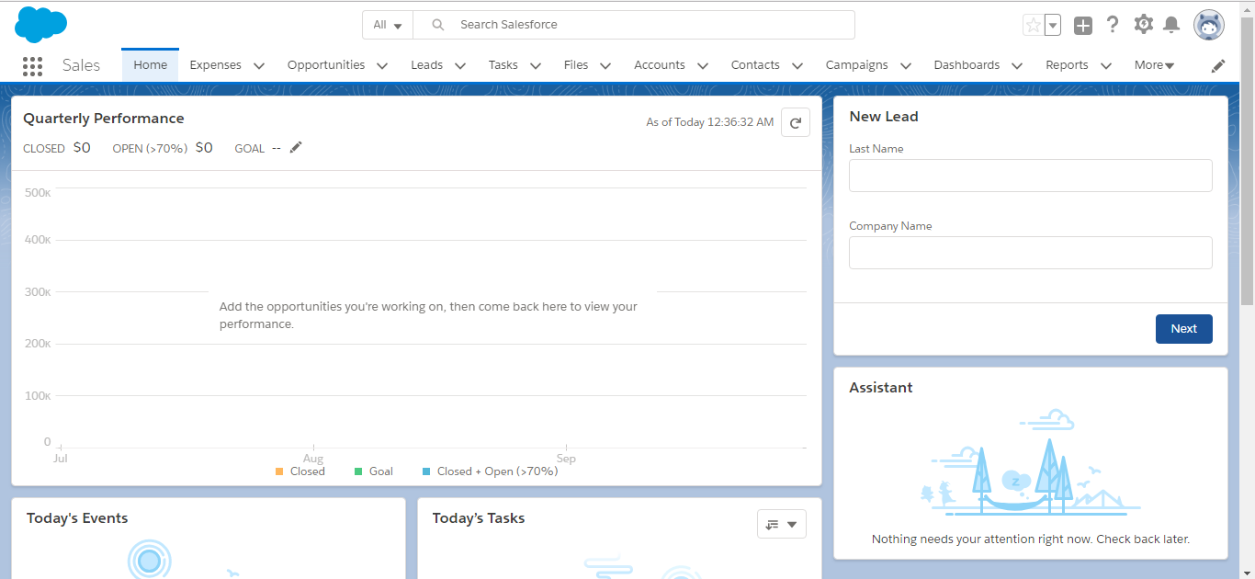
Org

Slide 7
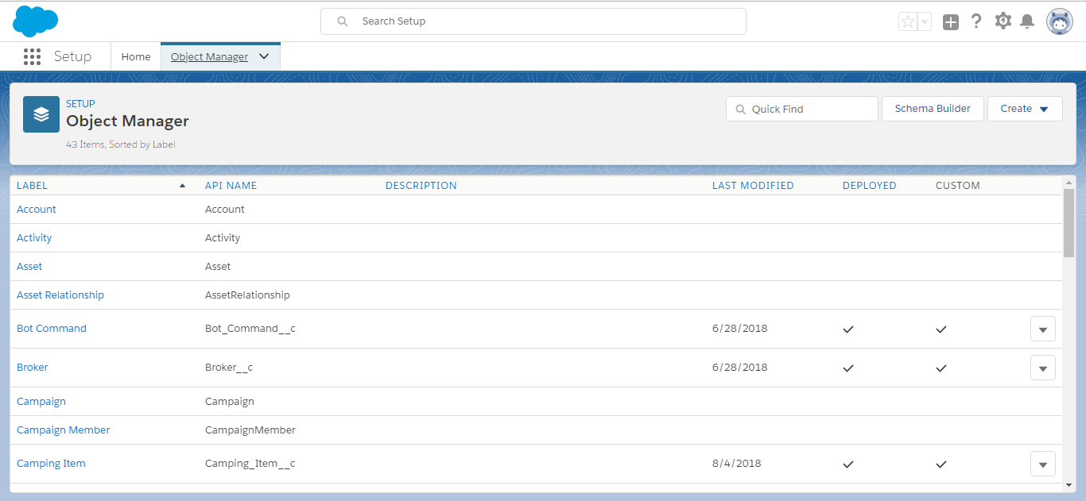
Org Setup

Slide 8
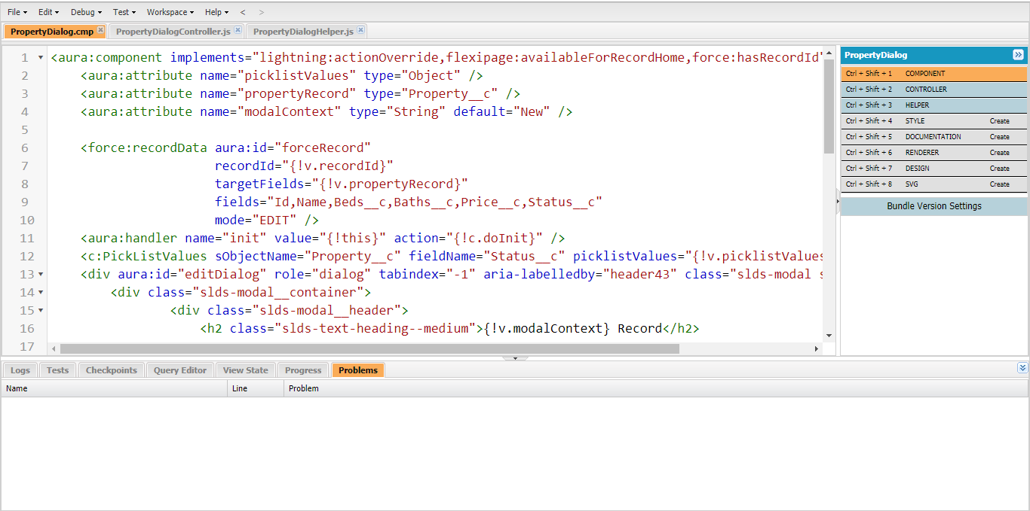
Developer Console

Slide 9
Implementation
Environment Configuration
Administrative Schema & Structural setup(Metadata)
Automated Business process configuration(Declarative)
Business data-Import & Export
Custom process actions(Triggers)
Custom User Interfacing
Customized Controlling & Testing
Interacting with data on Salesforce
Security and deployment

Slide 10
Environment Configuration
Setting up users
Security Profiles
Employee communication
Org defaults
Domain Settings
Session settings
Production vs. Sandbox orgs

Slide 11
Administrative Schema & Structural Setup
Setting up the Metadata
Custom Apps
Custom objects and fields
Relationship mappings
Object validations
Object access settings
Navigation bar
Record types on objects
Page & Compact layouts

Slide 12
Declarative Automation & Configuration
Email templates
Process Automation
Cloud Flow design
Approvals
Workflow Rules
Reports & Dashboards
Permission sets

Slide 13
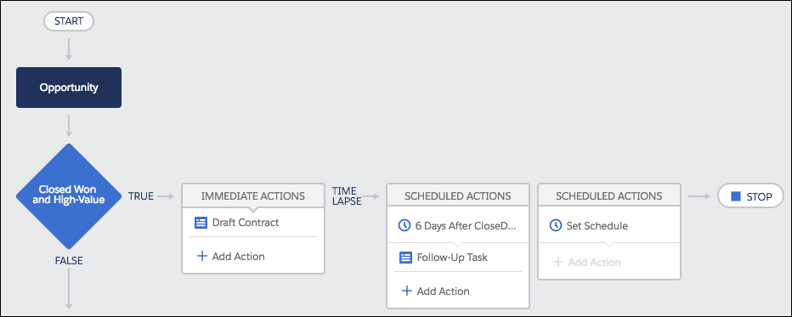
Process Automation

Slide 14
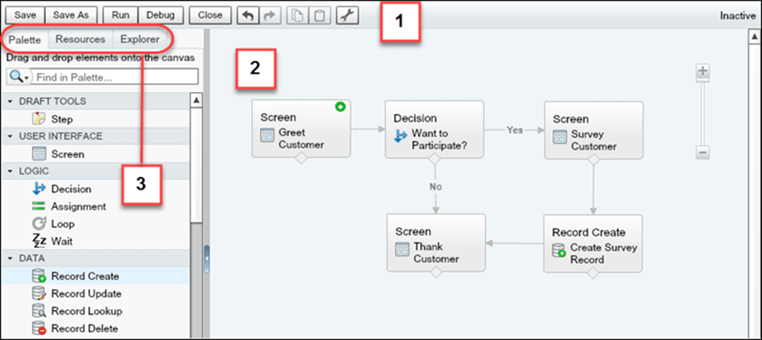
Cloud Flow setup

Slide 15
Data Management
Import & Export
.CSV Files
Salesforce Wizards
SFDC Dataloader
AppExchange apps
Dataloader.io

Slide 16
Complex Automation & Quick Actions
Customization is vital
Triggers
Written in Apex
Based on an object
Code action timing
Quick Actions

Slide 17
User Interface
Visualforce Pages(Analogy - HTML)
VF Components & Tags
Static Resources
Standard Controllers
Custom Controllers & List Controllers
Working (Multi-page Web App)
Standard Client Server Working
VF Page action on Client
Apex Controller Processing on server
New VF page rendered as per process

Slide 18
Controller Processing & Testing
Apex Classes (Analogy – Java)
Backend Handling
Data manipulation
Getter & Setter Methods
Static Methods
API Calls
Data Interaction
Testing
Test Runs
Minimum Coverage – 75%

Slide 19
SFDC Data Interaction
DML
insert, upsert, update, delete, merge
SOQL(Analogy - SQL)
Object based query
Standard working
SELECT FROM WHERE ORDERBY
SOSL
Search Language
Uses Salesforce org search index
Text based Search
Fuzzy parameters work
Returns Multiple objects
FIND IN RETURNING (WHERE)

Slide 20
Security & Deployment
Security
Two factor authentication
Single sing-on
SFDC Authenticator App
Deployment
Change Sets – Sandbox to production
Ant Migration – Org to local machine

Slide 21
Classic & Lightning Experience
Classic Salesforce
Lightning Development
Single Page Apps
Interactive UI
Lightning Components(js Controllers)
Apex Controllers
Lightning Design System

Slide 22
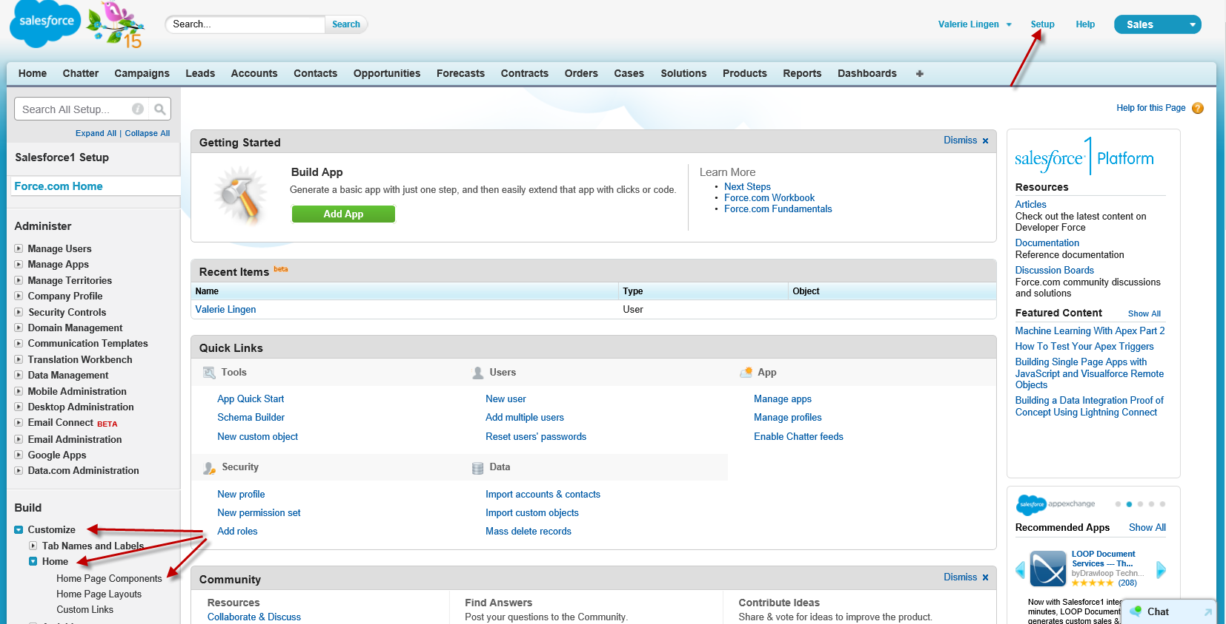
Classic

Slide 23
Lightning Components
Bundle
Component Markup
Controller .js
Style .css
Helper .js
Documentation
Nested Components
Component communication - Events

Slide 24
App Exchange
The App Store for Salesforce
Partners develop useful plug-ins and apps
Managed & Unmanaged Packages
Security Testing by Salesforce
Demos and trial periods
Licensing

Slide 25
Various feature Clouds
Sales & Service
Marketing
Commerce Cloud
IoT Connect
Einstein Analytics

