Slide 1
Assignment-2
Created by-
Parnita Kulkarni

Slide 2
Assignments
1 - Practice one java file and executing it.
2 – Differences
a – Object Oriented and Object Based
b – Compiler and interpreter
c - Encapsulation and abstraction
3 – Different Number system – Binary, Octal, Decimal ,Hexadecimal
4 – 12 , 12 , 12 , 12 - 360,
5 – You have to write this table 3 time on notebook

Slide 3
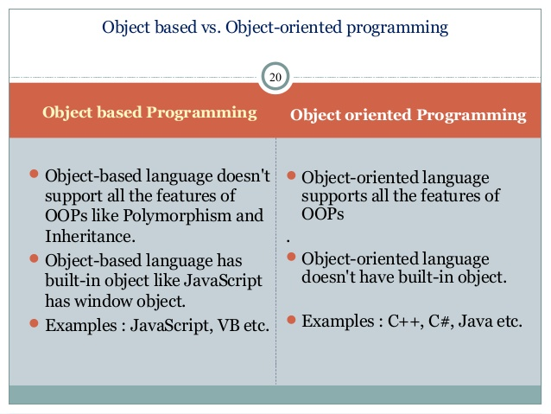

Slide 4
BASIS FOR COMPARISON | COMPILER | INTERPRETER
Input | It takes an entire program at a time. | It takes a single line of code or instruction at a time.
Output | It generates intermediate object code. | It does not produce any intermediate object code.
Working mechanism | The compilation is done before execution. | Compilation and execution take place simultaneously.
Speed | Comparatively faster | Slower
Memory | Memory requirement is more due to the creation of object code. | It requires less memory as it does not create intermediate object code.
Errors | Display all errors after compilation, all at the same time. | Displays error of each line one by one.
Error detection | Difficult | Easier comparatively

Slide 5
ABSTRACTION | ENCAPSULATION
Abstraction is the process or method of gaining the information. | While encapsulation is the process or method to contain the information.
In abstraction, problems are solved at the design or interface level. | While in encapsulation, problems are solved at the implementation level.
Abstraction is the method of hiding the unwanted information. | Whereas encapsulation is a method to hide the data in a single entity or unit along with a method to protect information from outside.
We can implement abstraction using abstract class and interfaces. | Whereas encapsulation can be implemented using by access modifier i.e. private, protected and public.
In abstraction, implementation complexities are hidden using abstract classes and interfaces. | While in encapsulation, the data is hidden using methods of getters and setters.
The objects that help to perform abstraction are encapsulated. | Whereas the objects that result in encapsulation need not be abstracted.

Slide 6
Number systems are the technique to represent numbers in the computer system architecture, every value that you are saving or getting into/from computer memory has a defined number system.
Computer architecture supports following number systems.
Binary number system
Octal number system
Decimal number system
Hexadecimal (hex) number system
1) Binary Number System
A Binary number system has only two digits that are 0 and 1. Every number (value) represents with 0 and 1 in this number system. The base of binary number system is 2, because it has only two digits.
2) Octal number system
Octal number system has only eight (8) digits from 0 to 7. Every number (value) represents with 0,1,2,3,4,5,6 and 7 in this number system. The base of octal number system is 8, because it has only 8 digits.
3) Decimal number system
Decimal number system has only ten (10) digits from 0 to 9. Every number (value) represents with 0,1,2,3,4,5,6, 7,8 and 9 in this number system. The base of decimal number system is 10, because it has only 10 digits.
4) Hexadecimal number system
A Hexadecimal number system has sixteen (16) alphanumeric values from 0 to 9 and A to F. Every number (value) represents with 0,1,2,3,4,5,6, 7,8,9,A,B,C,D,E and F in this number system. The base of hexadecimal number system is 16, because it has 16 alphanumeric values. Here A is 10, B is 11, C is 12, D is 13, E is 14 and F is 15.
Table of the Numbers Systems with Base, Used Digits, Representation, C language representation:

Slide 7
Number system | Base | Used digits | Example | C Language assignment
Binary | 2 | 0,1 | (11110000)₂ | int val=0b11110000;
Octal | 8 | 0,1,2,3,4,5,6,7 | (360)₈ | int val=0360;
Decimal | 10 | 0,1,2,3,4,5,6,7,8,9 | (240)₁₀ | int val=240;
Hexadecimal | 16 | 0,1,2,3,4,5,6,7,8,9, A,B,C,D,E,F | (F0)₁₆ | int val=0xF0;

Slide 8
Basic Data Types
Data Type name | Values covered | Memory Required
byte |  | 1 byte – 8 bits
short |  | 2 byte – 16 bits
int |  | 4 byte – 32 bits
long |  | 8 byte – 64 bits
float |  | 4 bytes = 32 bits
double |  | 8 bytes – 64 bits
char |  | 1 byte (ASCII) 2 byte (Unicode)
boolean |  | 1 bit

