Slide 1
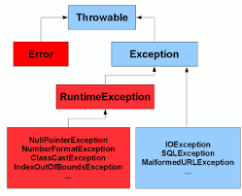

Slide 2
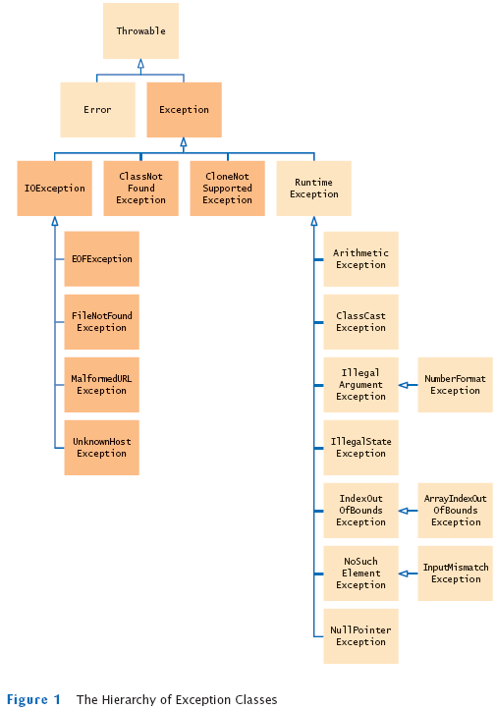

Slide 3
Compile Time Exception
Throws enforce us to handle exception ,otherwise it wont compile , if there isn't throws exception may occur at runtime , which we may not aware in advance

Slide 4
Collection
We need to deal with dynamic number of elements
List – ordered collection
Set
Queue
Map

Slide 5
List
Set
Map
Ordered Collection
Duplicates are allowed
Multiple null allowed
Cannot sort
Duplicates not are allowed
one null allowed
Set don’t have index
Key-Value pair
Dictionary
Non duplicate key
Value can be duplicate
rice
Bread
Jam
Xyz
Abc
Rice
Null
Name=“test”
Age = 20
1
2
4
6
3

Slide 6
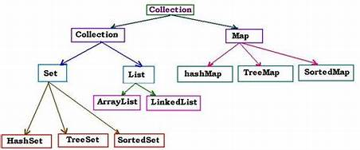

Slide 7
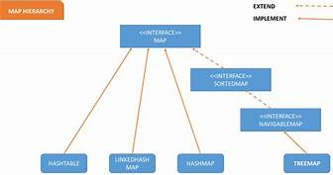

Slide 8
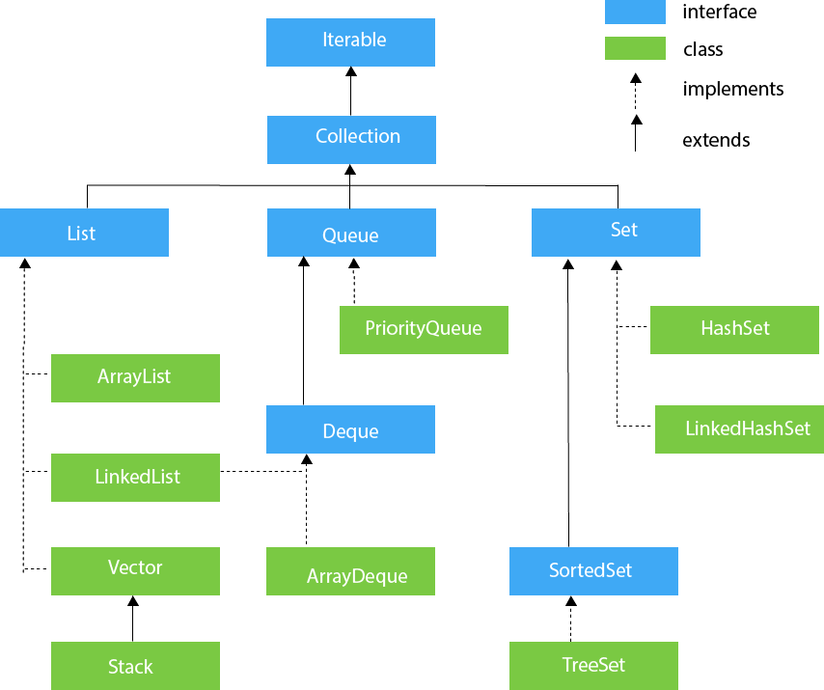

Slide 9
Array List
Linked List
0
0
1
1
2
2
3
3
3
4
4
Why we called it array List?

Slide 10
Assignment
List Set and Map
ArrayList and Linked List
HashSet, LinkedHashSet and TreeSet
HashMap, LinkedHashMap, TreeMap and HashTable
Iterator – ListIterator

