Slide 1
Session2

Slide 2
Topics to cover
JDK?
JRE?
How java works?
What is OOPS
Basic intro to OOPS
Data type – basic

Slide 3
Why java is platform independent
Uses a process to execute its code
Whether my java code is correct or not
Syntax wise
Compilation
Javac.exe
Java Virtual Machine
Java Code
byte code
Interpreted
Java.exe
Executing the Code
Java Runtime Environment
(JRE)
Java Development KIT (JDK)

Slide 4
How to Execute one java file
Compile the code (javac <FILENAME with extension>)
Executing the code (java <ClassName>)

Slide 5
Java is a OOPS language
Object + Oriented + languages
Object –
state and behaviour
Car – Tyre of car + Gears + seats + acclr + headlights
Object name | State | Property
Car | Color, Length, Height | Driving, acclr, braking
Tyre of car | Radius, Color, material | Rotation, helps car to move
Gears | Shape, color etc | Help car to move

Slide 6
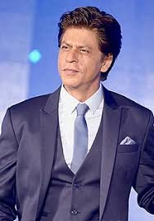
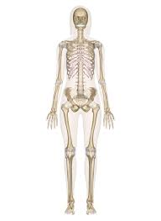
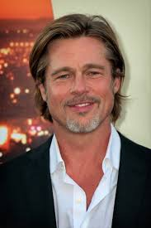
Class
Name - Shahrukh
Height – 5.9
Weight - 80
Color – black
Occupation( - actor)
Class Human
Name
Height
Weight
Color
Occupation()
Name – Brad Pitt
Height – 5.7
Weight - 70
Color - white
Occupation( - actor)

Slide 7
TestSuite
TestStep
TestCase
TestSuite

Slide 8
4 concepts in OOPS
Encapsulation – process of wrapping code in term of security and arrangement
Polymorphism – poly morphic nature of object
Inheritance – properties of parent automatic comes to child
Abstraction – hiding complex code and shows functionality only.

Slide 9
Basic Data Types
Data Type name | Values covered | Memory Required
byte |  | 1 byte – 8 bits
short |  | 2 byte – 16 bits
int |  | 4 byte – 32 bits
long |  | 8 byte – 64 bits
float |  | 4 bytes = 32 bits
double |  | 8 bytes – 64 bits
char |  | 1 byte (ASCII) 2 byte (Unicode)
boolean |  | 1 bit

Slide 10
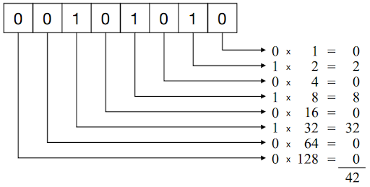
1
1
1
1
0
0
42 = 101010
58 = 111010
58 – 32 = 26
26 -16 = 10
10 -8 = 2

Slide 11
Assignments
1 - Practice one java file and executing it.
2 – Differences
a – Object Oriented and Object Based
b – Compiler and interpreter
c - Encapsulation and abstraction
3 – Different Number system – Binary, Octal, Decimal ,Hexadecimal
4 – 12 , 12 , 12 , 12 - 360,
5 – You have to write this table 3 time on notebook

