Slide 1
Session-4

Slide 2
Keyword
Predefined logical meaning
Variables
First letter cannot be a number. It can be A-Za-z$_
We cannot use any keyword as a variable.

Slide 3
Blocking language
Java compiler talk in terms of { }
Semi color ; is mandatory after every instruction.

Slide 4
Byte, short, int, long
number system - Decimal
// if we add 0 then it became octal
// if we add 0X then hexadecimal
System.out.println(i);
byte bt = 12_1;
int j = 34_5;
long lng = 237_3_2_4_7_8_2_73l;
System.out.println(lng);
System.out.println(bt);
All number are cyclic in nature
0
16 bits= 2 power 16
127
-128

Slide 5
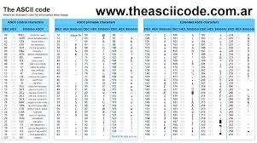

Slide 6
Bitwise & Logical Operators
Bitwise - &, I
Logical - &&, ||
A | B | A & B | A | B
True | True | True | True
True | False | False | True
False | True | False | True
False | False | False | False

Slide 7
Assignment
Write about obfuscation?
How many keyword are available in java? At-least 10 keyword
Write ranges of datatype
Is Floating datatype follow cyclic nature or not?
Write the difference between logical and bitwise operator
Write Swapping code in java
Which increment is faster , (post or pre) why?
What is the difference between while, do while and for loop
Write a code to print sum of all digits ,
123 = 1 +2 +3 = 6
456 = 4 + 5 + 6 = 15

