Slide 1
Session - 6

Slide 2
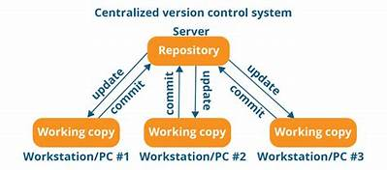
GIT - Introduction
Distributed Version Controlling Tool
a) Data redundancy and replication
b) High availability
c) Only one.git directory per repository
d) Superior disk utilization and network performance
e) Collaboration friendly
f) Any sort of projects can use GIT

Slide 3
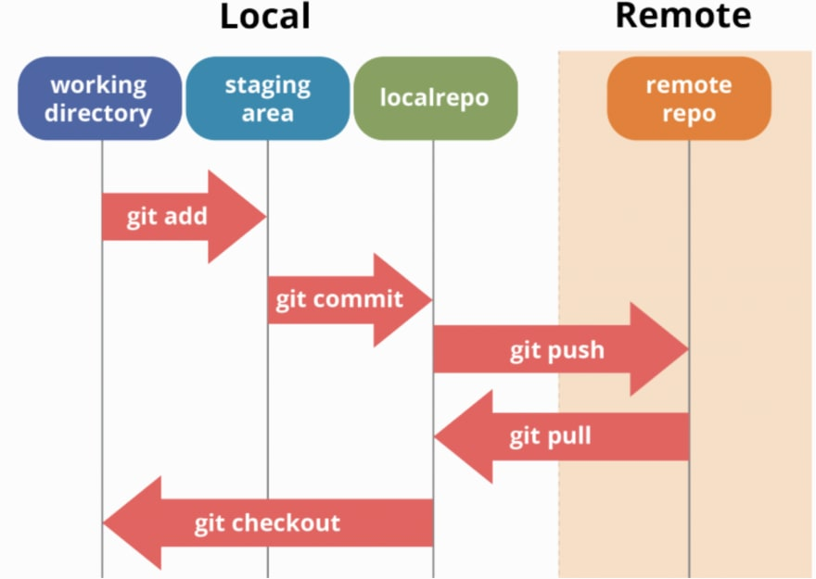
GIT
1
2
3

Slide 4
Commands
git –version
bitbucket, stash, github
Git clone <Remote repo url>
git add –all
git commit –m “initial commit”
Git log

