Slide 1
Session 7

Slide 3
Human h1 = new Human();
Name= ankit
age
h1
Name = pooja
age
country
h2
Name = dipak
age
h3

Slide 4
Memory Management in java?
Stack – Last in First Out (LIFO)
Queue – First in First OUT (FIFO)
List – index bases
Graph – edges and vertices
Tree – child, parent
Heap -
h3
h2
h3
h1
h2
h1

Slide 5
Heap
h2
h1
Object
Hash
Algorithm

Slide 6
Garbage Collector
It delete/ clear all those objects whose ref is not available
Automatic call to gc()
System.gc(); // when we want to run garbage collection manually

Slide 7
Constructor
instantiation
construction
A obj = new A()
Reference
Object creation
Assignment operator
new keyword will always called when java creating objects.
Contractor – method except 3 things
1 – return type – non metioned
2 – constructor name – always same as Class name
3 – constructor only calls once in object life time.
Every class has a default constructor. But if we create any explicit constructor then default is not available.

Slide 8
Method Overloading
Same method name but different params type or count
Compile time Polymorphism

Slide 9
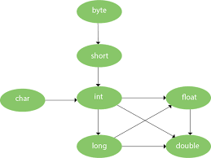
Type Promotion

Slide 10
Assignment
varargs -> Various Arguments

