Slide 1
DiscoveryEngine: Analyzing First Impression Bias
Jong Ha Lee and Vaibhav Ramamoorthy
UC Berkeley
March 04, 2018

Slide 2
Question: Are evaluators’ ratings affected by their first impressions of the research paper?
DiscoveryEngine’s data collection process prone to bias
Evaluators self-select which papers to read
Evaluations are conducted through a qualitative process
Readers determine their perceptions of papers from certain sections
Abstract is the most formative
How do we measure the effect of abstract on reader’s ratings?

Slide 3
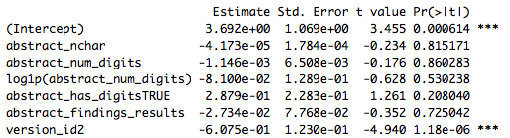

Methodology and Results
Linear regression with the following features
Number of characters in abstract
Number of digits in abstract
Count of words “findings” and “results”
Year of publication
*Version ID of evaluation form
*Expertise level of evaluator
Count of Discovery Value synonyms
Count of Actionability synonyms
Count of Confidence/Concreteness synonyms
Altmetric and *log(Altmetric)
Few of the abstract-specific features were significant in predicting any of the ratings
Exception: Abstracts with higher instances of the words “findings” and “results” received better confidence/concreteness scores
Little evidence that abstract-based bias caused Discovery scores to deviate from Altmetric

Slide 4
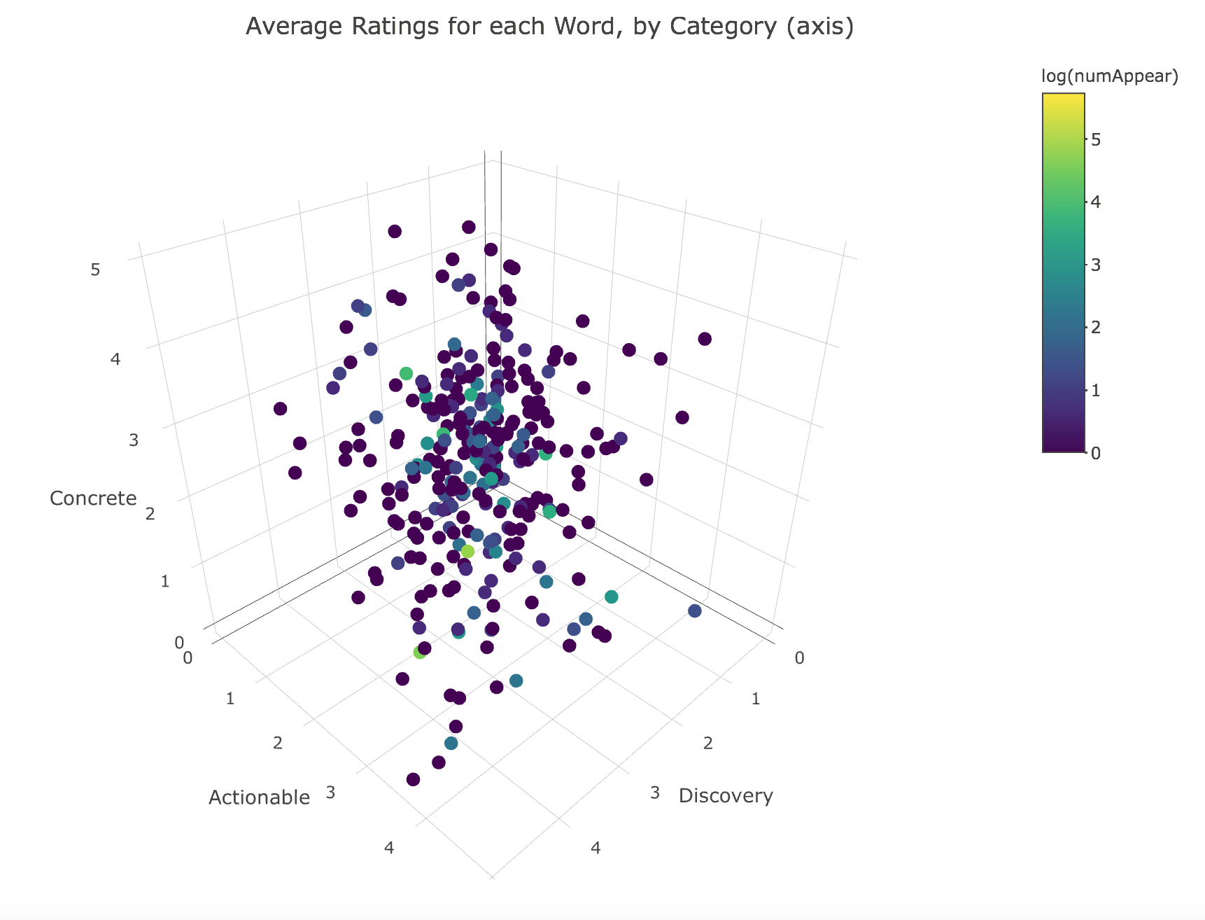

Slide 5
Conclusion and Impact
Explored possibility of first impressions on affecting DiscoverEngine’s ratings
Regression showed no significant impact of bias-related abstract metrics
Next Steps:
Include covariates regarding paper’s relevance to current research trends
Impact of authors’ reputation and pedigree on evaluator’s ratings

