Slide 1

Efficient Graph-Based Solution for the Travelling Salesman Problem with Apache Giraph and Hadoop
Vaibhav Ramakrishnan

Slide 2
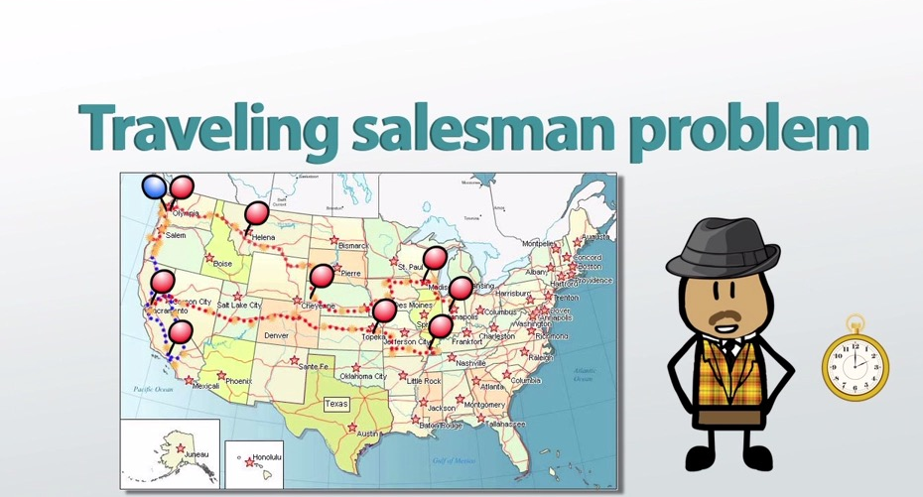
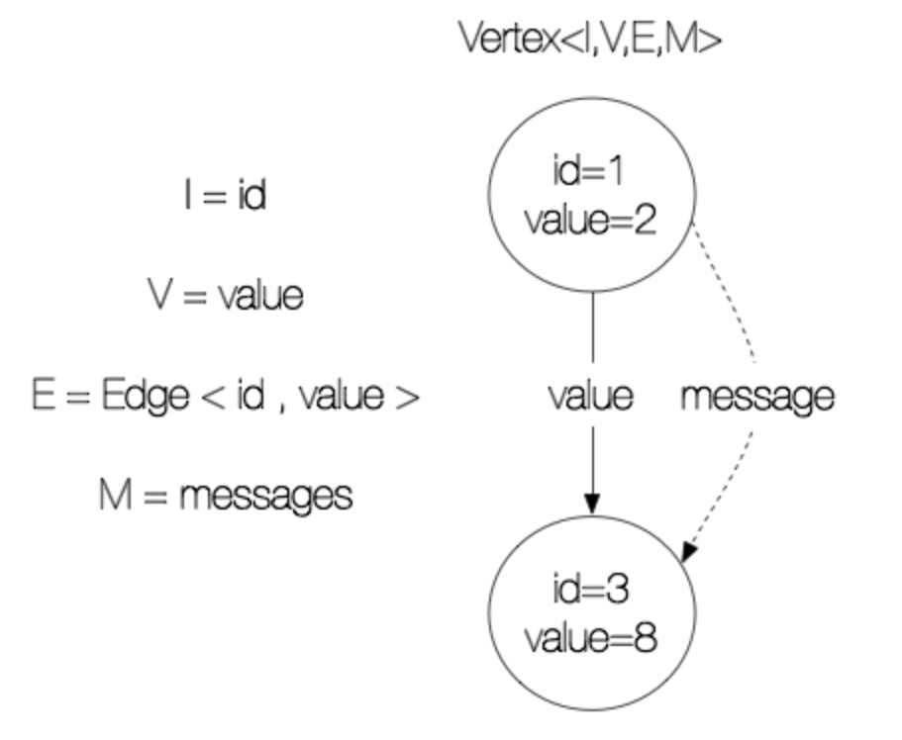
Project Overview
The objective of Travelling Salesman Problem (TSP) is to determine the most efficient route that visits multiple
cities exactly once and returns to the starting city, thereby minimizing the total distance travelled.
To implement TSP, we have used Apache Giraph in conjunction with Apache Hadoop.
Apache Giraph is an open-source graph processing system that is built on Apache Hadoop.
Giraph is designed to process graphs at scale and can handle complex graph algorithms, including TSP.
Hadoop provides a distributed storage and processing framework that allows Giraph to operate on large graphs
across multiple nodes. By using Giraph with Hadoop, we can efficiently solve TSP and other graph-based problems.
In this project, we installed Java, Hadoop, and Giraph, configured them properly, and implemented TSP using a GitHub repository.
We then ran the Giraph JAR command to obtain the results
Fig.1 – Animation of the TSP
Fig. 2 – Basic vision of the vertexes from Giraph

Slide 3
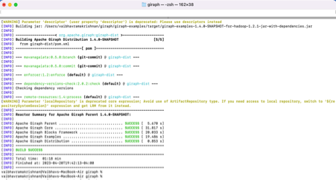
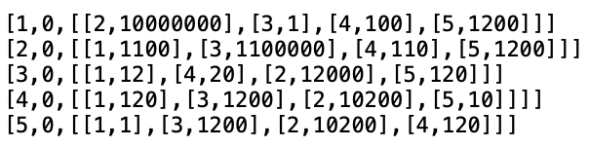
Implementation
Installed Java 1.8, Hadoop 1.2.1, and Apache Giraph 1.4.
Configured Hadoop and Giraph settings.
Downloaded TSP.java and input file from GitHub repository.
Compiled using maven and Giraph JAR files.
The input file contained a list of vertices and their corresponding edges and edge weights in the graph format.
The edges between the vertices represented the distance between two cities.
The output file contained the minimum distance and the order in which the cities were visited to achieve it.
Fig. 3 – Input file contents from GitHub repository
Fig. 4 – Successful Maven compilation

Slide 4
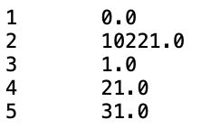
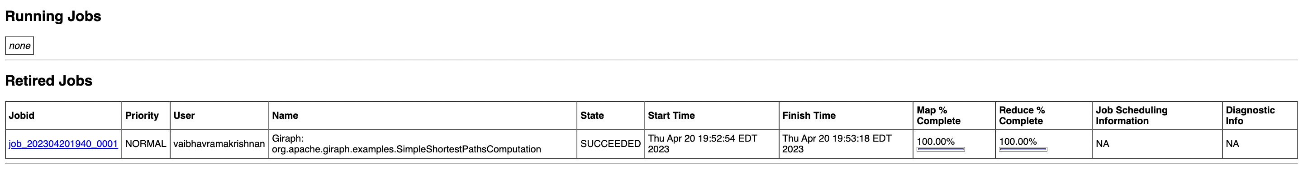
Summary of Results
The results show that the algorithm was able to successfully find the most efficient route that visits multiple cities exactly once and returns to the starting city, thereby minimizing the total distance traveled. Look at Fig. 5 for the detailed output.
Each line represents a vertex and the estimated distance between it and the rest of the graph's vertices.
The line "1 0.0" represents, for example, the distance from vertex 1 to itself, which is 0.0. The line "2 10221.0" represents the 10221.0 distance between vertex 1 and vertex 2. Similarly, the line "3 1.0" depicts the 1.0 distance between vertex 1 and vertex 3. The remaining lines in the graph represent the distances between vertex 1 and other vertices.
The output demonstrates the effectiveness of Apache Giraph and Hadoop in solving complex graph-based problems such as the Traveling Salesperson Problem.
Fig. 6 below shows the successful implementation of the algorithm on the JobTracker WebGui
Fig. 5 – Output from Travelling Salesman Problem Algorithm
Fig. 6 – JobTracker WebGui showing progress of our implementation

