Slide 1
Sales Insights and Performance Dashboard for NVIDIA
Vaibhav Ramakrishnan

Slide 2
North Star Metrics
1. Total Revenue Numbers: Overall revenue generated during the analysis period.
2. Sales Quantity Numbers: Total units sold.
3. Year-over-Year (YOY) Growth: Comparing sales performance with previous years.
4. Revenue Breakdown: Analysis by regions, products, and customer segments.
5. Revenue Trends: Insights into how revenue evolves over time.

Slide 3
Stakeholders Involved
1. Sales Director
2. Marketing Team
3. Customer Service Team
4. Data & Analytics Team
5. IT

Slide 4
Success Criteria & Insights
1. Dashboard uncovering sales order insights with the latest data available
2. Sales team able to make better decisions & prove cost savings of total spend
3. Sales Analysts stop data gathering manually in order to save business time and reinvest in value-added activity
4. Projected to boost quarterly revenue by 8.5% - through enhanced market penetration, and streamlining decision-making for 38 key customers

Slide 5
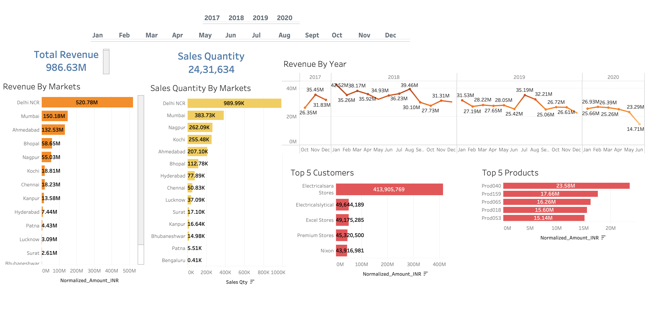
Tableau Dashboard

