Slide 1


Slide 2













USING AI FOR SENTIMENT ANALYSIS OF ONLINE CUSTOMER REVIEWS
Introduction & Background
Processing & Modelling
Neural Networks
Segmentation
AWS Deployment
Sentiment analysis is the process of determining the emotional tone behind a series of words, used to gain an understanding of the attitudes, opinions and emotions expressed within an online mention.
Large Volume of Customer Inputs
Actionable Insights and Business Intelligence
Social Media comments & posts
Customer Enquiries
SENTIMENT ANALYSIS
Improving Customer Service
Product Development Ideas
Monitoring Brand Perception
Reviews & UGC
Order Support enquiries
Market Research & Trends
Competitive Benchmarking
Real Time Response to problems
DATA
How can you mine vast stores of unstructured data to drive actionable insights
Booking.com customer reviews data – 1 MILLION ++ RECORDS
53% Negative review – 47% Positive Reviews
19 Million Words – 227 MB Data

Slide 3
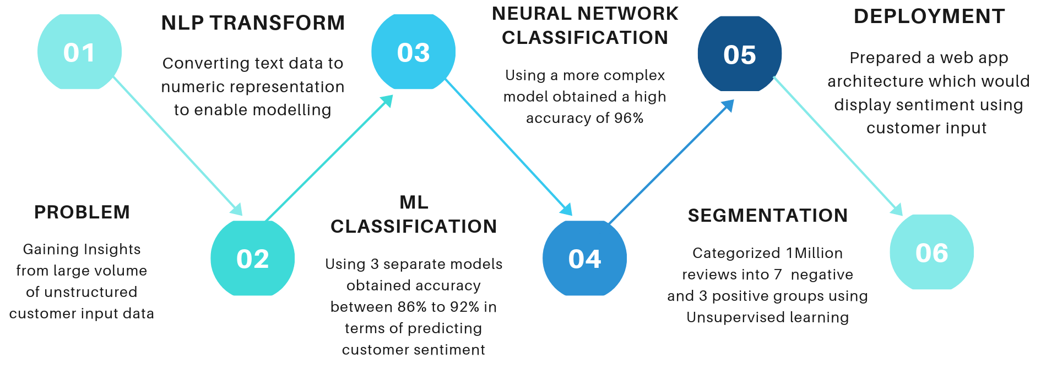
USING AI FOR SENTIMENT ANALYSIS OF ONLINE CUSTOMER REVIEWS
Introduction & Background
Processing & Modelling
Neural Networks
Segmentation
AWS Deployment
WORKFLOW AND APPROACH

Slide 4
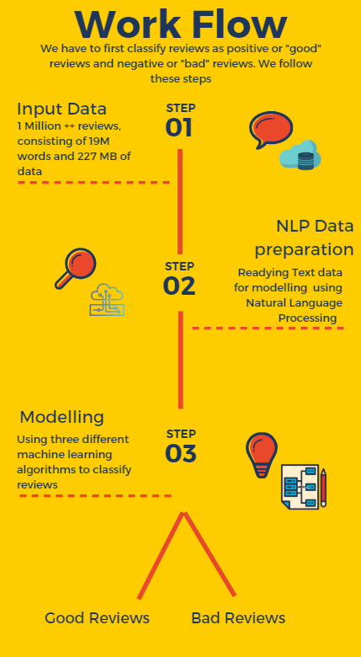
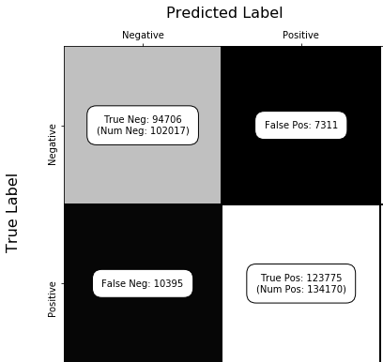
USING AI FOR SENTIMENT ANALYSIS OF ONLINE CUSTOMER REVIEWS
Introduction & Background
Processing & Modelling
Neural Networks
Segmentation
AWS Deployment
Accuracy, Complexity
NLP Methods -> | Uni-grams | Bi-grams | TF-IDF
Modelling Methods ↓
Logistic Regression | 92.2 | 86.6 | 92.0
Multi NB | 91.6 | 90.6 | 91.3
SVM | 92.5 | 86.4 | 92.4
Confusion Matrix for SVM - unigrams

Slide 5
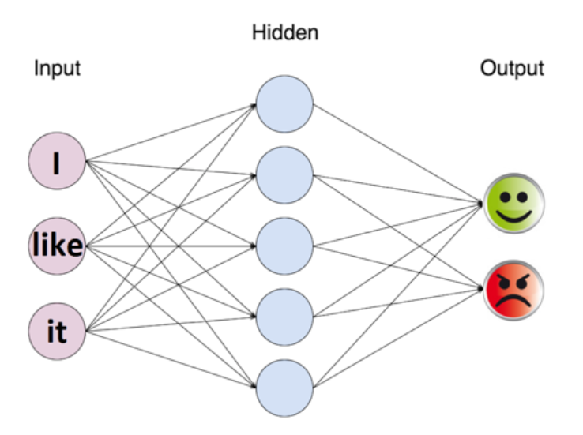
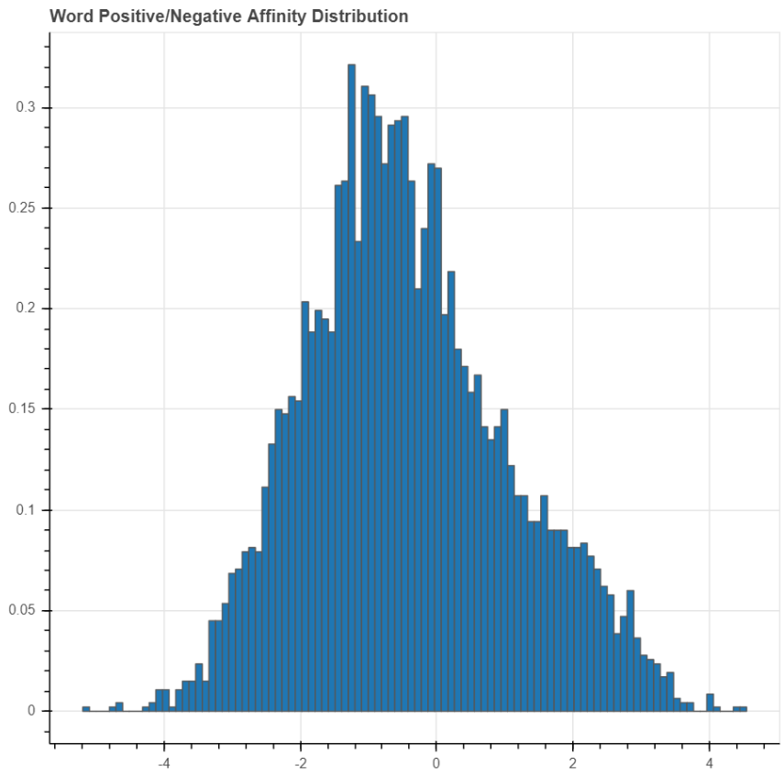
USING AI FOR SENTIMENT ANALYSIS OF ONLINE CUSTOMER REVIEWS
Introduction & Background
Processing & Modelling
Neural Networks
Segmentation
AWS Deployment
With ML Classification models we were getting an classification accuracy between 86% to 92%. We will now build a model, a Neural Network and try to get even higher prediction accuracy. A Neural Network "learns" recursively from the error and tries to minimize it with each iteration called an epoch.
Model Name | Number of Hidden Layers | Hidden Nodes | Train Accuracy | Test Accuracy | Time Taken
Feedforward Neural Network 1 | 1 | 10 | 97.5 | 96.1 | 8678 seconds
Feedforward Neural Network 2 | 1 | 10 | 97.2 | 95.9 | 215 seconds

Slide 6
USING AI FOR SENTIMENT ANALYSIS OF ONLINE CUSTOMER REVIEWS
Introduction & Background
Processing & Modelling
Neural Networks
Segmentation
AWS Deployment
After building predictive models to classify 1M reviews as positive or negative, we segmented them into broader categories
We used TF-IDF and Count-vectorizer NLP and LDA-LSA methods for creating the cluster
Category | Words used | Category | Words used
Room size | Small room, small size, small bed, small bathroom | Room Service | Poor room service, order service, order late
Wifi | poor wifi, wifi didn't work | Swimming Pool | swimming pool small, pool cold, sauna
Aircon | AC not working, hot air, hot room, room cold | Value for Money | poor value for money, expensive
Breakfast | Breakfast Expensive, Small Breakfast, Breakfast poor | Other Reasons
Category | Words used
Location | Great location, excellent location, near metro, near market
Staff | Staff friendly, staff helpful,
Rooms | Rooms clean, room tidy, room comfortable, bed comfortable
Other reasons

Slide 7
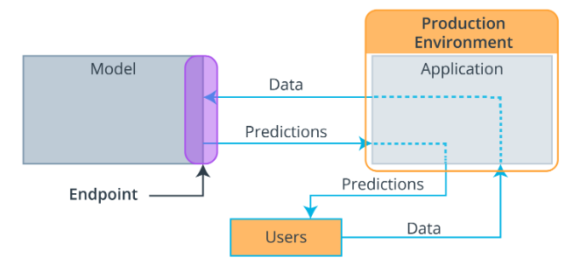
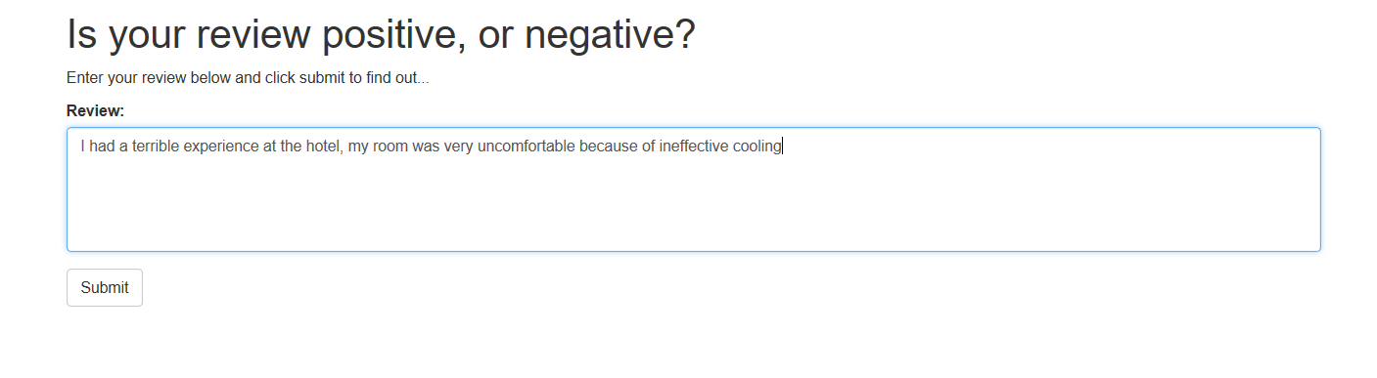
USING AI FOR SENTIMENT ANALYSIS OF ONLINE CUSTOMER REVIEWS
Introduction & Background
Processing & Modelling
Neural Networks
Segmentation
AWS Deployment
“Deployment to production is a method that integrates a machine learning model into an existing production environment so that the model can be used to make decisions or predictions based upon data input into the model.”
ARCHITECTURE
This architecture has been replicated on Amazon Web Services Sagemaker
The prediction is the lambda functions, the data is sent through an API
The model is our sagemaker notebook and the app is a web app
WEB APP
This simple web app sends information to the model using API and receives information from the model using the lamba function

Slide 8


Slide 9
Appendix Slides

