Slide 1
PostgreSQL in pgAdmin
SQL commands, constraints, filtering, functions, subqueries and table modification
Practice screenshots with concise definitions

Slide 2
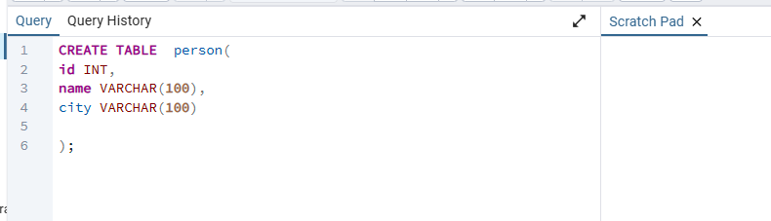
Creating a Table in PostgreSQL
DDL basics
CREATE TABLE
CREATE TABLE creates a new table and defines its columns and data types. Here, the person table contains id (INT), name (VARCHAR(100)), and city (VARCHAR(100)).

Slide 3
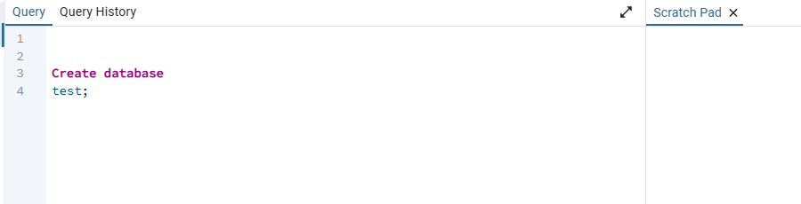
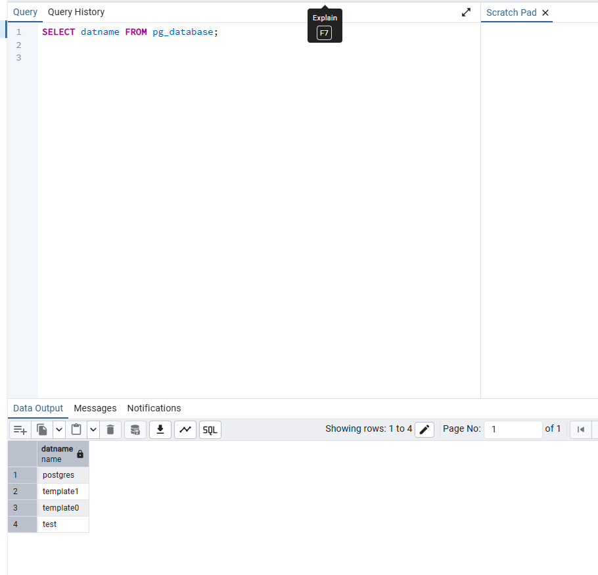
Database Management in PostgreSQL
Creating and viewing databases
Creating a Database
Listing Databases
CREATE DATABASE creates a new PostgreSQL database. The example creates a database named test.
SELECT datname FROM pg_database retrieves the names of databases available on the PostgreSQL server.

Slide 4
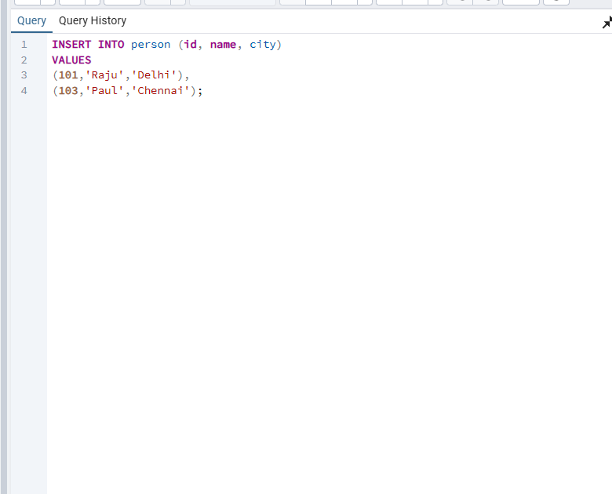
Inserting Data into a Table
DML basics
INSERT INTO
INSERT INTO adds new rows to an existing table. The example inserts multiple records into person by supplying values for id, name, and city.

Slide 5
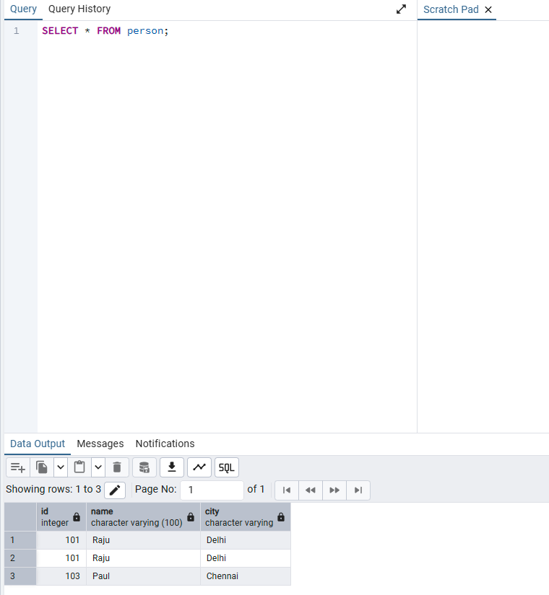
Retrieving Data Using SELECT
Selecting all columns
SELECT *
SELECT retrieves data from a table. The * symbol means all columns, so SELECT * FROM person returns every row and every column.

Slide 6
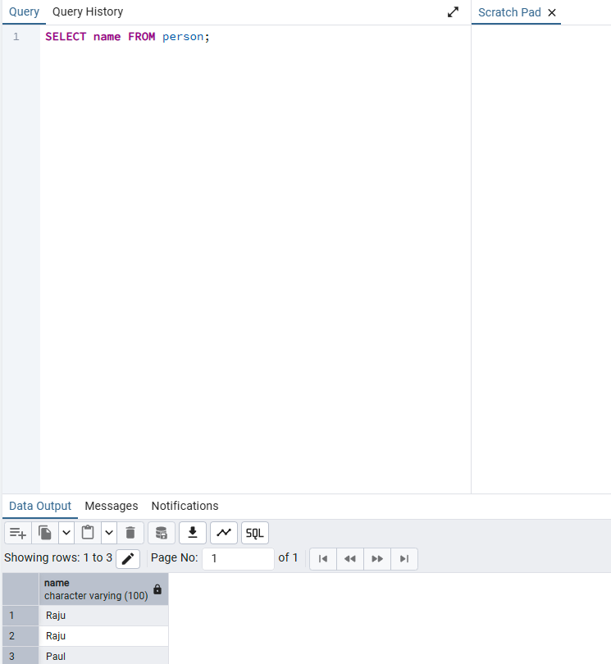
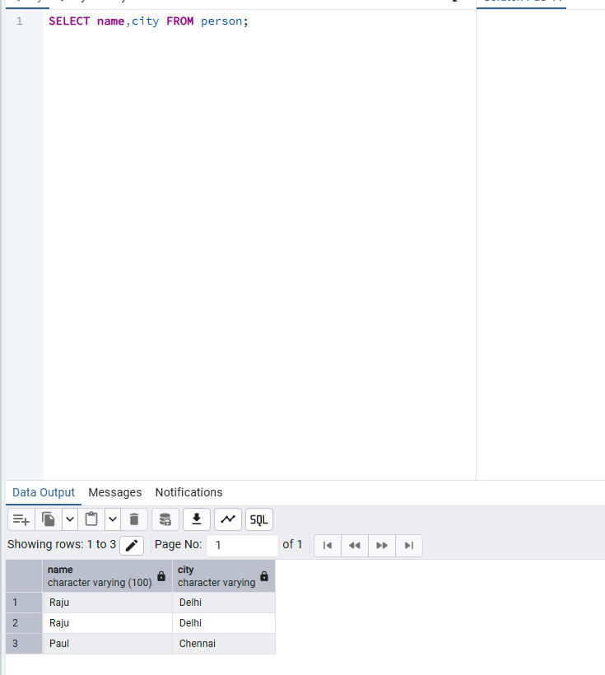
Retrieving Data Using SELECT
Selecting only required columns
One Specific Column
Multiple Specific Columns
SELECT name FROM person returns only the name column. Use this when the other columns are not required.
Separate column names with commas. SELECT name, city FROM person returns only those two columns.

Slide 7
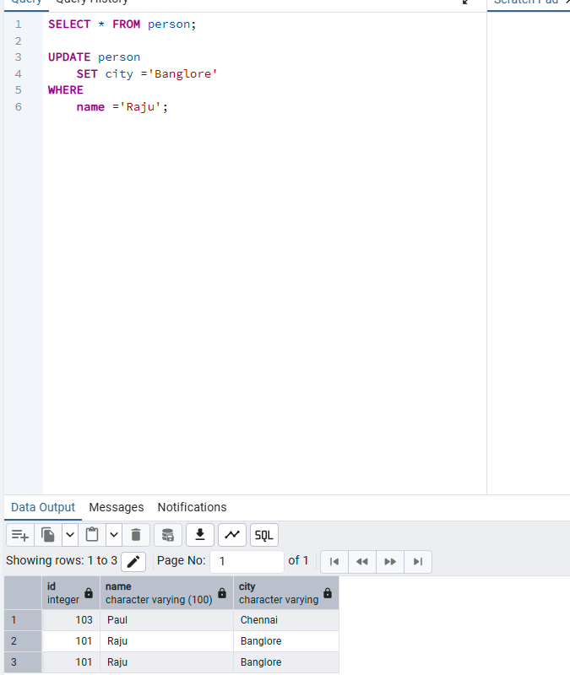
Updating Existing Data
Changing stored values
UPDATE + SET + WHERE
UPDATE modifies existing rows. SET specifies the new value and WHERE chooses the rows to change. Here, every row with name = Raju gets city = Banglore.

Slide 8
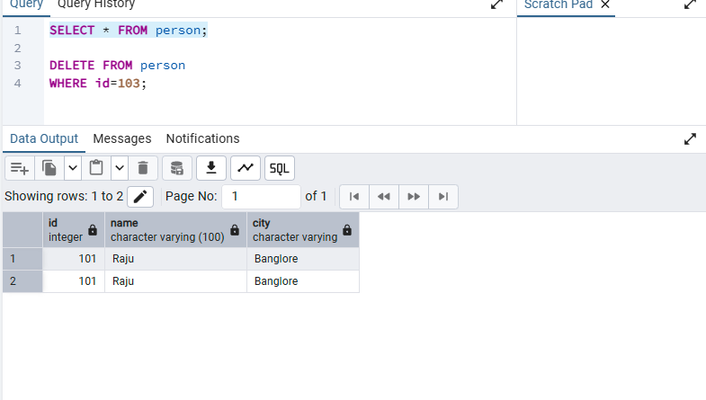
Deleting Existing Data
Removing selected rows
DELETE + WHERE
DELETE removes records from a table. WHERE limits the deletion to matching rows. Here, the row with id = 103 is removed.

Slide 9
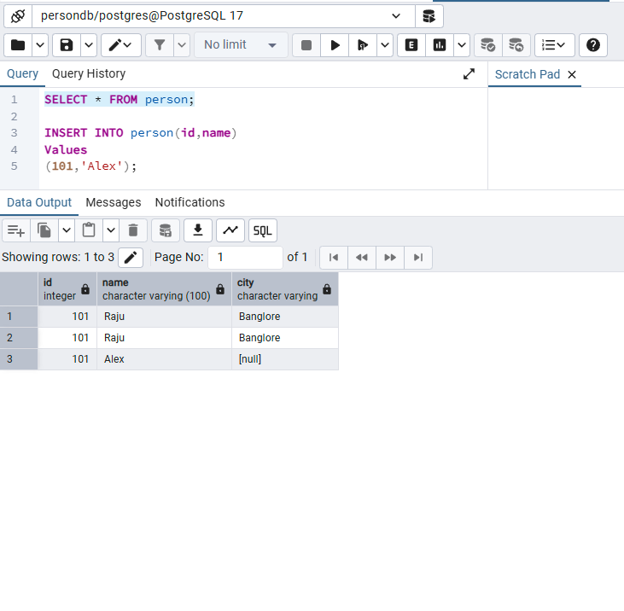
NULL Values in PostgreSQL
Missing or unknown data
NULL
NULL represents missing or unknown data. When city is omitted from the INSERT and no default exists, PostgreSQL stores NULL in city.

Slide 10
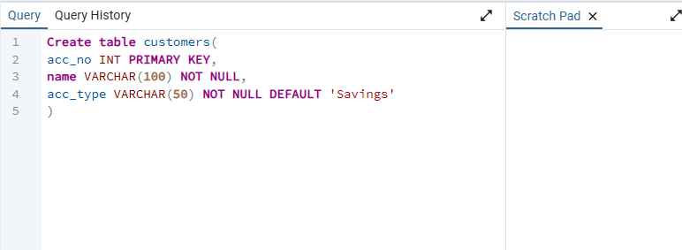
Constraints in PostgreSQL
Rules that protect data quality
PRIMARY KEY • NOT NULL • DEFAULT
PRIMARY KEY uniquely identifies each row and cannot be NULL. NOT NULL makes a value mandatory. DEFAULT supplies a predefined value when one is not provided.

Slide 11
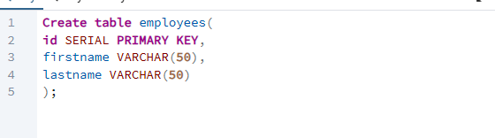
Auto-Incrementing Keys
Generating IDs automatically
SERIAL PRIMARY KEY
SERIAL automatically generates sequential integer values. Combined with PRIMARY KEY, it creates a convenient unique ID for each new row.

Slide 12
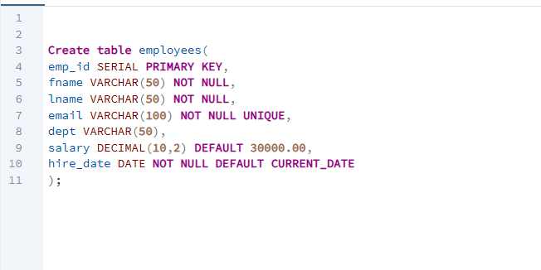
Employee Table with Multiple Constraints
Combining common table rules
Constraints and Defaults
This employees table combines SERIAL PRIMARY KEY, NOT NULL, UNIQUE, DECIMAL(10,2), DEFAULT salary, and DEFAULT CURRENT_DATE to enforce consistent employee data.

Slide 13
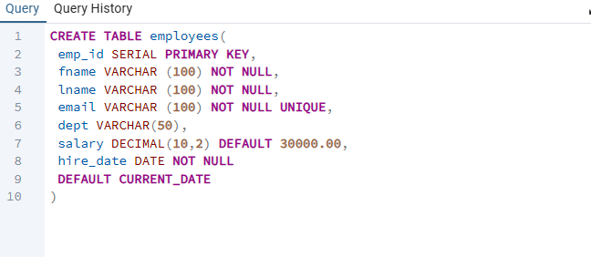
Employee Table Definition
A second view of the same design
Constraint Review
The table definition shows how multiple column rules can be declared directly inside CREATE TABLE. It reinforces mandatory names, unique emails, default salary, and automatic hire date.

Slide 14
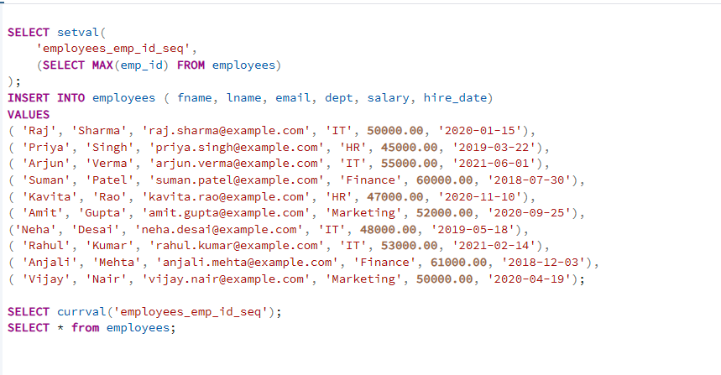
Managing a SERIAL Sequence
Synchronizing generated IDs
setval() + INSERT + currval()
setval() synchronizes the employees sequence with the current maximum emp_id. New rows then omit emp_id so SERIAL generates it. currval() checks the current sequence value.

Slide 15
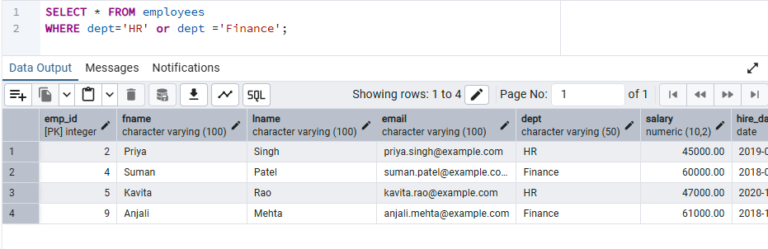
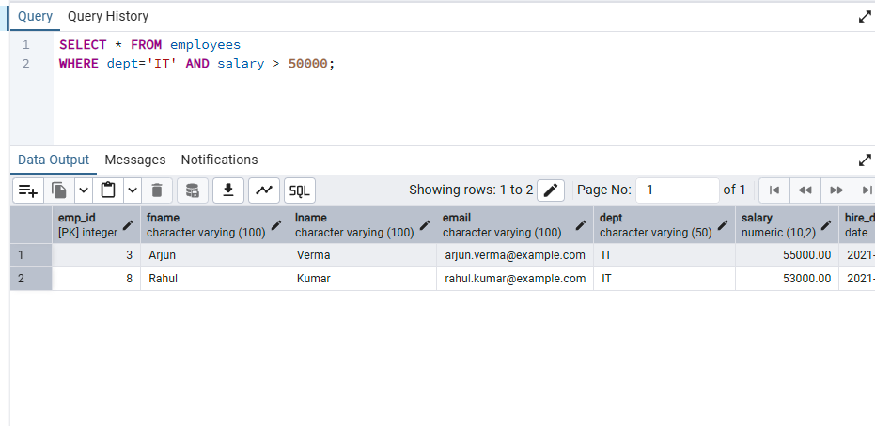
Filtering Data with WHERE
Logical conditions
OR Operator
AND Operator
OR returns a row when at least one condition is true. The example returns employees in HR or Finance.
AND requires all conditions to be true. The example returns IT employees whose salary is greater than 50,000.

Slide 16
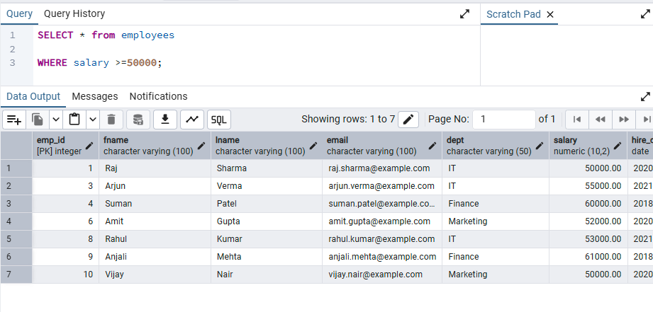
Filtering Numeric Values
Comparison operators
Greater Than or Equal To
WHERE salary >= 50000 returns employees earning 50,000 or more. Comparison operators can filter numeric, date, and other comparable values.

Slide 17
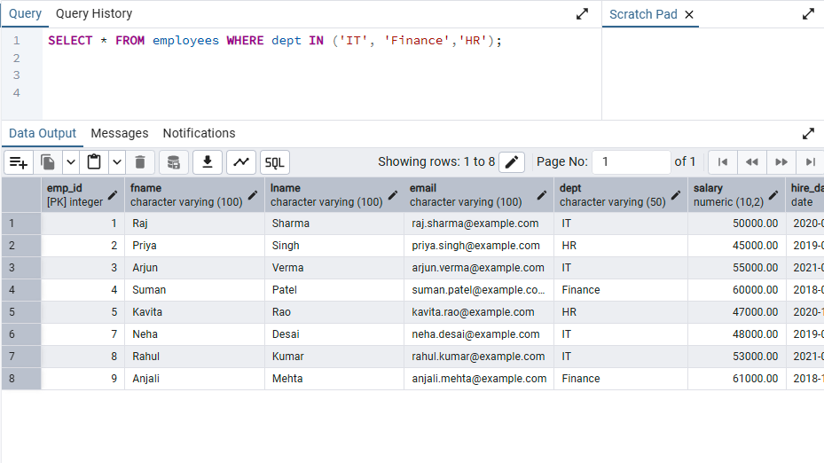
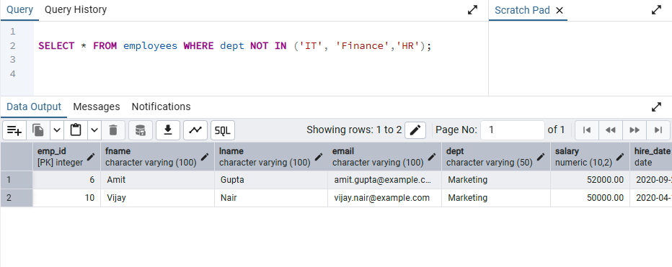
Filtering with Lists
IN and NOT IN
IN
NOT IN
IN checks whether a value matches any item in a list. It is a compact alternative to several OR conditions.
NOT IN excludes rows whose value matches any item in the list. Here, IT, Finance, and HR are excluded.

Slide 18
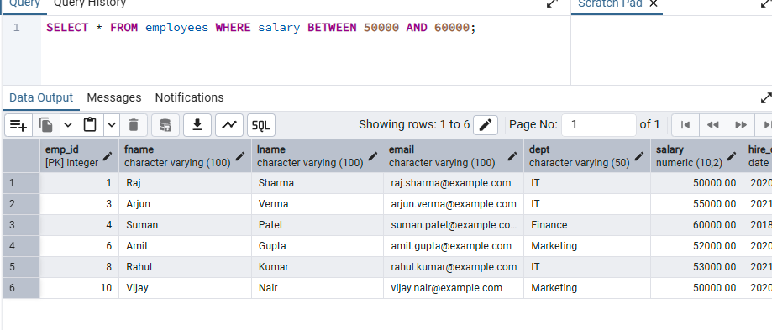
Filtering a Range
Inclusive boundaries
BETWEEN
BETWEEN selects values inside an inclusive range. salary BETWEEN 50000 AND 60000 means salary >= 50000 AND salary <= 60000.

Slide 19
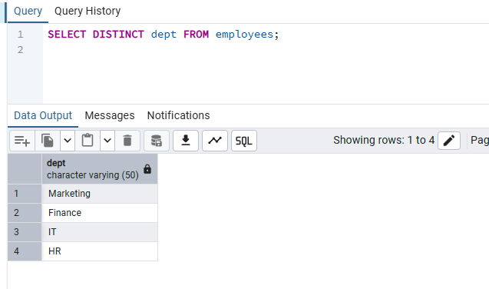
Removing Duplicate Results
Unique values only
DISTINCT
DISTINCT removes duplicate values from the result set. SELECT DISTINCT dept returns each department only once.

Slide 20
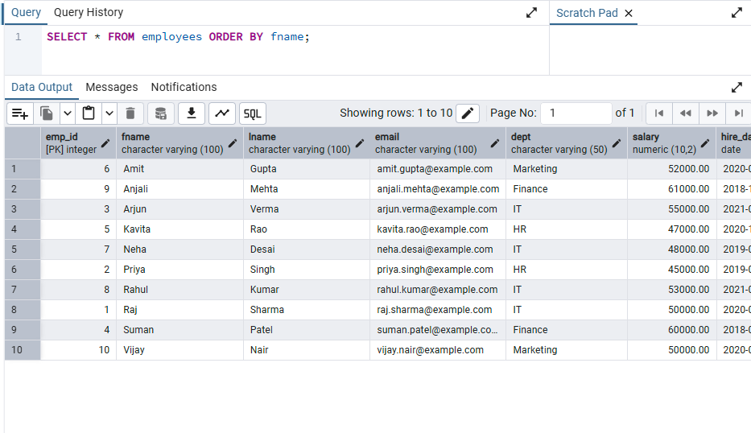
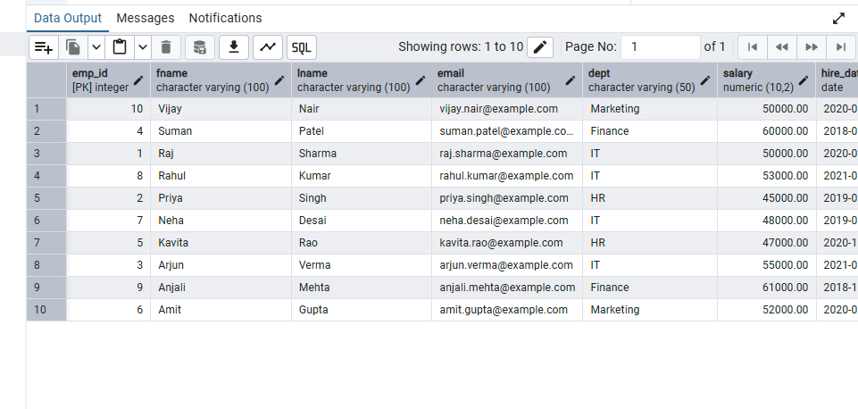
Sorting Data with ORDER BY
Ascending and descending order
Ascending Order
Descending Order
ORDER BY fname sorts first names alphabetically. ASC is the default, so it can be omitted.
DESC reverses the sort order. For text, names are arranged from Z to A.

Slide 21
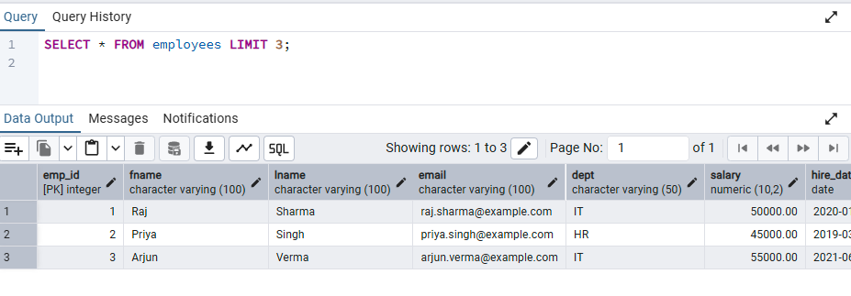
Limiting Query Results
Returning only a few rows
LIMIT
LIMIT restricts the maximum number of rows returned. SELECT * FROM employees LIMIT 3 returns only three rows.

Slide 22
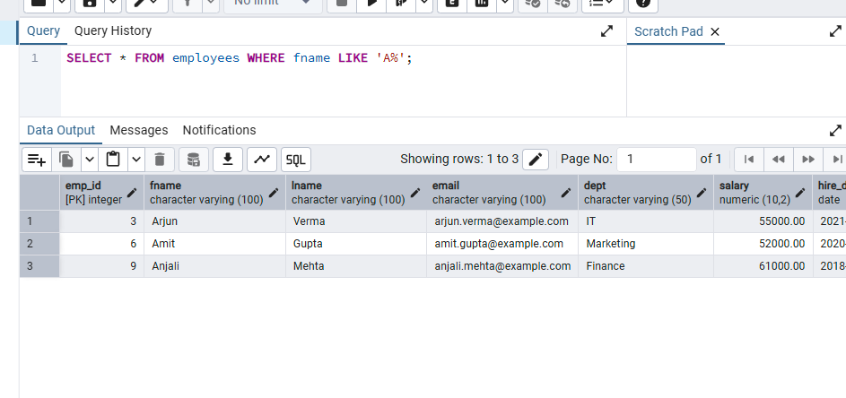
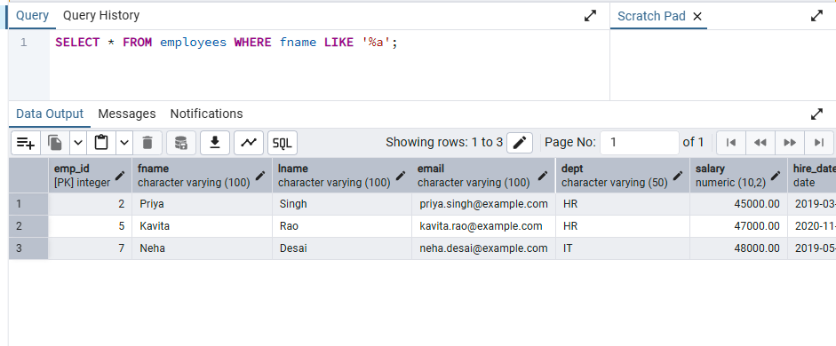
Pattern Matching with LIKE
Using the % wildcard
Starts With
Ends With
LIKE 'A%' finds values that begin with A. % represents zero or more characters after A.
LIKE '%a' finds values that end with a. % can represent any preceding characters.

Slide 23
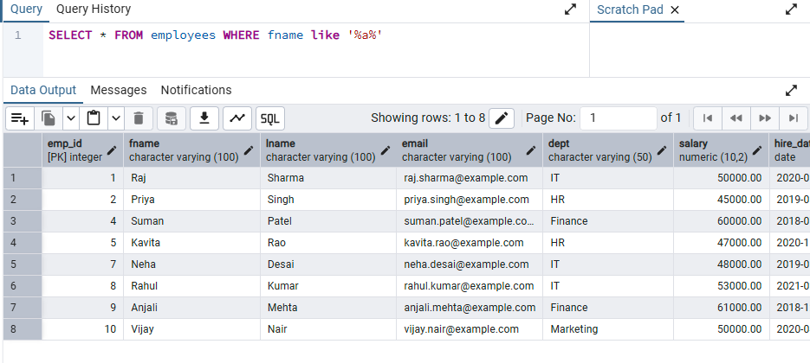
Pattern Matching with LIKE
Finding text anywhere
Contains Pattern
LIKE '%a%' finds values containing lowercase a anywhere in the text. The % wildcard is used on both sides.

Slide 24
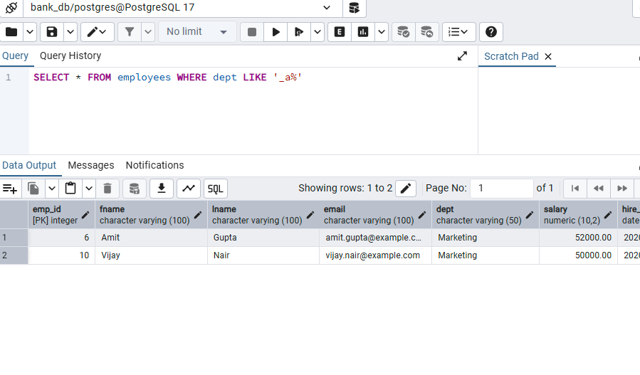
Pattern Matching with LIKE
Using the underscore wildcard
_ Wildcard
The underscore (_) represents exactly one character. dept LIKE '_a%' requires any first character, a as the second character, then any remaining text.

Slide 25
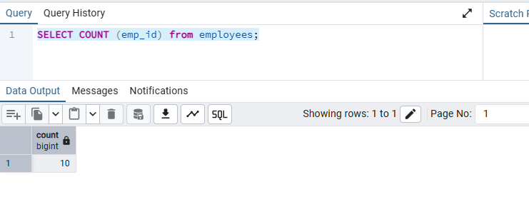
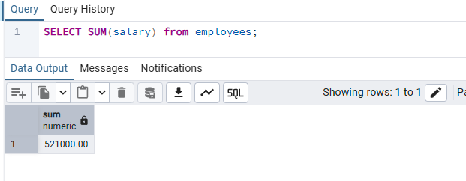
Aggregate Functions
Summarizing many rows
COUNT()
SUM()
COUNT(emp_id) counts non-NULL employee IDs. Because emp_id is a primary key, the result 10 means there are 10 employee records.
SUM(salary) adds all non-NULL salary values. The example returns a total salary of 521,000.

Slide 26
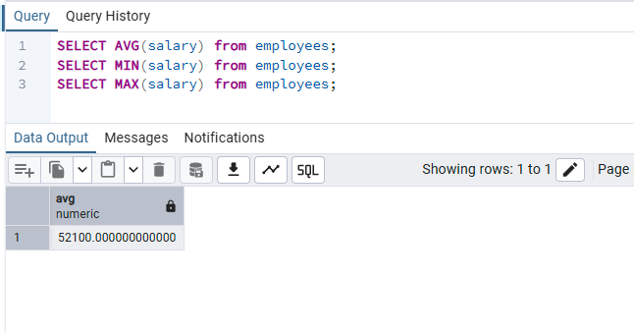
Aggregate Functions
Average, minimum and maximum
AVG() • MIN() • MAX()
AVG() calculates the average, MIN() finds the smallest value, and MAX() finds the largest value. The visible result shows AVG(salary) = 52,100.

Slide 27
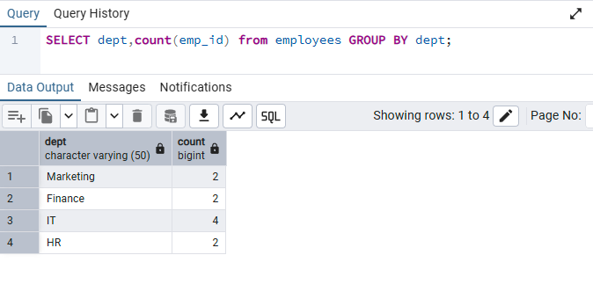
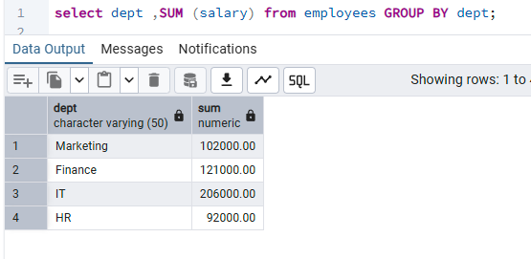
Grouping Data with GROUP BY
Aggregates per department
Count by Department
Salary Total by Department
GROUP BY dept forms one group per department. COUNT(emp_id) then calculates the number of employees in each group.
SUM(salary) with GROUP BY dept calculates a separate salary total for each department.

Slide 28
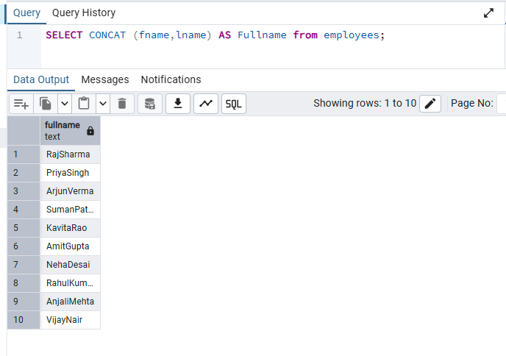
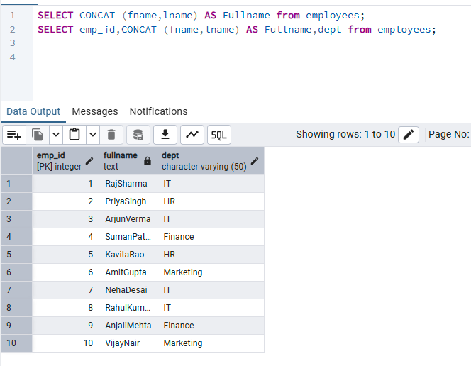
String Functions: CONCAT
Combining text values
CONCAT()
With Other Columns
CONCAT(fname, lname) joins first and last names into one string. AS Fullname gives the result column a temporary alias.
A calculated CONCAT result can be selected alongside normal columns such as emp_id and dept.

Slide 29
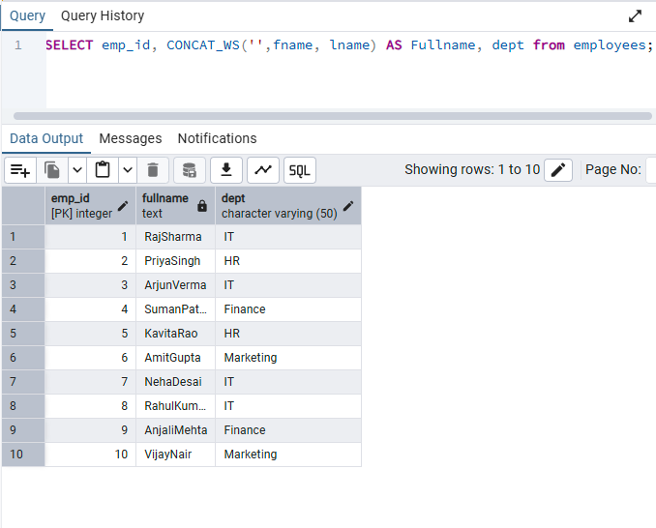
String Functions: CONCAT_WS
Concatenate with separator
CONCAT_WS()
CONCAT_WS(separator, ...) combines values while inserting a chosen separator. An empty separator joins the names directly; a space would produce Raj Sharma.

Slide 30
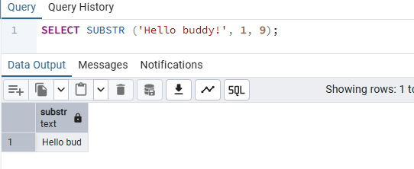
String Functions: SUBSTR
Extracting part of a string
SUBSTR()
SUBSTR(text, start, length) extracts part of a string. SUBSTR('Hello buddy!', 1, 9) starts at character 1 and returns 9 characters: Hello bud.

Slide 31
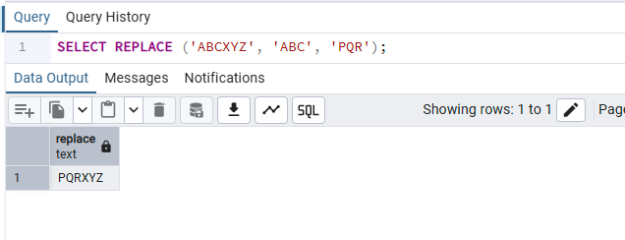
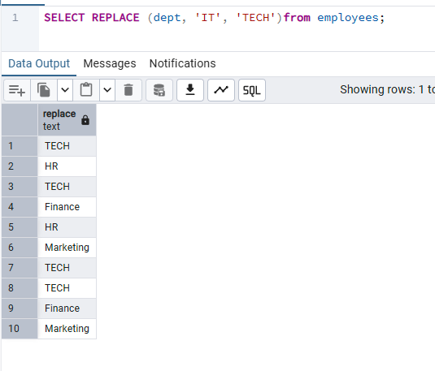
String Functions: REPLACE
Replacing text
Replace in a Literal
Replace in a Column
REPLACE('ABCXYZ','ABC','PQR') finds ABC and substitutes PQR, producing PQRXYZ.
REPLACE(dept,'IT','TECH') changes matching text in the query output. It does not permanently update the stored table data.

Slide 32
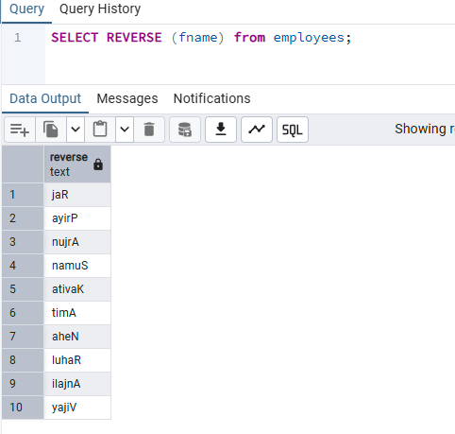
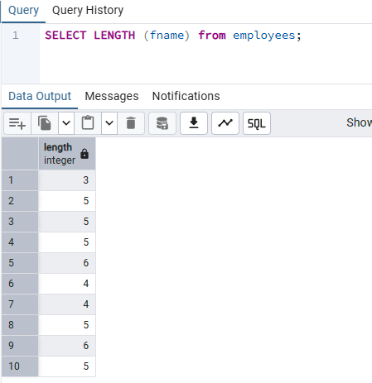
String Functions
Reversing and measuring text
REVERSE()
LENGTH()
REVERSE(fname) reverses the characters of each first name in the displayed result.
LENGTH(fname) returns the number of characters in each first name.

Slide 33
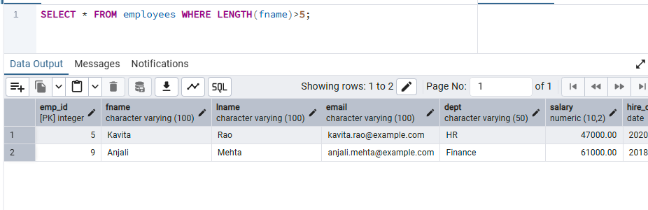
Using String Functions in WHERE
Filtering by calculated length
LENGTH() + WHERE
WHERE LENGTH(fname) > 5 returns only rows whose first name contains more than five characters. Kavita and Anjali both have six characters.

Slide 34
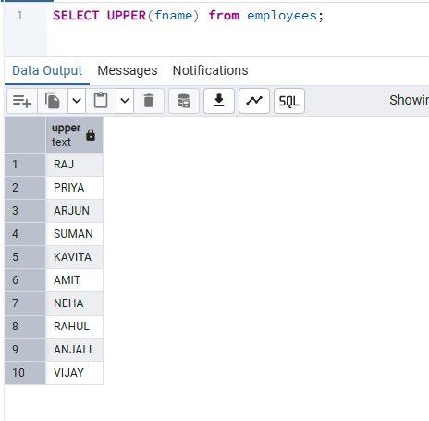
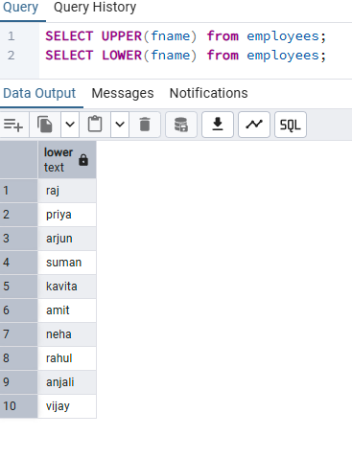
Changing Text Case
UPPER and LOWER
UPPER()
LOWER()
UPPER(fname) converts text to uppercase in the query result without changing the stored value.
LOWER(fname) converts text to lowercase in the query result without changing the stored value.

Slide 35
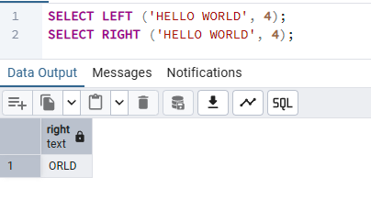
Extracting from the Left and Right
String slicing helpers
LEFT() and RIGHT()
LEFT(text, n) returns the first n characters; RIGHT(text, n) returns the last n characters. For HELLO WORLD, LEFT(...,4) gives HELL and RIGHT(...,4) gives ORLD.

Slide 36
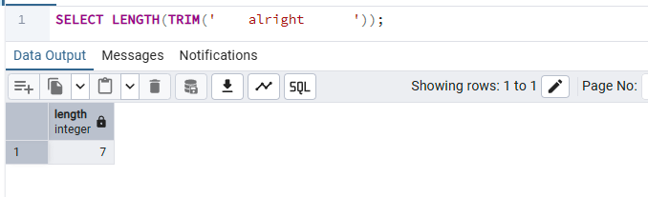
Removing Extra Spaces
Cleaning text before processing
TRIM() + LENGTH()
TRIM() removes leading and trailing spaces. LENGTH(TRIM(...)) then measures the cleaned text. The cleaned word alright contains 7 characters.

Slide 37
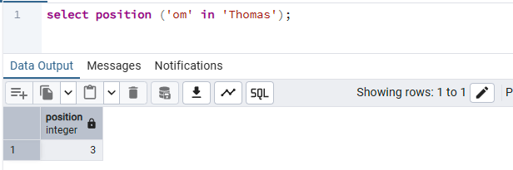
Finding Text Position
Locating a substring
POSITION()
POSITION(substring IN string) returns the starting position of the substring, counting from 1. In Thomas, om starts at position 3.

Slide 38
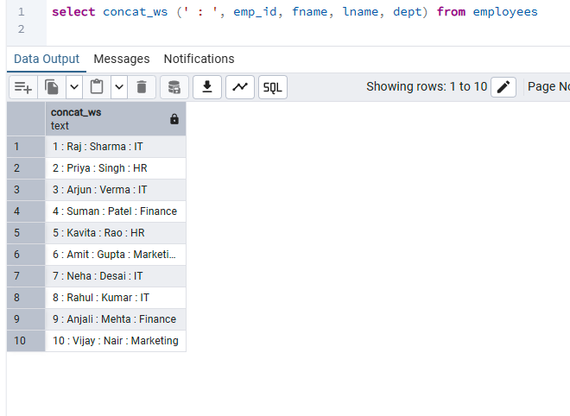
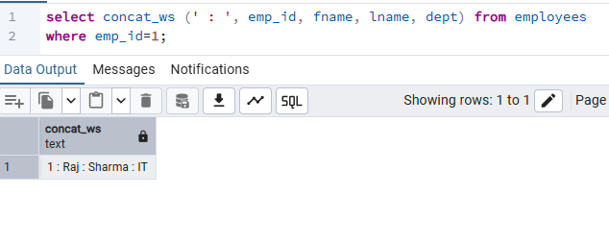
Advanced CONCAT_WS Examples
Formatting employee output
Multiple Columns
With WHERE
Using ' : ' as a separator combines emp_id, fname, lname, and dept into a readable single string.
The same formatting can be restricted to a selected employee using WHERE emp_id = 1.

Slide 39


Nested String Functions
Functions can be used inside functions
Nested CONCAT_WS()
CONCAT_WS() + UPPER()
The inner CONCAT_WS joins first and last name with a space; the outer CONCAT_WS joins ID, full name, and department with colons.
UPPER(dept) converts the department before CONCAT_WS formats the final output. WHERE limits the row to emp_id = 1.

Slide 40

Creating a Custom Employee Code
Combining LEFT() and CONCAT()
Nested String Functions
LEFT(dept,1) extracts the department initial and CONCAT joins it with emp_id. Examples include I1, H2, F4, and M10.

Slide 41


Subqueries in PostgreSQL
Using aggregate results inside another query
Highest Salary
Lowest Salary
The inner SELECT MAX(salary) finds the highest salary. The outer query returns the employee whose salary equals that result.
The inner SELECT MIN(salary) finds the lowest salary. The outer query returns the employee whose salary equals that result.

Slide 42


ALTER TABLE
Adding and removing columns
ADD COLUMN
DROP COLUMN
ALTER TABLE ... ADD COLUMN adds a new column to an existing table. Existing rows receive NULL when no default value is defined.
ALTER TABLE ... DROP COLUMN permanently removes a column from the table structure.

Slide 43

ALTER TABLE
Renaming a column
RENAME COLUMN
ALTER TABLE person RENAME COLUMN name TO fname changes the column name while keeping the existing data.

Slide 44

ALTER TABLE
Renaming a table
RENAME TO
In PostgreSQL, ALTER TABLE contacts RENAME TO mycontacts renames the table while preserving its columns and data. The alternative RENAME TABLE syntax shown is not PostgreSQL syntax.

Slide 45


ALTER TABLE
Changing column properties
SET DATA TYPE
SET DEFAULT
ALTER COLUMN ... SET DATA TYPE changes a column type or size. Here, fname becomes VARCHAR(200).
ALTER COLUMN ... SET DEFAULT 'unknown' assigns a default for future inserts where fname is omitted. Existing rows are not changed.

Slide 46

Inspecting Table Structure in psql
Verifying table metadata
\d meta-command
The psql \d person command displays columns, data types, constraints, and defaults. It confirms fname is VARCHAR(200) with default unknown.

Slide 47


CHECK Constraints
Validating and managing rules
Testing a CHECK Constraint
Dropping a Constraint
CHECK (LENGTH(mob) >= 10) requires at least 10 characters. A 9-character mobile value is rejected. UNIQUE also prevents duplicates.
ALTER TABLE contacts DROP CONSTRAINT contacts_mob_check removes the named CHECK constraint, so that rule is no longer enforced.

Slide 48
Summary
Concepts covered so far
DDL & DML • Constraints • Filtering • Sorting • Aggregate Functions • GROUP BY • String Functions • Subqueries • ALTER TABLE
All examples are based on the pgAdmin / PostgreSQL screenshots provided in this chat.

