Slide 1
PostgreSQL Practice
CASE Expressions • Database Relationships • JOIN Operations
New screenshot collection

Slide 2
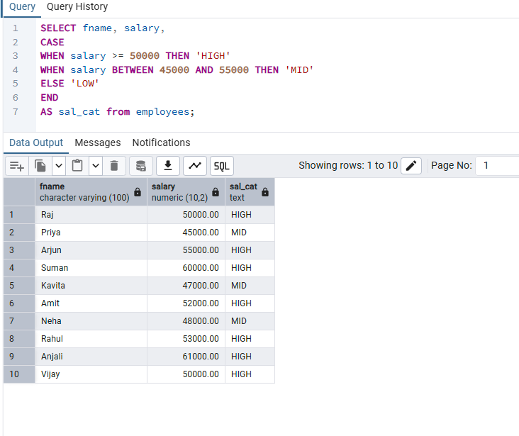
Conditional Logic Using CASE
Categorizing Employees Based on Salary
Definition / Explanation
The CASE expression applies conditional logic inside a query. PostgreSQL checks conditions from top to bottom and returns the result for the first true condition.
PostgreSQL / pgAdmin

Slide 3
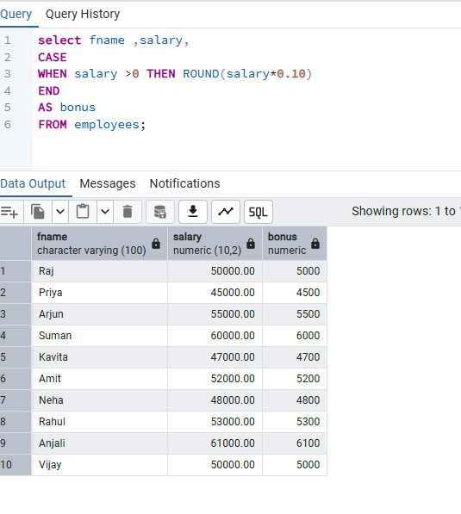
Conditional Calculations Using CASE
Calculating Employee Bonus
Definition / Explanation
CASE can also perform calculations. Here, employees with salary greater than 0 receive a bonus equal to 10% of salary, rounded with ROUND().
PostgreSQL / pgAdmin

Slide 4
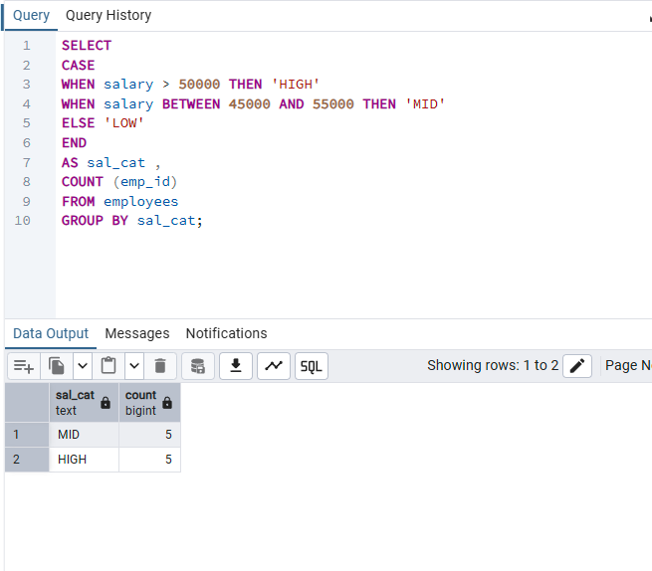
CASE with GROUP BY
Grouping and Counting Salary Categories
Definition / Explanation
The CASE expression creates salary categories, GROUP BY forms one group for each category, and COUNT(emp_id) counts employees in each group.
PostgreSQL / pgAdmin

Slide 5
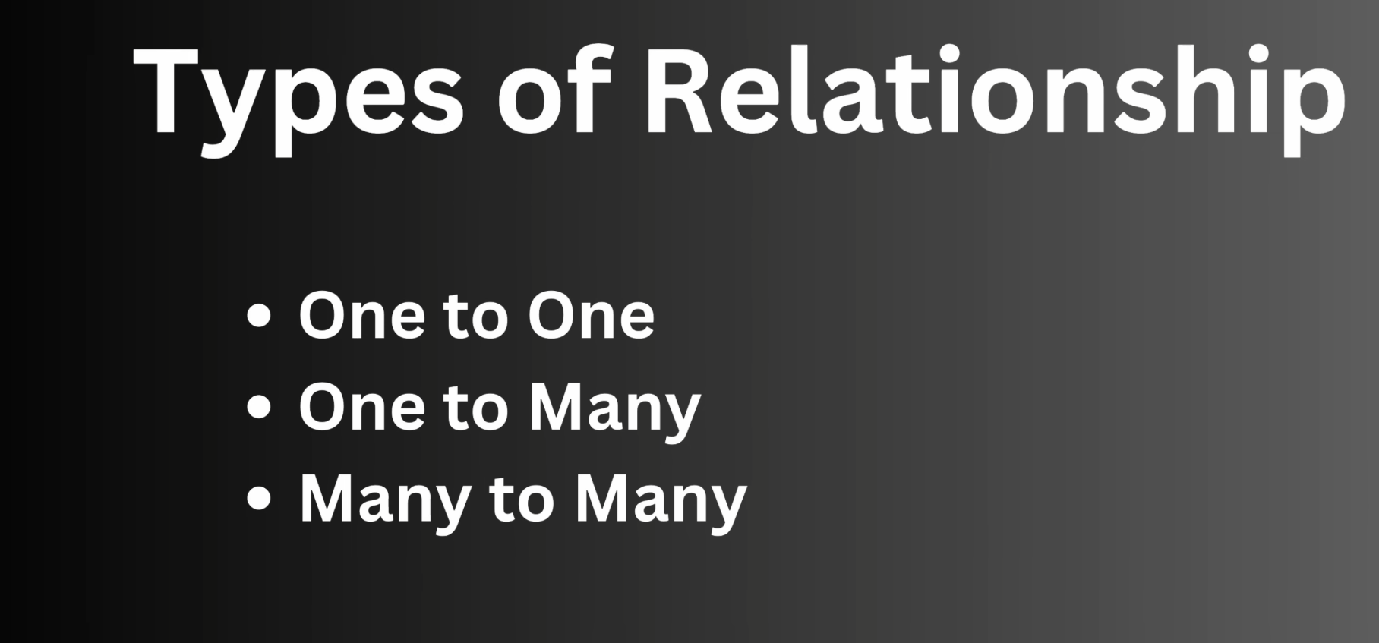
Database Relationships
Types of Relationships
Definition / Explanation
Relationships describe how records in different tables are connected. The main types are One-to-One, One-to-Many, and Many-to-Many.
PostgreSQL / pgAdmin

Slide 6
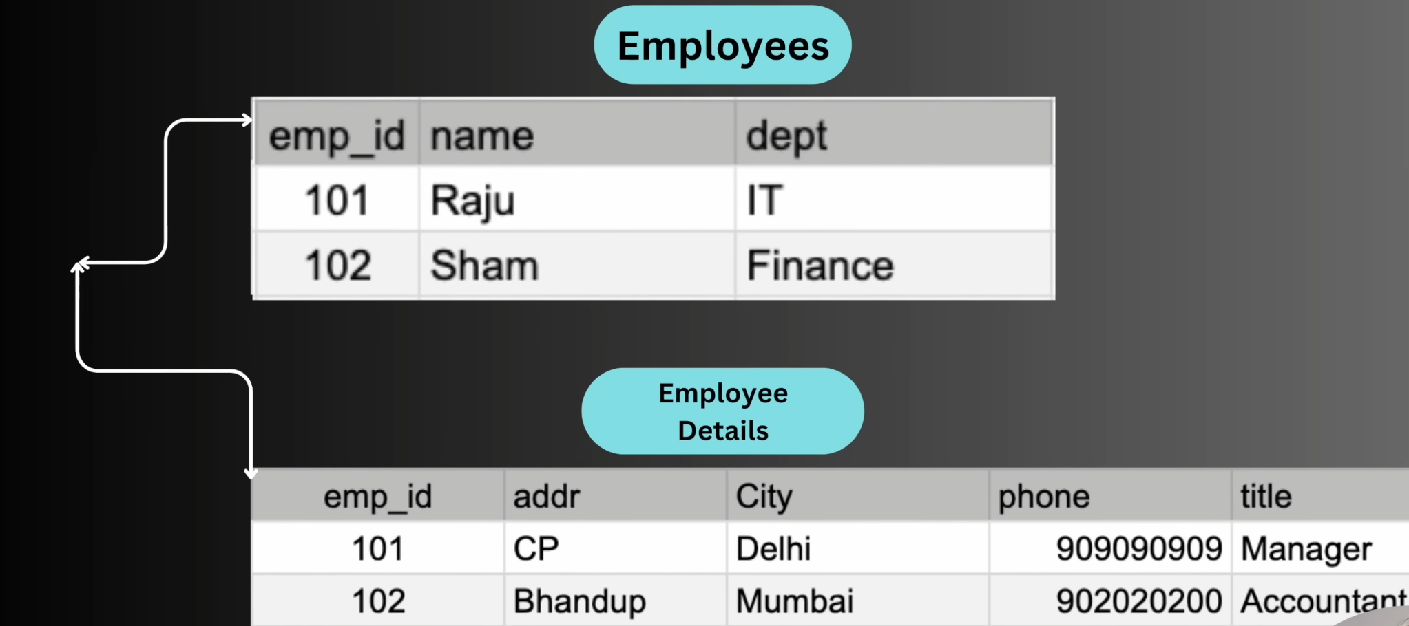
One-to-One Relationship (1:1)
Employees and Employee Details
Definition / Explanation
One record in the first table is associated with only one record in the second table. Here, each employee has one corresponding employee-details record.
PostgreSQL / pgAdmin

Slide 7
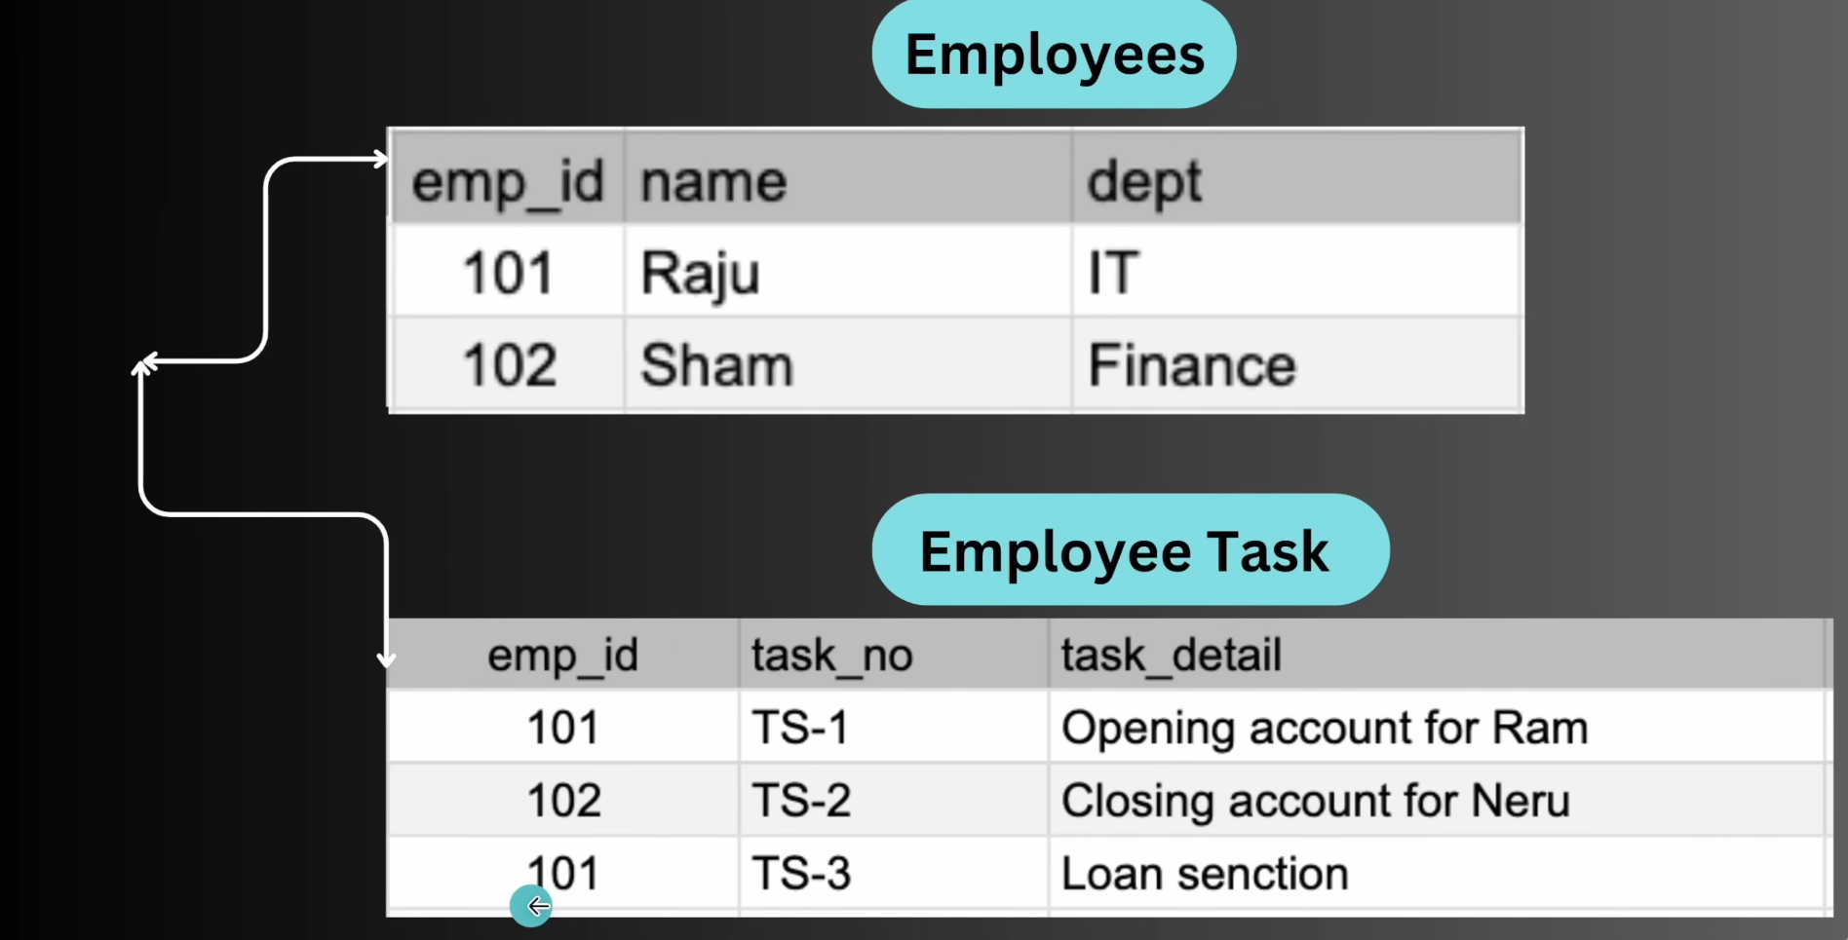
One-to-Many Relationship (1:M)
Employees and Employee Tasks
Definition / Explanation
One record in the first table can be associated with multiple records in the second table. Here, one employee can have several tasks.
PostgreSQL / pgAdmin

Slide 8
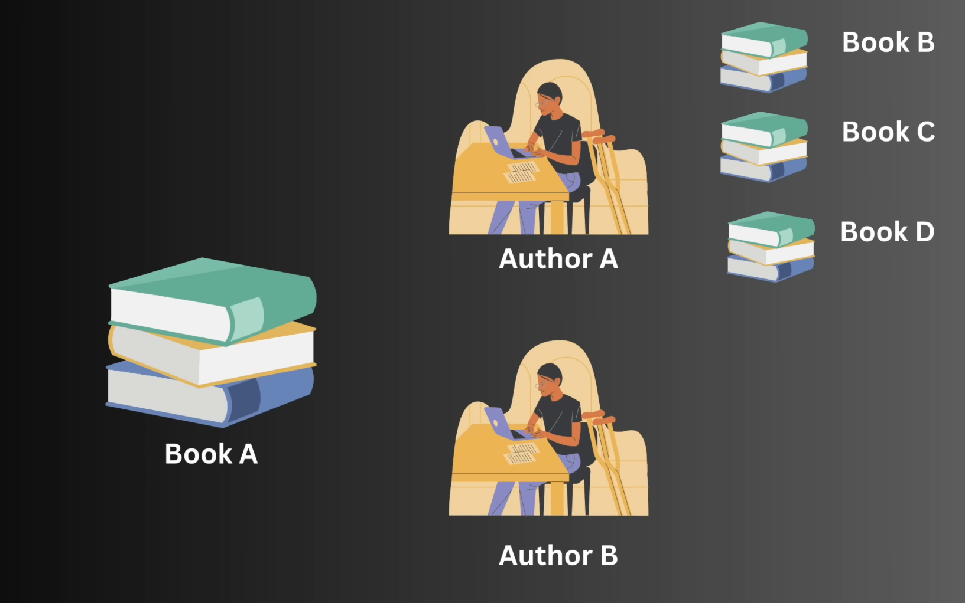
Many-to-Many Relationship (M:N)
Authors and Books
Definition / Explanation
Multiple records in one table can relate to multiple records in another. An author can write several books, and a book can have several authors.
PostgreSQL / pgAdmin

Slide 9
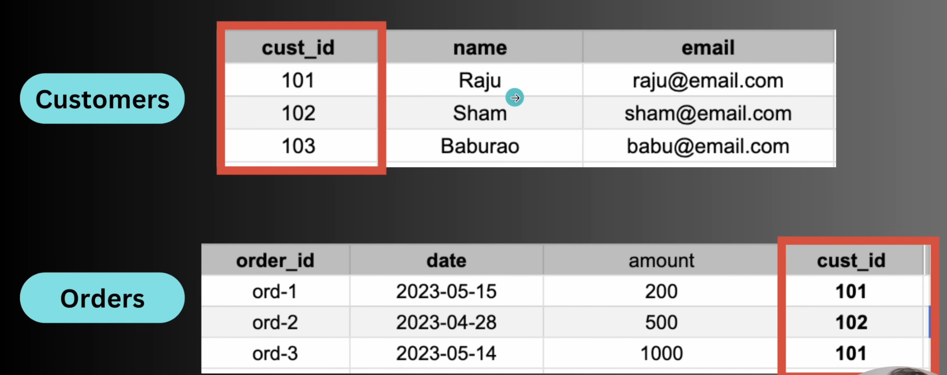
Primary Key and Foreign Key
Customers and Orders
Definition / Explanation
A primary key uniquely identifies a row. A foreign key references a key in another table and establishes a relationship. One customer can therefore be linked to many orders.
PostgreSQL / pgAdmin

Slide 10
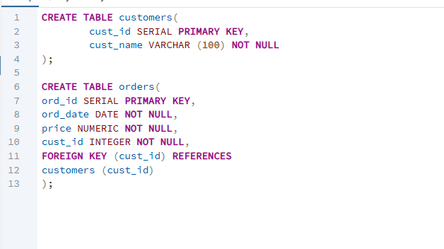
Creating a Foreign Key Relationship
Customers and Orders Tables
Definition / Explanation
The customers table uses cust_id as its primary key. The orders table stores cust_id as a foreign key referencing customers(cust_id), creating a one-to-many relationship.
PostgreSQL / pgAdmin

Slide 11
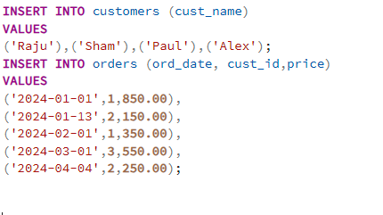
Inserting Data into Related Tables
Parent Table First, Child Table Second
Definition / Explanation
Data is inserted into customers first so referenced customer IDs exist. Orders are then inserted with cust_id values that connect each order to a customer.
PostgreSQL / pgAdmin

Slide 12
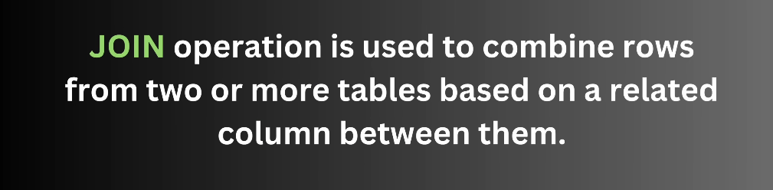
JOIN Operations in PostgreSQL
Introduction to JOIN
Definition / Explanation
A JOIN combines rows from two or more tables using a related column. It lets separately stored but related information be retrieved together.
PostgreSQL / pgAdmin

Slide 13
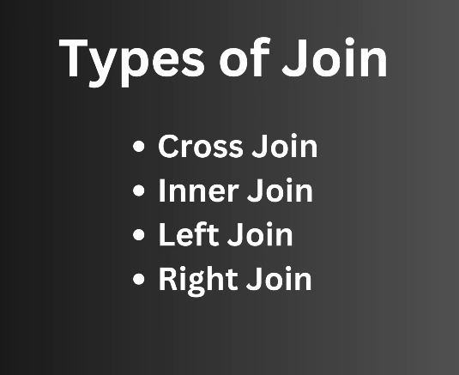
Types of JOINs
Overview
Definition / Explanation
Common JOIN types include CROSS JOIN, INNER JOIN, LEFT JOIN, and RIGHT JOIN. Each controls which matching or non-matching rows appear in the result.
PostgreSQL / pgAdmin

Slide 14
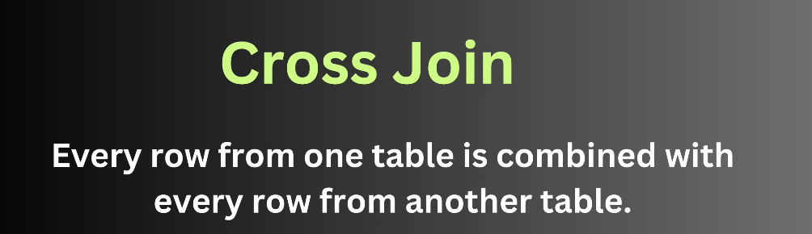
CROSS JOIN
Concept
Definition / Explanation
A CROSS JOIN combines every row from the first table with every row from the second table, producing the Cartesian product of both tables.
PostgreSQL / pgAdmin

Slide 15
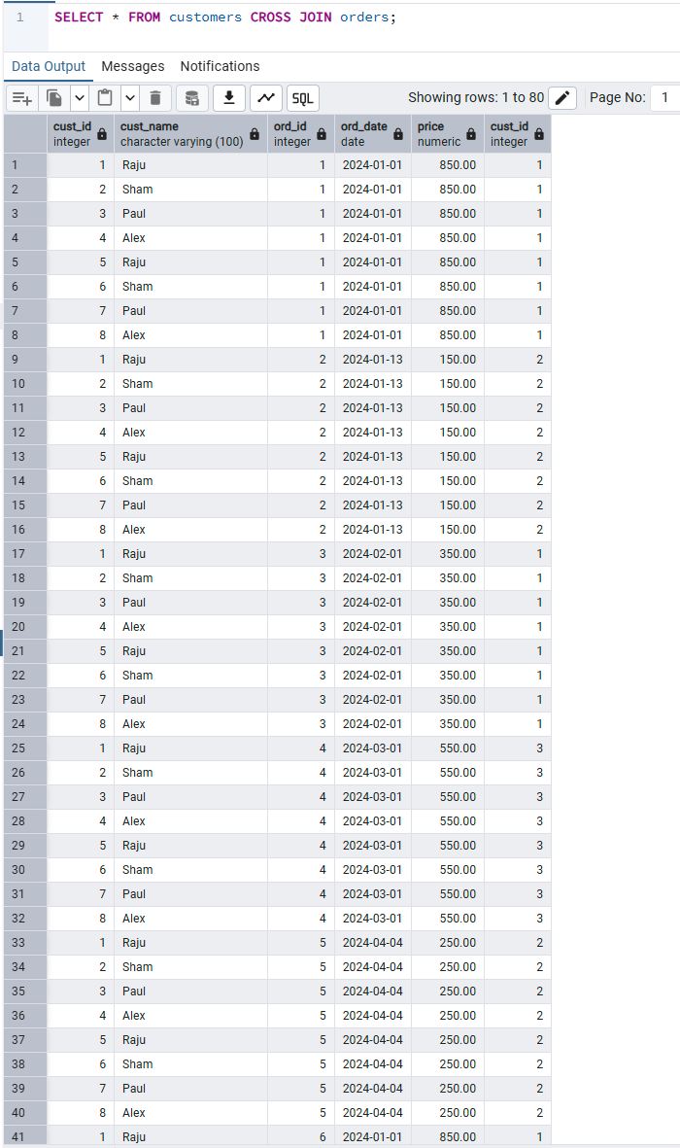
CROSS JOIN
Practical Query
Definition / Explanation
SELECT * FROM customers CROSS JOIN orders returns every possible customer-order combination. No matching condition is required.
PostgreSQL / pgAdmin

Slide 16
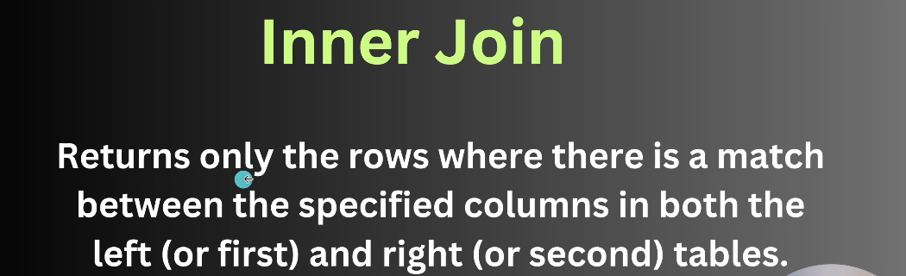
INNER JOIN
Concept
Definition / Explanation
An INNER JOIN returns only rows for which the specified join condition matches in both tables. Unmatched rows are excluded.
PostgreSQL / pgAdmin

Slide 17
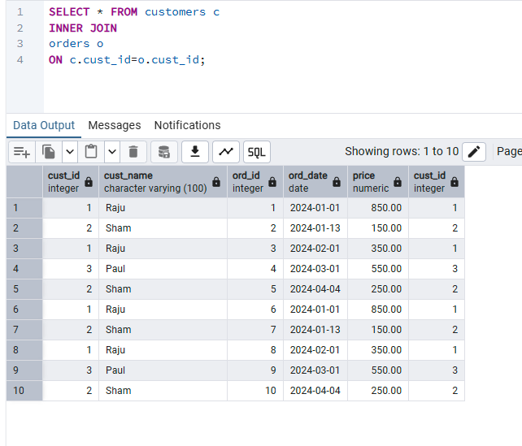
INNER JOIN
Matching Customers with Orders
Definition / Explanation
The aliases c and o represent customers and orders. ON c.cust_id = o.cust_id matches each order with the customer having the same ID.
PostgreSQL / pgAdmin

Slide 18
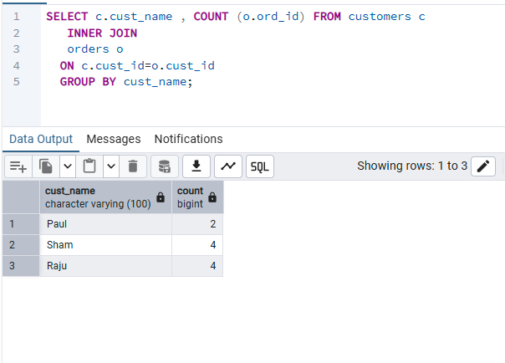
INNER JOIN with GROUP BY
Counting Orders per Customer
Definition / Explanation
After matching customers with orders, GROUP BY cust_name creates one group per customer and COUNT(o.ord_id) calculates how many matching orders each customer has.
PostgreSQL / pgAdmin

Slide 19
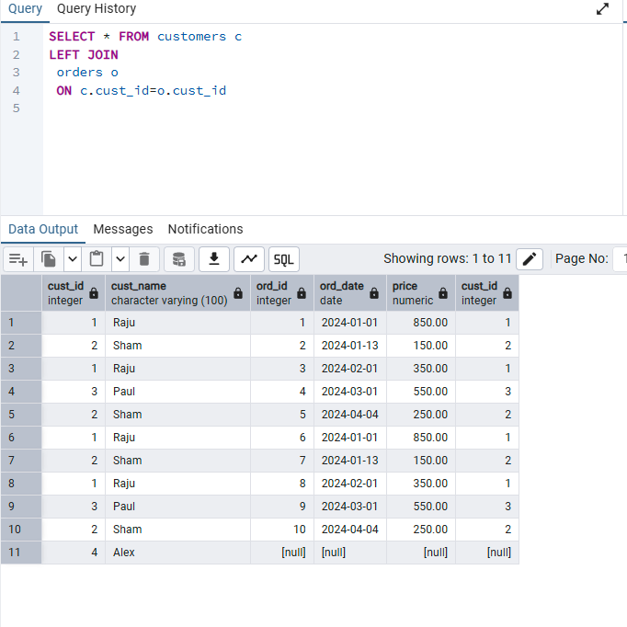
LEFT JOIN
Keeping All Rows from the Left Table
Definition / Explanation
A LEFT JOIN returns every row from the left table plus matching rows from the right table. When no match exists, right-table columns contain NULL.
PostgreSQL / pgAdmin

Slide 20
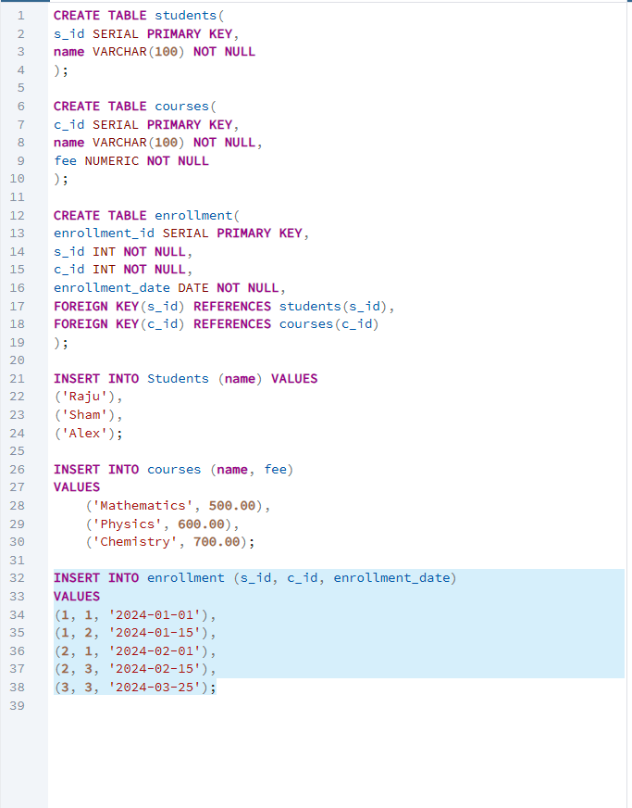
Many-to-Many Relationship
Students, Courses and Enrollment
Definition / Explanation
The enrollment table acts as a junction table. Its foreign keys connect students and courses, allowing each student to take many courses and each course to contain many students.
PostgreSQL / pgAdmin

Slide 21
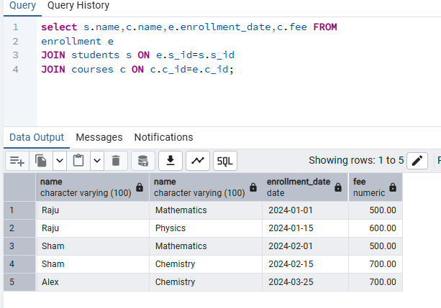
Multiple JOINs
Retrieving Many-to-Many Data
Definition / Explanation
The enrollment table is joined to students and courses. The result combines student name, course name, enrollment date, and fee in one query output.
PostgreSQL / pgAdmin

