Slide 1

SMART INDIA HACKATHON 2026
TITLE PAGE
Problem Statement ID –
Problem Statement Title-
Theme-
PS Category- Software/Hardware
Team ID-
Team Name (Registered on portal)

Slide 2
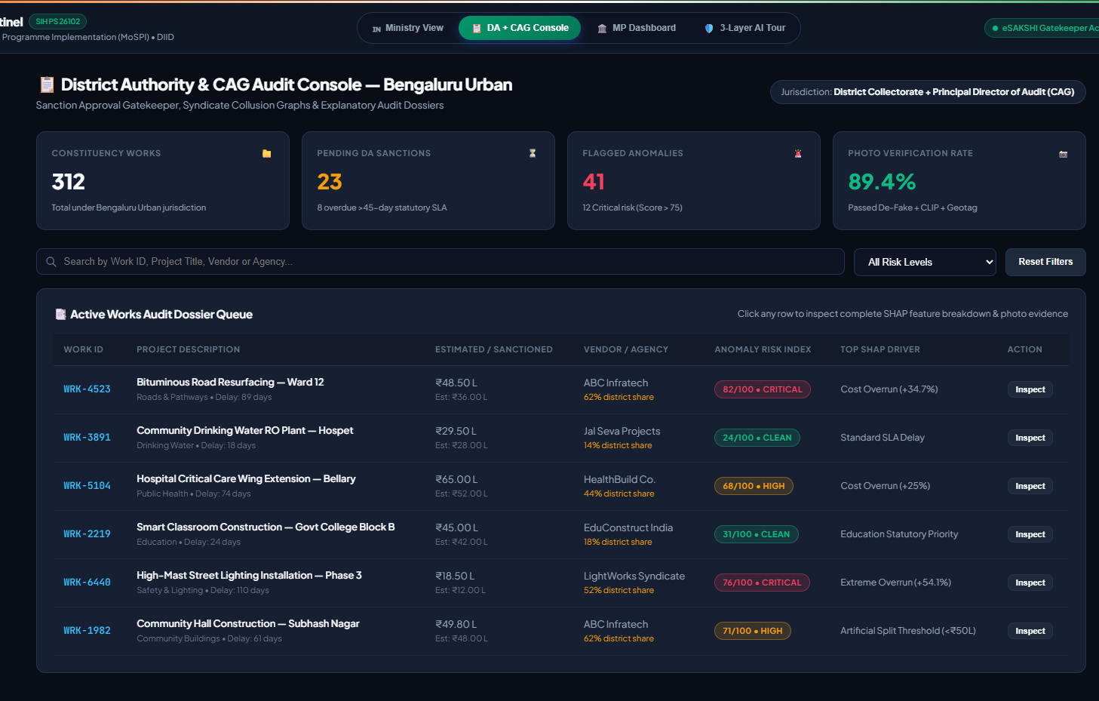
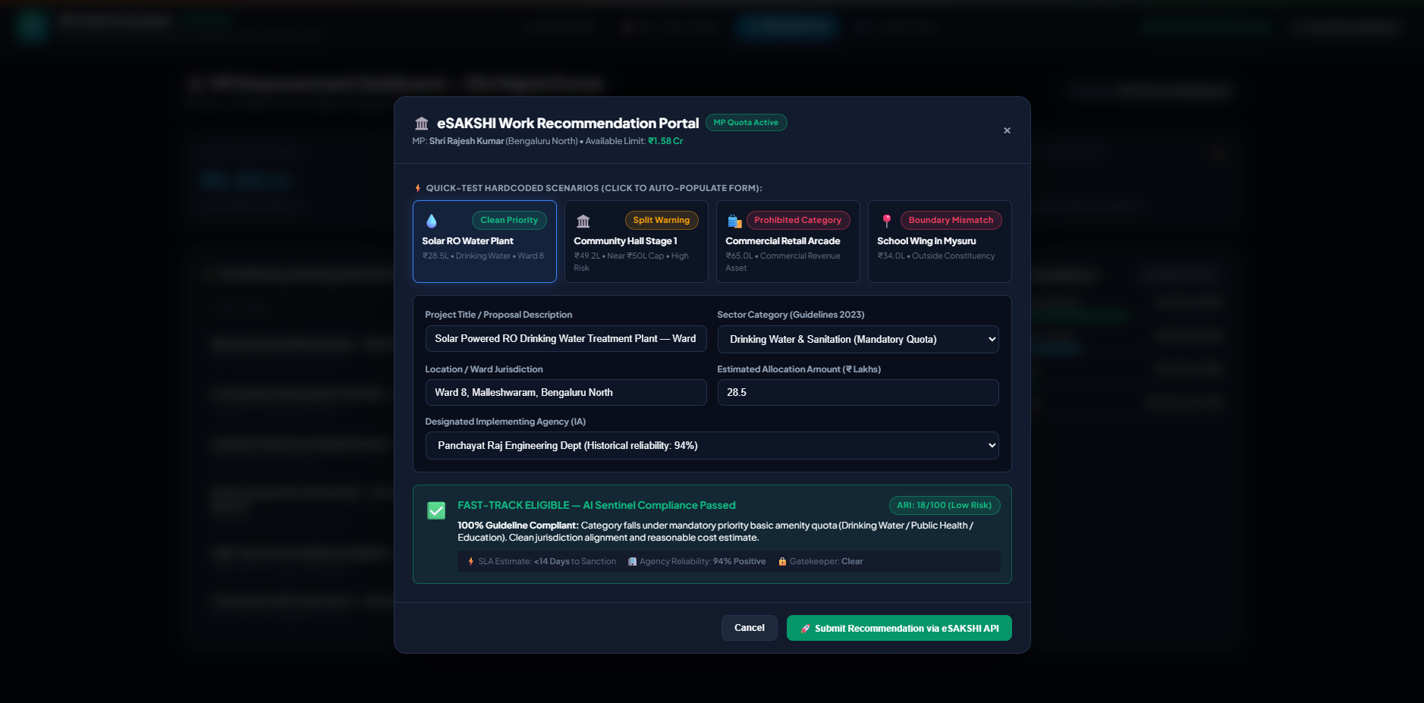
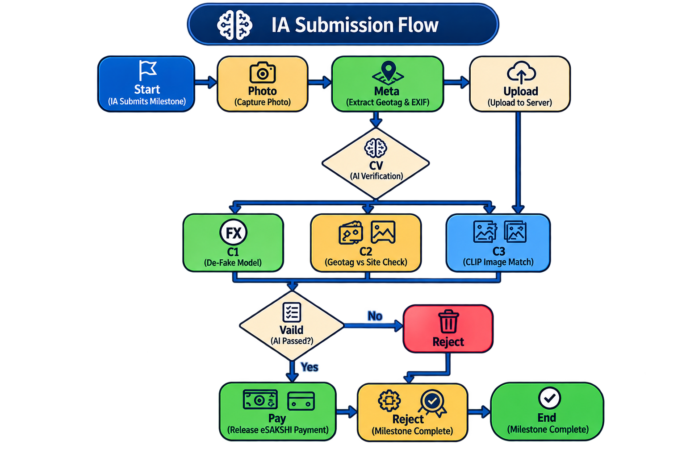
IDEA TITLE
Nan-Chalants
Proposed Solution (Describe your Idea/Solution/Prototype)
Computer Vision Verification: Prevents "ghost assets" and fraudulent payments by using AI to detect photo manipulation and verify that image content matches work descriptions via geotagged uploads.
Explainable & Actionable Data: Provides audit-grade transparency (XAI) to justify every flagged transaction in plain English, displayed through tailored governance dashboards for different stakeholders.
Unique Jurisdictional Logic: Tailors the AI to handle complex Indian parliamentary laws and electoral constraints, distinct from generic fraud detection systems.
Proactive, Low-Cost Solution: Shifts from reactive to proactive auditing using an open-source, serverless framework that represents a cost-effective, enterprise-scale prototype.
Multilayered AI/ML Engine: Utilizes a hybrid system of deterministic rules, unsupervised outlier detection, and supervised learning to identify project anomalies in real time.

Slide 3

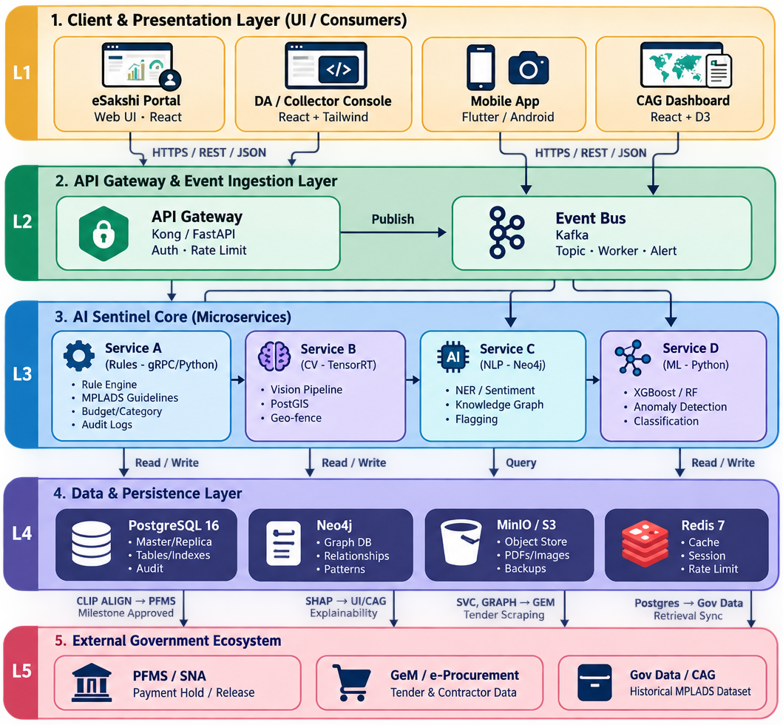
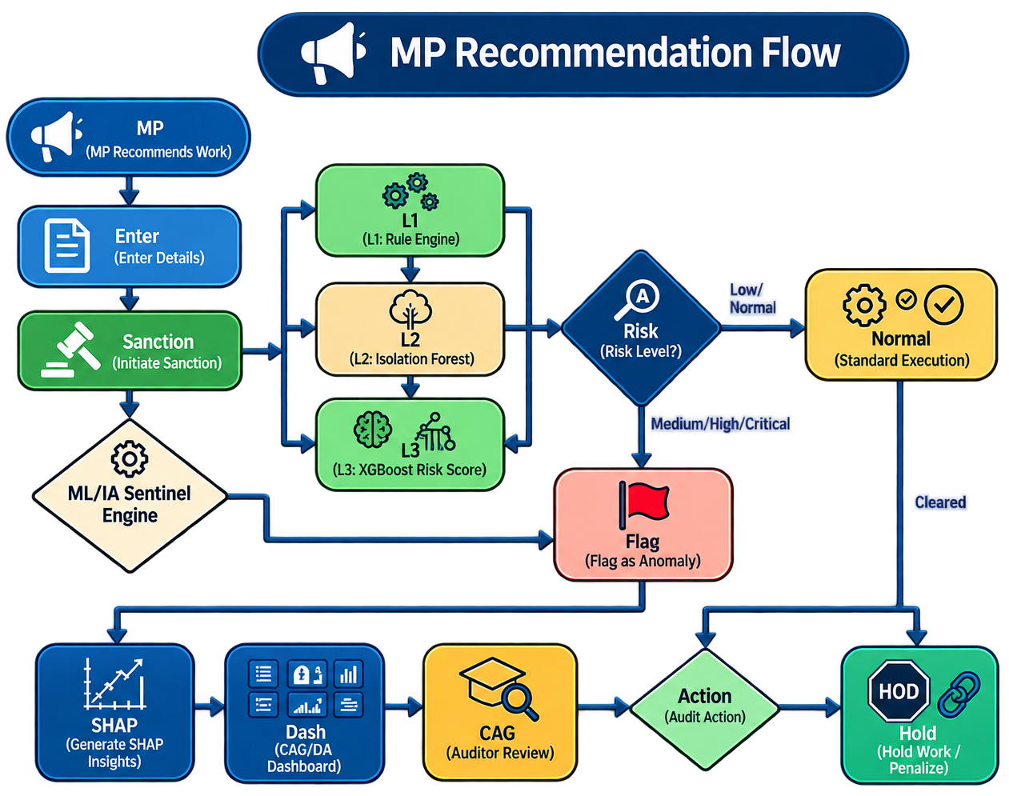
TECHNICAL APPROACH
Nan-Chalants
MPLADS AI Sentinel — Tech Stack
Frontend: Next.js 15, TypeScript
Backend: FastAPI, Python 3.11+
Database: SQLite → PostgreSQL (Neon)
ORM/Migrations: SQLAlchemy, Alembic
Authentication: PyJWT
AI/ML: Scikit-learn, Isolation Forest, XGBoost
Computer Vision: De-Fake, CLIP
Explainable AI: SHAP
NLP: Hugging Face Transformers, FinBERT
Data Processing: Pandas, NumPy, SciPy
Frontend Hosting: Vercel
Backend Hosting: Railway / Render
CI/CD: GitHub Actions

Slide 4
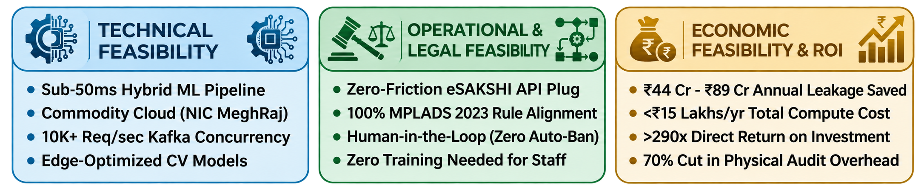
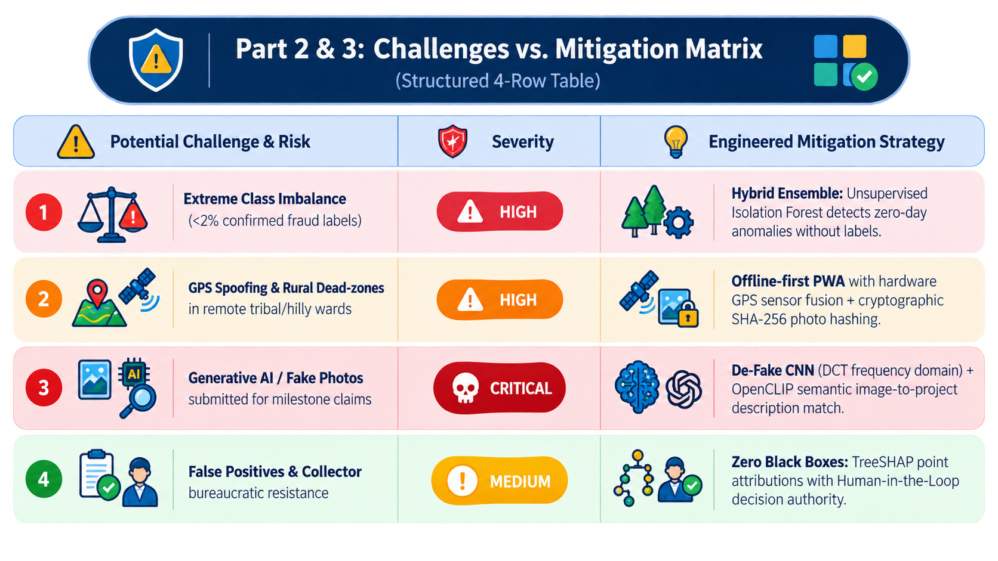
FEASIBILITY AND VIABILITY
Nan-Chalants
Proposed Solution (Describe your Idea/Solution/Prototype)
Feasibility Analysis
High Performance: Sub-50ms latency handling 10,000+ req/sec on low-cost government cloud.
Seamless Integration: Fully embeds MPLADS rules into eSAKSHI workflows with clear visual badges.
High ROI (>290x): Costs <₹15L/year, cuts physical audits by 70%, and saves up to ₹89 Cr annually.
Challenges vs. Mitigation Matrix
Challenges & Mitigations
Robust AI Security: Uses hybrid ML, sensor fusion, and computer vision to stop fraud and fake images.
Offline-First Sync: Encrypts photos and GPS locally for tamper-proof syncing when back online.
Transparent AI: Uses TreeSHAP to deliver clear, legally defensible evidence instead of a black box.
Human-in-the-Loop: Keeps final approval authority with District Collectors to ensure smooth adoption.

Slide 5
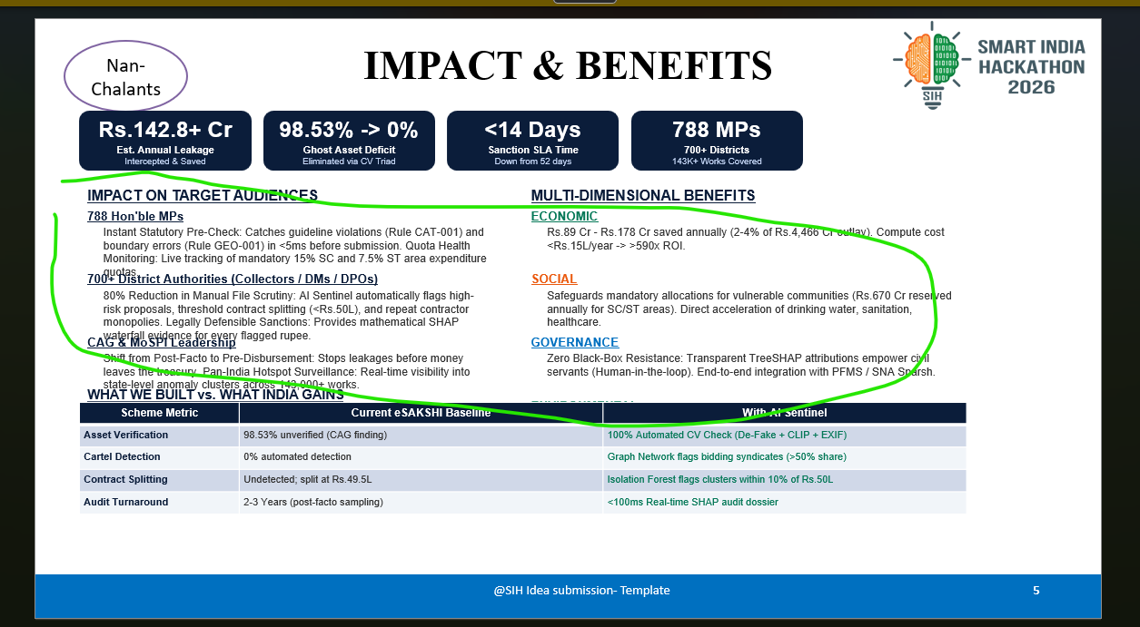
IMPACT & BENEFITS
Nan-Chalants
Rs.142.8+ Cr
Est. Annual Leakage
Intercepted & Saved
98.53% -> 0%
Ghost Asset Deficit
Eliminated via CV Triad
<14 Days
Sanction SLA Time
Down from 52 days
788 MPs
700+ Districts
143K+ Works Covered
IMPACT ON TARGET AUDIENCES
MULTI-DIMENSIONAL BENEFITS
788 Hon'ble MPs
ECONOMIC
Instant Statutory Pre-Check: Catches guideline violations (Rule CAT-001) and boundary errors (Rule GEO-001) in <5ms before submission. Quota Health Monitoring: Live tracking of mandatory 15% SC and 7.5% ST area expenditure quotas.
Rs.89 Cr - Rs.178 Cr saved annually (2-4% of Rs.4,466 Cr outlay). Compute cost <Rs.15L/year -> >590x ROI.
700+ District Authorities (Collectors / DMs / DPOs)
SOCIAL
80% Reduction in Manual File Scrutiny: AI Sentinel automatically flags high-risk proposals, threshold contract splitting (<Rs.50L), and repeat contractor monopolies. Legally Defensible Sanctions: Provides mathematical SHAP waterfall evidence for every flagged rupee.
Safeguards mandatory allocations for vulnerable communities (Rs.670 Cr reserved annually for SC/ST areas). Direct acceleration of drinking water, sanitation, healthcare.
CAG & MoSPI Leadership
GOVERNANCE
Shift from Post-Facto to Pre-Disbursement: Stops leakages before money leaves the treasury. Pan-India Hotspot Surveillance: Real-time visibility into state-level anomaly clusters across 143,000+ works.
Zero Black-Box Resistance: Transparent TreeSHAP attributions empower civil servants (Human-in-the-loop). End-to-end integration with PFMS / SNA Sparsh.
WHAT WE BUILT vs. WHAT INDIA GAINS
1.4 Billion Citizens
ENVIRONMENTAL
Scheme Metric | Current eSAKSHI Baseline | With AI Sentinel
Asset Verification | 98.53% unverified (CAG finding) | 100% Automated CV Check (De-Fake + CLIP + EXIF)
Cartel Detection | 0% automated detection | Graph Network flags bidding syndicates (>50% share)
Contract Splitting | Undetected; split at Rs.49.5L | Isolation Forest flags clusters within 10% of Rs.50L
Audit Turnaround | 2-3 Years (post-facto sampling) | <100ms Real-time SHAP audit dossier
Ensures public funds actually build tangible community assets (solar drinking water, anganwadis, hospital wings) rather than vanishing into contractor cartels or ghost assets.
100% Paperless Audit Trail across 700+ Collectorates. Fast-track AI lane for renewable energy works (Solar RO, solar street lighting, rainwater harvesting).

Slide 6
REFERENCES
Nan-Chalants
GOVERNMENT & REGULATORY SOURCES
TECHNICAL & RESEARCH REFERENCES
1
CAG Performance Audits of MPLADS (2005-2024)
85 documented fraud/misuse cases worth Rs.32,133+ Cr across multiple parliamentary terms.
https://www.cag.gov.in
Lundberg & Lee (2017) - SHAP
A Unified Approach to Interpreting Model Predictions. NeurIPS 2017.
https://proceedings.neurips.cc/paper/2017/hash/8a20a862197818fbd76f4f08898fc436-Abstract.html
1
9
9
2
MPLADS Guidelines 2023
MoSPI official rules governing fund allocation, disbursement, and utilization.
https://mplads.mospi.gov.in
10
Liu et al. (2012) - Isolation Forest
Anomaly detection algorithm. IEEE TKDE.
https://ieeexplore.ieee.org/document/6040193
2
10
3
11
3
eSAKSHI Portal
Existing digital transaction tracking system for MPLADS works and payments.
https://esakshi.mp.gov.in
11
RedFlags.ai (Kazakhstan)
Saved $86M in 6 months using rule-based fraud detection.
https://redflags.kz
4
12
4
data.gov.in MPLADS Dataset
143,257 records of works and expenditures across India for ML training.
https://data.gov.in
12
Tazama (Linux Foundation)
Open-source real-time payment monitoring at 2,300 TPS.
https://tazama.io
5
13
5
DPDP Act 2023
Digital Personal Data Protection Act compliance framework for AI systems.
https://www.indiacode.nic.in
13
UK HMRC / Quantexa Platform
GBP 175M entity resolution for tax fraud detection.
https://www.quantexa.com
6
14
7
RTI Act 2005
Right to Information Act transparency requirements for public fund monitoring.
https://rtionline.gov.in
15
RBI MuleHunter.AI
85-90% accuracy rate with 26+ bank partnerships.
https://www.rbi.org.in
6
14
8
ARC Report (2011) on MPLADS
Administrative Reforms Commission recommended abolishing scheme due to corruption.
https://arc.gov.in
16
Flower (flwr.ai)
Production-ready federated learning framework.
https://flower.ai
7
15
8
MPLADS Annual Reports (2019-2024)
Fund utilization: 37-52% across terms; Rs.1,092.5 Cr lapsed during COVID.
https://mospi.gov.in
16
Nigrini (2012) - Benford's Law
Application to financial fraud detection methodology.
https://www.benfordslaw.org

Slide 7
IMPORTANT INSTRUCTIONS
Please ensure below pointers are met while submitting the Idea PPT:
Kindly keep the maximum slides limit up to six (6). ( Including the title slide)
Try to avoid paragraphs and post your idea in points /diagrams / Infographics /pictures
Keep your explanation precise and easy to understand
Idea should be unique and novel.
You can only use provided template for making the PPT without changing the idea details pointers (mentioned in previous slides).
You need to save the file in PDF and upload the same on portal. No PPT, Word Doc or any other format will be supported.
Note - You can delete this slide (Important Pointers) when you upload the details of your idea on SIH portal.

