Slide 1


Lecture 2 : Data Types & Variables

Slide 2

Jupyter Notebook
The Jupyter Notebook is a web application for live coding, equations, visualizations and narrative text.
It is very popular among Data Scientists for creating interactive Data Analysis and Machine Learning projects.

Slide 3
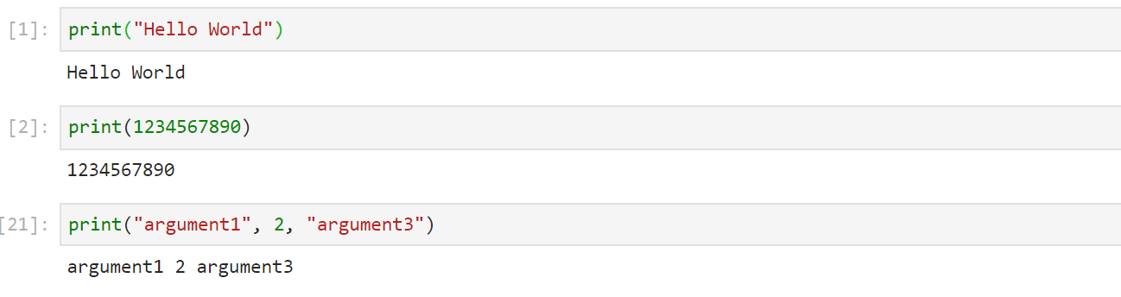
First Python Program
digipodium
Output in Python:
print() function is used to output anything on screen.

Slide 4
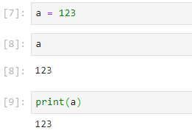
Basic Data Types
digipodium
Integer
Represented by : int
Function for type conversion : int()

Slide 5
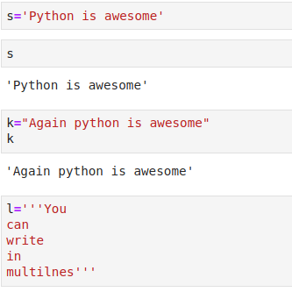
Basic Data Types
digipodium
String
Represented by : str
Function for type conversion : str()
Declaration:
str1=’I am a string’
str2=”I am also a string”
str3=’ ’ ’I am a multiline string’ ’ ’
str4=”““I am also a multiline string”””

Slide 6
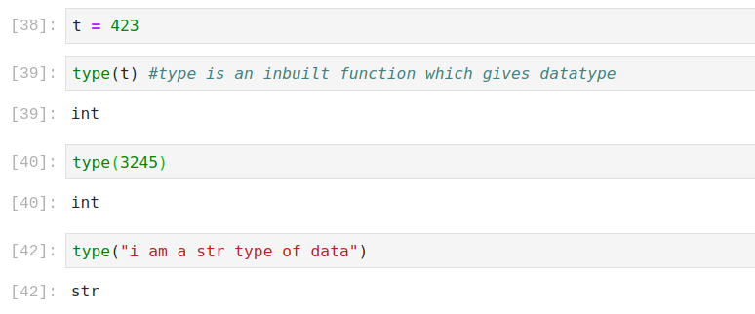
Python type() Function
digipodium
of a variable
In Python type() function can be used to get the datatype of any variable.

Slide 7
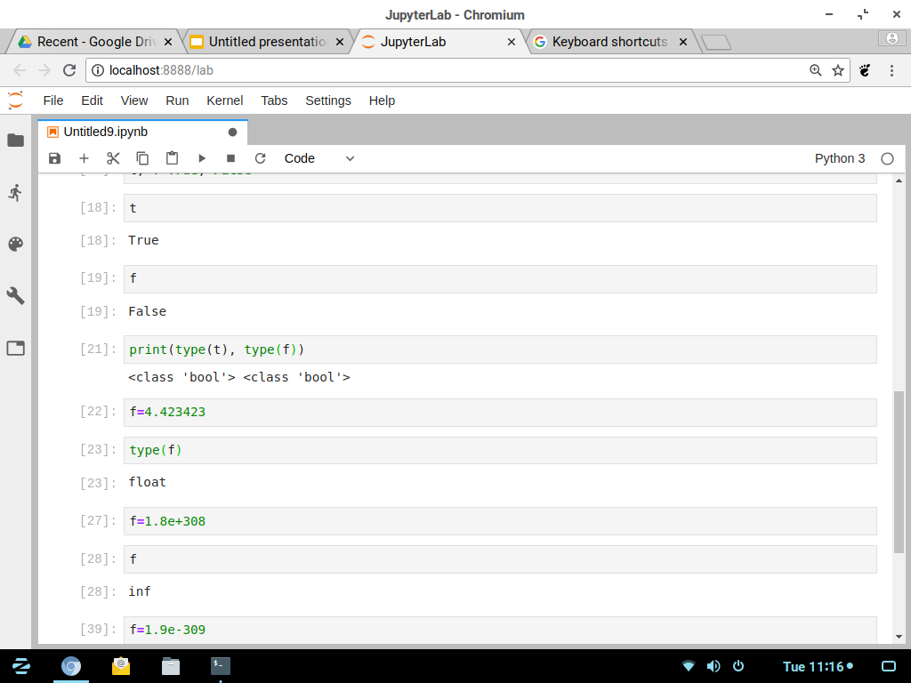
Basic Data Types
digipodium
Float
Represented by : float
Function for type conversion : float()
Range : 1.8 x 10³⁰⁸ to 1.8 x 10⁻³⁰⁸
Declaration: f = .4234
f = 4320.34

Slide 8
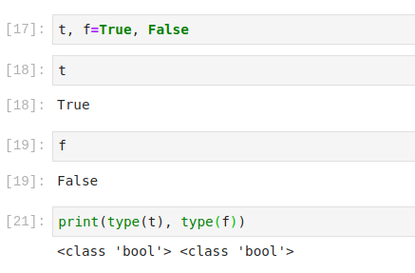
Basic Data Types
digipodium
Boolean
Represented by : bool
Function : bool()
Values : True, False
Declaration: var=True

Slide 9
digipodium
None
x = None
y = None
All basic data types
type(x)
Nonetype
int
float
bool
str
None
list
tuple
set
dict

Slide 10
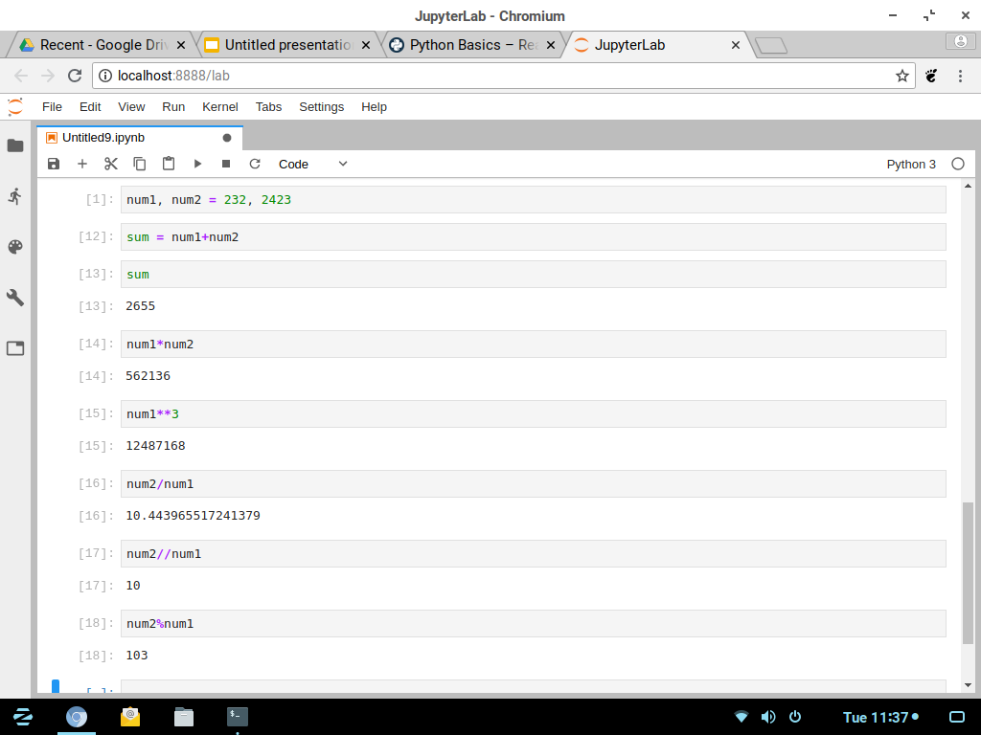
Python Operators
digipodium
Arithmetic Operators
Addition : +
Subtraction : -
Product : *
Exponent : **

Slide 11
Python Operators
digipodium
More Arithmetic Operators
Division : /
Integer Division : //
Modulus : %

Slide 12
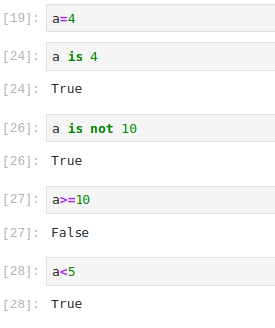
Python Operators
digipodium
Comparison Operators
Greater than, less than : >, <
Equals : ==
<=
>=
!= or

Slide 13
Logical operator
Exp 1 | Exp 2 | and
True | True | True
True | False | False
False | True | False
False | False | False
Exp 1 | Exp 2 | or
True | True | True
True | False | True
False | True | True
False | False | False
Exp 1 | not
True | False
False | True

Slide 14
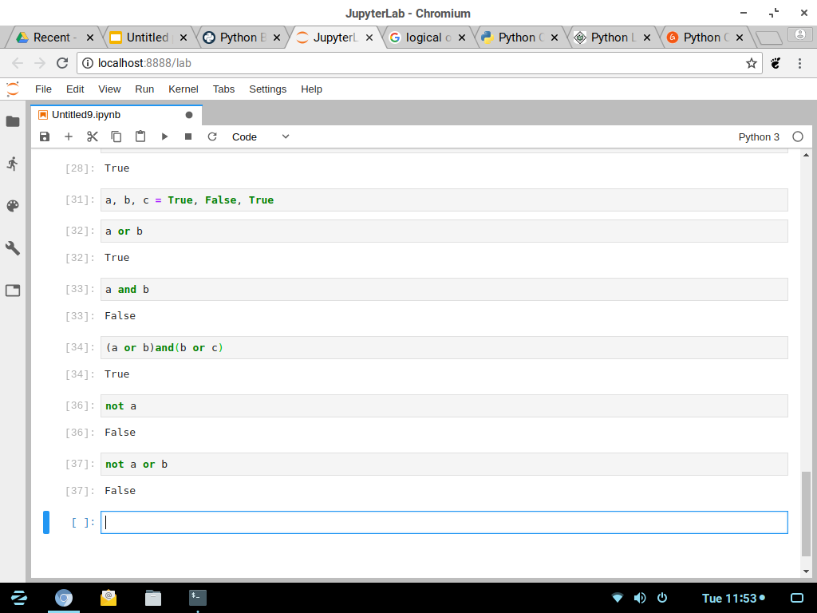
Python Operators
digipodium
Logical Operators
OR operator : ‘or’
AND Operator : ‘and’
NOT operator : ‘not’

Slide 15
Membership operator & identity operator
is -- identity operator
Used for checking if 2 variables share same memory location or not, it will return either true or false.
in -- membership operator
Used for checking a value is a member of a sequence or not, returns True or False.
Very useful in programming because it removes the need of loops for searching simple values in a sequence

