Slide 1

Cellular Sheaf Theory for Radiation Hardness
Leray's
Coboundary at Altitude
A cellular-sheaf compiler framework for software-defined
radiation hardness on deep-space flight computers
Vaibhav Shakya
Jayshree Periwal International School, Jaipur
github.com/vaibhavshakya11/lerays-coboundary-at-altitude

Slide 2
BACKGROUND
Why deep-space computers triplicate every calculation
Every flight computer beyond low Earth orbit faces single-event upsets — heavy ions and protons that flip individual bits in memory or registers. The standard defence is triple modular redundancy (TMR): run every calculation three times and take a majority vote.
How TMR works
replica 1
⚡
majority
vote
replica 2
TMR has carried Voyager, Cassini, and Europa Clipper. It is also wasteful. Three replicas burn three times the compute and three times the power. Worse, when a single ion clips all three replicas in the same way — a common-mode strike — the majority vote is unanimous and wrong.
replica 3
output
Common-mode strike
Heavy-ion data puts common-mode strikes at 1–10% of all upsets. Small fraction, catastrophic consequence.
All three replicas flipped identically. Vote is unanimous — and wrong. Adding more replicas does not help.
Leray's Coboundary at Altitude · Vaibhav Shakya · 2026
2 / 16

Slide 3


THE PRIOR ART
Forty years of partial fixes
Three families of alternatives have been proposed since the 1980s. Each addresses one weakness of TMR and leaves at least one other unsolved. None encodes program semantics directly; each new computational kernel requires fresh analysis.
Hamming / SECDED
Algorithm-Based Fault Tolerance
SWIFT / instruction duplication
Bit-level parity codes
(R. W. Hamming, 1950)
Algebraic kernel checksums
(Huang & Abraham, 1984)
Selective instruction replication
(Reis et al., 2005)
Cheap: ~30% storage overhead
Handles multi-bit and common-mode faults
Matches TMR coverage at lower overhead
Blind to faults wider than 2 bits. Production data: ~26% of strikes exceed the correction distance.
Per-kernel analysis. Each new algorithm needs custom invariants designed by hand.
Still vulnerable to correlated strikes — inherits the failure mode TMR cannot fix.
Leray's Coboundary at Altitude · Vaibhav Shakya · 2026
3 / 16

Slide 4
THE CONSTRUCTION
A cellular sheaf assigns algebra to the control-flow graph
Cellular sheaves come from algebraic topology (Curry 2014, Hansen & Ghrist 2019). For our purposes the definition is concrete: take the control-flow graph G of a program. Attach a vector space to each vertex (the program state at that point) and a vector space to each edge (the constraints that should hold across the transition). Attach a linear map to each vertex-edge incidence.
stalk ℱ(v₁) = ℝ^kv
k_v scalars of state
The coboundary operator, Leray 1942
(δx)_e = ℱ_{u ⊴ e}(x_u) − ℱ_{v ⊴ e}(x_v)
For each edge e = (u, v), the coboundary measures whether the state at vertex u maps to the same edge-stalk value as the state at vertex v. If a radiation event corrupts x somewhere, δx becomes non-zero in a structured way that identifies what went wrong.
Each black node holds a k_v-dimensional state vector.
Each edge holds a k_e-dim constraint vector. Restriction maps glue them.
Leray's Coboundary at Altitude · Vaibhav Shakya · 2026
4 / 16

Slide 5
THE PIPELINE
How the framework runs, from source code to fault recovery
A compile-time pass synthesises the parity-check matrix H once, from the program's source. At runtime the protected program computes its syndrome (Hx − b) every iteration; if the syndrome exceeds a numerical threshold, an orthogonal matching pursuit decoder identifies which state slot was corrupted and recovers the clean value.
COMPILE TIME
source
program
CFG G
frontend
(ℱ_{v⊴e})
sheaf ℱ
on G
parity
check H
the same H
RUNTIME
state x
at runtime
syndrome
s = Hx − b
OMP
recover
clean x̂
Leray's Coboundary at Altitude · Vaibhav Shakya · 2026
5 / 16

Slide 6
WHAT THE FRAMEWORK CAN PROTECT
Six frontends cover linear, polynomial, neural, and statistical programs
A frontend is a function that consumes a class of source program and emits the four-tuple (G, k_v, k_e, restriction maps). The same orthogonal matching pursuit decoder handles all six. Detection rates below are from the headline coverage matrix (n ≥ 130 per frontend, 95% Wilson confidence intervals).
Linear
100%
Polynomial
100%
Kalman filters, PID, FFT — state-space invariants
Quaternion norm, energy conservation — degree-d monomials
Piecewise linear
100%
Neural network
100%
Saturation, ReLU — per-region linear maps
MLP inference — activation-mask + linear relations
Statistical
83.2%
Nonlinear
100%
Black-box subsystems — PCA-derived ellipsoidal envelope
Transcendental dynamics — Carleman linearisation
The statistical frontend's 83.2% is structural. PCA-derived invariants have a numerical floor around 10⁻²; faults inside that noise envelope are statistically absorbed and produce no detectable syndrome.
Leray's Coboundary at Altitude · Vaibhav Shakya · 2026
6 / 16

Slide 7
THE ALTITUDE BOUND
Theorem 1: code distance is set by the graph's degree sequence
Theorem 1 (Altitude bound)
Let G be a finite graph. Suppose there exists a unique vertex v₀ with deg(v₀) < k_v / k_e, and every other vertex satisfies deg(v) ≥ ⌈k_v / k_e⌉. Under continuous restriction maps,
d(ℱ) = k_v almost surely.
The minimum distance of the code equals the vertex-stalk dimension. Set by program graph structure alone — not the program's content.
Two-part proof
Why the degree threshold matters
Upper bound: construct a weight-k_v codeword at v₀'s slack. Rank-nullity guarantees the kernel is at least 1-dimensional.
Lower bound: case analysis on the support — single vertex at v ≠ v₀, single vertex at v₀, or multiple vertices. Each case ruled out under genericity.
Exclusion set is a strict algebraic subvariety, hence measure-zero.
high deg = constrained
(no slack)
low deg = slack →
hosts the shortest codeword
v₀
Leray's Coboundary at Altitude · Vaibhav Shakya · 2026
7 / 16

Slide 8
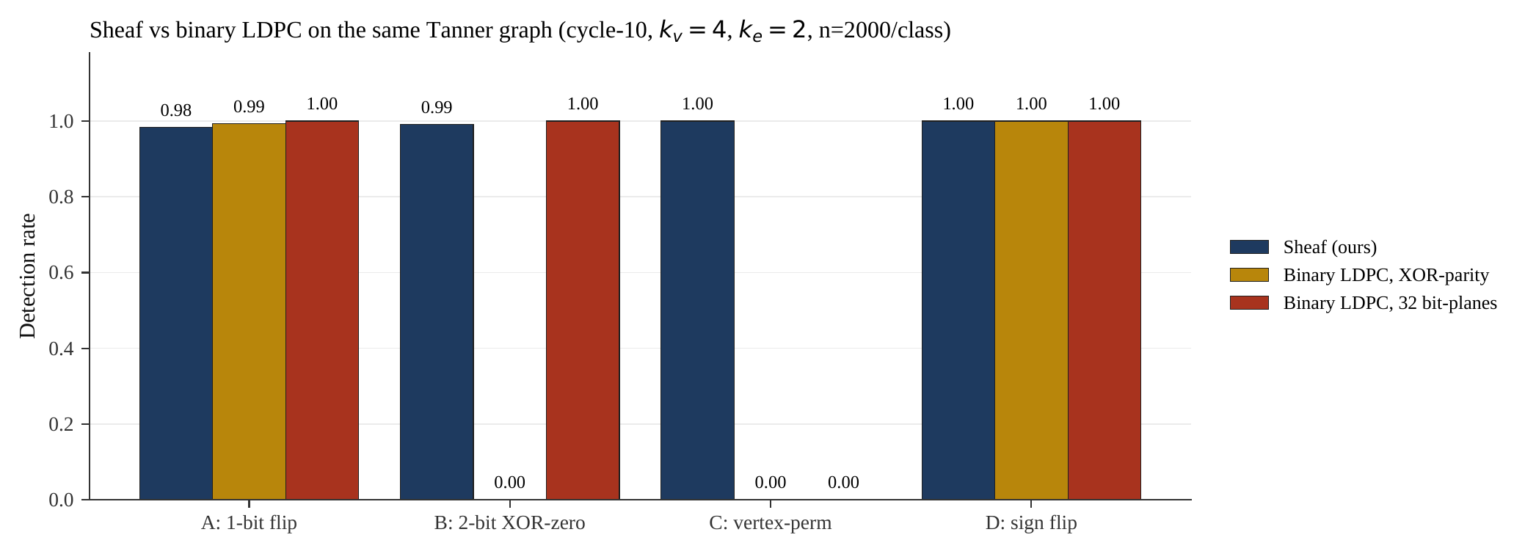
SHEAF VS LDPC
Theorem 2: real-valued restriction maps catch faults that binary parity cannot
Theorem 2 (Sheaf–LDPC separation)
Consider any binary LDPC code on the same Tanner graph as the sheaf. There exists a class of physically realistic faults — vertex-block scalar permutations — that the sheaf detects with probability one and that no binary LDPC code on the same support can detect.
Why the swap is invisible to binary parity
before strike
3.14
2.71
1.41
0.58
Sheaf check: each scalar is weighted by a distinct real-valued column. Swap → non-zero syndrome.
after vertex-permutation strike (slot 1 ↔ slot 2)
2.71
3.14
1.41
0.58
Binary parity check: each scalar hashed to one bit (XOR-parity). If both scalars have the same parity bit, the swap is invisible.
20 random binary LDPC codes constructed adversarially on the same support pattern. 40,000 vertex-permutation trials.
Sheaf: 100.00% · Best random LDPC: 97.9%
Leray's Coboundary at Altitude · Vaibhav Shakya · 2026
8 / 16

Slide 9
RESULTS OVERVIEW
Empirical campaign: fifteen experiments, deterministic seeds
Every experiment is driven by a fixed random seed and is reproducible from the released code with one command. Sample sizes were chosen per experiment to deliver 95% Wilson confidence intervals narrower than five percentage points on the primary outcome.
258,645
0 of 10,300
fault trials
false positives on clean trials
across 15 experiments, deterministic seeds
Wilson upper bound 3.7 × 10⁻⁴
100%
83.2%
63%
five algebraic frontends
statistical frontend
energy saved vs always-on TMR
linear, polynomial, PWL, NN, nonlinear
structural noise-floor ceiling
modelled 24-month Europa Clipper
Detection at 100% on five frontends is striking, but the cleanest single result is the zero false positives across 10,300 fault-free runs — the framework does not cry wolf.
Leray's Coboundary at Altitude · Vaibhav Shakya · 2026
9 / 16

Slide 10
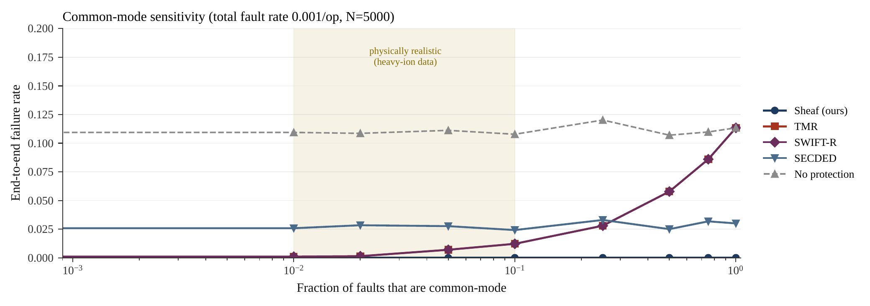
WHERE TMR FAILS AND WE DON'T
Common-mode resilience across the full contamination range
The single sweep that most distinguishes the framework: vary the fraction of faults that are common-mode (correlated across replicas) from 0 to 100% at a fixed per-operation fault rate. TMR's failure rate climbs with correlation. The sheaf's stays at zero across 45,000 trials.
0%
sheaf failure across 45,000 trials
11.3%
TMR failure at 100% common-mode
1–10%
common-mode in heavy-ion data
The structural reason: TMR votes on identical replicas, so correlated errors are unanimous. The sheaf checks algebraic relations between distinct state variables — correlated noise produces a non-zero syndrome regardless of how the underlying error was distributed.
Leray's Coboundary at Altitude · Vaibhav Shakya · 2026
10 / 16

Slide 11
HONEST LIMITS
Where the framework fails or underperforms
Three regimes where the headline numbers degrade, and one synthetic-program edge case. None of these were buried; surfacing them is necessary to make the strong claims credible.
Statistical frontend ceiling
Multi-fault degradation
Adversarial LDPC margin
17%
24%
2.1 pp
miss rate at deployment scale
recovery at k = 20 faults
lead over best random LDPC
PCA-derived invariants have a numerical floor near 10⁻². Sub-floor faults are absorbed.
OMP recovery guarantee is k ≲ √n. At k=15 we hit 53%, at k=20 we hit 24%.
Best of 20 random binary LDPC codes catches 97.9% of vertex-permutation faults.
Plus: 2.3% of randomly generated linear programs fail the structured-map rank lemma across 26,153 tested vertices. Real flight code with continuous sensor calibrations passes the lemma everywhere; only pathological synthetic constants produce the failure. The almost-sure qualifier in the proof is doing real work.
Leray's Coboundary at Altitude · Vaibhav Shakya · 2026
11 / 16

Slide 12
COMPOSITIONAL PROTECTION
Composing two frontends on one task: a quaternion attitude controller
A spacecraft attitude controller has both a linear part (a Kalman update on body rates) and a polynomial part (the quaternion norm constraint ‖q‖² = 1). The framework lets us protect the same task three ways: with the linear frontend alone, the polynomial frontend alone, or by stacking both via block-diagonal parity-check matrices. Four fault scenarios were tested at 1,000 trials each.
What composition buys
Burst scenario:
97.5% → 99.5%
Faults that escape one frontend are caught by the other.
Rate-flip scenario:
Polynomial frontend is blind by design (0%) — it doesn't see body rates. Composed regime recovers the linear regime's 66.7%.
Cost: block-diagonal stack of two H matrices. No new algorithm.
Leray's Coboundary at Altitude · Vaibhav Shakya · 2026
12 / 16

Slide 13

ENGINEERING TRACTABILITY
Runtime and memory: microseconds per check, kilobytes per matrix
Two measurements taken on this x86-64 Linux container. Memory: the sparse parity-check matrix in CSR format. Latency: median wall-clock time for one syndrome check and for one OMP recovery (single-fault and 5-fault), across 20 trials per frontend.
Caveat: x86-64 Linux, not RAD750.
Absolute numbers on flight hardware will differ. The portable claim is the scaling: linear-in-nnz syndrome check, O(n^1.5) OMP on dense H, sparse-CSR footprint dominated by non-zero count. All three trends persist regardless of processor.
Leray's Coboundary at Altitude · Vaibhav Shakya · 2026
13 / 16

Slide 14
MISSION-INTEGRATED ENERGY
Adaptive sheaf on a modelled 24-month Europa Clipper profile
63%
energy saved at 97.6% mean coverage
The adaptive strategy switches between low-coverage cruise and high-coverage flyby configurations based on a particle-flux threshold. The 63% number reflects the integrated energy across six Jupiter flybys at months 3, 7, 11, 14, 17, and 20 against always-on TMR.
TMR always
Max sheaf
Adaptive (ours)
Min sheaf
72 unit-mo @ 98.9%
36 unit-mo @ 99.0%
27 unit-mo @ 97.6%
24 unit-mo @ 92.0%
The adaptive strategy beats max-sheaf on energy and TMR on both axes simultaneously.
14 / 16

Slide 15



BEYOND SPACECRAFT
Where else the same edge applies
The framework's specific advantages — semantic invariants instead of bit-level parity, immunity to common-mode contamination, frontend extensibility — match the engineering needs of three other domains where similar pressures apply.
Autonomous-vehicle control
Electronic stability, adaptive cruise, lane-keeping loops face transient faults from electromagnetic interference and aging-induced bit upsets. The linear and polynomial frontends cover the typical control-loop invariants; common-mode resilience addresses the correlated failures that affect physically adjacent transistors.
Medical device firmware
Insulin pumps and cardiac pacemakers carry regulatory-critical dose-calculation and pacing-decision logic. The statistical frontend's principal-component approach naturally covers the patient-specific calibration curves these devices maintain across their service life.
Industrial process control
Nuclear plant programmable logic controllers and refinery distributed control systems carry sensor mass-balance, energy-balance, and thermodynamic-consistency relations — exactly the algebraic invariants the polynomial frontend was built to encode.
Leray's Coboundary at Altitude · Vaibhav Shakya · 2026
15 / 16

Slide 16
CONCLUSION
What the framework establishes
A single mathematical object — the cellular sheaf — recovers Hamming/SECDED, ABFT, and SWIFT as special cases. It dominates binary low-density parity-check codes on the same Tanner graph on a structurally identifiable fault class. It delivers 63% mission-integrated energy savings against always-on TMR while preserving immunity to common-mode contamination.
THE NEXT STEPS
Heavy-ion beam test on a radiation-hardened processor — replace modelled fault distributions with measured ones.
Extend the Sheaf-LDPC separation from within-vertex to cross-vertex permutations.
Apply the framework to autonomous-vehicle and medical-device firmware as a compiler pass.
github.com/vaibhavshakya11/lerays-coboundary-at-altitude
Vaibhav Shakya · Jayshree Periwal International School · 2026

