Slide 1
Human Inspired AI for Intelligent Traffic Management
IT 207 project presentation
Software prototype with video analytics and adaptive signal recommendations
Student and institution details: complete before submission
IT 207 | software-only prototype | simulation results are synthetic

Slide 2
Problem and project scope
Approach demand changes over time; fixed green allocations may not reflect current queues.
The project uses recorded video, software analysis, and simulated control.
No IoT devices, physical sensors, or traffic-light hardware are connected.
The supplied workspace had no video, labels, pretrained weights, or prior experiment output.
IT 207 | software-only prototype | simulation results are synthetic

Slide 3
Human cognition mapping
Selective attention: configurable lane and region-of-interest polygons.
Working memory: bounded traffic history and SQLite observations.
Learning: forecasting model code for Random Forest, XGBoost, and LSTM.
Decision-making: weighted demand, queue, waiting, and fairness inputs for green allocation.
These are computational analogies, not psychological measurements.
IT 207 | software-only prototype | simulation results are synthetic

Slide 4
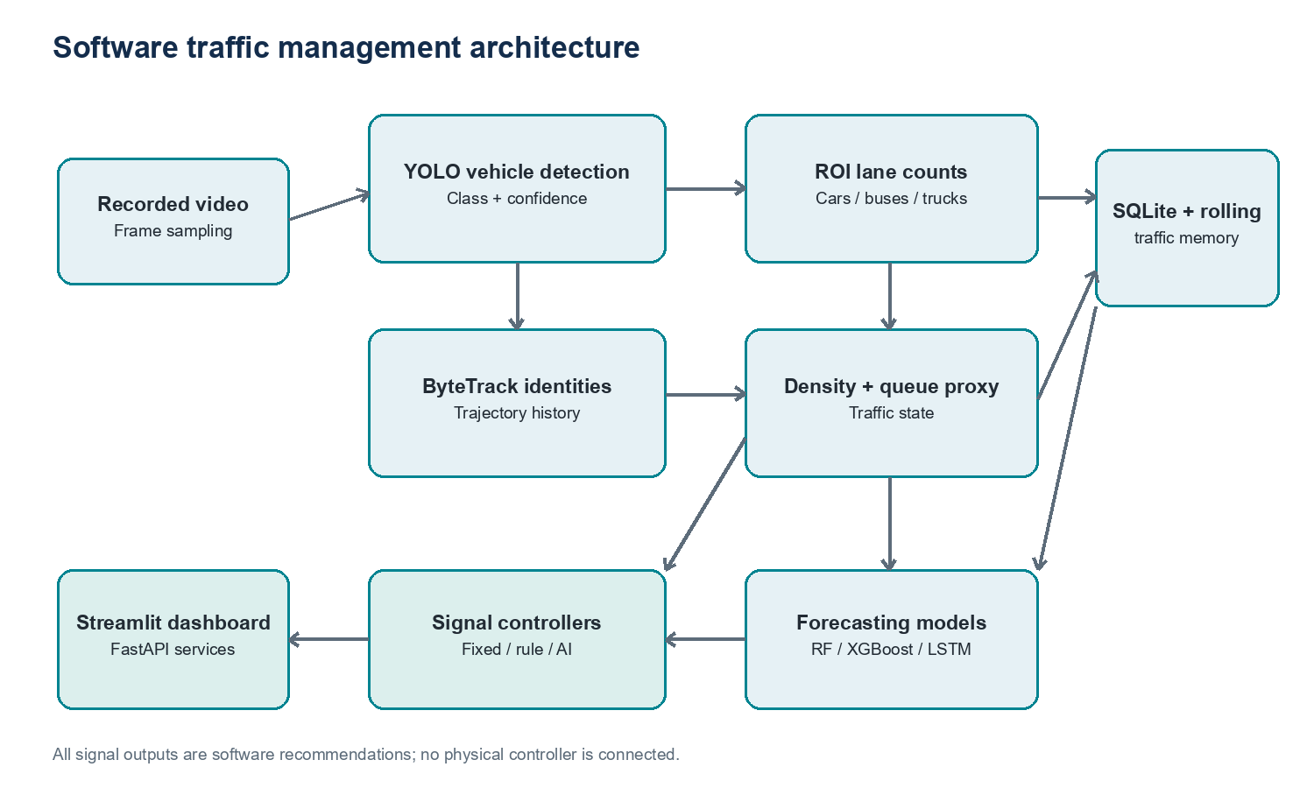
System architecture
Software recommendations only; no physical controller is connected.

Slide 5
Implementation status
Existing: detector, tracker, analyser, predictor classes, controllers, API, dashboard, and config.
Repaired: seeded simulation, scenario-specific demand, same simulated horizon, and metric units.
Not run: video inference, tracking metrics, forecast validation, full dashboard, and SUMO.
The environment had Python 3.14 and lacked the project's video and web runtime packages.
IT 207 | software-only prototype | simulation results are synthetic

Slide 6
Experiment design
Four scenarios: low, medium, heavy, and uneven approach demand.
Three controllers compared with the same seeded Poisson arrivals per scenario.
1,800 simulated seconds; 5 m per queued vehicle; 0.5 vehicles per green second.
Metrics: queue delay per completed departure, queue length, throughput per hour, and congestion fraction.
One deterministic run per condition; this is a simplified software simulation.
IT 207 | software-only prototype | simulation results are synthetic

Slide 7
Measured simulated queue delay
One seeded run per condition. Lower is better; synthetic software simulation, not SUMO or road data.

Slide 8
Results interpretation
Uneven demand: AI-assisted had 37.19 s delay and 724 vehicles/hour; fixed-time had 52.62 s and 686 vehicles/hour.
Medium demand: AI-assisted delay was 64.12 s versus 42.86 s fixed; throughput was 598 versus 606 vehicles/hour.
Heavy demand: AI-assisted delay was 103.87 s versus 45.01 s fixed; throughput was 1,168 versus 1,208 vehicles/hour.
The evidence is mixed and does not support a general improvement claim.
IT 207 | software-only prototype | simulation results are synthetic

Slide 9
Ethics and limitations
Video may expose faces, license plates, and movement patterns; minimize retention and restrict access.
Errors may vary by camera angle, lighting, weather, vehicle class, and local traffic mix.
Queue and speed values are rough proxies without camera calibration.
Simulation omits pedestrians, turning conflicts, startup loss, spillback, and repeated-seed uncertainty.
No public-road control is permitted by this prototype; recommendations are software-only.
IT 207 | software-only prototype | simulation results are synthetic

Slide 10
Next steps and references
Install the supported Python 3.11 stack and add compatible YOLO weights.
Evaluate on licensed video with detection and tracking annotations.
Train predictors on time-ordered real data and report forecast errors.
Validate a conflict-free SUMO signal plan and run repeated, multi-intersection scenarios.
References: IT 207 course PDF; Redmon et al. CVPR 2016; Zhang et al. ECCV 2022; Eclipse SUMO docs.
IT 207 | software-only prototype | simulation results are synthetic

