Slide 1
WGST 100-991: Introduction to Women’s and Gender Studies
Week 12: Wednesday, Nov. 21/18
Introduction to the Family, Part I

Slide 2
Final Exam (40%)-Dec. 19th
7-10pm
Wednesday, December 19th
CL 125
There will be 6 essay questions offered (comprehensive but only 2 questions will be from material before the midterm)
You choose three and construct one essay on each of your choices (three essays overall)
Each of your choices will be equally weighted (prorated to 40%).

Slide 3
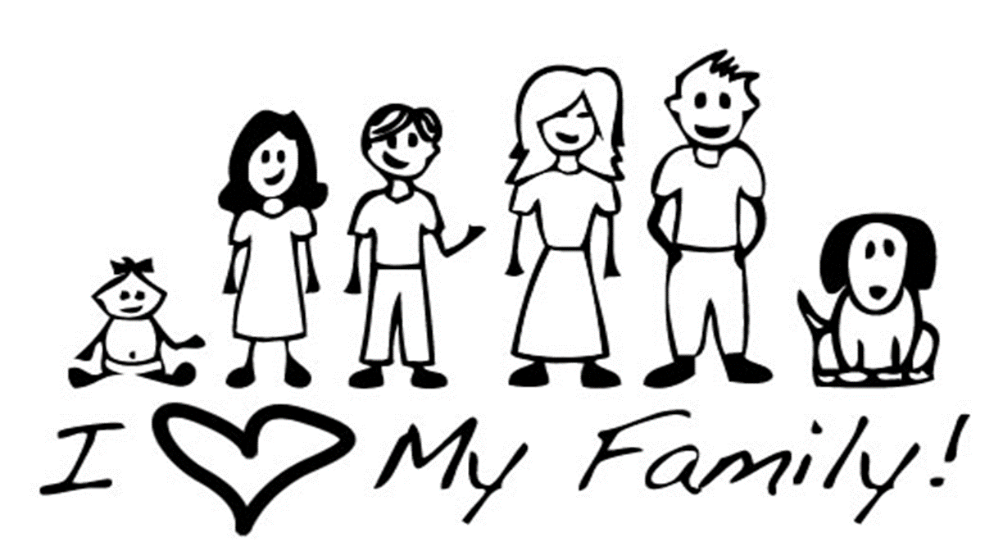
The Family: Introduction

Slide 4
The Family: The Quick and Dirty History
A Brief history of the family as a social institution:
Pre-Industrial-before 1800’s
Industrial-1800’s to 1950
Post-Industrial-1950 to present

Slide 5
The Family-Demographic Patterns
The 20th and 21st century has seen rapid changes in the composition of the family in Canada and western society as a whole.
There are three primary ones.
1. Changes in relative family size.
Overall there has been a long term incremental decline if the size of families.
In Canada the total fertility rate(the measurement of the average number of children born to women between the ages of 15-49) has declined from:
6.8 children per woman in 1851
3.53 children per woman in 1921
1.53 children per woman in 2003

Slide 6
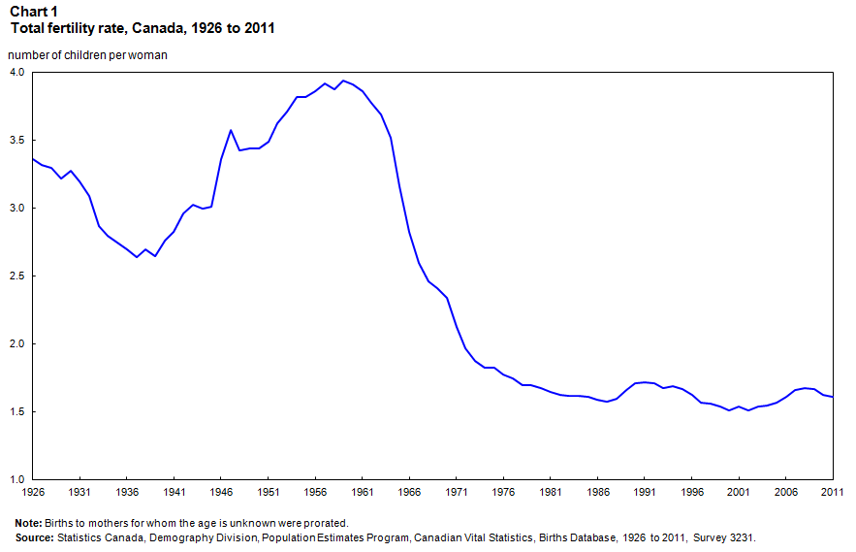
The Family: Demographic Patterns-Birth Rate

Slide 7
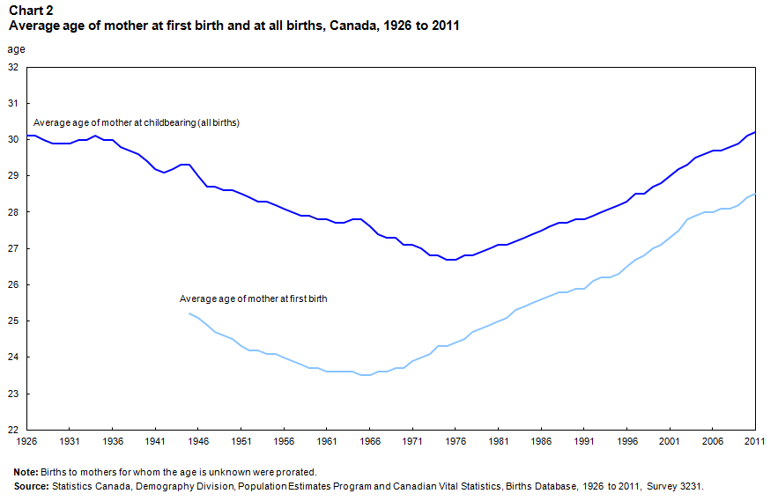
The Family: Demographic Patterns-Birth Rate

Slide 8
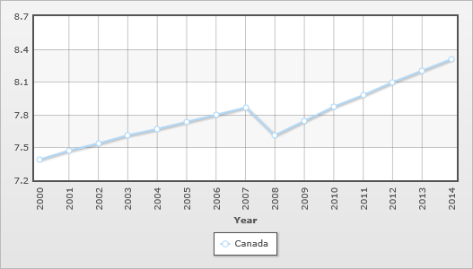
The Family: Demographic Patterns-Death Rate

Slide 9
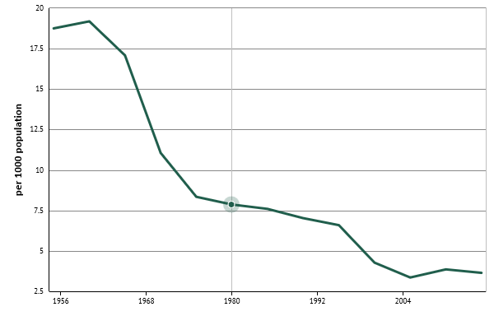
The Family: Demographic Patterns-Rate of Natural Increase

Slide 10
The Family: Demographic Patterns
2. Divorce Rates
Overall an upward trend due to divorce law changes in 1968 and 1985.
6.4 divorces for every 100,000 Canadians in 1921
231 divorces for every 100,000 Canadians in 2000
In fact, almost half of marriages in Canada and the United States end in divorce as of 2012.

Slide 11
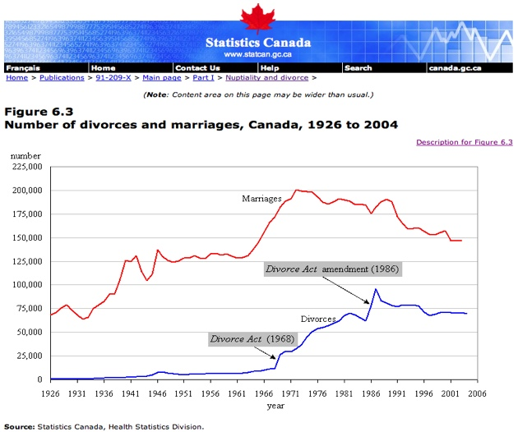
The Family: Demographic Patterns

Slide 12
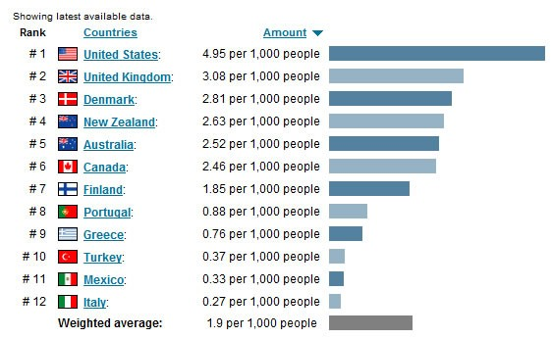
The Family: Demographic Patterns

Slide 13
The Family: Demographic Patterns
3. New Household Arrangements
In the 21st century only 45% of family households are married couples with children.
As per the 2001 census:
25% of households are single-person dwellings
10% of Canadians live completely alone

Slide 14
The Family: Demographic Patterns
Common Law Unions: Legally recognized unions by which two adults form a long term intimate relationship without participating in a legal or religious ceremony.
1981-first collection of data shows 6% of all family households
2001-14% of all family households

Slide 15
The Family: Demographic Patterns
Same Sex Households: which two adults of the same gender form a long term intimate relationship
first measured in the 2001 census.
34,000 couples self declared
19,000 male, 15,200 female

Slide 16
The Family: Demographic Patterns
64,575 — The number of same-sex couple families in 2011, up 42.4% from 2006.
21,015 — The number of same-sex married couples.
43,560 — The number of same-sex common-law couples.
0.8% — The proportion of all couples in 2011 who were same-sex couples.
54.5% — The proportion of same-sex couples who were male.
45.5% — The proportion of same-sex couples who were female.
25.3% — The proportion of same-sex married spouses and common-law partners aged 15 to 34.
17.5% — The proportion of opposite-sex married spouses and common-law partners aged 15 to 34.
6.2% — The proportion of same-sex married spouses and common-law partners aged 65 and over.

Slide 17
The Family: Demographic Patterns
Lone Parent Families: only one parent in the household.
In 1950, 60% lone parents were widowed, only 20% presently.
Why the change?

Slide 18
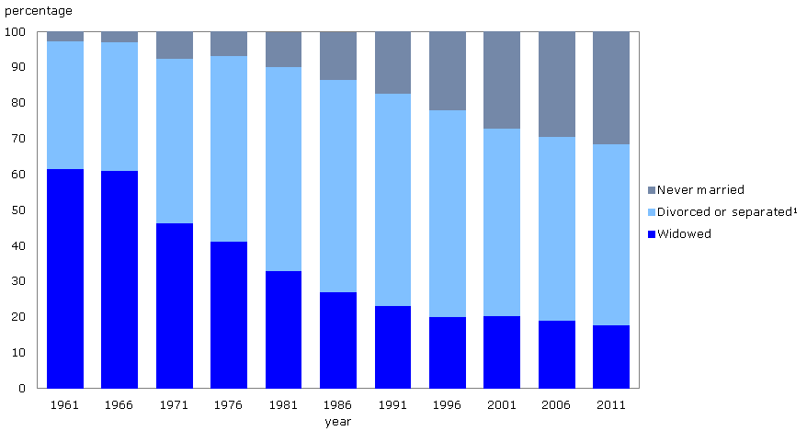
The Family: Demographic Patterns

Slide 19
The Family: Demographic Patterns
Parental Status
Married
CLU
Lone Mothers
Lone Fathers
Percent
70%
14%
13%
3%

Slide 20
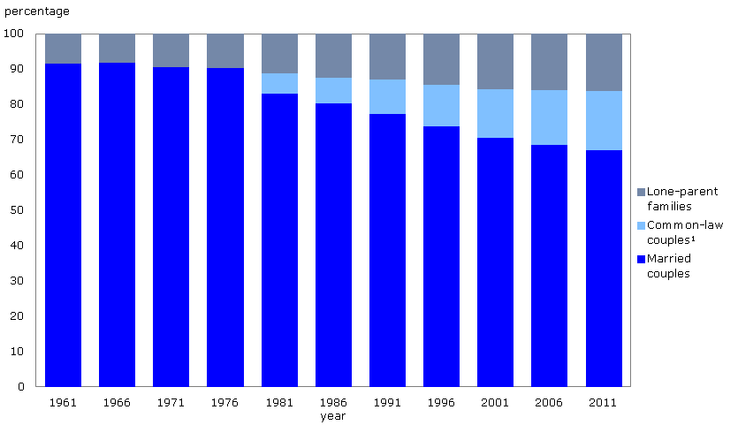
The Family: Demographic Patterns

