Slide 1
WGST 100-991: Introduction to Women’s and Gender Studies
Week 12: Wednesday, Nov. 21/18
The Family, Part II

Slide 2
The Family: Demographic Patterns
Step Families: a family in which at least one of the children in the household is from a previous of one of the parents.
Blended Families: contains children from both spouses from one or more previous unions and one or more from the current one.
12% of all families with children were step families.
Nearly half (49.7%) of same-sex couples with children were stepfamilies, while 12.5% of opposite-sex couples with kids were stepfamilies.
The total number of step families is split equally between married and common law couples, just over 250,000 of each.

Slide 3
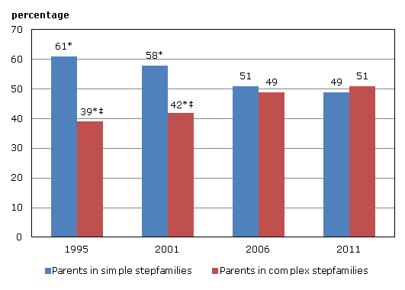
The Family: Demographic Patterns
Percentage of parents in stepfamilies aged 20 to 64, by type of stepfamily, Canada, 1995 to 2011.

Slide 4
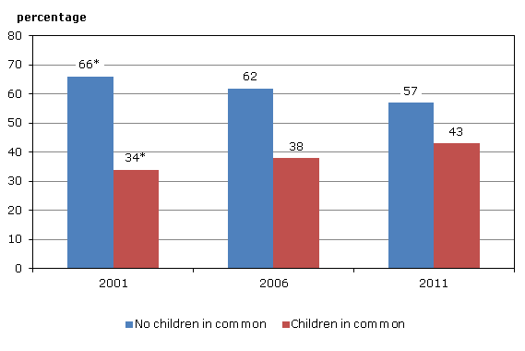
The Family: Demographic Patterns
Percentage of parents aged 20 to 64 living in a stepfamily, by having a child in common, Canada, 2001 to 2011

Slide 5
The Family: Demographic Patterns
Types of Step Families
His Children
Her Children
Blended (children in common)
Blended (no children in common)
Percentage
10%
50%
32%
8%

Slide 6
The Family: Traditional-The Ideal
Traditional Families: traditionally contains one unit of a mother (homemaker) and father (breadwinner) with children.
Also called “intact families.”
Is the “traditional family” most desirable?

Slide 7
The Family: Traditional-The Ideal
Most dominant pattern in middle-class North America in both the early 20th century and briefly in the 1950’s.
Based on the Victorian “ideal” of the two-sphere arrangement.
Breadwinner: men work outside the home as paid income earners for their family.
Homemaker: women work inside the home, unpaid, nurturing and maintaining the children and their husbands.

Slide 8
The Family: Traditional-The Ideal
Assumed by the general population and scholars alike as the ideal form.
Scholars provide the theoretical rationale.
Instrumental Roles: men provide for the tangible needs for a family (money)
Expressive Roles: Women provide the emotional support.

Slide 9
The Family: Traditional-The Ideal
Still advocates for it as the ideal:
REAL Women: extols the virtues of families where moms need to stay home for the overall health of the family.
Social Conservatives: long for the “good old days” and lament that the current issues of youth drugs, bullying, and violence due to lack of supervision at home.

Slide 10
The Family: Traditional-The Ideal?
But reality is usually much different.
Women:
Homemaking often thankless and unrewarding on a personal level.
Women in this role often feel unfulfilled on a personal level.
Untapped potential stifled under domestic responsibilities.
Completely dependent on their husband.
Is this all there is to life?
Rapid rise in depression and prescription drug use for middle-class women.

Slide 11
The Family: Traditional-The Ideal?
Men:
Granted decision-making authority and overall responsibility.
Sole pressure to provide.
Masculine expectations to make money and have family “prosper.”
Pressure to provide limits emotional connection and failure mixed in with loss of manhood.

Slide 12
The Family: Changing Dynamics
Overall, is it sustainable in the realities of the 21st century?
Why or why not?

Slide 13
The Family: Changing Dynamics
Luxton Study: Canadian Sociologist Meg Luxton.
A sample of 49 Canadian couples with at least one child under the age of 12 and both parents working.
Hierarchical Relations: 15%, it was agreed among the spouses that it would be better of if the woman stayed at home but not financially feasible.
Spheres to be separate and rigid.
The female did double duty and exhausted.
As such, they found their lives significantly worse off than simply staying in the home.
Children taught traditional family values.

Slide 14
The Family: Changing Dynamics
Separate Spheres/Cooperative Relations: 35%
Agree men and women to have separate priorities within and without the home.
But it is appropriate to help each other out when needed.
Women still did the vast majority of house work but the standard was relaxed to fit the situation.
It is ok to live with a little mess or eat out if life gets too hectic.
Children taught traditional family values.

Slide 15
The Family: Changing Dynamics
Shared Spheres/Changing Relations: 51%
Women have the right to work if they so wish.
Partners should be equal in both spheres.
Problems:
However, even though they said this it was evident, according to Luxton, that it strained their relationship.
Men felt women pressured them to help out.
Women felt men only helped when they had too and quality of help was low.

Slide 16
The Family: Changing Dynamics
Hochshild Study
Multi-year study of select families based on interviews and observation.
Findings revolve around division of labour arrangements.
Second Shift: women shoulder the bulk of domestic labour, even when they work longer hours or higher pay then spouses.
Third Shift: women also do the bulk of volunteer and community activities.

Slide 17
The Family: Changing Dynamics
Findings also suggest that every family develops a “gender strategy” through which they try to solve the problems at hand.
This strategy invariably follow cultural notions of gender roles.
Hochschild also suggests that western culture is in the midst of what he termed a “staled revolution.”
This means that while the actual activities of family members have changed along gender lines the institutions with society have not changed with them/
Example: while women are recognized as equal work places still have issues with accommodating family responsibilities.

