Slide 1
WGST 100-991: Introduction to Women’s and Gender Studies
Week 12: Wednesday, Nov. 21/18
The Workplace, Part III

Slide 2

Gender and Paid Work

Slide 3
Gender and Paid Work
Historically, Industrial Revolution ushered in a large-scale separation between the home and work-place.
Women primarily became laborers of the home while the paid workforce were the domain of men.
This is dubbed the “two-sphered arrangement” of labor.
The result of this is that men, by default, have historically earned more in the paid workforce than women.

Slide 4
Gender and Paid Work
Another aspect of interest is that the two-sphered arrangement has shaped the paid workplace as well.
According to research by Meier in the late 20th century many workplaces have been characterized as masculine due to the organizational practices that evolved from having primarily male workers.
Meier concludes that “a lasting consequence of the industrial revolution in society (and the related sex segregation of human activity) has been the creation of a bureaucratic social order grounded in the norms conventionally ascribed to men.”
He categorizes characteristics of jobs and positions and links them to those of traditional concepts of masculinity and femininity.

Slide 5
Gender and Paid Work
Masculine Workplace Characteristics
Feminine Workplace Characteristics
Competing
Relying on argument
Commanding
Ladder/pyramid/hierarchy
Directing
Compliance
Physicality
Collaborating
Relying on dialogue
Empowering
Network/community
Inspiring
Commitment
Appearance

Slide 6
Gender and Paid Work
The overall result of this is less quality of positions available and general lack of mobility in the work hierarchy.
This contrasts with the reality that more women are now in the workplace than ever before.
For example, in the 1960’s only a quarter of women in Canada over the age of 15 participate din the paid workforce. Currently that number is over 60%.
Furthermore, more participation does not mean equality of opportunity.
Women in Canada still are only paid three quarters (on average) the pay of men in similar positions.

Slide 7
Gender and Paid Work
The best overall example of this disparity in opportunity is the sheer number of quality of positions available to each gender (i.e. full time positions).
According to StatsCan, women still comprise the bulk of part-time employment in Canada.
Also, the reasons given by workers themselves follow gender trends.

Slide 8
Gender and Paid Work
Age | Female-Part time | Male-Part time
15-24 | 52% | 37%
25-54 | 21% | 5%
55-64 | 30% | 11%

Slide 9
Gender and Paid Work
Reasons | Female | Male
Child/family/personal responsibilities | 18% | 2%
School commitments | 25% | 42%
Personal illness | 3% | 4%
Could not find full-time work | 26% | 28%
Personal preference | 27% | 23%

Slide 10
Gender and Paid Work
Earnings ratio by sex in Canada:
http://www.statcan.gc.ca/tables-tableaux/sum-som/l01/cst01/labor01a-eng.htm

Slide 11
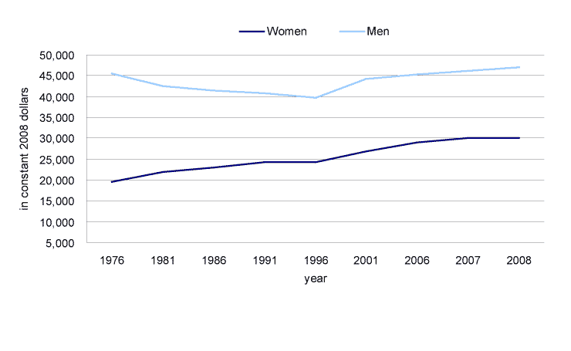
Gender and Paid Work

Slide 12
Gender and Paid Work
By Province:
http://www.statcan.gc.ca/pub/89-503-x/2010001/article/11388/tbl/tbl001-eng.htm

Slide 13
Gender and Paid Work
By Age:
http://www.statcan.gc.ca/pub/89-503-x/2010001/article/11388/tbl/tbl002-eng.htm

Slide 14
Gender and Paid Work
By Family type:
http://www.statcan.gc.ca/pub/89-503-x/2010001/article/11388/tbl/tbl003-eng.htm

Slide 15
Gender and Paid Work
Occupational Segregation: The different locations of men and women in the paid labor force.
Think about the working people you have encountered recently.
What was the job and what sex was the person?
Is this typical in your experience?

Slide 16
Gender and Paid Work
Two basic types of occupational segregation.
1. Horizontal Segregation: patterns of segregation that results in a concentration of men and women in different jobs.
In short, it’s the cluster of men and women around certain jobs.
Example: nurses are mostly women and construction workers primarily men.
2.Vertical Segregation: separation of men and women into different levels of authority and pay in a particular workplace hierarchy.
Invariably men are found in higher-level, better paying positions in the same workplace organization.
Glass Ceiling-unacknowledged barrier to advancement within an occupation or profession for women.

Slide 17
Gender and Paid Work
Even when women over-achieve in the hierarchy they are still faced with unique challenges for success.
According to Kantner there are two primary challenges for women.
1. Performance Pressure
If you are one of many no one pays any particular attention to you.
However, if you outperform relative to expectations then people tend to scrutinize more.
A woman successful in her occupation receives undue scrutiny and is constantly assessed as to whether she truly deserves the success or not.
Thus pressure to perform is much higher for a successful woman.

Slide 18
Gender and Paid Work
2. Marginalization
The successful woman, according to Kantner, is an anomaly to society in general.
As such, she is treated as an outsider both in the workplace and outside it as well.
This can create social isolation.

Slide 19
Gender and Paid Work
A third challenge not mentioned by Kantner but researched by others over the years is the hostile work environment.
It rests on the sexual conduct of the workplace that makes its environment offensive or intimidating for female employees.
Women are the primary recipients of workplace sexual harassment and misconduct.
Further, they tend to receive less mentoring and more negativity with their presence.
This partially explains why genders tend to cluster around sex specific jobs which increases comfort levels by being around similar people with similar experiences.

Slide 20
Gender and Paid Work: University Degrees Earned by Women
Education Level | 1973 | Present
B.A./Professional Degree | 38.4% | 57.7%
M.A. | 27.1% | 51.4%
Doctorate | 18.8% | 50.9%
All University Degrees | 37% | 56.7%

Slide 21
Gender and Paid Work: Income by Education
Education Level | Female Ave Wage | Male Ave Wage | Ratio
Less than Gr. 9 | $21,700 | $31,200 | 69.4%
Some H.S. | $22,900 | $40,000 | 57.3%
H.S. Diploma | $30,500 | $43,000 | 71%
Some Post-Secondary | $31,500 | $41,600 | 75%
University Degree | $53,400 | $77,500 | 68.9%

Slide 22
Gender and Paid Work: Top 10 Jobs by Sex
Male Occupations | Percent
Other Sales | 6.93%
Clerical | 5.5%
Transport/Equipment Operator | 5.07%
Machine Operator | 4.89%
Trades | 4.41%
Managers | 4.33%
Mechanics | 4.3%
Agriculture | 4.21%
Construction | 4.08%
Professional (Natural/Applied Science) | 3.62%

Slide 23
Gender and Paid Work: Top 10 Jobs by Sex
Female Occupations | Percentage
Clerical | 17.34%
Other Sales | 8.49%
Secretaries | 7.91%
Retail Sales | 5.76%
Teachers | 5.19%
Child Care | 4.02%
RN’s and Health Care Support | 3.71%
Food and Beverage | 3.42%
Cashiers | 3.39%
Managers: Retail, Food, Accommodation | 2.84%

