Slide 1
Part I: Fundamentals of Programming

Slide 2
Outline
Chapter 1 Introduction to Computers, Programs, and Java
Chapter 2 Elementary Programming
Chapter 3 Selections
Chapter 4 Mathematical Functions, Characters, and Strings
Chapter 5 Loops
Chapter 6 Methods
Chapter 7 Single-Dimensional Arrays
Chapter 8 Multidimensional Arrays

Slide 3
Chapter 1 Introduction to Computers, Programs, and Java

Slide 4
Programs
Computer programs, known as software, are instructions to the computer.
You tell a computer what to do through programs. Without programs, a computer is an empty machine. Computers do not understand human languages, so you need to use computer languages to communicate with them.
Programs are written using programming languages.

Slide 5
Programming Languages
Machine Language Assembly Language High-Level Language
Machine language is a set of primitive instructions built into every computer. The instructions are in the form of binary code, so you have to enter binary codes for various instructions. Program with native machine language is a tedious process. Moreover the programs are highly difficult to read and modify. For example, to add two numbers, you might write an instruction in binary like this:
  1101101010011010

Slide 6
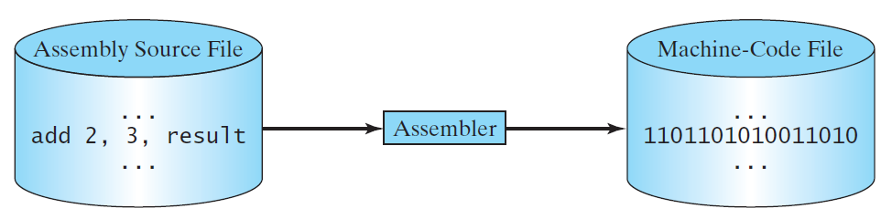
Programming Languages
Machine Language Assembly Language High-Level Language
Assembly languages were developed to make programming easy. Since the computer cannot understand assembly language, however, a program called assembler is used to convert assembly language programs into machine code. For example, to add two numbers, you might write an instruction in assembly code like this:
ADDF3 R1, R2, R3

Slide 7
Programming Languages
Machine Language Assembly Language High-Level Language
The high-level languages are English-like and easy to learn and program. For example, the following is a high-level language statement that computes the area of a circle with radius 5:
area = 5 * 5 * 3.1415;

Slide 8

Popular High-Level Languages

Slide 9
Interpreting/Compiling Source Code
A program written in a high-level language is called a source program or source code. Because a computer cannot understand a source program, a source program must be translated into machine code for execution. The translation can be done using another programming tool called an interpreter or a compiler.

Slide 10

Interpreting Source Code
An interpreter reads one statement from the source code, translates it to the machine code or virtual machine code, and then executes it right away, as shown in the following figure. Note that a statement from the source code may be translated into several machine instructions.

Slide 11

Compiling Source Code
A compiler translates the entire source code into a machine-code file, and the machine-code file is then executed, as shown in the following figure.

Slide 12
Why Java?
The answer is that Java enables users to develop and deploy applications on the Internet for servers, desktop computers, and small hand-held devices. The future of computing is being profoundly influenced by the Internet, and Java promises to remain a big part of that future. Java is the Internet programming language.
Java is a general purpose programming language.
Java is the Internet programming language.

Slide 13
Java, Web, and Beyond
Java can be used to develop standalone applications.
Java can be used to develop applications running from a browser.
Java can also be used to develop applications for hand-held devices.
Java can be used to develop applications for Web servers.

Slide 14
Characteristics of Java
Companion Website
Java Is Simple
Java Is Object-Oriented
Java Is Distributed
Java Is Interpreted
Java Is Robust
Java Is Secure
Java Is Architecture-Neutral
Java Is Portable
Java's Performance
Java Is Multithreaded
Java Is Dynamic
www.cs.armstrong.edu/liang/JavaCharacteristics.pdf

Slide 15
Characteristics of Java
Companion Website
Java Is Simple
Java Is Object-Oriented
Java Is Distributed
Java Is Interpreted
Java Is Robust
Java Is Secure
Java Is Architecture-Neutral
Java Is Portable
Java's Performance
Java Is Multithreaded
Java Is Dynamic
Java is partially modeled on C++, but greatly simplified and improved. Some people refer to Java as "C++--" because it is like C++ but with more functionality and fewer negative aspects.

Slide 16
Characteristics of Java
Companion Website
Java Is Simple
Java Is Object-Oriented
Java Is Distributed
Java Is Interpreted
Java Is Robust
Java Is Secure
Java Is Architecture-Neutral
Java Is Portable
Java's Performance
Java Is Multithreaded
Java Is Dynamic
Java is inherently object-oriented. Although many object-oriented languages began strictly as procedural languages, Java was designed from the start to be object-oriented. Object-oriented programming (OOP) is a popular programming approach that is replacing traditional procedural programming techniques.
One of the central issues in software development is how to reuse code. Object-oriented programming provides great flexibility, modularity, clarity, and reusability through encapsulation, inheritance, and polymorphism.

Slide 17
Characteristics of Java
Companion Website
Java Is Simple
Java Is Object-Oriented
Java Is Distributed
Java Is Interpreted
Java Is Robust
Java Is Secure
Java Is Architecture-Neutral
Java Is Portable
Java's Performance
Java Is Multithreaded
Java Is Dynamic
Distributed computing involves several computers working together on a network. Java is designed to make distributed computing easy. Since networking capability is inherently integrated into Java, writing network programs is like sending and receiving data to and from a file.

Slide 18
Characteristics of Java
Companion Website
Java Is Simple
Java Is Object-Oriented
Java Is Distributed
Java Is Interpreted
Java Is Robust
Java Is Secure
Java Is Architecture-Neutral
Java Is Portable
Java's Performance
Java Is Multithreaded
Java Is Dynamic
You need an interpreter to run Java programs. The programs are compiled into the Java Virtual Machine code called bytecode. The bytecode is machine-independent and can run on any machine that has a Java interpreter, which is part of the Java Virtual Machine (JVM).

Slide 19
Characteristics of Java
Companion Website
Java Is Simple
Java Is Object-Oriented
Java Is Distributed
Java Is Interpreted
Java Is Robust
Java Is Secure
Java Is Architecture-Neutral
Java Is Portable
Java's Performance
Java Is Multithreaded
Java Is Dynamic
Java compilers can detect many problems that would first show up at execution time in other languages.
Java has eliminated certain types of error-prone programming constructs found in other languages.
Java has a runtime exception-handling feature to provide programming support for robustness.

Slide 20
Characteristics of Java
Companion Website
Java Is Simple
Java Is Object-Oriented
Java Is Distributed
Java Is Interpreted
Java Is Robust
Java Is Secure
Java Is Architecture-Neutral
Java Is Portable
Java's Performance
Java Is Multithreaded
Java Is Dynamic
Java implements several security mechanisms to protect your system against harm caused by stray programs.

Slide 21
Characteristics of Java
Companion Website
Java Is Simple
Java Is Object-Oriented
Java Is Distributed
Java Is Interpreted
Java Is Robust
Java Is Secure
Java Is Architecture-Neutral
Java Is Portable
Java's Performance
Java Is Multithreaded
Java Is Dynamic
Write once, run anywhere
With a Java Virtual Machine (JVM), you can write one program that will run on any platform.

Slide 22
Characteristics of Java
Companion Website
Java Is Simple
Java Is Object-Oriented
Java Is Distributed
Java Is Interpreted
Java Is Robust
Java Is Secure
Java Is Architecture-Neutral
Java Is Portable
Java's Performance
Java Is Multithreaded
Java Is Dynamic
Because Java is architecture neutral, Java programs are portable. They can be run on any platform without being recompiled.

Slide 23
Characteristics of Java
Companion Website
Java Is Simple
Java Is Object-Oriented
Java Is Distributed
Java Is Interpreted
Java Is Robust
Java Is Secure
Java Is Architecture-Neutral
Java Is Portable
Java's Performance
Java Is Multithreaded
Java Is Dynamic
Java’s performance Because Java is architecture neutral, Java programs are portable. They can be run on any platform without being recompiled.

Slide 24
Characteristics of Java
Companion Website
Java Is Simple
Java Is Object-Oriented
Java Is Distributed
Java Is Interpreted
Java Is Robust
Java Is Secure
Java Is Architecture-Neutral
Java Is Portable
Java's Performance
Java Is Multithreaded
Java Is Dynamic
Multithread programming is smoothly integrated in Java, whereas in other languages you have to call procedures specific to the operating system to enable multithreading.

Slide 25
Characteristics of Java
Companion Website
Java Is Simple
Java Is Object-Oriented
Java Is Distributed
Java Is Interpreted
Java Is Robust
Java Is Secure
Java Is Architecture-Neutral
Java Is Portable
Java's Performance
Java Is Multithreaded
Java Is Dynamic
Java was designed to adapt to an evolving environment. New code can be loaded on the fly without recompilation. There is no need for developers to create, and for users to install, major new software versions. New features can be incorporated transparently as needed.

Slide 26
JDK Versions
JDK 1.02 (1995)
JDK 1.1 (1996)
JDK 1.2 (1998)
JDK 1.3 (2000)
JDK 1.4 (2002)
JDK 1.5 (2004) a. k. a. JDK 5 or Java 5
JDK 1.6 (2006) a. k. a. JDK 6 or Java 6
JDK 1.7 (2011) a. k. a. JDK 7 or Java 7
JDK 1.8 (2014) a. k. a. JDK 8 or Java 8
JDK 1.11 (now)

Slide 27
JDK Editions
Java Standard Edition (J2SE)
  J2SE can be used to develop client-side standalone applications or applets.
Java Enterprise Edition (J2EE)
  J2EE can be used to develop server-side applications such as Java servlets, Java ServerPages, and Java ServerFaces.
Java Micro Edition (J2ME).
  J2ME can be used to develop applications for mobile devices such as cell phones.
This book uses J2SE to introduce Java programming.

Slide 28
Popular Java IDEs
NetBeans (official for this course)
Eclipse

Slide 29
A Simple Java Program
Listing 1.1
// This program prints Welcome to Java!
public class Welcome {
public static void main(String[] args) {
System.out.println("Welcome to Java!");
}
}
Note: Clicking the green button displays the source code with interactive animation. You can also run the code in a browser. Internet connection is needed for this button.
Welcome
Run
Note: Clicking the blue button runs the code from Windows. If you cannot run the buttons, see liveexample.pearsoncmg.com/slide/javaslidenote.doc.

Slide 30
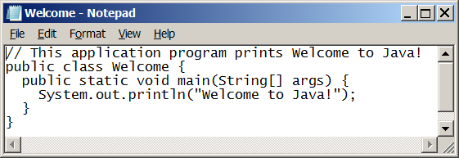
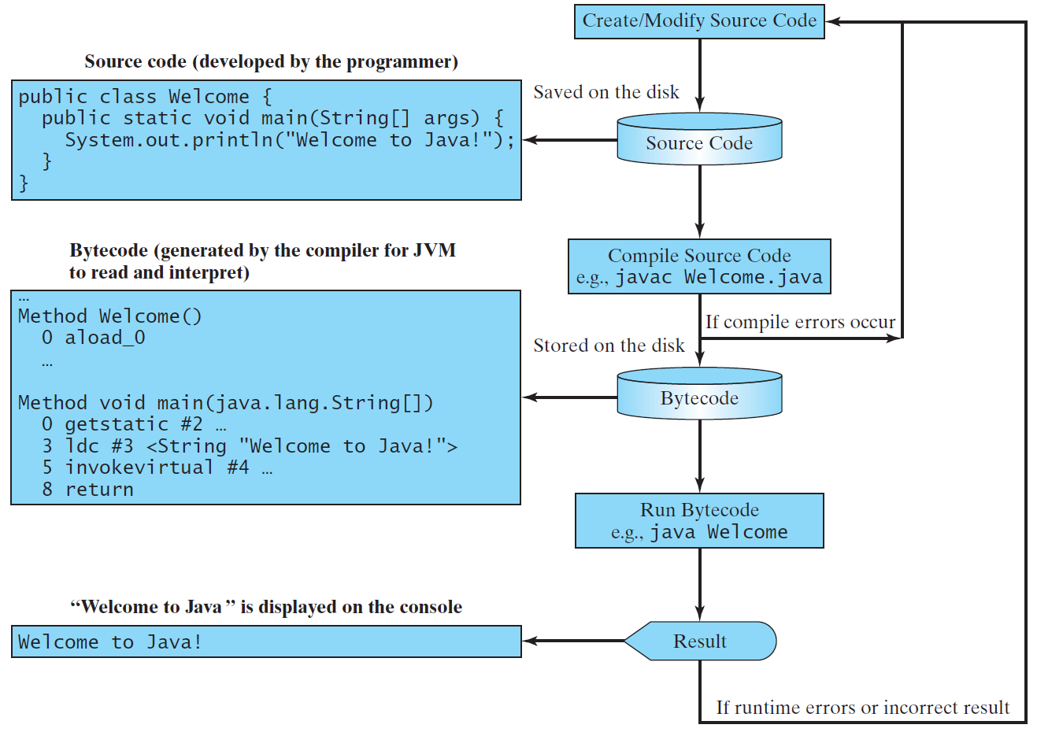
Creating, Compiling, and Running Programs

Slide 31
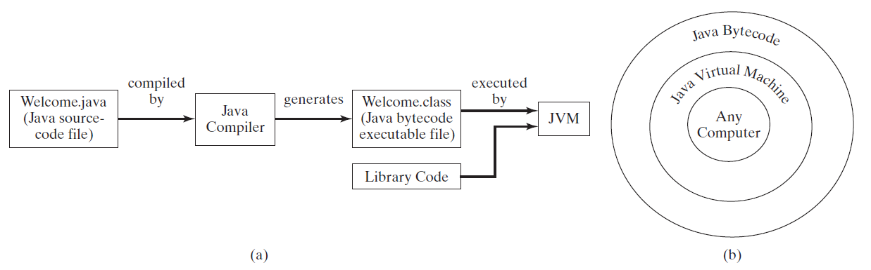
Compiling Java Source Code
You can port a source program to any machine with appropriate compilers. The source program must be recompiled, however, because the object program can only run on a specific machine. Nowadays computers are networked to work together. Java was designed to run object programs on any platform. With Java, you write the program once, and compile the source program into a special type of object code, known as bytecode. The bytecode can then run on any computer with a Java Virtual Machine, as shown below. Java Virtual Machine is a software that interprets Java bytecode.

Slide 32
Trace a Program Execution
animation
Enter main method
// This program prints Welcome to Java!
public class Welcome {
public static void main(String[] args) {
System.out.println("Welcome to Java!");
}
}

Slide 33
Trace a Program Execution
animation
Execute statement
// This program prints Welcome to Java!
public class Welcome {
public static void main(String[] args) {
System.out.println("Welcome to Java!");
}
}

Slide 34

Trace a Program Execution
animation
// This program prints Welcome to Java!
public class Welcome {
public static void main(String[] args) {
System.out.println("Welcome to Java!");
}
}
print a message to the console

Slide 35
Anatomy of a Java Program
Class name
Main method
Statements
Statement terminator
Reserved words
Comments
Blocks

Slide 36
Class Name
Every Java program must have at least one class. Each class has a name. By convention, class names start with an uppercase letter. In this example, the class name is Welcome.
// This program prints Welcome to Java!
public class Welcome {
public static void main(String[] args) {
System.out.println("Welcome to Java!");
}
}

Slide 37
Main Method
Line 2 defines the main method. In order to run a class, the class must contain a method named main. The program is executed from the main method.
// This program prints Welcome to Java!
public class Welcome {
public static void main(String[] args) {
System.out.println("Welcome to Java!");
}
}

Slide 38
Statement
A statement represents an action or a sequence of actions. The statement System.out.println("Welcome to Java!") in the program in Listing 1.1 is a statement to display the greeting "Welcome to Java!“.
// This program prints Welcome to Java!
public class Welcome {
public static void main(String[] args) {
System.out.println("Welcome to Java!");
}
}

Slide 39
Statement Terminator
Every statement in Java ends with a semicolon (;).
// This program prints Welcome to Java!
public class Welcome {
public static void main(String[] args) {
System.out.println("Welcome to Java!");
}
}

Slide 40
Reserved words
Reserved words or keywords are words that have a specific meaning to the compiler and cannot be used for other purposes in the program. For example, when the compiler sees the word class, it understands that the word after class is the name for the class.
// This program prints Welcome to Java!
public class Welcome {
public static void main(String[] args) {
System.out.println("Welcome to Java!");
}
}

Slide 41

Blocks
A pair of braces in a program forms a block that groups components of a program.

Slide 42

Special Symbols

Slide 43
Programming Style and Documentation
Appropriate Comments
Naming Conventions
Proper Indentation and Spacing Lines
Block Styles

Slide 44
Appropriate Comments
Include a summary at the beginning of the program to explain what the program does, its key features, its supporting data structures, and any unique techniques it uses.
Include your name, class section, instructor, date, and a brief description at the beginning of the program.

Slide 45
Naming Conventions
Choose meaningful and descriptive names.
  Do NOT use abbreviations.
Class names:
  Capitalize the first letter of each word in the name. For example, the class name ComputeExpression.
CamelCase Notation
  writing compound words or phrases in which the words are joined without spaces and are capitalized within the compound
  Two varieties:
    UpperCamelCase - every word is capitalized; class names
    lowerCamelCase – the first word is not capitalized; variable names, method names

Slide 46
Proper Indentation and Spacing
Indentation
  Indent two spaces.
Spacing
  Use blank line to separate segments of the code.

Slide 47

Block Styles
Use end-of-line style for braces.

Slide 48
Compiling and Running Java from NetBeans
Companion Website
Check UR Courses for installation guidelines
Vesion: Apache NetBeans IDE 9.0/10.0
Demo Welcome.java in NetBeans
  Create project
  Create package (Do NOT use the default package)
  Create your class (Same name should be used for .java file)

Slide 49

Compiling and Running Java from the Command Window
Companion Website
Install JDK
Set path to JDK bin directory
  set path=c:\Program Files\java\jdk1.8.0\bin
Set classpath to include the current directory
  set classpath=.
Compile
  javac Welcome.java
Run
  java Welcome

Slide 50
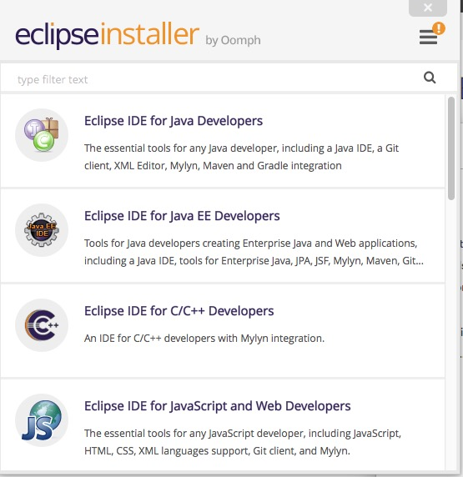
Compiling and Running Java from Eclipse
Companion Website
Not official for this course
Chose Eclipse IDE for Java Developers

