Slide 1
Chapter 2 Elementary Programming

Slide 2
Introducing Programming with an Example
Listing 2.1 Computing the Area of a Circle
This program computes the area of the circle.
ComputeArea
Note: Clicking the green button displays the source code with interactive animation. You can also run the code in a browser. Internet connection is needed for this button.
Run
Note: Clicking the blue button runs the code from Windows. If you cannot run the buttons, see
IMPORTANT NOTE: If you cannot run the buttons, see liveexample.pearsoncmg.com/slide/javaslidenote.doc.

Slide 3
Trace a Program Execution
animation
allocate memory for radius
public class ComputeArea {
/** Main method */
public static void main(String[] args) {
double radius;
double area;
// Assign a radius
radius = 20;
// Compute area
area = radius * radius * 3.14159;
// Display results
System.out.println("The area for the circle of radius " +
radius + " is " + area);
}
}
radius
no value

Slide 4
Trace a Program Execution
animation
public class ComputeArea {
/** Main method */
public static void main(String[] args) {
double radius;
double area;
// Assign a radius
radius = 20;
// Compute area
area = radius * radius * 3.14159;
// Display results
System.out.println("The area for the circle of radius " +
radius + " is " + area);
}
}
memory
radius
no value
area
no value
allocate memory for area

Slide 5
Trace a Program Execution
animation
public class ComputeArea {
/** Main method */
public static void main(String[] args) {
double radius;
double area;
// Assign a radius
radius = 20;
// Compute area
area = radius * radius * 3.14159;
// Display results
System.out.println("The area for the circle of radius " +
radius + " is " + area);
}
}
assign 20 to radius
radius
20
area
no value

Slide 6
Trace a Program Execution
animation
public class ComputeArea {
/** Main method */
public static void main(String[] args) {
double radius;
double area;
// Assign a radius
radius = 20;
// Compute area
area = radius * radius * 3.14159;
// Display results
System.out.println("The area for the circle of radius " +
radius + " is " + area);
}
}
memory
radius
20
area
1256.636
compute area and assign it to variable area

Slide 7

Trace a Program Execution
animation
public class ComputeArea {
/** Main method */
public static void main(String[] args) {
double radius;
double area;
// Assign a radius
radius = 20;
// Compute area
area = radius * radius * 3.14159;
// Display results
System.out.println("The area for the circle of radius " +
radius + " is " + area);
}
}
memory
radius
20
area
1256.636
print a message to the console

Slide 8
Reading Input from the Console
1. Create a Scanner object
  Scanner input = new Scanner(System.in);
2. Use the method nextDouble() to obtain to a double value. For example,
  System.out.print("Enter a double value: ");
  Scanner input = new Scanner(System.in);
  double d = input.nextDouble();
ComputeAreaWithConsoleInput
Run
ComputeAverage
Run

Slide 9
Implicit Import and Explicit Import
java.util.* ; // Implicit import
java.util.Scanner; // Explicit Import
No performance difference

Slide 10
Identifiers
An identifier is a sequence of characters that consist of letters, digits, underscores (_), and dollar signs ($).
An identifier must start with a letter, an underscore (_), or a dollar sign ($). It cannot start with a digit.
An identifier cannot be a reserved word. (See Appendix A, “Java Keywords,” for a list of reserved words).
An identifier cannot be true, false, or
null.
An identifier can be of any length.

Slide 11
Named Constants
final datatype CONSTANTNAME = VALUE;
final double PI = 3.14159;
final int SIZE = 3;
Fina int SIZE_OF_ARRAY = 10;

Slide 12
Naming Conventions
Choose meaningful and descriptive names.
Variables and method names:
  Use lowercase. If the name consists of several words, concatenate all in one, use lowercase for the first word, and capitalize the first letter of each subsequent word in the name. For example, the variables radius and area, and the method computeArea.

Slide 13
Naming Conventions, cont.
Class names:
  Capitalize the first letter of each word in the name. For example, the class name ComputeArea.
Constants:
  Capitalize all letters in constants, and use underscores to connect words. For example, the constant PI and MAX_VALUE

Slide 14

Numerical Data Types

Slide 15
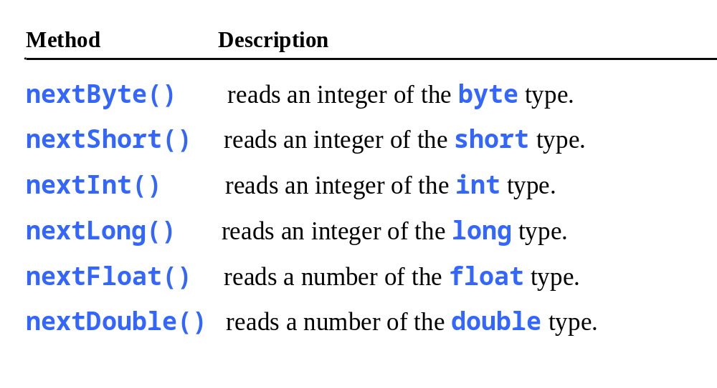
Reading Numbers from the Keyboard
Scanner input = new Scanner(System.in);
int value = input.nextInt();

Slide 16
Problem: Displaying Time
Write a program that obtains minutes and remaining seconds from seconds.
DisplayTime
Run

Slide 17
NOTE
Calculations involving floating-point numbers are approximated because these numbers are not stored with complete accuracy. For example,
System.out.println(1.0 - 0.1 - 0.1 - 0.1 - 0.1 - 0.1);
displays 0.5000000000000001, not 0.5, and
System.out.println(1.0 - 0.9);
displays 0.09999999999999998, not 0.1. Integers are stored precisely. Therefore, calculations with integers yield a precise integer result.

Slide 18
Exponent Operations
System.out.println(Math.pow(2, 3));
// Displays 8.0
System.out.println(Math.pow(4, 0.5));
// Displays 2.0
System.out.println(Math.pow(2.5, 2));
// Displays 6.25
System.out.println(Math.pow(2.5, -2));
// Displays 0.16

Slide 19
Floating-Point Literals
Floating-point literals are written with a decimal point. By default, a floating-point literal is treated as a double type value. For example, 5.0 is considered a double value, not a float value. You can make a number a float by appending the letter f or F, and make a number a double by appending the letter d or D. For example, you can use 100.2f or 100.2F for a float number, and 100.2d or 100.2D for a double number.

Slide 20
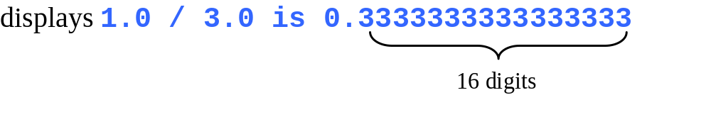
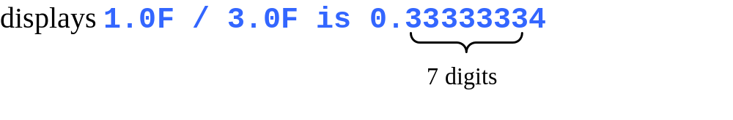
double vs. float
The double type values are more accurate than the float type values. For example,
System.out.println("1.0 / 3.0 is " + 1.0 / 3.0);
System.out.println("1.0F / 3.0F is " + 1.0F / 3.0F);

Slide 21

Problem: Displaying Current Time
Write a program that displays current time in GMT in the format hour:minute:second such as 1:45:19.
The currentTimeMillis method in the System class returns the current time in milliseconds since the midnight, January 1, 1970 GMT. (1970 was the year when the Unix operating system was formally introduced.) You can use this method to obtain the current time, and then compute the current second, minute, and hour as follows.
ShowCurrentTime
Run

Slide 22
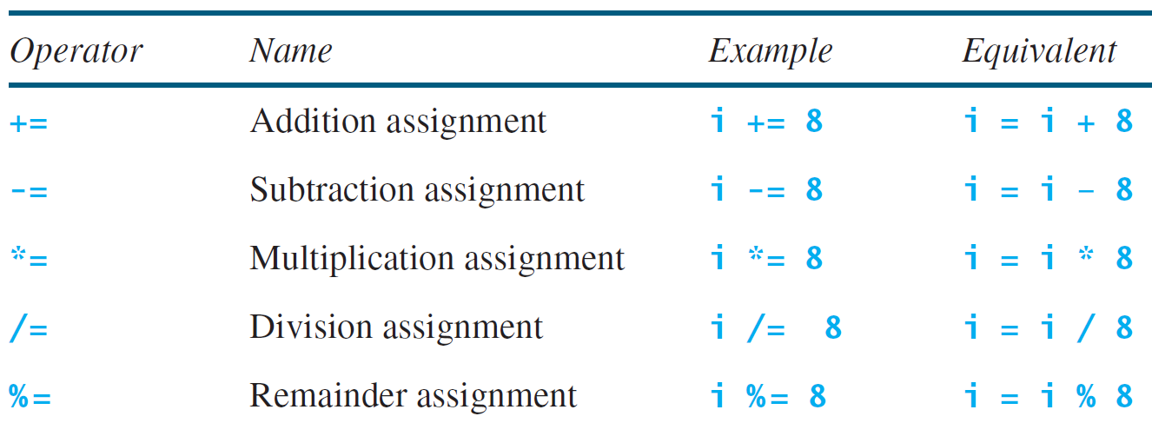
Augmented Assignment Operators

Slide 23
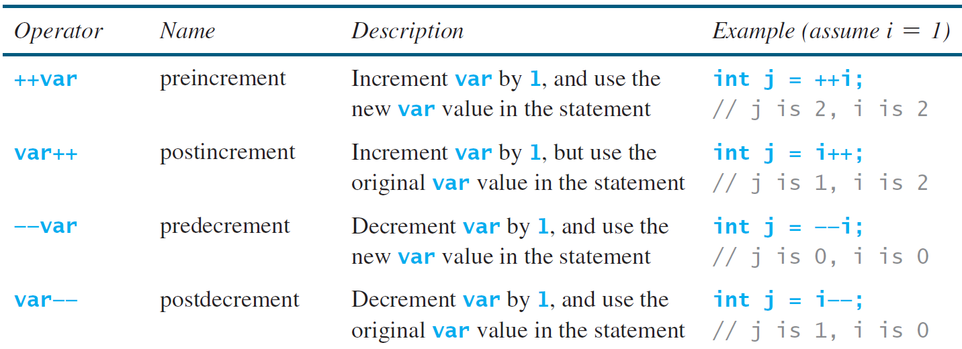
Increment and
Decrement Operators

Slide 24
Increment and
Decrement Operators, cont.
Using increment and decrement operators makes expressions short, but it also makes them complex and difficult to read. Avoid using these operators in expressions that modify multiple variables, or the same variable for multiple times such as this: int k = ++i + i. It will be easier to read if written as:
++i;
int k = i + i;

Slide 25
Numeric Type Conversion
Consider the following statements:
byte i = 100;
long k = i * 3 + 4;
double d = i * 3.1 + k / 2;

Slide 26
Conversion Rules
When performing a binary operation involving two operands of different types, Java automatically converts the operand based on the following rules:
1. If one of the operands is double, the other is converted into double.
2. Otherwise, if one of the operands is float, the other is converted into float.
3. Otherwise, if one of the operands is long, the other is converted into long.
4. Otherwise, both operands are converted into int.

Slide 27
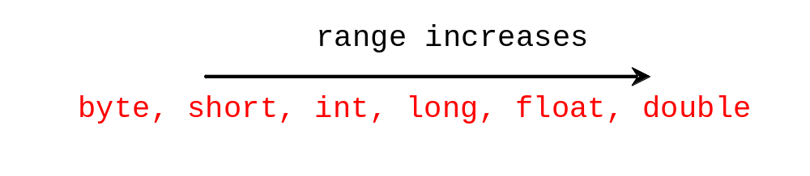
Type Casting
Implicit casting
double d = 3; (type widening)
Explicit casting
int i = (int)3.0; (type narrowing)
int i = (int)3.9; (Fraction part is truncated)
What is wrong? int x = 5 / 2.0;

Slide 28
Problem: Keeping Two Digits After Decimal Points
Write a program that displays the sales tax with two digits after the decimal point.
SalesTax
Run

Slide 29
Casting in an Augmented Expression
In Java, an augmented expression of the form x1 op= x2 is implemented as x1 = (T)(x1 op x2), where T is the type for x1. Therefore, the following code is correct.
int sum = 0;
sum += 4.5; // sum becomes 4 after this statement
sum += 4.5 is equivalent to sum = (int)(sum + 4.5).

Slide 30

Problem:
Computing Loan Payments
This program lets the user enter the interest rate, number of years, and loan amount, and computes monthly payment and total payment.
ComputeLoan
Run

Slide 31
Problem: Monetary Units
This program lets the user enter the amount in decimal representing dollars and cents and output a report listing the monetary equivalent in single dollars, quarters, dimes, nickels, and pennies. Your program should report maximum number of dollars, then the maximum number of quarters, and so on, in this order.
ComputeChange
Run

Slide 32
Common Errors and Pitfalls
Common Error 1: Undeclared/Uninitialized Variables and Unused Variables
Common Error 2: Integer Overflow
Common Error 3: Round-off Errors
Common Error 4: Unintended Integer Division
Common Pitfall 1: Redundant Input Objects

Slide 33
Common Error 1: Undeclared/Uninitialized Variables and Unused Variables
double interestRate = 0.05;
double interest = interestrate * 45;

Slide 34
Common Error 2: Integer Overflow
int value = 2147483647 + 1;
// value will actually be -2147483648

Slide 35
Common Error 3: Round-off Errors
System.out.println(1.0 - 0.1 - 0.1 - 0.1 - 0.1 - 0.1);
System.out.println(1.0 - 0.9);

Slide 36
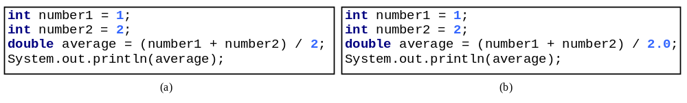
Common Error 4: Unintended Integer Division

Slide 37
Common Pitfall 1: Redundant Input Objects
Scanner input = new Scanner(System.in);
System.out.print("Enter an integer: ");
int v1 = input.nextInt();
Scanner input1 = new Scanner(System.in);
System.out.print("Enter a double value: ");
double v2 = input1.nextDouble();

