Slide 1
Chapter 3 Selections
Liang, Introduction to Java Programming, Eleventh Edition, (c) 2017 Pearson Education, Inc. All rights reserved.

Slide 2
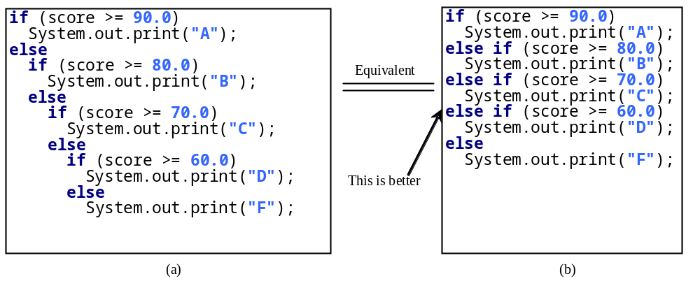
Multiple Alternative if Statements

Slide 3
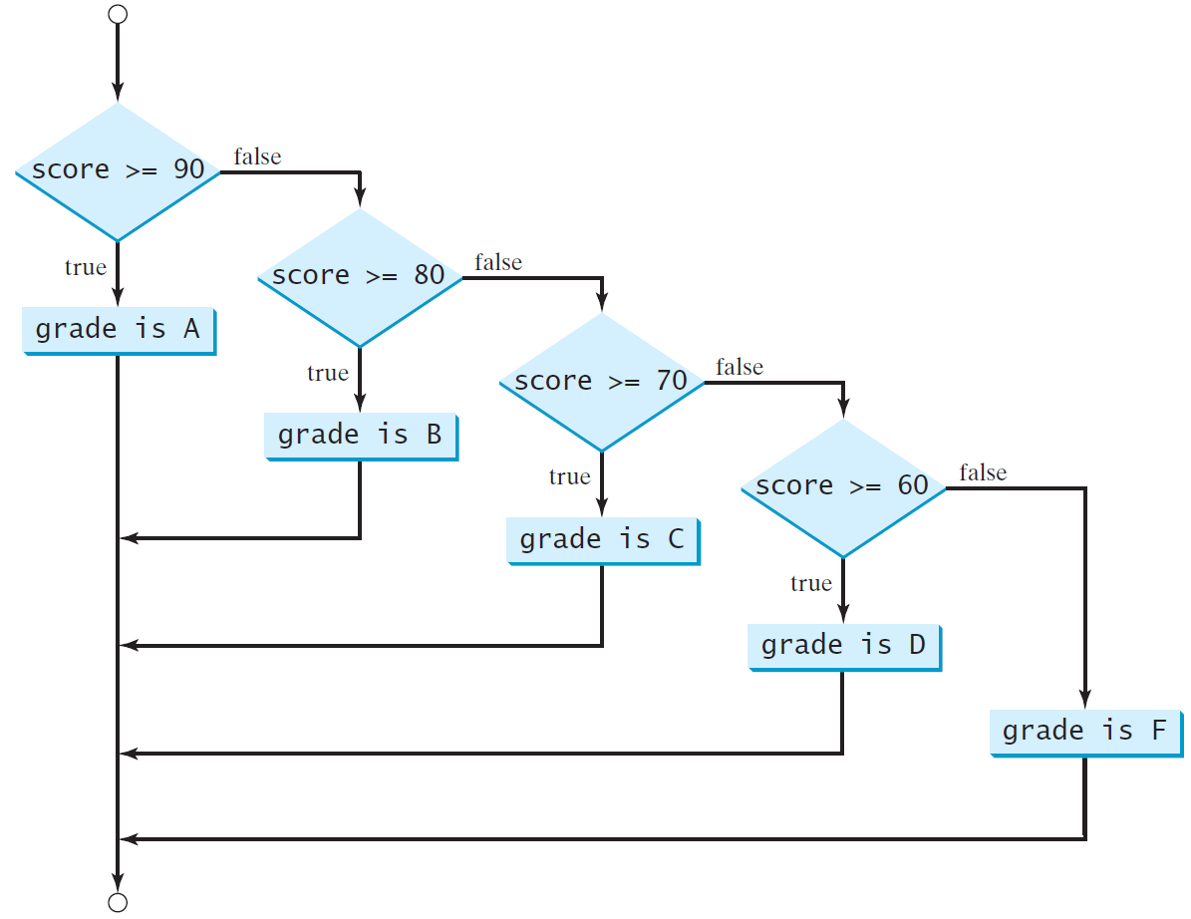
Multi-Way if-else Statements

Slide 4
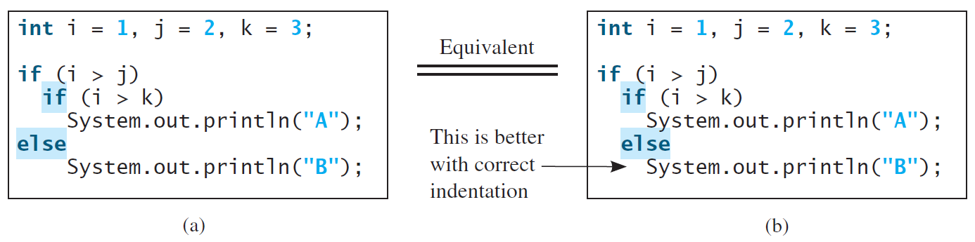
Note
The else clause matches the most recent if clause in the same block.

Slide 5
Note, cont.
Nothing is printed from the preceding statement. To force the else clause to match the first if clause, you must add a pair of braces:
int i = 1;
int j = 2;
int k = 3;
if (i > j) {
if (i > k)
System.out.println("A");
}
else
System.out.println("B");
This statement prints B.

Slide 6
Common Errors
Adding a semicolon at the end of an if clause is a common mistake.
if (radius >= 0);
{
area = radius*radius*PI;
System.out.println(
"The area for the circle of radius " +
radius + " is " + area);
}
This mistake is hard to find, because it is not a compilation error or a runtime error, it is a logic error.
This error often occurs when you use the next-line block style.
Wrong

Slide 7

TIP

Slide 8

CAUTION

Slide 9
Problem: An Improved Math Learning Tool
This example creates a program to teach a first grade child how to learn subtractions. The program randomly generates two single-digit integers number1 and number2 with number1 >= number2 and displays a question such as “What is 9 – 2?” to the student. After the student types the answer, the program displays whether the answer is correct.
SubtractionQuiz
Run

Slide 10
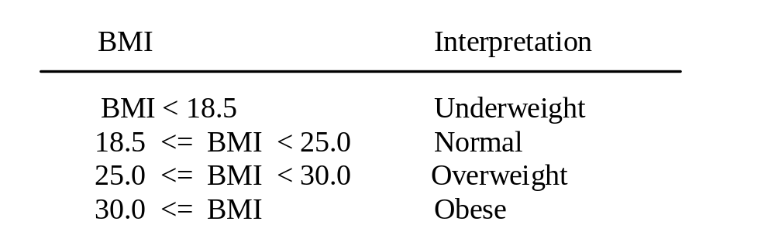
Problem: Body Mass Index
Body Mass Index (BMI) is a measure of health on weight. It can be calculated by taking your weight in kilograms and dividing by the square of your height in meters. The interpretation of BMI for people 16 years or older is as follows:
ComputeAndInterpretBMI
Run

Slide 11
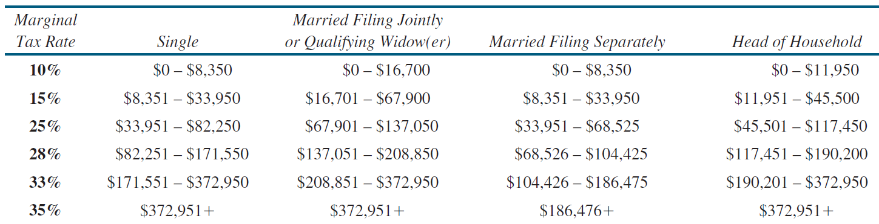
Problem: Computing Taxes
The US federal personal income tax is calculated based on the filing status and taxable income. There are four filing statuses: single filers, married filing jointly, married filing separately, and head of household. The tax rates for 2009 are shown below.

Slide 12
Problem: Computing Taxes, cont.
if (status == 0) {
// Compute tax for single filers
}
else if (status == 1) {
// Compute tax for married file jointly
// or qualifying widow(er)
}
else if (status == 2) {
// Compute tax for married file separately
}
else if (status == 3) {
// Compute tax for head of household
}
else {
// Display wrong status
}
ComputeTax
Run

Slide 13
Logical Operators
Operator | Name | Description
! | not | logical negation
&& | and | logical conjunction
|| | or | logical disjunction
^ | exclusive or | logical exclusion

Slide 14
Truth Table for Operator ^
p₁ | p₂ | p₁ ^ p₂ | Example (assume age = 24, weight = 140)
false | false | false | (age > 34) ^ (weight > 140) is true, because (age > 34) is false and (weight > 140) is false.
false | true | true | (age > 34) ^ (weight >= 140) is true, because (age > 34) is false but (weight >= 140) is true.
true | false | true | (age > 14) ^ (weight > 140) is true, because (age > 14) is true and (weight > 140) is false.
true | true | false

Slide 15
Trace switch statement
animation
Suppose day is 2:
switch (day) {
case 1:
case 2:
case 3:
case 4:
case 5: System.out.println("Weekday"); break;
case 0:
case 6: System.out.println("Weekend");
}

Slide 16
Trace switch statement
animation
Match case 2
switch (day) {
case 1:
case 2:
case 3:
case 4:
case 5: System.out.println("Weekday"); break;
case 0:
case 6: System.out.println("Weekend");
}

Slide 17
Trace switch statement
animation
Fall through case 3
switch (day) {
case 1:
case 2:
case 3:
case 4:
case 5: System.out.println("Weekday"); break;
case 0:
case 6: System.out.println("Weekend");
}

Slide 18
Trace switch statement
animation
Fall through case 4
switch (day) {
case 1:
case 2:
case 3:
case 4:
case 5: System.out.println("Weekday"); break;
case 0:
case 6: System.out.println("Weekend");
}

Slide 19
Trace switch statement
animation
Fall through case 5
switch (day) {
case 1:
case 2:
case 3:
case 4:
case 5: System.out.println("Weekday"); break;
case 0:
case 6: System.out.println("Weekend");
}

Slide 20
Trace switch statement
animation
Encounter break
switch (day) {
case 1:
case 2:
case 3:
case 4:
case 5: System.out.println("Weekday"); break;
case 0:
case 6: System.out.println("Weekend");
}

Slide 21
Trace switch statement
animation
Exit the statement
switch (day) {
case 1:
case 2:
case 3:
case 4:
case 5: System.out.println("Weekday"); break;
case 0:
case 6: System.out.println("Weekend");
}

Slide 22
Conditional Operators
if (x > 0)
y = 1;
else
y = -1;
is equivalent to
y = (x > 0) ? 1 : -1;
(boolean-expression) ? expression1 : expression2
Ternary operator

Slide 23
Conditional Operator
if (num % 2 == 0)
System.out.println(num + “is even”);
else
System.out.println(num + “is odd”);
System.out.println(
(num % 2 == 0)? num + “is even” :
num + “is odd”);

Slide 24
Operator Precedence
var++, var--
+, - (Unary plus and minus), ++var,--var
(type) Casting
! (Not)
*, /, % (Multiplication, division, and remainder)
+, - (Binary addition and subtraction)
<, <=, >, >= (Relational operators)
==, !=; (Equality)
^ (Exclusive OR)
&& (Conditional AND) Short-circuit AND
|| (Conditional OR) Short-circuit OR
=, +=, -=, *=, /=, %= (Assignment operator)

