Slide 1
Chapter 4 Mathematical Functions, Characters, and Strings

Slide 2
The Math Class
Class constants:
  PI
  E
Class methods:
  Trigonometric Methods
  Exponent Methods
  Rounding Methods
  min, max, abs, and random Methods

Slide 3
Trigonometric Methods
sin(double a)
cos(double a)
tan(double a)
acos(double a)
asin(double a)
atan(double a)
Examples:
Math.sin(0) returns 0.0
Math.sin(Math.PI / 6) returns 0.5
Math.sin(Math.PI / 2) returns 1.0
Math.cos(0) returns 1.0
Math.cos(Math.PI / 6) returns 0.866
Math.cos(Math.PI / 2) returns 0
Radians
toRadians(90)

Slide 4
Exponent Methods
exp(double a)
  Returns e raised to the power of a.
log(double a)
  Returns the natural logarithm of a.
log10(double a)
  Returns the 10-based logarithm of a.
pow(double a, double b)
  Returns a raised to the power of b.
sqrt(double a)
  Returns the square root of a.
Examples:
Math.exp(1) returns 2.71
Math.log(2.71) returns 1.0
Math.pow(2, 3) returns 8.0
Math.pow(3, 2) returns 9.0
Math.pow(3.5, 2.5) returns 22.91765
Math.sqrt(4) returns 2.0
Math.sqrt(10.5) returns 3.24

Slide 5
Rounding Methods
double ceil(double x)
  x rounded up to its nearest integer. This integer is returned as a double value.
double floor(double x)
  x is rounded down to its nearest integer. This integer is returned as a double value.
double rint(double x)
  x is rounded to its nearest integer. If x is equally close to two integers, the even one is returned as a double.
int round(float x)
  Return (int)Math.floor(x+0.5).
long round(double x)
  Return (long)Math.floor(x+0.5).

Slide 6
Rounding Methods Examples
Math.ceil(2.1) returns 3.0
Math.ceil(2.0) returns 2.0
Math.ceil(-2.0) returns –2.0
Math.ceil(-2.1) returns -2.0
Math.floor(2.1) returns 2.0
Math.floor(2.0) returns 2.0
Math.floor(-2.0) returns –2.0
Math.floor(-2.1) returns -3.0
Math.rint(2.1) returns 2.0
Math.rint(2.0) returns 2.0
Math.rint(-2.0) returns –2.0
Math.rint(-2.1) returns -2.0
Math.rint(2.5) returns 2.0
Math.rint(-2.5) returns -2.0
Math.round(2.6f) returns 3
Math.round(2.0) returns 2
Math.round(-2.0f) returns -2
Math.round(-2.6) returns -3

Slide 7
min, max, and abs
max(a, b)and min(a, b)
  Returns the maximum or minimum of two parameters.
abs(a)
  Returns the absolute value of the parameter.
random()
  Returns a random double value
  in the range [0.0, 1.0).
Examples:
Math.max(2, 3) returns 3
Math.max(2.5, 3) returns 3.0
Math.min(2.5, 3.6) returns 2.5
Math.abs(-2) returns 2
Math.abs(-2.1) returns 2.1

Slide 8

The random Method
Generates a random double value greater than or equal to 0.0 and less than 1.0 (0 <= Math.random() < 1.0).
Examples:
In general,

Slide 9
Character Data Type
Four hexadecimal digits.
char letter = 'A'; (ASCII)
char numChar = '4'; (ASCII)
char letter = '\u0041'; (Unicode)
char numChar = '\u0034'; (Unicode)
NOTE: The increment and decrement operators can also be used on char variables to get the next or preceding Unicode character. For example, the following statements display character b.
  char ch = 'a';
  System.out.println(++ch);

Slide 10

Unicode Format
Java characters use Unicode, a 16-bit encoding scheme established by the Unicode Consortium to support the interchange, processing, and display of written texts in the world’s diverse languages. Unicode takes two bytes, preceded by \u, expressed in four hexadecimal numbers that run from '\u0000' to '\uFFFF'. So, Unicode can represent 65535 + 1 characters.
Unicode \u03b1 \u03b2 \u03b3 for three Greek letters

Slide 11
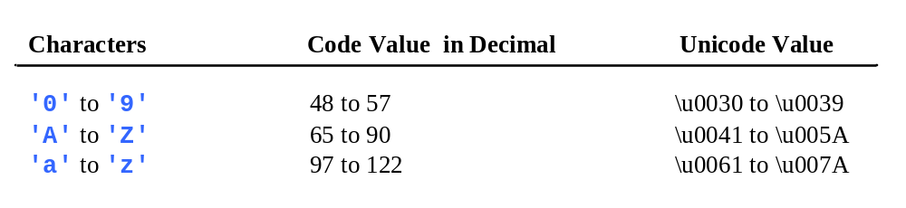
ASCII Code and Unicode for Commonly Used Characters

Slide 12
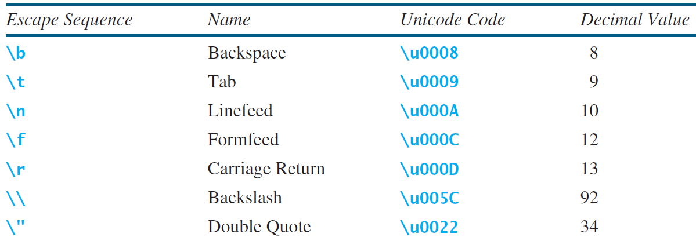
Escape Sequences for Special Characters

Slide 13
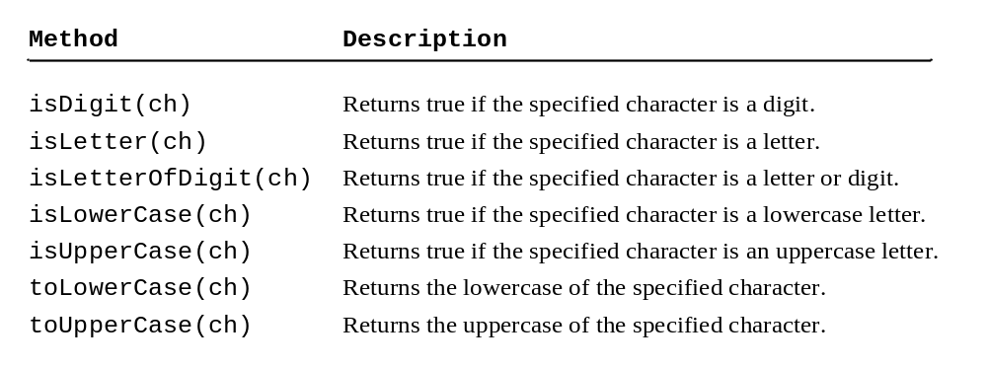
Methods in the Character Class
Note: isLetterOfDigit(ch) should be isLetterOrDigit(ch)

Slide 14
The String Type
The char type only represents one character. To represent a string of characters, use the data type called String. For example,
String message = "Welcome to Java";
String is actually a predefined class in the Java library just like the System class and Scanner class. The String type is not a primitive type. It is known as a reference type. Any Java class can be used as a reference type for a variable. Reference data types will be thoroughly discussed in Chapter 9, “Objects and Classes.” For the time being, you just need to know how to declare a String variable, how to assign a string to the variable, how to concatenate strings, and to perform simple operations for strings.

Slide 15
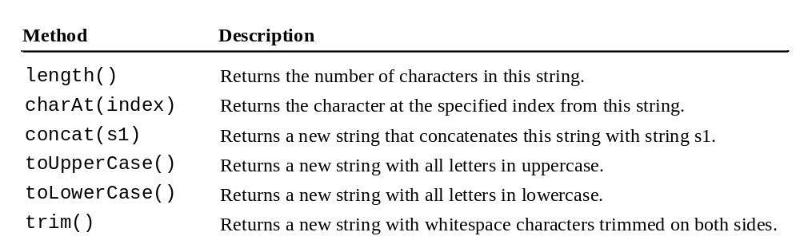
Simple Methods for String Objects

Slide 16
Simple Methods for String Objects
Strings are objects in Java. The methods in the preceding table can only be invoked from a specific string instance. For this reason, these methods are called instance methods. A non-instance method is called a static method. A static method can be invoked without using an object. All the methods defined in the Math class are static methods. They are not tied to a specific object instance. The syntax to invoke an instance method is
referenceVariable.methodName(arguments).

Slide 17
Getting String Length
String message = "Welcome to Java";
System.out.println("The length of " + message + " is "
+ message.length());

Slide 18
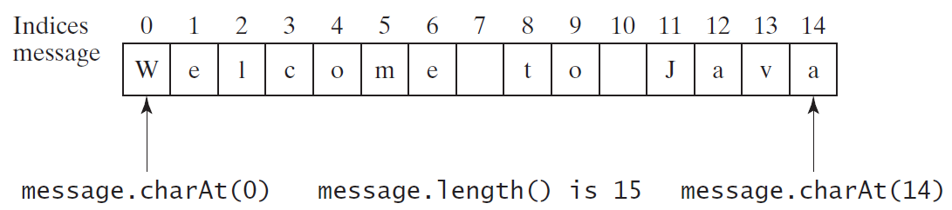
Getting Characters from a String
String message = "Welcome to Java";
System.out.println("The first character in message is "
+ message.charAt(0));

Slide 19
Converting Strings
"Welcome".toLowerCase() returns a new string, welcome.
"Welcome".toUpperCase() returns a new string, WELCOME.
" Welcome ".trim() returns a new string, Welcome.

Slide 20
String Concatenation
String s3 = s1.concat(s2); or String s3 = s1 + s2;
// Three strings are concatenated
String message = "Welcome " + "to " + "Java";
// String Chapter is concatenated with number 2
String s = "Chapter" + 2; // s becomes Chapter2
// String Supplement is concatenated with character B
String s1 = "Supplement" + 'B'; // s1 becomes SupplementB

Slide 21
Reading a String from the Console
Scanner input = new Scanner(System.in);
System.out.print("Enter three words separated by spaces: ");
String s1 = input.next();
String s2 = input.next();
String s3 = input.next();
System.out.println("s1 is " + s1);
System.out.println("s2 is " + s2);
System.out.println("s3 is " + s3);

Slide 22
Reading a Character from the Console
Scanner input = new Scanner(System.in);
System.out.print("Enter a character: ");
String s = input.nextLine();
char ch = s.charAt(0);
System.out.println("The character entered is " + ch);

Slide 23
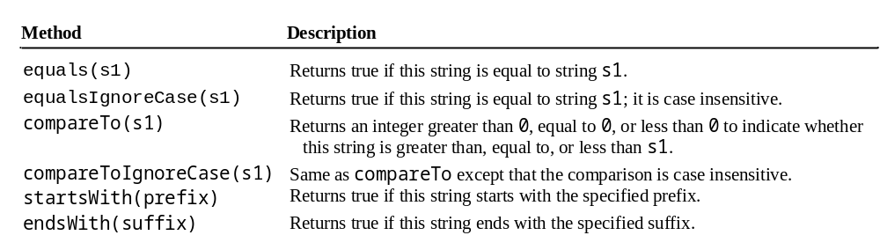
Comparing Strings
OrderTwoCities
Run

Slide 24
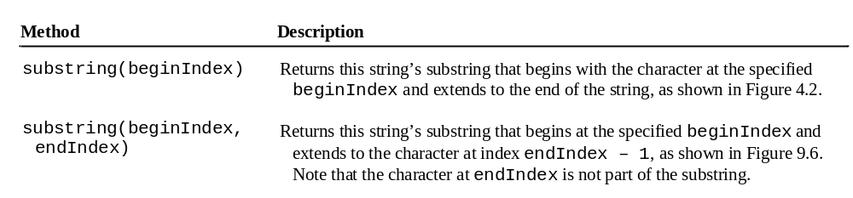
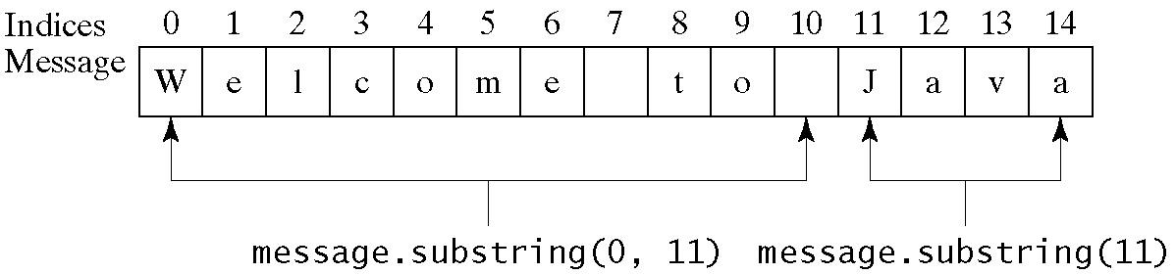
Obtaining Substrings

Slide 25
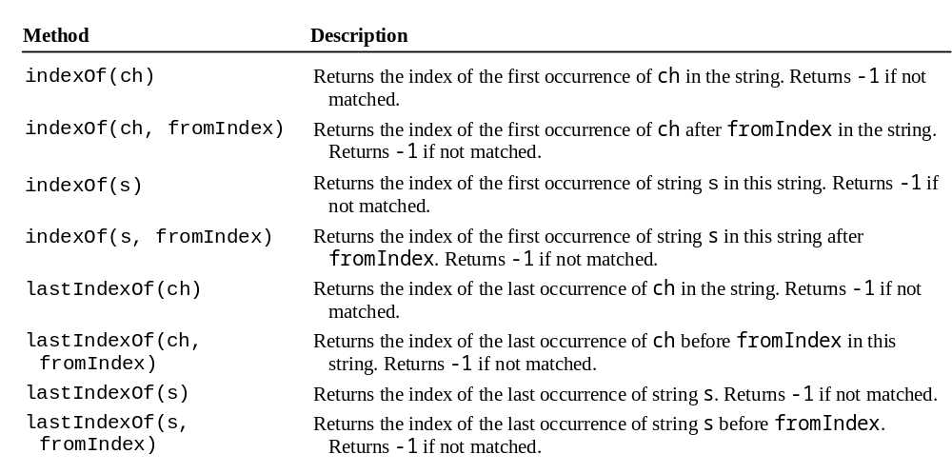
Finding a Character or a Substring in a String

Slide 26
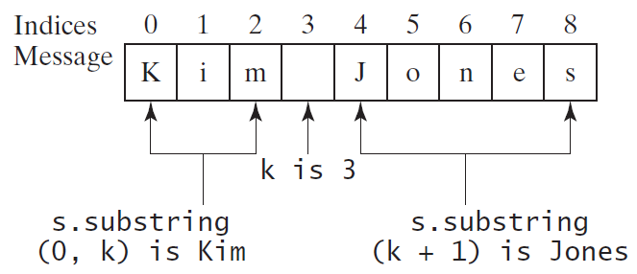
Finding a Character or a Substring in a String
int k = s.indexOf(' ');
String firstName = s.substring(0, k);
String lastName = s.substring(k + 1);

Slide 27
Conversion between Strings and Numbers
int intValue = Integer.parseInt(intString);
double doubleValue = Double.parseDouble(doubleString);
String s = number + "";

Slide 28
Formatting Output
Use the printf statement.
  System.out.printf(format, items);
Where format is a string that may consist of substrings and format specifiers. A format specifier specifies how an item should be displayed. An item may be a numeric value, character, boolean value, or a string. Each specifier begins with a percent sign.

Slide 29

Frequently-Used Specifiers
Specifier Output Example
%b a boolean value true or false
%c a character 'a'
%d a decimal integer 200
%f a floating-point number 45.460000
%e a number in standard scientific notation 4.556000e+01
%s a string "Java is cool"

Slide 30
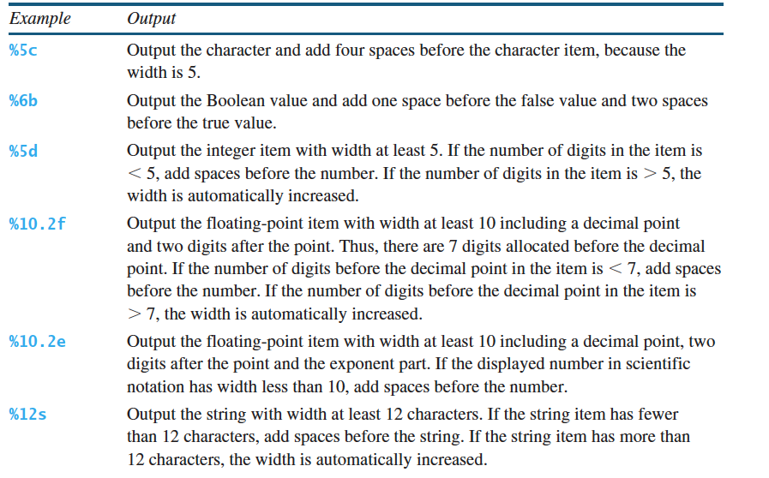
Specify Width and Precision
%width.precision?

Slide 31
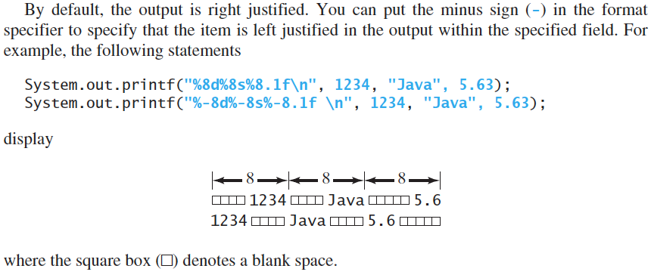
Specify Width and Precision, Cont

Slide 32
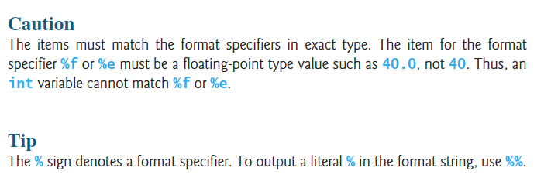

Slide 33
FormatDemo
The example gives a program that uses printf to display a table.
FormatDemo
Run

