Slide 1
Chapter 8 Multidimensional Arrays

Slide 2
Declare/Create Two-dimensional Arrays
// Declare array ref var
dataType[][] refVar;
// Create array and assign its reference to variable
refVar = new dataType[10][10];
// Combine declaration and creation in one statement
dataType[][] refVar = new dataType[10][10];
// Alternative syntax, not preferred
dataType refVar[][] = new dataType[10][10];

Slide 3
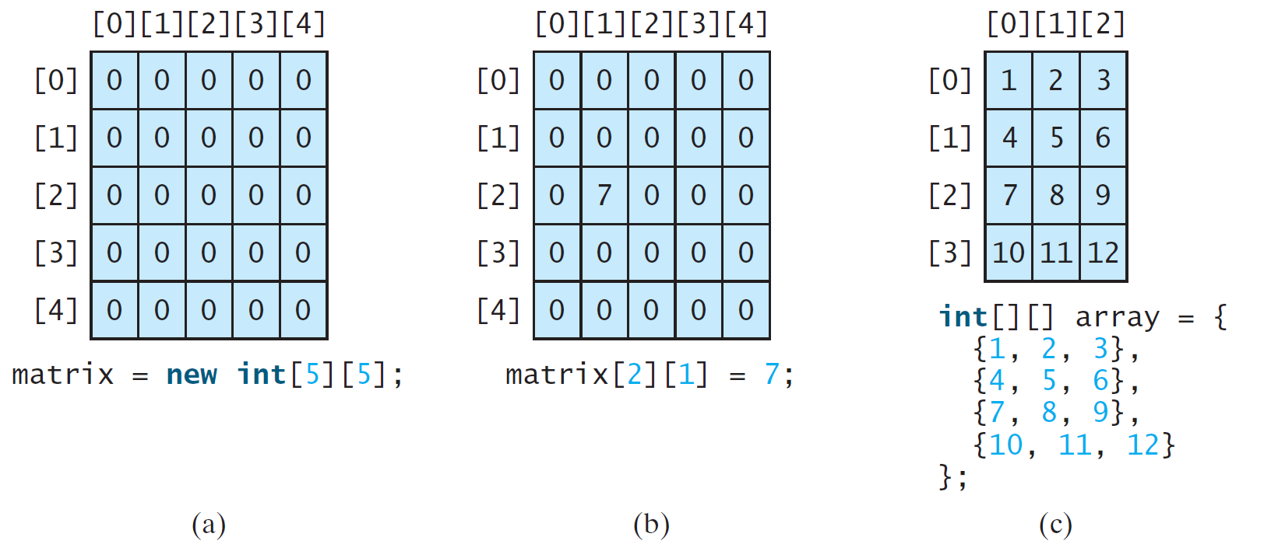
Two-dimensional Array Illustration

Slide 4
Declaring, Creating, and Initializing Using Shorthand Notations
You can also use an array initializer to declare, create and initialize a two-dimensional array. For example,
int[][] array = {
{1, 2, 3},
{4, 5, 6},
{7, 8, 9},
{10, 11, 12}
};
int[][] array = new int[4][3];
array[0][0] = 1; array[0][1] = 2; array[0][2] = 3;
array[1][0] = 4; array[1][1] = 5; array[1][2] = 6;
array[2][0] = 7; array[2][1] = 8; array[2][2] = 9;
array[3][0] = 10; array[3][1] = 11; array[3][2] = 12;
Same as

Slide 5
Two dimensional arrays in C++ and Java
C++: continuous memory location
Java: one-dimensional array of reference variables to one-dimensional arrays
C++: int array[4][]; //compile error
Java: int[][] array = new int[4][];// correct
  array[0], array[1], array[2], array[3] are null
  array[0][1] will give you an error

Slide 6
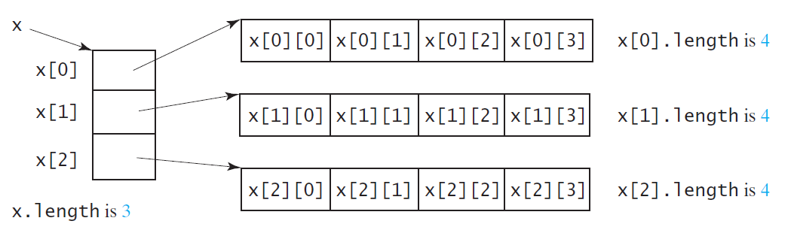
Lengths of Two-dimensional Arrays
int[][] x = new int[3][4];

Slide 7
Lengths of Two-dimensional Arrays, cont.
int[][] array = {
{1, 2, 3},
{4, 5, 6},
{7, 8, 9},
{10, 11, 12}
};
array.length
array[0].length
array[1].length
array[2].length
array[3].length
array[4].length ArrayIndexOutOfBoundsException

Slide 8
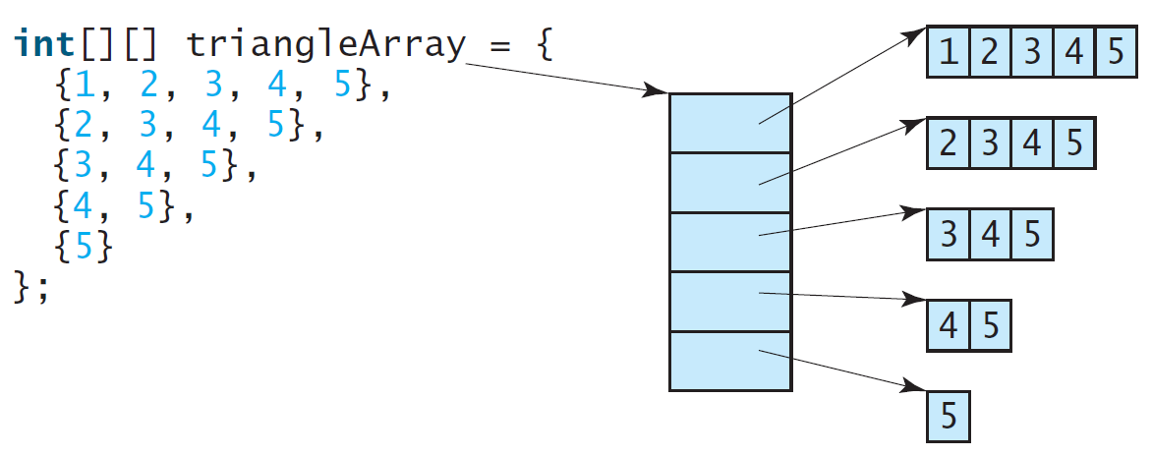
Ragged Arrays
Each row in a two-dimensional array is itself an array. So, the rows can have different lengths. Such an array is known as a ragged array.

Slide 9
Ragged Arrays, cont.
triangleArray.length?

Slide 10
Ragged Arrays, cont.
triangleArray.length? 5
triangleArray[0].length?

Slide 11
Ragged Arrays, cont.
triangleArray.length? 5
triangleArray[0].length? 5
triangleArray[1].length?

Slide 12
Ragged Arrays, cont.
triangleArray.length? 5
triangleArray[0].length? 5
triangleArray[1].length? 4

Slide 13
Ragged Arrays, cont.
triangleArray.length? 5
triangleArray[0].length? 5
triangleArray[1].length? 4
triangleArray[2].length? 3
triangleArray[3].length? 2
triangleArray[4].length? 1

Slide 14
Processing Two-Dimensional Arrays
See the examples in the text.
(Initializing arrays with input values)
(Printing arrays)
(Summing all elements)
(Summing all elements by column)
(Which row has the largest sum)
(Finding the smallest index of the largest element)
(Random shuffling)

Slide 15
Initializing arrays with input values
java.util.Scanner input = new Scanner(System.in);
System.out.println("Enter " + matrix.length + " rows and " +
matrix[0].length + " columns: ");
for (int row = 0; row < matrix.length; row++) {
for (int column = 0; column < matrix[row].length; column++) {
matrix[row][column] = input.nextInt();
}
}

Slide 16
Initializing arrays with random values
for (int row = 0; row < matrix.length; row++) {
for (int column = 0; column < matrix[row].length; column++) {
matrix[row][column] = (int)(Math.random() * 100);
}
}

Slide 17
Printing arrays
for (int row = 0; row < matrix.length; row++) {
for (int column = 0; column < matrix[row].length; column++) {
System.out.print(matrix[row][column] + " ");
}
System.out.println();
}

Slide 18
Summing all elements
int total = 0;
for (int row = 0; row < matrix.length; row++) {
for (int column = 0; column < matrix[row].length; column++) {
total += matrix[row][column];
}
}

Slide 19
Random shuffling
for (int i = 0; i < matrix.length; i++) {
for (int j = 0; j < matrix[i].length; j++) {
int i1 = (int)(Math.random() * matrix.length);
int j1 = (int)(Math.random() * matrix[i1].length);
// Swap matrix[i][j] with matrix[i1][j1]
int temp = matrix[i][j];
matrix[i][j] = matrix[i1][j1];
matrix[i1][j1] = temp;
}
}

Slide 20
Duplicate
double[][] source = { {1,2,3}, {4,5,6}, {7,8,9,10} };
double[][] target = new double[source.length][];
How to duplicate source into target?

Slide 21
Duplicate
double[][] source = { {1,2,3}, {4,5,6}, {7,8,9,10} };
double[][] target = new double[source.length][];
How to duplicate source into target?
target = source;

Slide 22
Duplicate
double[][] source = { {1,2,3}, {4,5,6}, {7,8,9,10} };
double[][] target = new double[source.length][];
How to duplicate source into target?
target = source; WRONG!!!

Slide 23
Duplicate
double[][] source = { {1,2,3}, {4,5,6}, {7,8,9,10} };
double[][] target = new double[source.length][];
How to duplicate source into target?
target = source; WRONG!!!
for (int i = 0; i < source.length; i++)
target[i] = source[i];

Slide 24
Duplicate
double[][] source = { {1,2,3}, {4,5,6}, {7,8,9,10} };
double[][] target = new double[source.length][];
How to duplicate source into target?
target = source; WRONG!!!
for (int i = 0; i < source.length; i++)
target[i] = source[i];
WRONG!!! (Shallow copy)

Slide 25
Duplicate
double[][] source = { {1,2,3}, {4,5,6}, {7,8,9,10} };
double[][] target = new double[source.length][];
How to duplicate source into target?
target = source; WRONG!!!
for (int i = 0; i < source.length; i++)
target[i] = source[i];
WRONG!!! (Shallow copy)
for (int i = 0; i < source.length; i++)
for (int j = 0; j < source[i].length; j++)
target[i][j] = source[i][j];

Slide 26
Duplicate
double[][] source = { {1,2,3}, {4,5,6}, {7,8,9,10} };
double[][] target = new double[source.length][];
How to duplicate source into target?
target = source; WRONG!!!
for (int i = 0; i < source.length; i++)
target[i] = source[i];
WRONG!!! (Shallow copy)
for (int i = 0; i < source.length; i++)
target[i] = new double[source[i].length];
for (int j = 0; j < source[i].length; j++)
target[i][j] = source[i][j];

Slide 27
Duplicate
double[][] source = { {1,2,3}, {4,5,6}, {7,8,9,10} };
double[][] target = new double[source.length][];
How to duplicate source into target?
target = source; WRONG!!!
for (int i = 0; i < source.length; i++)
target[i] = source[i];
WRONG!!! (Shallow copy)
for (int i = 0; i < source.length; i++)
target[i] = new double[source[i].length];
for (int j = 0; j < source[i].length; j++)
target[i][j] = source[i][j];
CORRECT!!!

Slide 28
Passing Tow-Dimensional Arrays to Methods
PassTwoDimensionalArray
Run

Slide 29
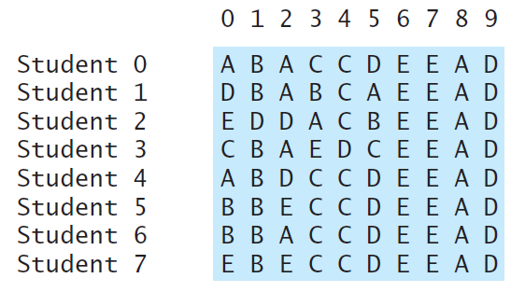
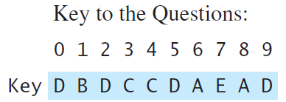
Problem: Grading Multiple-Choice Test
Students’ answer
Objective: write a program that grades multiple-choice test.
PassTwoDimensionalArray
Run

Slide 30
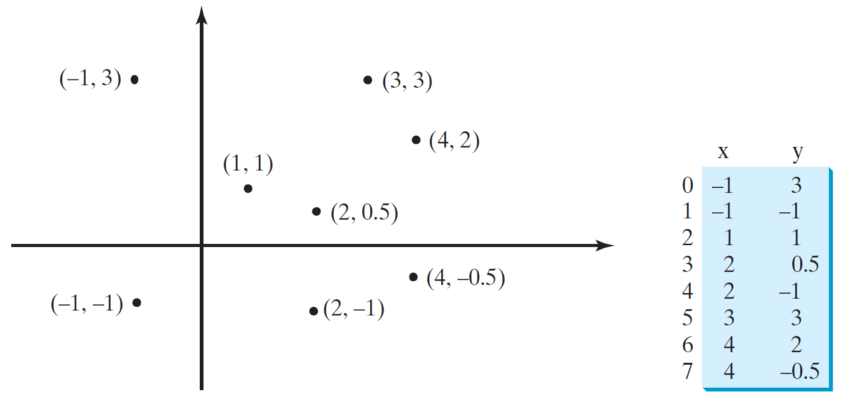
Problem: Finding Two Points Nearest to Each Other
https://liveexample.pearsoncmg.com/dsanimation/ClosestPaireBook.html
PassTwoDimensionalArray
Run

Slide 31
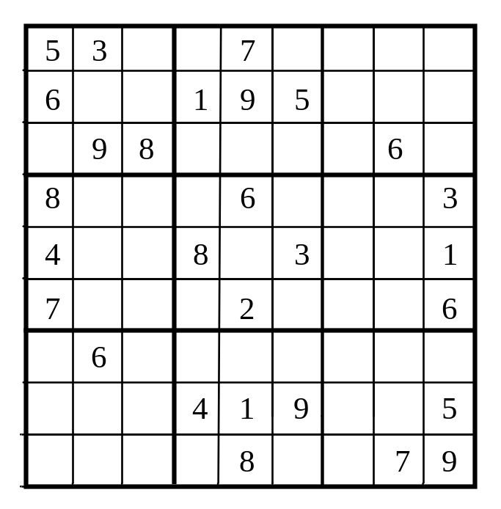
What is Sudoku?
https://liveexample.pearsoncmg.com/dsanimation/Sudoku.html

Slide 32
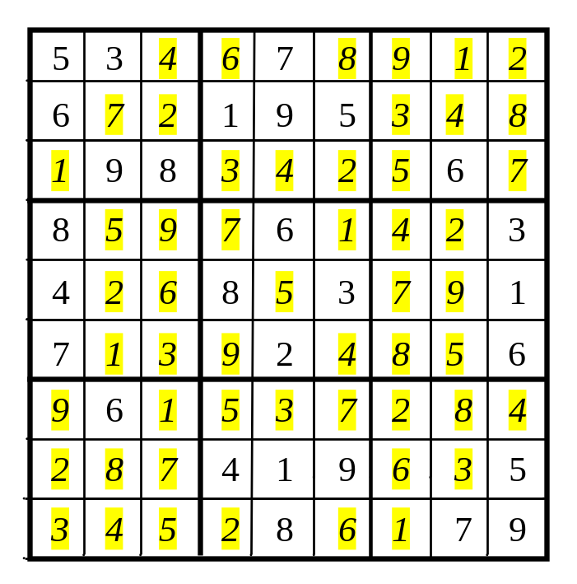
Every row contains the numbers 1 to 9

Slide 33
Every column contains the numbers 1 to 9
5 3
4
6
7
8
9
1
2
6
7
2
1 9 5
3
4
8
1
9 8
3
4
2
5
6
7
8
5
9
7
6
1
4
2
3
4
2
6
8
5
3
7
9
1
7
1
3
9
2
4
8
5
6
9
6
1
5
3
7
2
8
4
2
8
7
4 1 9
6
3
5
3
4
5
2
8
6
1
7 9

Slide 34
Every 3×3 box contains the numbers 1 to 9
5 3
4
6
7
8
9
1
2
6
7
2
1 9 5
3
4
8
1
9 8
3
4
2
5
6
7
8
5
9
7
6
1
4
2
3
4
2
6
8
5
3
7
9
1
7
1
3
9
2
4
8
5
6
9
6
1
5
3
7
2
8
4
2
8
7
4 1 9
6
3
5
3
4
5
2
8
6
1
7 9

Slide 35
Checking Whether a Solution Is Correct
CheckSudokuSolution
Run

Slide 36
Multidimensional Arrays
Occasionally, you will need to represent n-dimensional data structures. In Java, you can create n-dimensional arrays for any integer n.
The way to declare two-dimensional array variables and create two-dimensional arrays can be generalized to declare n-dimensional array variables and create n-dimensional arrays for n >= 3.

Slide 37
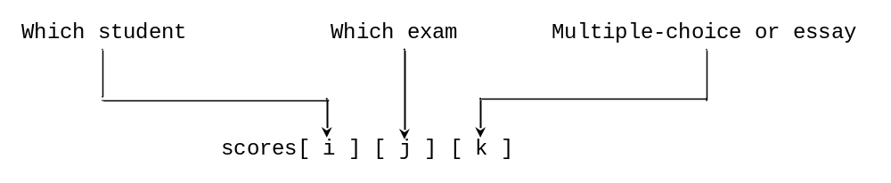
Multidimensional Arrays
double[][][] scores = {
{{7.5, 20.5}, {9.0, 22.5}, {15, 33.5}, {13, 21.5}, {15, 2.5}},
{{4.5, 21.5}, {9.0, 22.5}, {15, 34.5}, {12, 20.5}, {14, 9.5}},
{{6.5, 30.5}, {9.4, 10.5}, {11, 33.5}, {11, 23.5}, {10, 2.5}},
{{6.5, 23.5}, {9.4, 32.5}, {13, 34.5}, {11, 20.5}, {16, 7.5}},
{{8.5, 26.5}, {9.4, 52.5}, {13, 36.5}, {13, 24.5}, {16, 2.5}},
{{9.5, 20.5}, {9.4, 42.5}, {13, 31.5}, {12, 20.5}, {16, 6.5}}
};

Slide 38
Problem: Calculating Total Scores
Objective: write a program that calculates the total score for students in a class. Suppose the scores are stored in a three-dimensional array named scores. The first index in scores refers to a student, the second refers to an exam, and the third refers to the part of the exam. Suppose there are 7 students, 5 exams, and each exam has two parts--the multiple-choice part and the programming part. So, scores[i][j][0] represents the score on the multiple-choice part for the i’s student on the j’s exam. Your program displays the total score for each student.
TotalScore
Run

