Slide 1
Chapter 11 Inheritance and Polymorphism

Slide 2
Motivations
Suppose you will define classes to model circles, rectangles, and triangles. These classes have many common features. What is the best way to design these classes so to avoid redundancy? The answer is to use inheritance.

Slide 3

Superclasses and Subclasses
GeometricObject
Circle
Rectangle
TestCircleRectangle
Run

Slide 4
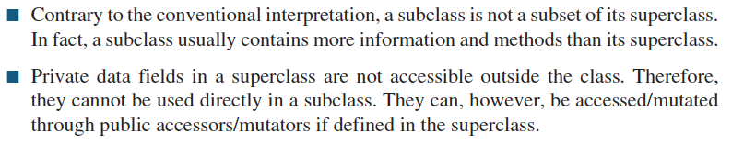
Notes regarding inheritance

Slide 5
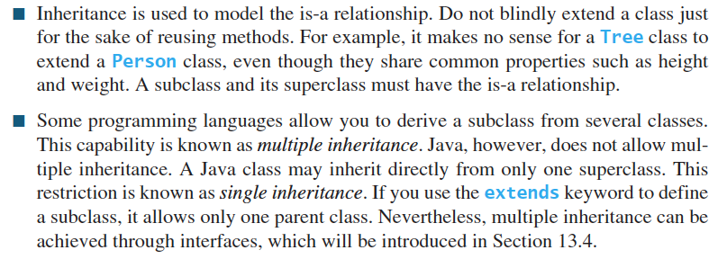
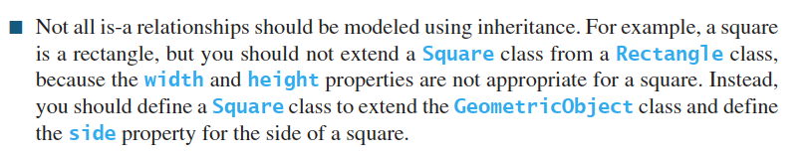
Notes regarding inheritance

Slide 6
Are superclass’s Constructor Inherited?
No. They are not inherited.
They are invoked explicitly or implicitly.
Explicitly using the super keyword.
A constructor is used to construct an instance of a class. Unlike properties and methods, a superclass's constructors are not inherited in the subclass. They can only be invoked from the subclasses' constructors, using the keyword super. If the keyword super is not explicitly used, the superclass's no-arg constructor is automatically invoked.

Slide 7


Superclass’s Constructor Is Always Invoked
A constructor may invoke an overloaded constructor or its superclass’s constructor. If none of them is invoked explicitly, the compiler puts super() as the first statement in the constructor. For example,

Slide 8
Using the Keyword super
The keyword super refers to the superclass of the class in which super appears. This keyword can be used in two ways:
To call a superclass constructor
To call a superclass method

Slide 9
CAUTION
You must use the keyword super to call the superclass constructor. Invoking a superclass constructor’s name in a subclass causes a syntax error. Java requires that the statement that uses the keyword super appear first in the constructor.

Slide 10
this() and super()
this() is used to call overloaded constructors in the same class
super() is used to call constructors of superclass
Both this() and super() should be the first statement in a constructor in such uses. Thus, they cannot appear both.

Slide 11
Constructor Chaining
Constructing an instance of a class invokes all the superclasses’ constructors along the inheritance chain. This is known as constructor chaining.
public class Faculty extends Employee {
public static void main(String[] args) {
new Faculty();
}
public Faculty() {
System.out.println("(4) Faculty's no-arg constructor is invoked");
}
}
class Employee extends Person {
public Employee() {
this("(2) Invoke Employee’s overloaded constructor");
System.out.println("(3) Employee's no-arg constructor is invoked");
}
public Employee(String s) {
System.out.println(s);
}
}
class Person {
public Person() {
System.out.println("(1) Person's no-arg constructor is invoked");
}
}

Slide 12
Trace Execution
animation
public class Faculty extends Employee {
public static void main(String[] args) {
new Faculty();
}
public Faculty() {
System.out.println("(4) Faculty's no-arg constructor is invoked");
}
}
class Employee extends Person {
public Employee() {
this("(2) Invoke Employee’s overloaded constructor");
System.out.println("(3) Employee's no-arg constructor is invoked");
}
public Employee(String s) {
System.out.println(s);
}
}
class Person {
public Person() {
System.out.println("(1) Person's no-arg constructor is invoked");
}
}
1. Start from the main method

Slide 13
Trace Execution
animation
public class Faculty extends Employee {
public static void main(String[] args) {
new Faculty();
}
public Faculty() {
System.out.println("(4) Faculty's no-arg constructor is invoked");
}
}
class Employee extends Person {
public Employee() {
this("(2) Invoke Employee’s overloaded constructor");
System.out.println("(3) Employee's no-arg constructor is invoked");
}
public Employee(String s) {
System.out.println(s);
}
}
class Person {
public Person() {
System.out.println("(1) Person's no-arg constructor is invoked");
}
}
2. Invoke Faculty constructor

Slide 14
Trace Execution
animation
public class Faculty extends Employee {
public static void main(String[] args) {
new Faculty();
}
public Faculty() {
System.out.println("(4) Faculty's no-arg constructor is invoked");
}
}
class Employee extends Person {
public Employee() {
this("(2) Invoke Employee’s overloaded constructor");
System.out.println("(3) Employee's no-arg constructor is invoked");
}
public Employee(String s) {
System.out.println(s);
}
}
class Person {
public Person() {
System.out.println("(1) Person's no-arg constructor is invoked");
}
}
3. Invoke Employee’s no-arg constructor

Slide 15
Trace Execution
animation
public class Faculty extends Employee {
public static void main(String[] args) {
new Faculty();
}
public Faculty() {
System.out.println("(4) Faculty's no-arg constructor is invoked");
}
}
class Employee extends Person {
public Employee() {
this("(2) Invoke Employee’s overloaded constructor");
System.out.println("(3) Employee's no-arg constructor is invoked");
}
public Employee(String s) {
System.out.println(s);
}
}
class Person {
public Person() {
System.out.println("(1) Person's no-arg constructor is invoked");
}
}
4. Invoke Employee(String) constructor

Slide 16
Trace Execution
animation
public class Faculty extends Employee {
public static void main(String[] args) {
new Faculty();
}
public Faculty() {
System.out.println("(4) Faculty's no-arg constructor is invoked");
}
}
class Employee extends Person {
public Employee() {
this("(2) Invoke Employee’s overloaded constructor");
System.out.println("(3) Employee's no-arg constructor is invoked");
}
public Employee(String s) {
System.out.println(s);
}
}
class Person {
public Person() {
System.out.println("(1) Person's no-arg constructor is invoked");
}
}
5. Invoke Person() constructor

Slide 17
Trace Execution
animation
public class Faculty extends Employee {
public static void main(String[] args) {
new Faculty();
}
public Faculty() {
System.out.println("(4) Faculty's no-arg constructor is invoked");
}
}
class Employee extends Person {
public Employee() {
this("(2) Invoke Employee’s overloaded constructor");
System.out.println("(3) Employee's no-arg constructor is invoked");
}
public Employee(String s) {
System.out.println(s);
}
}
class Person {
public Person() {
System.out.println("(1) Person's no-arg constructor is invoked");
}
}
6. Execute println

Slide 18
Trace Execution
animation
public class Faculty extends Employee {
public static void main(String[] args) {
new Faculty();
}
public Faculty() {
System.out.println("(4) Faculty's no-arg constructor is invoked");
}
}
class Employee extends Person {
public Employee() {
this("(2) Invoke Employee’s overloaded constructor");
System.out.println("(3) Employee's no-arg constructor is invoked");
}
public Employee(String s) {
System.out.println(s);
}
}
class Person {
public Person() {
System.out.println("(1) Person's no-arg constructor is invoked");
}
}
7. Execute println

Slide 19
Trace Execution
animation
public class Faculty extends Employee {
public static void main(String[] args) {
new Faculty();
}
public Faculty() {
System.out.println("(4) Faculty's no-arg constructor is invoked");
}
}
class Employee extends Person {
public Employee() {
this("(2) Invoke Employee’s overloaded constructor");
System.out.println("(3) Employee's no-arg constructor is invoked");
}
public Employee(String s) {
System.out.println(s);
}
}
class Person {
public Person() {
System.out.println("(1) Person's no-arg constructor is invoked");
}
}
8. Execute println

Slide 20
Trace Execution
animation
public class Faculty extends Employee {
public static void main(String[] args) {
new Faculty();
}
public Faculty() {
System.out.println("(4) Faculty's no-arg constructor is invoked");
}
}
class Employee extends Person {
public Employee() {
this("(2) Invoke Employee’s overloaded constructor");
System.out.println("(3) Employee's no-arg constructor is invoked");
}
public Employee(String s) {
System.out.println(s);
}
}
class Person {
public Person() {
System.out.println("(1) Person's no-arg constructor is invoked");
}
}
9. Execute println

Slide 21
Example on the Impact of a Superclass without no-arg Constructor
Find out the errors in the program:
public class Apple extends Fruit {
}
class Fruit {
public Fruit(String name) {
System.out.println("Fruit's constructor is invoked");
}
}

Slide 22
Calling Superclass Methods
You could rewrite the printCircle() method in the Circle class as follows:
public void printCircle() {
System.out.println("The circle is created " +
super.getDateCreated() + " and the radius is " + radius);
}

Slide 23
Defining a Subclass
A subclass inherits from a superclass. You can also:
  Add new properties
  Add new methods
  Override the methods of the superclass

Slide 24
Overriding Methods in the Superclass
A subclass inherits methods from a superclass. Sometimes it is necessary for the subclass to modify the implementation of a method defined in the superclass. This is referred to as method overriding.
public class Circle extends GeometricObject {
// Other methods are omitted
/** Override the toString method defined in GeometricObject */
public String toString() {
return super.toString() + "\nradius is " + radius;
}
}

Slide 25
Overriding
To override a method, the method must be defined in the subclass with the same signature and the same return type as in its superclass.

Slide 26
NOTE
An instance method can be overridden only if it is accessible. Thus a private method cannot be overridden, because it is not accessible outside its own class. If a method defined in a subclass is private in its superclass, the two methods are completely unrelated.

Slide 27
NOTE
Like an instance method, a static method can be inherited. However, a static method cannot be overridden. If a static method defined in the superclass is redefined in a subclass, the method defined in the superclass is hidden. The hidden static method can be revoked by using :
SuperClassName.staticMethodName

Slide 28
Overriding vs. Overloading
Overloading: define multiple methods with same name but different signatures (different parameters)
Overriding: provide a new implementation of a method in subclass

Slide 29

Overriding vs. Overloading
a.p(10) a.p(10.0)
both invoke p() in class A
a.p(10) invokes p() defined in A a.p(10.0) invokes p() defined in B

Slide 30
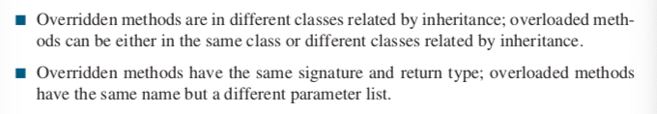
Notes

Slide 31
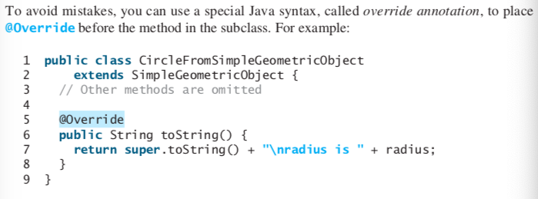
Override annotation

Slide 32

The Object Class and Its Methods
Every class in Java is descended from the java.lang.Object class. If no inheritance is specified when a class is defined, the superclass of the class is Object.

Slide 33
The toString() method in Object
The toString() method returns a string representation of the object. The default implementation returns a string consisting of a class name of which the object is an instance, the at sign (@), and a number representing this object.
Loan loan = new Loan();
System.out.println(loan.toString());
The code displays something like Loan@15037e5 . This message is not very helpful or informative. Usually you should override the toString method so that it returns a digestible string representation of the object.

Slide 34
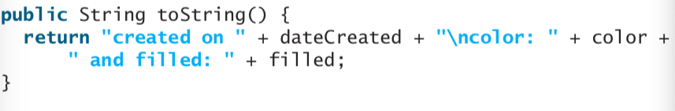
The toString() method in Object

Slide 35
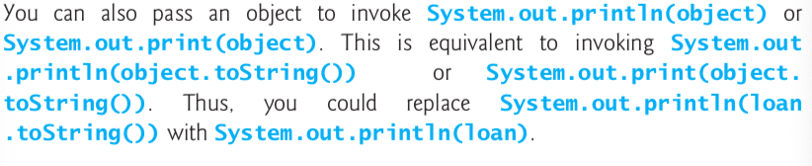
Note on toString()

Slide 36
Polymorphism
Polymorphism means that a variable of a supertype can refer to a subtype object.
A class defines a type. A type defined by a subclass is called a subtype, and a type defined by its superclass is called a supertype. Therefore, you can say that Circle is a subtype of GeometricObject and GeometricObject is a supertype for Circle.
PolymorphismDemo
Run

Slide 37
Polymorphism, Dynamic Binding and Generic Programming
public class PolymorphismDemo {
public static void main(String[] args) {
m(new GraduateStudent());
m(new Student());
m(new Person());
m(new Object());
}
public static void m(Object x) {
System.out.println(x.toString());
}
}
class GraduateStudent extends Student {
}
class Student extends Person {
public String toString() {
return "Student";
}
}
class Person extends Object {
public String toString() {
return "Person";
}
}
Method m takes a parameter of the Object type. You can invoke it with any object.
An object of a subtype can be used wherever its supertype value is required. This feature is known as polymorphism.
When the method m(Object x) is executed, the argument x’s toString method is invoked. x may be an instance of GraduateStudent, Student, Person, or Object. Classes GraduateStudent, Student, Person, and Object have their own implementation of the toString method. Which implementation is used will be determined dynamically by the Java Virtual Machine at runtime. This capability is known as dynamic binding.
DynamicBindingDemo
Run

Slide 38

Dynamic Binding
Dynamic binding works as follows: Suppose an object o is an instance of classes C₁, C₂, ..., C_{n-1}, and C_{n}, where C₁ is a subclass of C₂, C₂ is a subclass of C₃, ..., and C_{n-1} is a subclass of C_{n}. That is, C_{n} is the most general class, and C₁ is the most specific class. In Java, C_{n} is the Object class. If o invokes a method p, the JVM searches the implementation for the method p in C₁, C₂, ..., C_{n-1} and C_{n}, in this order, until it is found. Once an implementation is found, the search stops and the first-found implementation is invoked.

Slide 39
Method Matching vs. Binding
Matching a method signature and binding a method implementation are two issues. The declared type of a reference variable determines which method to match during the compile time. The compiler finds a matching method according to parameter type, number of parameters, and order of the parameters at compilation time. A method may be implemented in several subclasses. The Java Virtual Machine dynamically binds the implementation of the method at runtime.

Slide 40
Generic Programming
public class PolymorphismDemo {
public static void main(String[] args) {
m(new GraduateStudent());
m(new Student());
m(new Person());
m(new Object());
}
public static void m(Object x) {
System.out.println(x.toString());
}
}
class GraduateStudent extends Student {
}
class Student extends Person {
public String toString() {
return "Student";
}
}
class Person extends Object {
public String toString() {
return "Person";
}
}
Polymorphism allows methods to be used generically for a wide range of object arguments. This is known as generic programming. If a method’s parameter type is a superclass (e.g., Object), you may pass an object to this method of any of the parameter’s subclasses (e.g., Student or String). When an object (e.g., a Student object or a String object) is used in the method, the particular implementation of the method of the object that is invoked (e.g., toString) is determined dynamically.

Slide 41
Casting Objects
You have already used the casting operator to convert variables of one primitive type to another. Casting can also be used to convert an object of one class type to another within an inheritance hierarchy. In the preceding section, the statement
  m(new Student());
assigns the object new Student() to a parameter of the Object type. This statement is equivalent to:
  Object o = new Student(); // Implicit casting
  m(o);
The statement Object o = new Student(), known as implicit casting, is legal because an instance of Student is automatically an instance of Object.

Slide 42
Why Casting Is Necessary?
Suppose you want to assign the object reference o to a variable of the Student type using the following statement:
  Student b = o;
A compile error would occur. Why does the statement Object o = new Student() work and the statement Student b = o doesn’t? This is because a Student object is always an instance of Object, but an Object is not necessarily an instance of Student. Even though you can see that o is really a Student object, the compiler is not so clever to know it. To tell the compiler that o is a Student object, use an explicit casting. The syntax is similar to the one used for casting among primitive data types. Enclose the target object type in parentheses and place it before the object to be cast, as follows:
  Student b = (Student)o; // Explicit casting

Slide 43
Casting from
Superclass to Subclass
Explicit casting must be used when casting an object from a superclass to a subclass. This type of casting may not always succeed.
  Apple x = (Apple)fruit;
  Orange x = (Orange)fruit;

Slide 44
The instanceof Operator
Use the instanceof operator to test whether an object is an instance of a class:
  Object myObject = new Circle();
  ... // Some lines of code
  /** Perform casting if myObject is an instance of Circle */
  if (myObject instanceof Circle) {
  System.out.println("The circle diameter is " +
  ((Circle)myObject).getDiameter());
  ...
  }

Slide 45
Why casting is necessary?
myObject is declared Object. The declared type decides which method to match at compile time. Using myObject.getDiameter() will cause a compile error, since the Object class doesn’t have the getDiameter() method. Thus, it is necessary to cast myObject into Circle type to tell the compiler that it is also an instance of Circle.

Slide 46
Why not define myObject as Circle type?
To enable generic programming, it is a good practice to define a variable with a supertype, which can accept an object of any subtype.

Slide 47
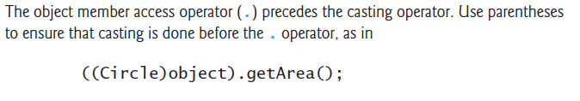
Caution

Slide 48
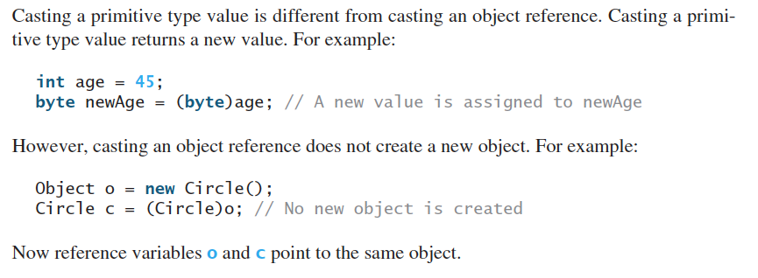
Casting primitive type and object reference

Slide 49
TIP
To help understand casting, you may also consider the analogy of fruit, apple, and orange with the Fruit class as the superclass for Apple and Orange. An apple is a fruit, so you can always safely assign an instance of Apple to a variable for Fruit. However, a fruit is not necessarily an apple, so you have to use explicit casting to assign an instance of Fruit to a variable of Apple.

Slide 50
Example: Demonstrating Polymorphism and Casting
This example creates two geometric objects: a circle, and a rectangle, invokes the displayGeometricObject method to display the objects. The displayGeometricObject displays the area and diameter if the object is a circle, and displays area if the object is a rectangle.
CastingDemo
Run

Slide 51
The equals Method
The equals() method compares the
contents of two objects. The default implementation of the equals method in the Object class is as follows:
public boolean equals(Object obj) {
return this == obj;
}
It checks whether two reference variables point to the same object.

Slide 52
Overriding the equals Method
The equals method is usually supposed to compare the contents of two distinct objects. Thus, it is usually overridden in subclasses.
For example, the equals method is overridden in the Circle class.
public boolean equals(Object o) {
if (o instanceof Circle) {
return radius == ((Circle)o).radius;
}
else
return false;
}

Slide 53

Causion
Tip: Use @Override

Slide 54

The ArrayList Class
You can create an array to store objects. But the array’s size is fixed once the array is created. Java provides the ArrayList class that can be used to store an unlimited number of objects. It is provided in java.util package.

Slide 55
Generic Type
ArrayList is known as a generic class with a generic type E. You can specify a concrete type to replace E when creating an ArrayList. For example, the following statement creates an ArrayList and assigns its reference to variable cities. This ArrayList object can be used to store strings.
ArrayList<String> cities = new ArrayList<String>();

Slide 56
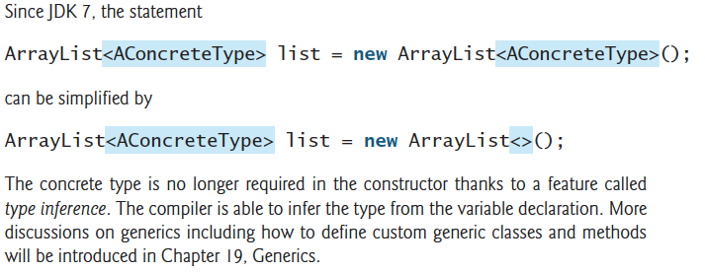
Generic Type
TestArrayList
Run

Slide 57

Differences and Similarities between Arrays and ArrayList
DistinctNumbers
Run

Slide 58
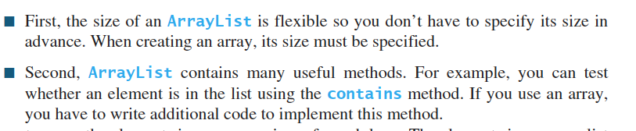
Notes
It is simpler to implement DistinctNumbers using ArrayList that using an array:

Slide 59
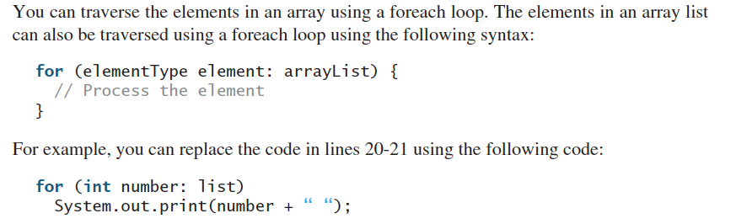
Traverse an array list

Slide 60
ArrayLists from/to Arrays
Creating an ArrayList from an array of objects:
static method asList()
String[] array = {"red", "green", "blue"};
ArrayList<String> list = new ArrayList<>(Arrays.asList(array));
Creating an array of objects from an ArrayList:
instance method toArray()
String[] array1 = new String[list.size()];
list.toArray(array1);

Slide 61
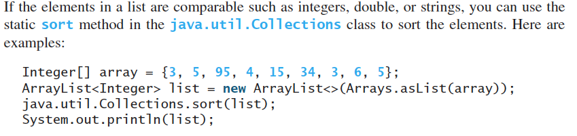
sort method
The sort() method by default uses ascending order. For descending order, use:
Collections.sort(list, Collections.reverseOrder())

Slide 62
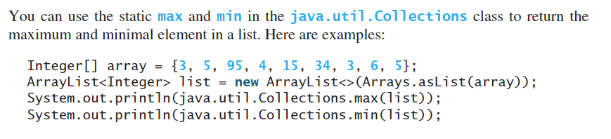
max and min in an Array List

Slide 63
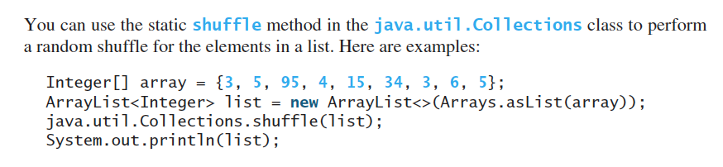
Shuffling an Array List

Slide 64
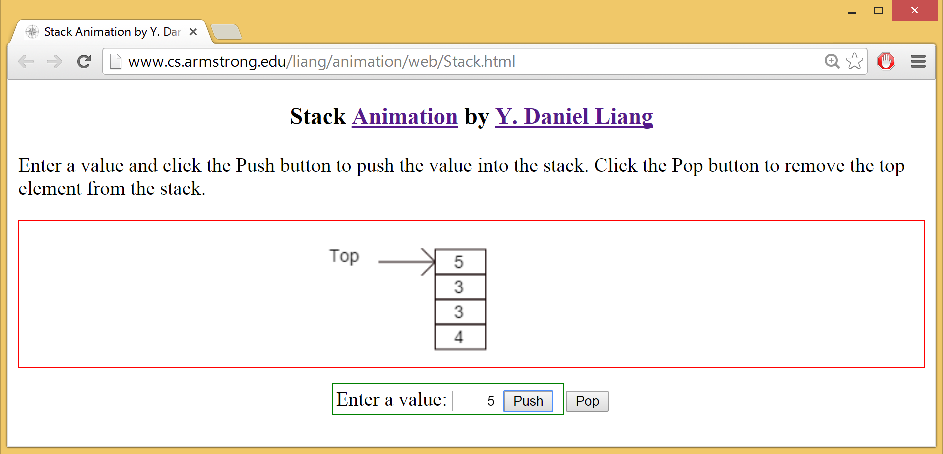
Stack Animation
https://liveexample.pearsoncmg.com/dsanimation/StackeBook.html

Slide 65

The MyStack Classes
A stack to hold objects.
MyStack

Slide 66

The protected Modifier
The protected modifier can be applied on data and methods in a class. A protected data or a protected method in a public class can be accessed by any class in the same package or its subclasses, even if the subclasses are in a different package.
private, default, protected, public

Slide 67

Accessibility Summary

Slide 68

Visibility Modifiers

Slide 69
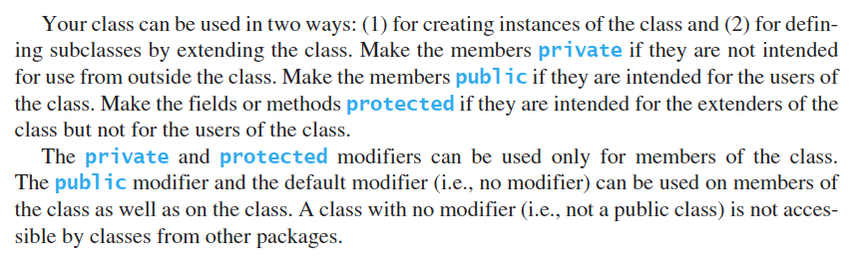
How to choose visibility

Slide 70
A Subclass Cannot Weaken the Accessibility
A subclass may override a protected method in its superclass and change its visibility to public. However, a subclass cannot weaken the accessibility of a method defined in the superclass. For example, if a method is defined as public in the superclass, it must be defined as public in the subclass.

Slide 71

Prevent extending
Use final modifier to indicate that a class is final and cannot be a parent class (i.e. cannot be extended)
E.g. Math, String, StringBuilder, StringBuffer are final classes
The following class A is final and cannot be extended:

Slide 72
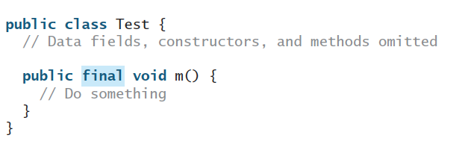
Prevent overriding
Define a method to be final. A final method cannot be overridden by its subclasses.

Slide 73
The final Modifier
The final class cannot be extended:
final class Math {
...
}
The final method cannot be
overridden by its subclasses.
The final variable is a constant:
final static double PI = 3.14159;

